Slide 1
5g Super Blueprint
Secure Slicing Use Case Development
Muddasar Ahmed
September 6, 2022

Slide 2
Network Slicing Security
Slice Confidentiality
    Authentication Framework (Person, Nonperson/VNF)
    Network Function Communication Security (All APIs)
Slice Integrity
    Network Slice Isolation
    IP/Optical Transport, Vir. Infra, Host, NF
Slice Availability
    Network Slice Profile-Availability Attributes
    UE Access Policy
Slice Accountability
    Network Data Analytics Function (NWDAF), DCAE, VNF , Infra domain Events etc.
Beyond 3GPP/ORAN – 5G Ecosystem Security Consideration
    CI/CD Security (SW Acquisition, Custody and Deployment automation)
    NFV/SDN Security (SDN Controller, v-Devices, CP/UP)
    Services Management and Orchestration
    Supply Chain Security (Internal/External)

Slide 3
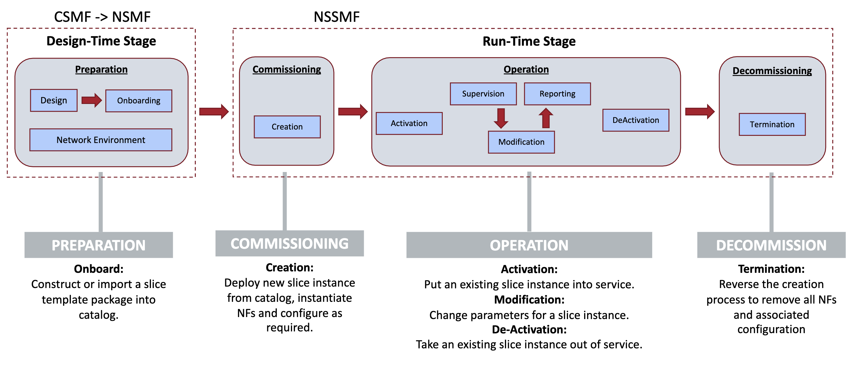
Slice Lifecycle Security

Slide 4
O-RAN Slice Use case details＊
High-Level O-RAN Slicing Use Cases
      Subnet Management and Provisioning Use Cases
      Subnet Instance Creation
      Slice Subnet Instance Activation
      Subnet Instance Modification
      Subnet Instance Deactivation
      Subnet Instance Termination
      Subnet Feasibility Check
O-RAN Slicing Use Cases
      Use Case 1: SLA Assurance
      Use Case 2: Multi-vendor Slices
      Use Case 3: NSSI Resource Allocation Optimization
＊O-RAN.WG1.Slicing-Architecture-v07.00

