Slide 1
VNF Test tools for CVC
Victor Gao
Kanagaraj Manickam
ONAP Paris summit
1-10-2019

Slide 2
Objective
LFN/ONAP wants test platform where VNF packages could be certified (CVP) using LFN/ONAP requirements to drive industry adoption
Provide an platform where vendor/operator can develop, deploy, run test cases and query the results
Test cases, test results and VNF should be manageable .i,e with authorization (RBAC), so only user with given roles is allowed to perform operation like VNF package upload/download, run compliance verification tests, allow only specific VIM for specific users, etc.
Test results should be persisted and should be available for human analysis later via LFN infrastructure.
Provides test flow where author make flow across different test cases for a given program like compliance verification and VNFREQS/ETSI NFV standards .
Provide integration with OPNFV dovetail to run test cases across dovetail and VNFSDK

Slide 3








VNFSDK and Dovetail for CVC
Test
repository
Ad-hoc Check
Submit Result
Query Result
VTP
Operator
Unified Certification Repository/Portal
VNFs
√ Compliance A
X Compliance B
√ Validation A
X Validation B
√ Performance A
X Performance B
NFVI
√ Compliance A
X Compliance B
√ Validation A
X Validation B
√ Performance A
X Performance B
Approval Process
Certified
NFVI/VIM
VNF/NFVI Vendor
Self Certification
Report
Test
repository
Publish Result
OVP
Submit Result
Request
Certification
Dovetail
VNF/NFVI Vendor
Approved
Lab

Slide 4




VNF Test Platform (VTP) a VNFSDK service
CVP Test case
Results publish to
Dublin
Operator Test case
Dovetail
Vendor Test case
Functional Test case
Operator
SDC
Lifecycle Test case
VNF Test Platform (VTP)
Powered by OCLIP
Package Test case
Marketplace Portal/ CLI
Script based Test case
Vendor
Java based Test case
Dublin
Python based Test case
VNF packages
Test case, profiles, results
Dublin
VVP
A platform to automate and manage different kind/nature of test cases for given VNF package(s) and provides unified accessibility over CLI, REST API and UI portal for operating the test cases with RBAC enabled.
Casablanca | Validate TOSCA based VNF package from Dovetail/CLI
Dublin | Validate HEAT based VNF package from Dovetail/CLI Add required CVP test cases During VSP on-boarding, enable operator specific validation from SDC. Web UI portal
:
:
Brought you by VNFSDK, In association with LFN CVC under CVP

Slide 5
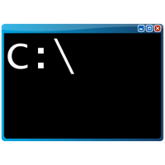

VTP High level architecture
VNF Test Platform
Java based
Test case
Java based
Test case
Web portal/Command console
Java based
Test case
VNF
Market place
(Controller)
Test Center
Operator/user
Test
Runner
(Java based)
gRPC
Test
Runner
(Python based)
Python based
Test case
gRPC
Test
Runner
(Shell based)
Python based
Test case
REST API
Python based
Test case
Vendor/author
Results publish to
Shell script based
Test case
Shell script based
Test case
Test case, result & profile
repository
Shell script based
Test case
VNF package repository
Controller provides RESTful service on top of VNF package and Test cases with RBAC enabled. And User/author can run the test cases via CLI/Portal.
Test center helps to route the execution of test cases with to the appropriate Test runner and stores the result of each execution in the Test repository.
Test runner provides different execution environment like shell, java, etc, which facilitates authors to write test cases in their know languages like java, shell scripts, etc
Admin/user can upload the test results to the LFN OVP portal
Profile is provided to capture the required inputs for running test cases like VIM details, inputs.

Slide 6
VTP: Casablanca
TOSCA VNF package validation
CVP Test case
Results publish to
Operator Test case
Dovetail
Vendor Test case
Functional Test case
Operator
SDC
Lifecycle Test case
VNF Test Platform (VTP)
Powered by OCLIP
Package Test case
Marketplace Portal/ CLI
Script based Test case
Vendor
Java based Test case
Python based Test case
VNF packages
Test case, profiles, results
Java based TOSCA VNF Package validation is enabled and integrated with Dovetail - Demoed as part of Dovetail integration with VTP session
SDC can import valid VNF packages from VTP – already part of it.
:
:
Brought you by VNFSDK, In association with LFN CVC under CVP

Slide 7
VTP: Dublin
HEAT package validation (using VVP)
CVP Test case
Results publish to
Operator Test case
Dovetail
Vendor Test case
Functional Test case
Operator
SDC
Lifecycle Test case
VNF Test Platform (VTP)
Powered by OCLIP
Package Test case
Marketplace Portal/ CLI
Script based Test case
Vendor
Java based Test case
Python based Test case
VNF packages
Test case, profiles, results
VVP
Enable VTP with Python based test case execution and on-board the VVP test cases
:
:
Brought you by VNFSDK, In association with LFN CVC under CVP

Slide 8
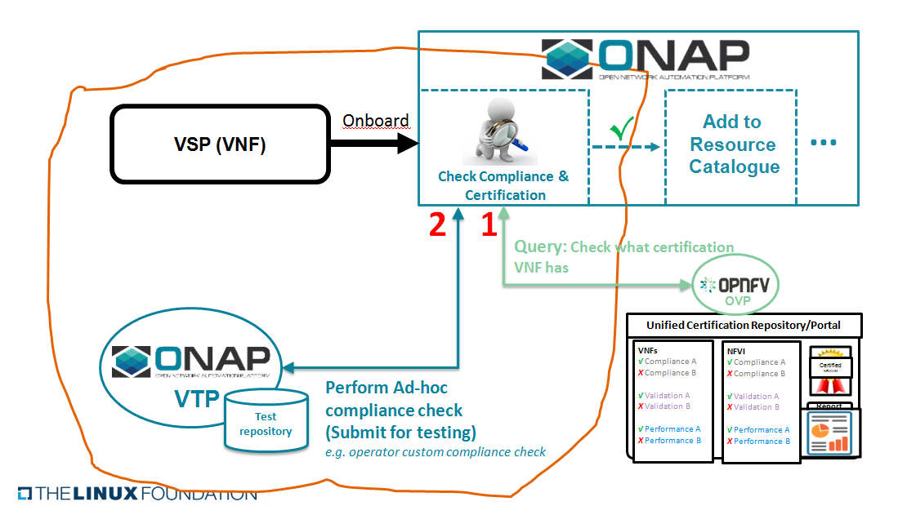
VTP: Dublin
Perform custom on-boarding verification. (Operator specific test cases)
CVP Test case
Results publish to
Operator Test case
Dovetail
Vendor Test case
Functional Test case
Operator
SDC
Lifecycle Test case
VNF Test Platform (VTP)
Powered by OCLIP
Package Test case
Marketplace Portal/ CLI
Script based Test case
Vendor
Java based Test case
Python based Test case
VNF packages
Test case, profiles, results
VVP
Enable SDC to perform some operator specific validation as part of on-boarding process. Also enable profile/metadata management
:
:
Brought you by VNFSDK, In association with LFN CVC under CVP

Slide 9
VTP: Dublin
Additional VNFREQS + ETSI Std. test cases
CVP Test case(s)
Results publish to
Operator Test case
Dovetail
Vendor Test case
Functional Test case
Operator
SDC
Lifecycle Test case
VNF Test Platform (VTP)
Powered by OCLIP
Package Test case
Marketplace Portal/ CLI
Script based Test case
Vendor
Java based Test case
Python based Test case
VNF packages
Test case, profiles, results
Enable additional VNFREQS and ETSI package related test cases validation.
:
:
Brought you by VNFSDK, In association with LFN CVC under CVP

Slide 10
VTP: Dublin
REST API Enhancements
VNFs
GET on /vtp/v1/vnfs
GET on /vtp/v1/vnfs/vnf-id
GET on /vtp/v1/vnfs/vnf-id/pkg - get vnf package
POST on /vtp/v1/vnfs/vnf-id/pkg - upload vnf package
PUT on /vtp/v1/vnfs/vnf-id/pkg - update vnf package
DELETE on /vtp/v1/vnf-id
Profiles/configurations
GET on /vtp/v1/profiles?vnf-id=xxx
GET on /vtp/v1/profiles/profile-id
POST on /vtp/v1/profiles
PUT on /vtp/v1/profiles/profile-id
DELETE on /vtp/v1/profiles/profile-id
Tests
GET on /vtp/v1/tests
GET on /vtp/v1/tests/test-id
Executions & results
POST on /vtp/v1/tests/test-id for given VNF id
returns execution id
GET on /vtp/v1/tests/test-id/executions?vnf-id=xxx&&test-id=yyy
GET on /vtp/v1/tests/test-id/executions/execution-id

Slide 11
Let us Collaborate !
Test cases w.r.t CVC
Joint meeting VNFREQS and VVP

Slide 12
Thank you

