Slide 1
ONAP DCAE - Dublin and beyond
Vijay Venkatesh Kumar
(vv770d@att.com)
2019-01-09

Slide 2
Casablanca Recap
New MS introduced
PRH
DFC
HV-VES
SNMPTrap
Foundational/Platform enhancement
Support for Certificate distribution through Cloudify Blueprint/plugin
PNDA Integration-prep
  PNDA mirror and bootstrap setup (App support and DCAE integration TBW for Dublin).
VES Upgrade

Slide 3
ONAP DCAE R3 ARCHITECTURE
DMAAP
DCAE Services
Consul Cluster
Deployment
Consul Cluster
Service distribution
Consul Cluster
TCA-Gen2
Event Data flow
DCAE Platform
Policy Changes & Configuration flow
Holmes
TCA
Heartbeat
PRH
Cloudify Manager
SNMP-VES Mapper
PM-Mapper
Config Binding Service
Inventory API
PostGres DB
GPB->JSON
Deployment Handler
Service Change Handler
Policy Handler
SNMP Trap Collector
VESCollector (JSON)
DataFile Collector
HV-VES
DMAAP
xNF
xNF
CLAMP
SDC
Policy

Slide 4
DCAE R3 Deployment Sequence (Integration tenant)
Helm deploy/install (OOM)
Consul
Postgres
Cloudify
~4 min 30 sec
Full ONAP Installation ~ 2 hours
Healthcheck
Redis DB
Configbinding Service
~9 min 40 sec
Bootstrap
PG Initalization
Deployment Handler
~10-20 min
Inventory API & SCH*
~5 min 28 sec
Policy Handler
TCA
VES
SNMPTRap
PRH
HV-VES
DFC
~2 min 15 sec
Homes Rules
Homes Engine
~ 21 min 53 sec

Slide 5
DCAE R3 Deployment Sequence (Prepulled images)
Helm deploy/install (OOM)
Consul
Postgres
Cloudify
59 sec
<11 min – Complete DCAE platform and Services deployment
Healthcheck
Redis DB
Configbinding Service
6 min and 1 sec
Bootstrap
PG Initalization
Deployment Handler
6 min 24 sec
Inventory API & SCH*
2 min 40 sec
Policy Handler
TCA
VES
SNMPTRap
PRH
HV-VES
DFC
1 min 16 sec
Homes Rules
Homes Engine
10 min 56 sec
Notes:
6 platform component
8 service component

Slide 6
DCAE R3 Bootstrap Work flow
Dependency
dcae-cloudifymanager
consul server
msb-discovery
kube2msb
DCAE bootstrap
Consul registration for CBS, Inventory, Policy handler (looked up from a plugin on CM)
Setup profiles for cfy manager
Load KV store (used by CM)
Install cloudify plugins
Notes:
*All above precedes component deployment via blueprints

Slide 7
MicroServices targeted for Dublin
Collectors
RESTConf collector (Huawei)
Event Processors
SNMP VES/Universal Mapper* (TechM)
  Extension to support RestConf input (Huawei)
PM-Mapper* (Ericsson)
PCI-Handler (Wipro)
ZTT?(Cisco)
Analytics/RCA
Heartbeat* (AT&T)
TCA-Gen2* (AT&T)
* Continuation from work in Casablanca

Slide 8
DCAE Enhancement - Dublin Focus
Common SDK for Service Component
  Dmaap pub/sub
  Configbindingservice
  A&AI client
  Cert-based TLS
Refactoring existing MS to utilize these libraries gradually

Slide 9
DCAE Controller Enhancement - Dublin (Helm support)
Support helm chart deployment in DCAE-C using custom helm plugin
Transitioning Cloudify blueprint to Helm for DCAE platform component
  InventoryAPI, DeploymentHandler, PolicyHandler, ServicechangeHandler, CBS
Migrate other static service components into deployment into helm chart (stretch)
DCAE Healthcheck Enhancement
  Usable by CLAMP or external system for querying DCAE services status

Slide 10
DCAE Controller Enhancement – Dublin
Contribution of blueprint generator tool in ONAP/DCAE.
Dmaap plugin support for Buscontroller integration
Cloudify container resiliency
Multi-site K8S cluster deployment support via K8s plugin*
Support AAF integration of DCAE components via Istio/Servicemesh (stretch)
* Dependency on OOM

Slide 11
Other areas for discussions – seeking ONAP community support (beyond Dublin)
Helm chart generator tool from component spec/tosca_models (for higher level of abstraction)
Generic templating Helm chart deployment of DCAE services components
Policy configuration management for service deployed under helm
Integration with DMAAP BusController for topic provisioning from Helm
DCAE Platform support for helm chart retrieval and creating internal store and maintaining state of deployed MS
CLAMP-DCAE solution to determine new deploy vs reconfiguration for CL
  - Binding between services (vnf) deployed and corresponding CL flow components with healthcheck & location info
PNDA Integration

Slide 12
Uscases for Dublin (Tentative)
5G Use Case (Dublin)
  5G - Bulk PM (Casablanca carry-over items)
  5G - OOF and PCI (Casablanca carry-over items)*
BBS Broadband Service Use Case (Dublin)*
CCVPN (E-LAN Service (EP-LAN, EVP-LAN) *
Control Loop Requirements
Other related usecases under discussion
Edge Automation Functional Requirements for Dublin
Distributed Analytics as a Service - Edge Automation
  PNDA containerization and deployment via helm
  Dynamic configuration support helm deployed application
  Cloud information storage/retrieval from Helm.
* Open questions; pending Dublin commitment.
Notes:
https://wiki.onap.org/display/DW/Release+4+%28Dublin%29+Use+Cases+and+functional+requirements?src=contextnavpagetreemode

Slide 13
Design Flow Updates

Slide 14
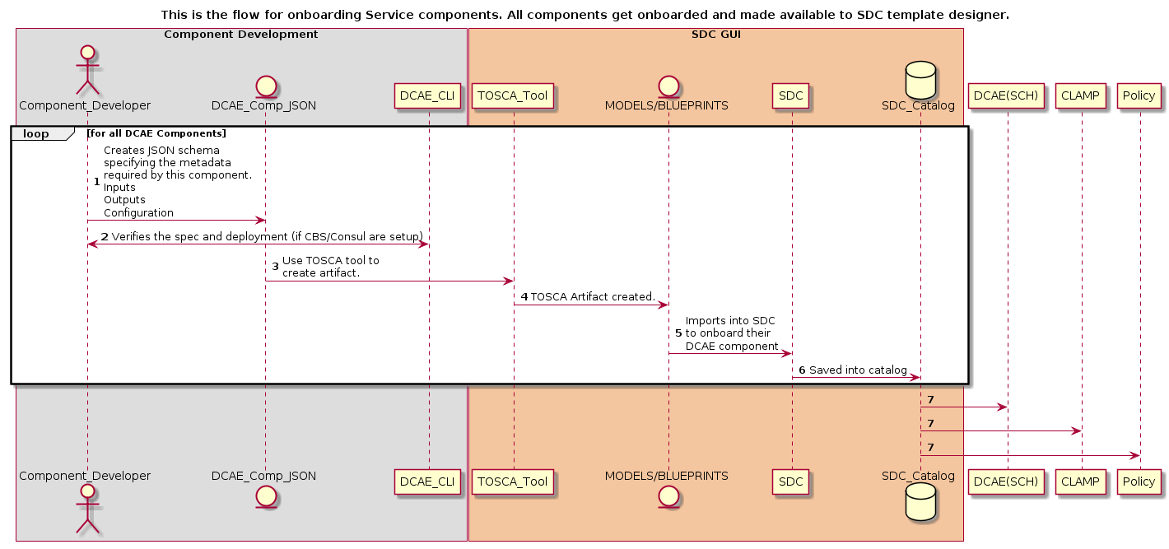
Design time Flow (Target)

Slide 15
DCAE CLI and Blueprint generator
Blueprint generator tool
Cloudify blueprint with input as component spec
Dcae_cli
Validate component spec
Test container deploy on docker with CBS emulation
(Vagrant setup available for bootstrapping a VM with minimal DCAE; incorporate blueprint generator*)
* Stretch
Notes:
Vagrant setup - https://gerrit.onap.org/r/#/c/58953/1/vagrant/README.md

Slide 16
Continuing PNDA Integration
PNDA platform containerization and deployment via HELM
Integrate PNDA apps with ONAP onboarding flow (SDC/CLAMP/Policy)
Leverage DMAAP/Kafka for PNDA instead of native
PNDA adapter for supporting dynamic deploy and configuration support

Slide 17
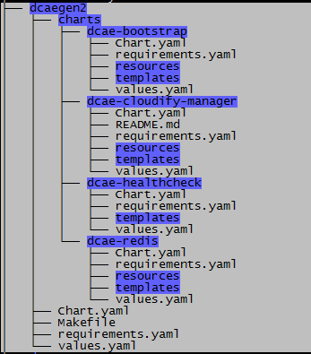
OOM dependency for Dublin
Multi-site configuration support (OOM-1572)
  Consistent identification of cluster information under helm charts
  Mechanism for deployment (e.g via helm deploy) to specify the target cluster
  Servicename convention for cross site scenarios
  Each cluster should be classifiable under {cloud-owner } + {cloud-region-id} + {tenant}
  Credentials/access for each of the cluster maintained in consistent manner
  Healthcheck requirement for multi-site components
Creating sub-chart granular package (
OOM-1574)
Consul – TLS enablement (OOM-1490)

Slide 18
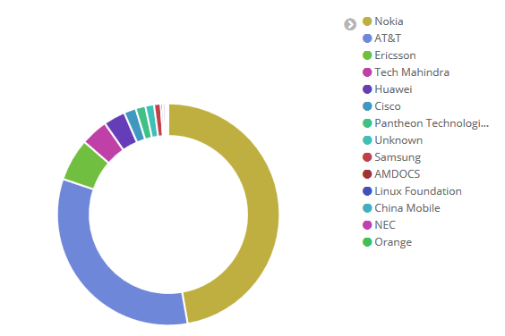
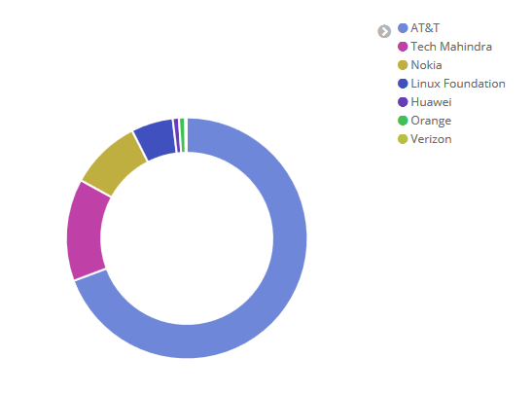
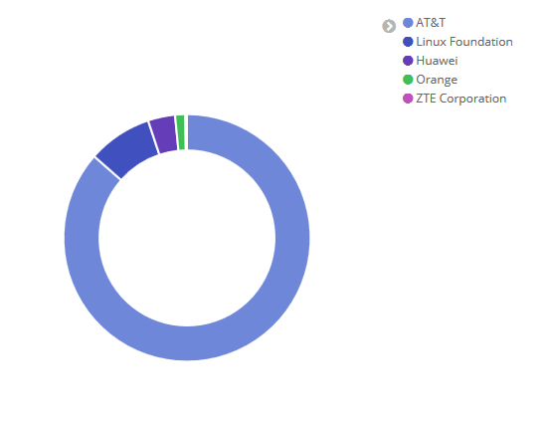
ONAP DCAE Contributions
Casablanca Release
Amsterdam Release
Beijing Release

Slide 19
Questions

