Slide 1
ONAP Casablanca Use Case in CMCC Lab
China Mobile: Yan Yang
Intel: Haibin Huang

Slide 2
CMCC Lab Overview

Slide 3







Physical Lab Overview @CMCC
ONAP Deployment Env
(POD3)
ONAP Deployment Env & VNF Env
(POD5)
Titaninum Cloud R4 (Newton),
Controller nodes:2 , Compute nodes: 3
Core Switch
Titaninum Cloud 16.10 (Mitaka),
Controller nodes:2 , Compute nodes: 2
VPN Client
Firewall
OpenVPN
Server
Leaf Switch
LOM Management, Admin, Private, Public networks inside
Leaf Switch
DC 1
(POD1)
DC 2
(POD2)
Leaf Switch
ONAP Deployment Env & VNF Env
(POD4)
Leaf Switch
VIO 4.0 (Ocata)
Controller node:2
Compute nodes: 6
Titaninum Cloud 16.10 (Mitaka),
Controller nodes:2 , Compute nodes: 9
Titaninum Cloud 16.10 (Mitaka),
Controller nodes:2 , Compute nodes: 2
Hardware: R5300/E9000, 3 rack servers and 1 blade server with 6 blades

Slide 4

Use Case Deployment @CMCC
vCPE
CCVPN
CMCC Domain :Casablanca
VDF Domain : Casablanca
Casablanca
(POD3)
(POD4)
vCPE
(POD5)
vCPE
OS
OS
Integrate with 3rd Part Specific Components
Integrate with 3rd Part Specific Components
vDHCP
vAAA
SD-WAN Controller
(Huawei)
OTN Controller
(Huawei)
SD-WAN Controller
(ZTE)
OTN Controller
(ZTE)
OS
OS
vBNG
vGMUX
vxxx
OS
OS
OS
(POD1)

Slide 5








Key Data @CMCC
CMCC Lab key data
ONAPs ：3
Cloud ：5 windrive(4) and
Physical hardware ：73
Participating member ：8
(1)

Slide 6
CCVNP Use Case

Slide 7
CCVPN Overview
  CCVPN(Cross Domain and Cross Layer VPN) by ONAP Peering Orchestration Between SPs
ONAP (CMCC)
ONAP (VDF)
SOTN Controller
SD-WAN
Controller
SOTN Controller
SD-WAN
Controller
Internet
uCPE
vCPE
vCPE
uCPE
Connection（ E-Line）
Site
Connection（ E-Line）
Site
Site
Site
UNI
UNI
UNI
UNI
Notes:
首先重点介绍的是CCVPN的用例场景，这个场景是ONAP在C版本引入的一个全新的，比较完整的端到端的用例场景。目前参与的成员包括中国移动、vdf、华为、zte、风河以及vmware。因为这个场景在之前的演讲中也已经做了详细介绍，我这里只做个简单的说明。实际上CCVPN是借助ONAP的自动编排管理能力，实现跨域（SOTN+SD-WAN）跨层(L1, L2, L3)的以及跨运营商的端到端VPN业务的自动化部署和动态调整。

Slide 8
CCVPN Network Topology
Lab
CMCC portal
Vodafone portal
CMCC ONAP
Vodafone ONAP
SD-WAN Controller
(HW)
OTN
Controller
Server A
(HW)
OTN
Controller
Server B
(HW)
SD-WAN
Controller
Server
(ZTE)
OTN
Controller
Server
(ZTE)
L3
uCPE
(HW)
vCPE
(HW)
vCPE
(ZTE)
OTN
Domain A
(HW)
GE/10GE/OTU
OTN
Domain B
(HW)
OTN network
(ZTE)
uCPE
(ZTE)
L2
GE/10GE/OTU
Notes:
那么针对社区的11月份交付的CCVPN用例场景，我们在中国移动的ONAP实验室也进行了规划。在demo的基础上，我们引入了中兴的OTN以及SD-WAN设备，用于验证ONAP C版本的CCVPN功能。
目前我们已经在开始部署C 版本的ONAP.

Slide 9


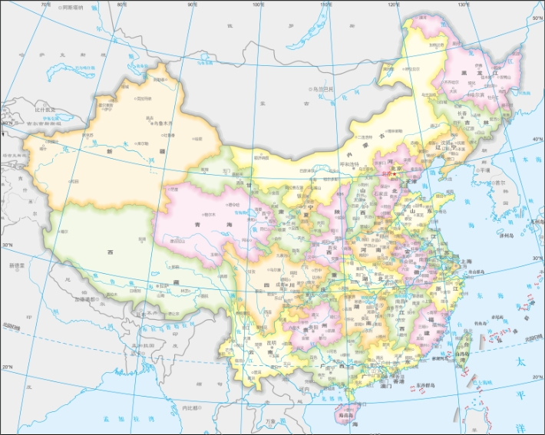
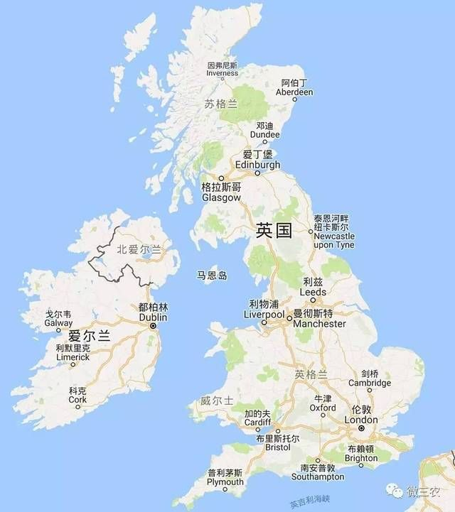



CCVPN Test Case
Topology Discovery
Service Provisioning
Closed Loop
ONAP(CMCC)
ONAP(VDF)
OTN Controller
OTN Controller
SD-WAN
Controller
SD-WAN
Controller
OTN Controller
OTN
Domain1
OTN
Domain2
OTN
Domain
CPE
vGW
vGW
CPE
L3 PNF
L2 Underlay (EoODU)
L3 VNF
Handoff
Handoff
L3 VNF
L2 Underlay (EoODU)
L3 PNF
CCVPN Service
Notes:
在刚刚过去的9月份的ONS 欧洲峰会上，中国移动联合VDF和华为在ONS现场联合发布了CCVPN的示范应用，在LFN的展台我们通过远程连接中国移动的CCVPN实验室，现场演示了CCVPN的三个功能场景，包括网络拓扑发现、服务提供以及闭环自愈的场景。

Slide 10
vCPE Use Case

Slide 11
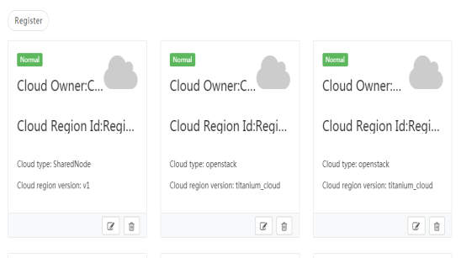



vCPE Test Case
Key Test Case: ESR Registration, Model Design, Service Deployment, Service Recovery
Model Design
ESR Registration
Service Deployment
Service Recovery
VNF Onboarding
NS Design
Vim Registration
VNFM Registration
Instantiation
Termination
VM shutdown
Triger Healing
CPE
Healing
vGRE
vINFRA
vGMUX
vGW
VNF Instantiation
vBNG
vCPE NS
VNF Destruction
CPE
Notes:
另外要提到的一个端到端的应用场景是vCPE的场景，目前vCPE的场景在ONAP社区有两种部署方式，一种是通过HEAT模版，一种是通过Tosca模板。ONAP C版本的HEAT模型主要用于一系列回归测试，Tosca-based vCPE 在上一个Beijing版本我们做个初步尝试，但由于SDC对tosca模型支持的限制，没有完成端到端的测试。那么这个版本，我们在中移的ONAP实验室会继续端到端的验证测试，最终的Tosca-based的vCPE主要基于VFC 的gvnfm来进行部署，同时我们叠加了硬件能力发现HPA的功能。

Slide 12
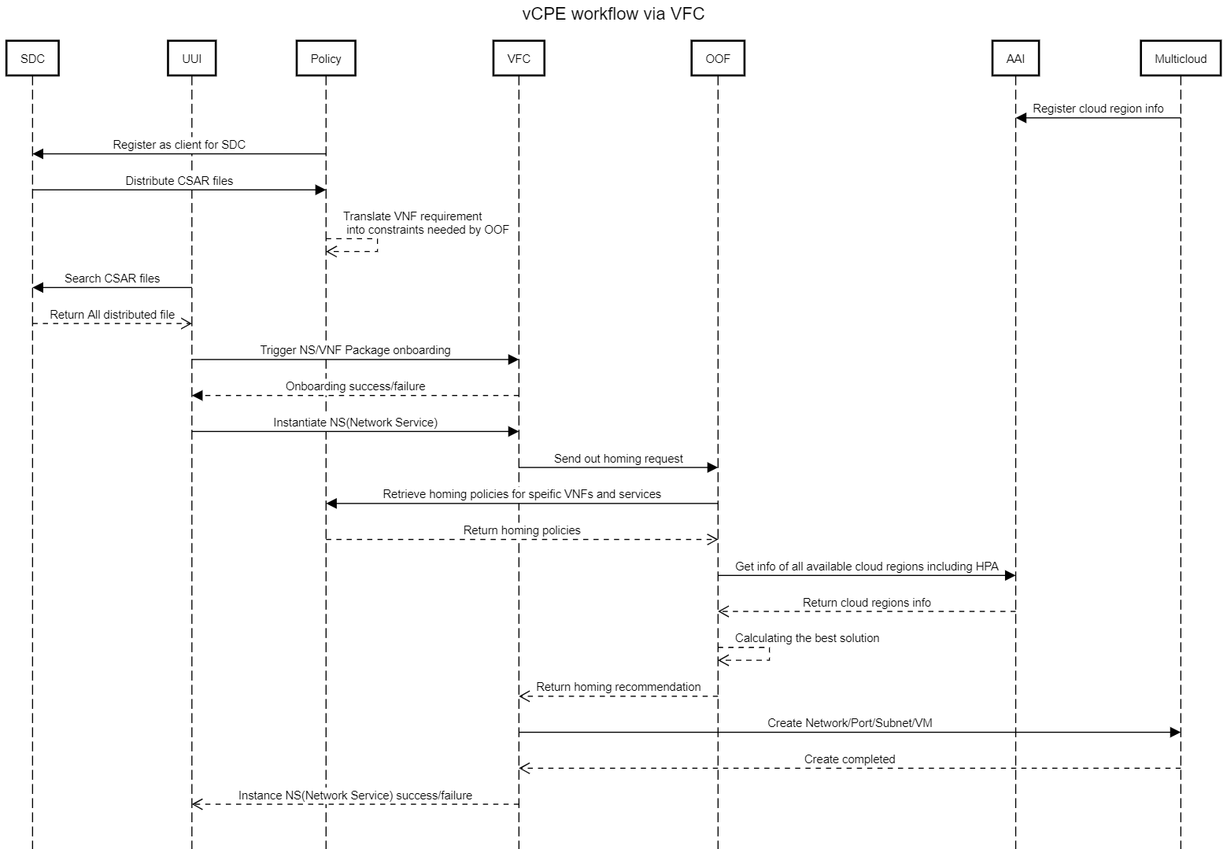
vCPE – Overall Sequence
Design Time
Run Time
Notes:
VF-C aligns with R2 VNF data model in Beijing Release. In addition to supporting VoLTE use case, VF-C also supports CPE use case which integrates with open source VNF via GVNFM in Beijing release.

Slide 13
Design Time

Slide 14
vCPE – Package Design & Distribution
SDC
CPE E2E
3.Service Package Design
Service Package
4.2 E2E Service Pkg Distribution
SO
vCPE E2E Service Package
4.1 E2E Service Pkg Distribution
CPE NS
2.NS Package Design
NS Package
4.4 Query NS Pkg
Policy
GW\BNG\...
1.VNF Package Upload
VNF Package
4.3 Query VNF Pkg
VFC
Catalog
5.NS/VNF Pkg Distribution
NS/VNFs Package
Usecase UI
Notes:
VF-C aligns with R2 VNF data model in Beijing Release. In addition to supporting VoLTE use case, VF-C also supports CPE use case which integrates with open source VNF via GVNFM in Beijing release.

Slide 15
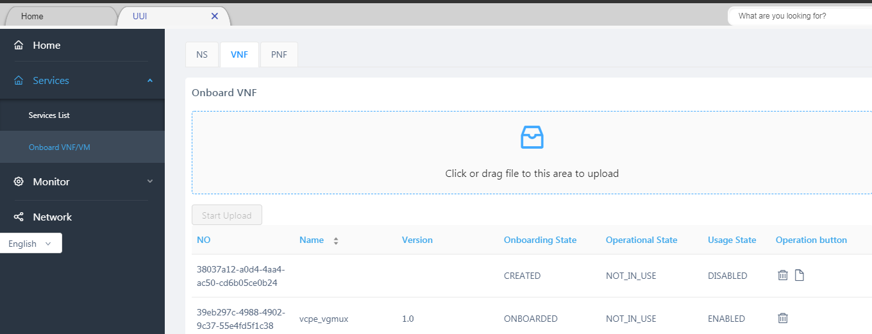
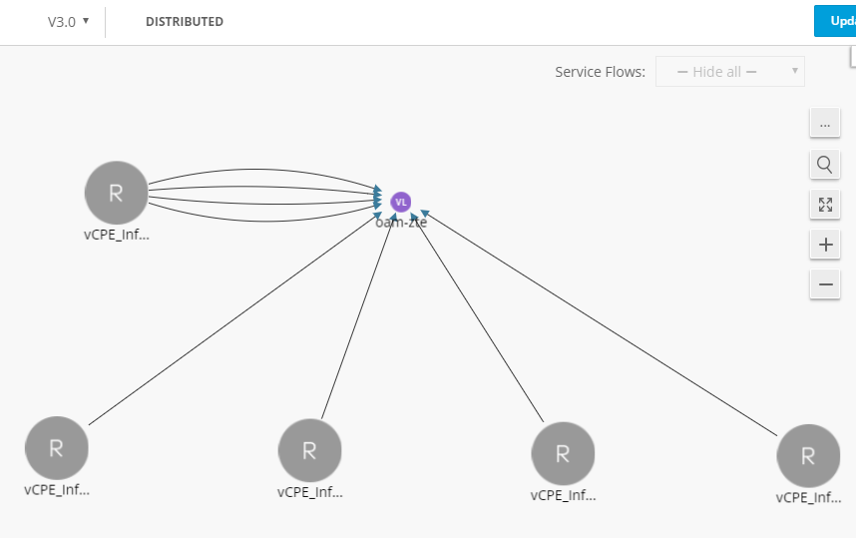
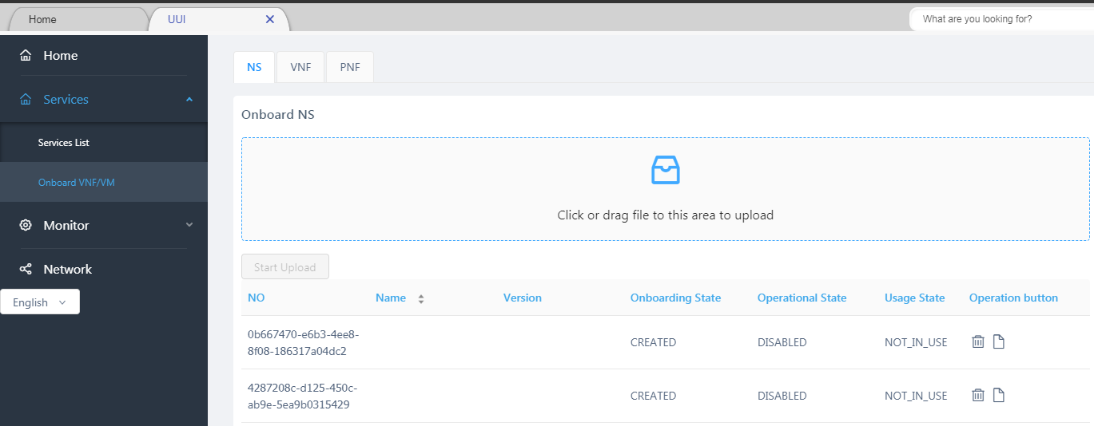
vCPE – Package Design & Distribution
VNF Package Onboarding in UUI
NS Design in SDC
NS Package Onboarding in UUI
Notes:
VF-C aligns with R2 VNF data model in Beijing Release. In addition to supporting VoLTE use case, VF-C also supports CPE use case which integrates with open source VNF via GVNFM in Beijing release.

Slide 16
ESR Registration

Slide 17
VIM Configuration
NIC configure
We can refer to [1] before “Launching instances with SR-IOV ports”
pci_passthrough_whitelist = { "devname": "eth3", "physical_network": "physnet2"}
Create aggregate
$ openstack aggregate create --property sriov_nic=sriov-nic-intel-1234-5678-physnet1:1 aggr11
Create flavor
$ openstack flavor create onap.flavor1 --id auto --ram 512 --disk 40 --vcpus 4
$ openstack flavor set onap.flavor1 --property sriov_nic=sriov-nic-intel-1234-5678-physnet1:1
Create provider network
10

Slide 18
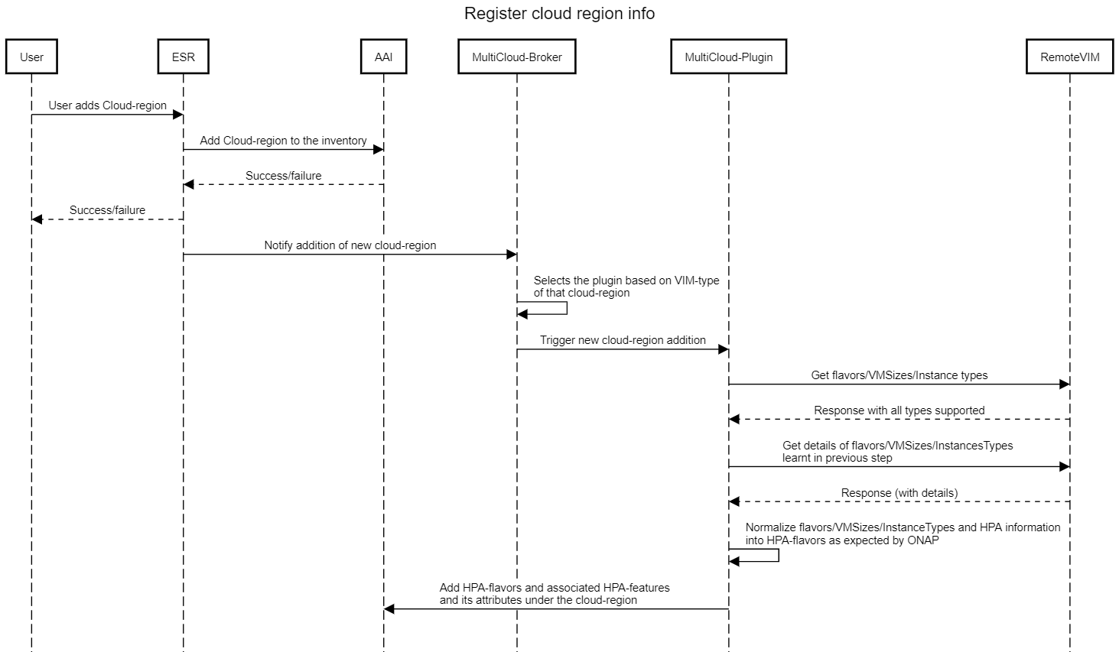
MultiCloud register and HPA discovery

Slide 19
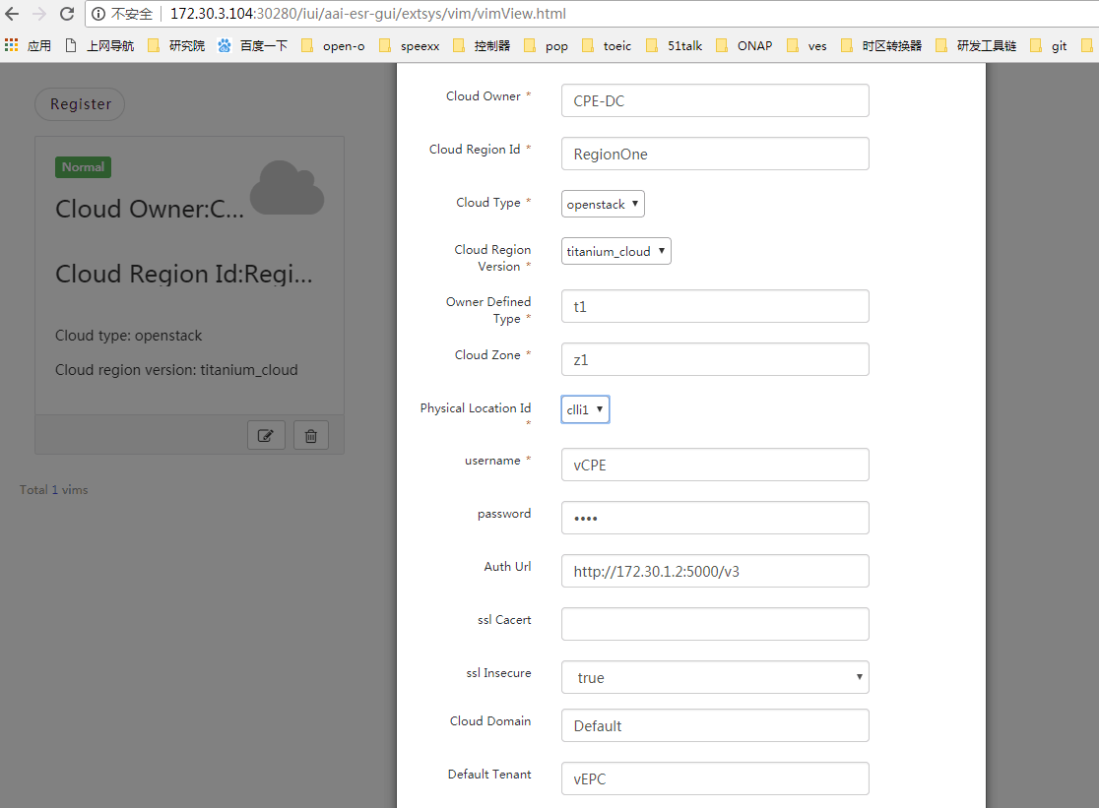
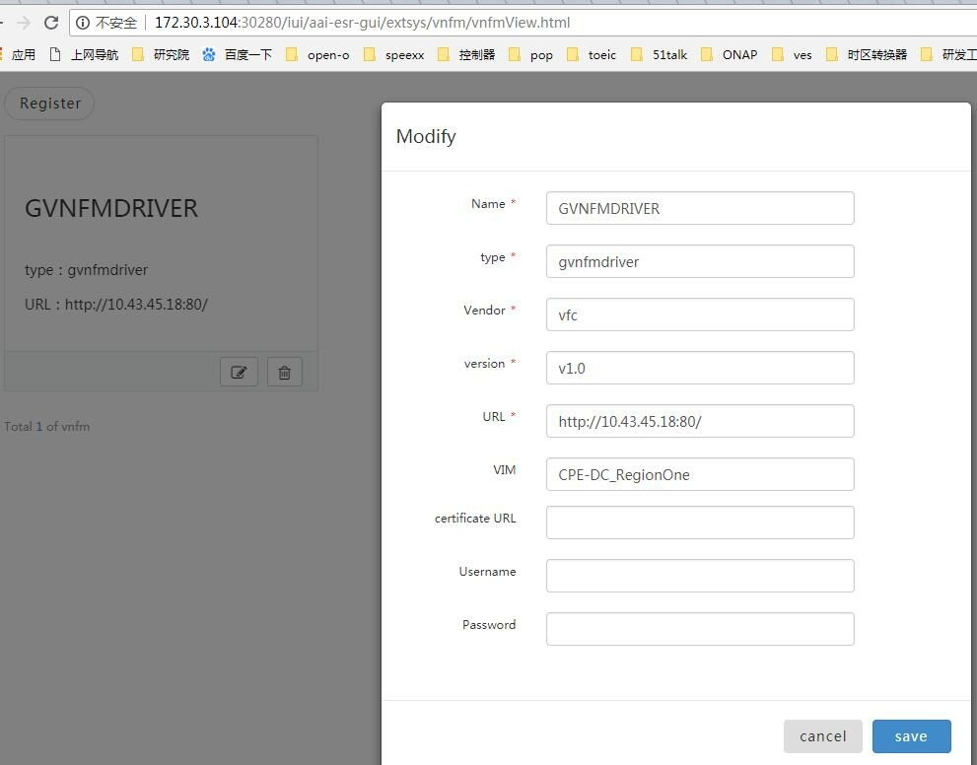
VIM & GVNFM Registration via ESR GUI
GVNFM Registration
VIM Registration

Slide 20
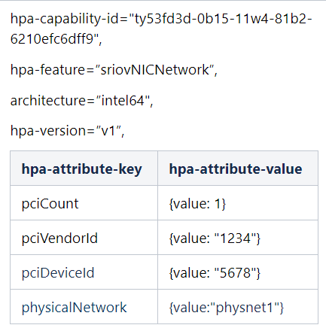
AAI information
sriov_nic=sriov-nic-<vendor>-<Vendor ID>-<Device ID>-<physicalNetwork:COUNT>
It is expected thatOpenstackadministrator creates alias that stars with sriov and put the vendor ID, device ID.
Example:
Assume that there are two SRIOV-NIC cards supported by a region, Intel and Mellanox.
sriov-nic-intel-1234-5678-physnet1:1
sriov-nic-mellanox-2345-6543-physnet1:1
10

Slide 21
Run Time

Slide 22
ONAP – Run Time
Lifecycle: Instantiate/terminate/heal…
OOF
3
Policy
2
1
4
5
WindRiver
(Openstack)
UUI
VF-C
Multi-Cloud

Slide 23
Policy
Customer
Input
"flavorLabel":"vcpe.vgw",
"flavorProperties":[{
"hpa-feature": "sriovNICNetwork",
"mandatory": "True",
"architecture": "generic",
"hpa-version": "v1",
"directives" : [
{
"type": "sriovNICNetwork_directives",
"attributes": [
{"attribute_name": "vgw_nic_type", "attribute_value": “direct"},
{"attribute_name": "vgw_provider_network", "attribute_value": “physnet1"}
]
}
],
"hpa-feature-attributes": [
{
"hpa-attribute-key": "pciVendorId",
"hpa-attribute-value": "1234", "operator": "=", "unit": ""
},
{
"hpa-attribute-key": "pciDeviceId",
"hpa-attribute-value": "5678", "operator": "=", "unit": ""
},
{
"hpa-attribute-key": "pciCount",
"hpa-attribute-value": "1", "operator": ">=", "unit": ""
},
{
"hpa-attribute-key": "physicalNetwork",
"hpa-attribute-value": "physnet1", "operator": "=", "unit": "“
}
]
},
]
REST APIs
Policy
Policy Driven Decision & Enforcement Framework
Policy Creation
Administration
Policy DB
REST APIs/Event Driven
Policy Distribution
OOF
SDC

Slide 24
VF-C — OOF Homing
OOF: ONAP Optimization Framework
OSDF: Optimization Service Design Framework
HAS: Homing Allocation Service
VFC
①
Policy
VFC sends out homing request to OOF(OSDF) containing resource info
OOF(OSDF) pulls all the related homing constraints from Policy
OOF(HAS) check AAI database to pull region(flavor) information
OOF(OSDF) returns homing allocation solution to VFC
②
OOF- OSDF
④
OOF - HAS
③
AAI

Slide 25
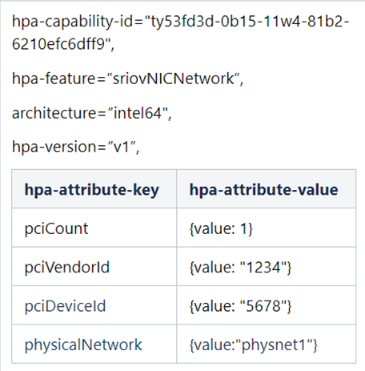
OOF Homing
"flavorLabel":"vcpe.vgw",
"flavorProperties":[{
"hpa-feature": "sriovNICNetwork",
"mandatory": "True",
"architecture": "generic",
"hpa-version": "v1",
"directives" : [
{
"type": "sriovNICNetwork_directives",
"attributes": [
{"attribute_name": “vgw_vnic_type", "attribute_value": "direct"},
{"attribute_name": “vgw_provider_network", "attribute_value": "physnet1"}
]
}
],
"hpa-feature-attributes": [
{
"hpa-attribute-key": "pciVendorId",
"hpa-attribute-value": "1234", "operator": "=", "unit": ""
},
{
"hpa-attribute-key": "pciDeviceId",
"hpa-attribute-value": "5678", "operator": "=", "unit": ""
},
{
"hpa-attribute-key": "pciCount",
"hpa-attribute-value": "1", "operator": ">=", "unit": ""
},
{
"hpa-attribute-key": "physicalNetwork",
"hpa-attribute-value": "physnet1", "operator": "=", "unit": "“
}
]
},
]
AAI
Policy

Slide 26
VFC Create network and port
"type": "sriovNICNetwork_directives",
"attributes": [
{"attribute_name": “vgw_vnic_type", "attribute_value": "direct"},
{"attribute_name": “vgw_provider_network", "attribute_value": "physnet1"}
Create network, ports
# openstack network create --provider-network-type vlan --provider-physical-network physnet1 tst-network
# openstack port create --name sriov-port --binding:vnic-type direct
b. Create server
# openstack server create --flavor onap.hpa.flavor11 --image Ubuntu_16.04 --nic port-id= test-sriov-nic

Slide 27
MultiCloud
ONAP
SO and VFC will call Framework
Other Components
MultiCloud
Framework
Plugin-
Pike
Plugin-StarlingX
Plugin-vmware
Plugin-windriver
Pike
StarlingX
vmware
Windrvier
27

Slide 28
Thank you!

Slide 29
Back Up

Slide 30

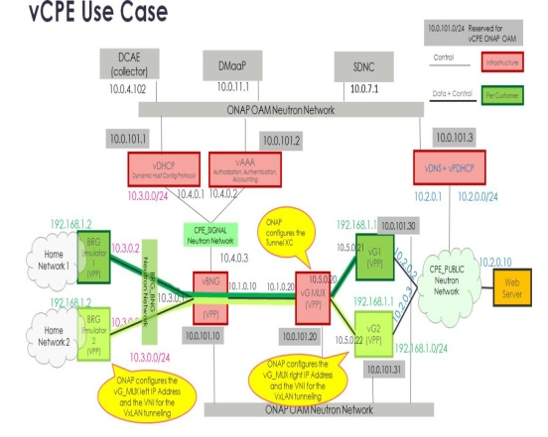
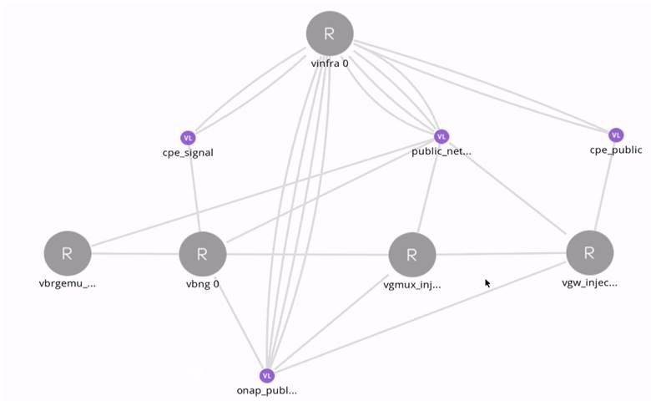
vCPE - Design Time
1
VNF包
2
VF
GW
GW
3
Network Service
4
vCPE E2E
GMUX
GMUX
vINFRA
VBGREMU
BNG
BNG
OS
OS
vBNG
vGMUX
vGW
OS
OS
OS
INFRA
INFRA
BGREMU
BGREMU

Slide 31
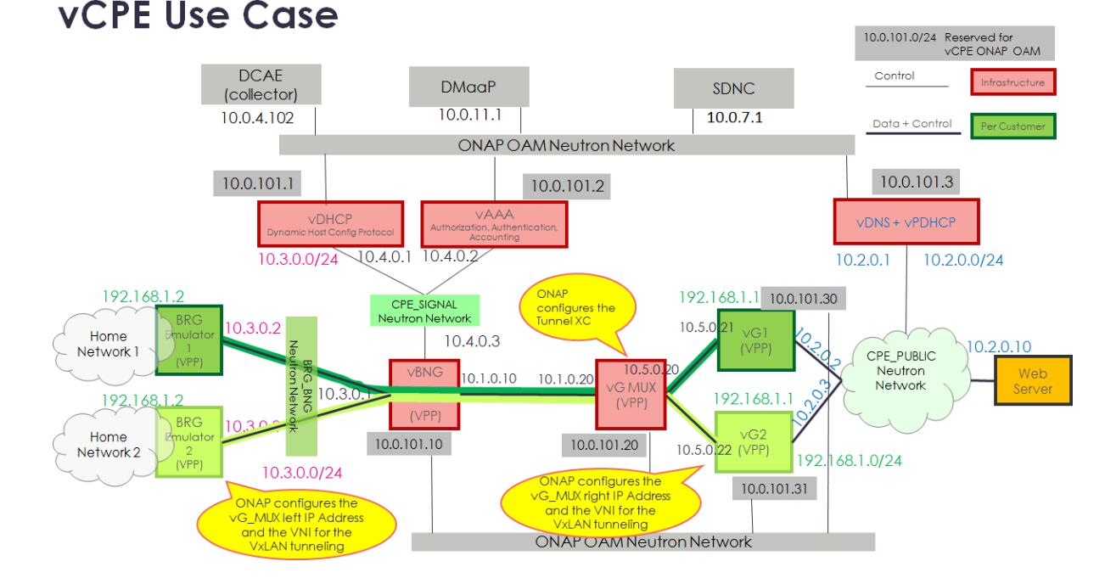
vCPE Test Case
HEAT
TOSCA
Tosca based vCPE in CMCC
SO
SDC
VF-C
NSLCM
A&AI
GVNFM
OOF
MultiCloud
vGMUX
vGMUX
vGW
vXX
Notes:
另外要提到的一个端到端的应用场景是vCPE的场景，目前vCPE的场景在ONAP社区有两种部署方式，一种是通过HEAT模版，一种是通过Tosca模板。ONAP C版本的HEAT模型主要用于一系列回归测试，Tosca-based vCPE 在上一个Beijing版本我们做个初步尝试，但由于SDC对tosca模型支持的限制，没有完成端到端的测试。那么这个版本，我们在中移的ONAP实验室会继续端到端的验证测试，最终的Tosca-based的vCPE主要基于VFC 的gvnfm来进行部署，同时我们叠加了硬件能力发现HPA的功能。

Slide 32
vCPE Test Cases
vCPE
E2E service
Use GVNFM to integrate with Open source VNFs of CPE use case .
No commercial software
Service Instantiation
vCPE
Network service
Topology
Service lifecycle
Management
Model distribution
Service Termination
VF
vGMUX
VF x
vGW
VF
VF
Service Healing
VL
Public_net
VL
VL
Private_net
VL x

