Slide 1
TST009 – NFVI Network Benchmarks and Measurement Methods
Expands the Requirements and Methods of RFC2544
  New reality of NFVI platforms are different than dedicated “boxes” of the past
Benchmark definition
Test setups
Test tool requirements
Methods of Measurement
Rapporteur: Al Morton (AT&T Labs)

Slide 2
Benchmarks
For each Benchmark:
}
Throughput
  Offered Load Frame Size
  Offered Load Step Size
  Min Trial Repetition Interval
  Trial Duration
  Max X% Loss Ratio
  Max # of Trials
Latency
Delay Variation
Loss
Background
Name
Parameters
Scope
Units of Measure
Definition
Units of Measure
Sources of Error
Discussion
Reporting Format

Slide 3
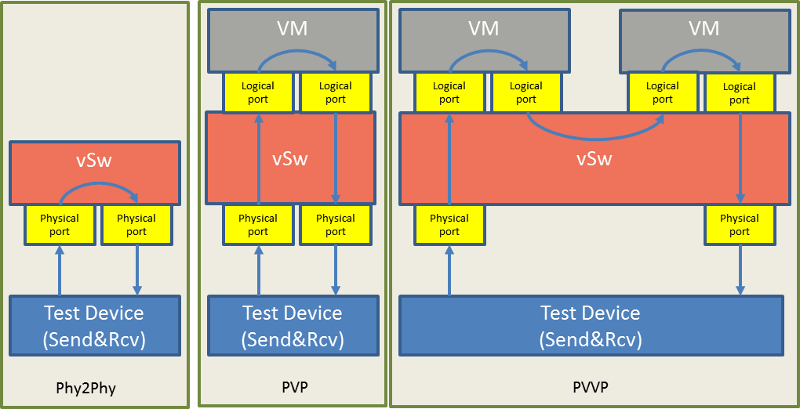
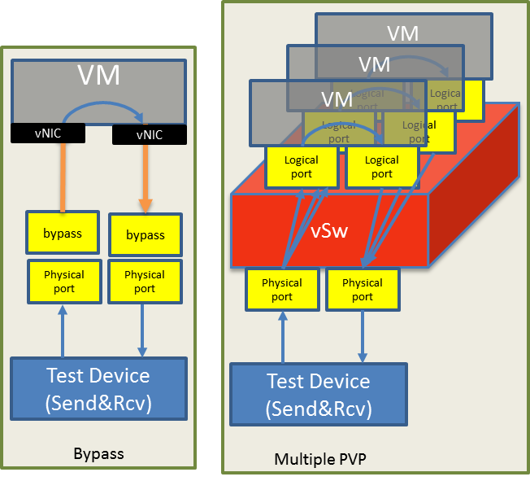
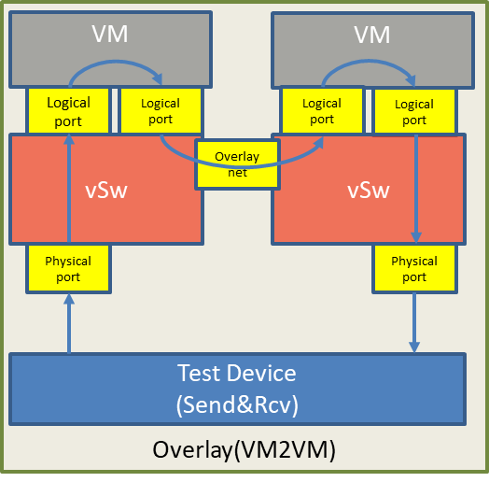
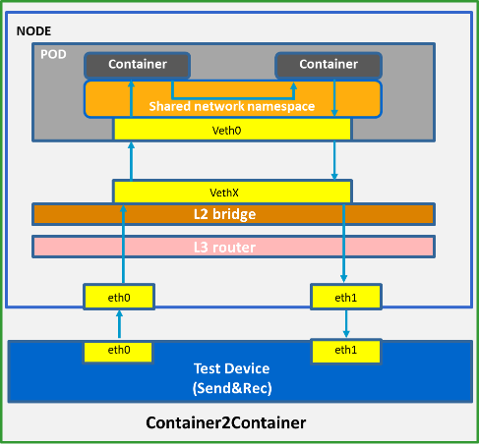
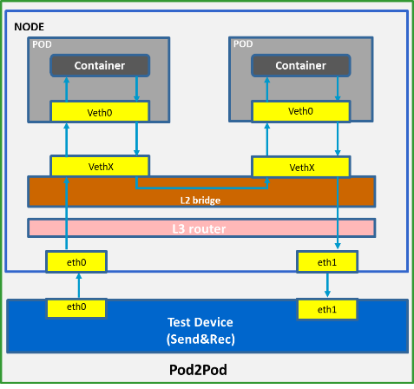
Test Setup Examples

Slide 4
Methods of Measurement: Core Procedures
Method (iterate over multiple frame sizes)
64 oct
128 oct
.256 oct
512 oct
1024oct
1280 oct
1518 oct
Method
Rep #1
Rep #2
Set (multiple repetitions of the same settings from Method)
Set
Meas Goal
Meas Goal
Test (multiple Trials searching for a Measurement Goal)
Test
30 Mfps
45 Mfps
37 Mfps
41 Mfps
43 Mfps
44 Mfps
Trials at different Offered Load levels
Trial

Slide 5


Mitigating Background Processes that Cause Errors (Loss)
0 Mfps
12 Mfps
1 Mfps
2 Mfps
....
11 Mfps
12 Mfps
Resource Exhaust, or Loss
False
False
....
True
True
Questioner
Responder / DUT
Traffic
Generator
~
Error-Free
Resource Limit Exceeded
Messages:
TRUE or FALSE
Traffic
Receiver
RCVR
Background Process Errors
Events per
Unit Time
Error converts FALSE -> TRUE
Error retains TRUE -> TRUE (half-lies)
Because of the nature of NFVI platform
Andrzej Pelc, "Searching games with errors— fifty years of coping with liars ", Theoretical Computer Science 270 (2002) 71–109. Available from https://www.gwern.net/docs/statistics/comparison/2002-pelc.pdf

Slide 6
Binary Search with Loss Verification
Goal
  Separate resource exhaustion and loss due to transient processes
  They are dealt with in separate ways
Solution
  If a trial fails because of loss (< z), run the trial again with the same stimulus (Max (r) = 2)
  Keep trials short to avoid transients
  Isolate loss due to transients
    Run long duration tests to characterize effects and frequency
Prototyped with OPNFV
Showed marked success in repeatability

