Slide 1
LFN MAC Meeting
December 8, 2021

Slide 2
2021 LF Networking Board Approved Goals
Identify & Tackle consumption barriers, celebrate success (Accelerate POC to Production)
  Ease of project consumption (Integration, Interop, upgrades, CI/CD, tools, processes people, documentation, etc.)
  Demonstrate Enterprise & Government consumption (end-to-end 5G, API, modularity of projects, use case driven open interop/integration)
  Track Market Success for repeatability (case studies, marketing, communication, etc.) & identify post deployment requirements/gaps
Enable Cloud, Telecom & Enterprise Ecosystems collaboration
  Enable Open Interop & Integration Projects or initiatives (Anuket, 5G Super Blueprint)
  Facilitate Collaboration in LFN with CNCF, LF Edge, ORAN SC, OIF as top priorities
  Increase focus on Enterprise use cases and ecosystem
  Promote Research & Community Insights in Enterprise, Telecom, Cloud Ecosystems coming together
Maintain and Grow Community (Developers, Projects, Members, Innovative ideas)
  Focus on Documentation and Technical Marketing of projects / onboarding, etc.
  Focus on Developers & Satisfaction (tools, surveys) & attracting system integration developers & testers
  Maintain/Grow Members (including ISVs)
  Create opportunities for new innovation and experimental ideas across ecosystem

Slide 3
Key Inputs to LFN Marketing Priorities
LFN Board Priorities
LFN Marketing Objectives and Strategies
LFN Recruitment Goals
LFN Project Goals
3

Slide 4
LFN Marketing Objectives
Influence consumption of LFN project software and artifacts
Position LFN as center of gravity and source of knowledge in networking
Heighten awareness of innovations
in LFN communities
To motivate companies to...
TRANSFORM
business
COLLABORATE
in new ways
INNOVATE
in our projects
4

Slide 5
Influence Consumption
Strategies and Programs
Influence consumption of LFN project software and artifacts
Marketing Strategies (“how” we accomplish the goal)
Create and publish high-quality proof points of deployments, trials, POCs, tooling, and demos
Spotlight enterprise participation and use cases
Marketing Programs and Channels (“what” we will do)
Proofpoint content and enterprise stories via webinars, infographics, case studies, whitepapers, blogs, videos
Promote content and stories via marketing & press channels:
  LFN website, member deck
  Press pitches (via LFN Fabric)
  Social outreach
  Speakerships (LF + non LF events)

Slide 6
Position LFN as Networking Center of Gravity Strategies and Programs
Position LFN as center of gravity and source of knowledge in networking
Marketing Strategies (“how” we accomplish the goal)
Integrate updated LFN messaging consistently into marketing content and communications (Best Effort)
Spotlight 5G Super Blueprint as hero example
Drive marketing collaborations with other groups (LF Edge, CNCF, Magma, O-RAN SC) to extend LFN reach
Marketing Programs and Channels (“what” we will do)
Messaging
  Train project teams and support staff on messaging framework
  Implement messaging in ALL content (see next slide)
5G Super Blueprint content & promotion
Maintain touch points with other groups, jointly promote 5G Super Blueprint
Distributed Anuket Assured badging

Slide 7
Putting LFN Messaging in Action
LFN Website: Homepage, Getting Started, Join (Ola, Paula Personas)
LFN Wiki (Sally): Homepage, Getting Started
Updated LFN messages
Bold, Assertive
LFN Member Onboarding Deck
LFN PPT Template
LFN Pitch Deck (Mike/Arpit)
Social Outreach
Events: Keynote, Content
Marketing Campaigns, Content
Press Material, Boilerplate
Project Messaging
7

Slide 8
Heighten Awareness of Developer Innovations Strategies and Programs
Heighten awareness of innovations
in LFN communities
Marketing Strategies (“how” we accomplish the goal)
Engage with the technical community at TAC level and through developer events (LFN Developer & Testing Forums, industry events)
Create and publish developer-focused content featuring community innovations
Marketing Programs and Channels (“what” we will do)
Recognize top community leaders and contributors via Community Badging Program
Developer content via webinars, whitepapers, blogs, videos
Promote content via LFN website, social outreach, speakerships (LF + non LF events)

Slide 9
How We Measure Success
Marketing Will Influence these KPIs:
Project consumption
# of new members joined
% increase in developer engagement
Marketing Will Measure these KPIs:
# of high quality marketing content pieces w/ promotion plans
  Minimum 5 developer assets / year
  Minimum 10 proof points (across >5 projects) / year
  Minimum 2 enterprise spotlights / year
  Super Blueprint Content
Content engagement: # viewers, % who took action after viewing asset
Awareness
Influence companies to consume LFN SW & artifacts
Consideration
Influence companies to join and contribute
Decision

Slide 10
2021 Marketing Post-Mortem
Full metrics available here (Q4 still in progress): https://wiki.lfnetworking.org/display/LN/MAC%3A+Digital+Marketing+KPIs+2021
What’s Working?
Webinars: 10 LFN webinars have produced 1,838 Reg, 873 Attendees, 6,052 YT Views
Tech Events Attendance Rate: ~90%, ONE Summit Satisfaction Rate: 96%
LFN Year in Review Report: 455+ Downloads
What’s Not?
Website Traffic: Trending down (around 40% for the year)
Downloadable Content: 6-month gap in new content (Mar-Oct) = much lower stats vs ‘20
LFN Newsletter: Clicks down ~30% from 2020, Unsubscribe Rate: X

Slide 11
Detailed KPIs
Activity | Goal | X quarter results | Red/yellow/green arrow
Blogs | Benchmarks: X views / per post X clicks / per post Goals: Achieve 10% increase in Metrics QoQ | Q1 results: Q2 results: Q3 results: Q4 results:
PR | Benchmarks: x# of articles in Top 50 pubs x# of mentions in member announcements Goals: Achieve 10% increase in Metrics QoQ | Q1 results: Q2 results: Q3 results: Q4 results:
Newsletter | Benchmarks: Open Rate: 22% Clicks per Newsletter: 736 Ubsubscribe Rate: X% Goals: Open Rate: 30% Clicks: 1,000 Ubsubscribe Rate: TBD | Q1 results: Q2 results: Q3 results: Q4 results:
Social Engagement | Benchmarks: TBD Goals: TBD | Q1 results: Q2 results: Q3 results: Q4 results:

Slide 12
Detailed KPIs
Note: Developing Member Growth Goals with LF Biz Dev. To be added.
Activity | Goal | X quarter results | Red/yellow/green arrow
Website | Benchmarks: 7,766 Users / per Q 14,821 Pageviews / per Q 1,451 Downloads / per Q Goals: Achieve 10% increase in Metrics QoQ | Q1 results: Q2 results: Q3 results: Q4 results:
Webinars | Benchmarks: 184 Registrations / per event 87 Attendees, / per event Goals: Achieve 10% increase in Metrics QoQ | Q1 results: Q2 results: Q3 results: Q4 results:
Content Production | Minimum 5 developer assets / year Minimum 10 proof points (across >5 projects) / year Minimum 2 enterprise spotlights / year Super Blueprint Content | Q1 results: Q2 results: Q3 results: Q4 results:
Content Engagement | Benchmarks: 75 downloads / per asset Goals: 100 downloads / per asset 400 views / asset

Slide 13
2022 Budget
Staffing and Infrastructure | $469K: Marketing staff + services, digital tools, operations, lead gen, creative services $50K: Website maint., security, hosting, content/page overhaul
Content production and promotion | $85K: production (writer, video production) $90K: promotion (paid social, Google Ads/SEM)
Communications | $15K: (AR, PR, social)
Developer awards and SWAG | $15K: (community award program, ONE Summit swag)
Community events & meetups | $40K: (1 Regional tour + 3 virtual events + small scale meetups)
68%
FUNDED
23%
2%
2%
5%
$764K

Slide 14
Paid Promos Options
Paid Promotion Options
Up to $90K Promotional Budget (assuming separate ONE Summit Budget and no other major vent sponsorships)
  Options:
    Paid Social: Twitter, LinkedIn, YouTube
    Google (Display/SEM)
    Others: TBD
  Consulting with LF Central Marketing (Digital Demand Manager) on optimal allocation of spend, priority channels, program kick off, A/B Testing, etc.

Slide 15
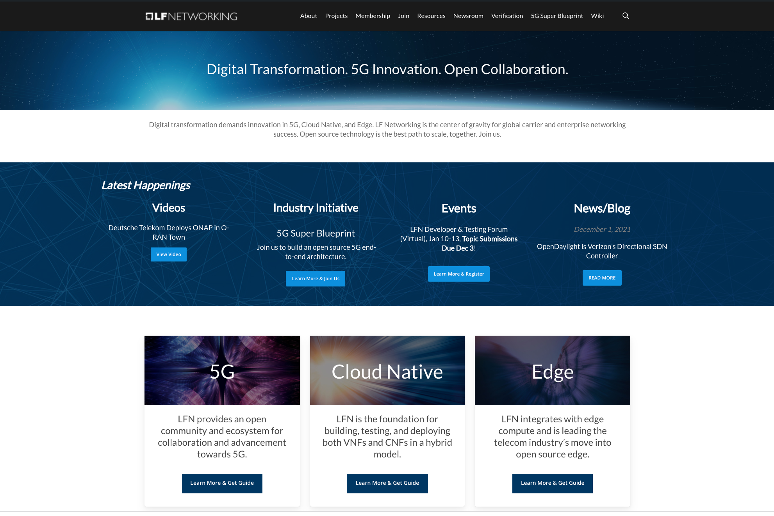
LFN Website Revamp Q1
LFN website has largely kept the same since launch
Needs:
  Streamlined Site Map / Nav
  Rotating banner
  New messaging / copy throughout
  Highlight user stories
  Highlight collaboration
  Landing pages
  SEO
https://www.lfnetworking.org/

Slide 16
2022 Timeline
Q1 | Q2 | Q3 | Q4
LFN Developer & Testing Forum (Virtual) (Jan 10-14) | Open Networking & Edge Forum, (Virtual) (Date TBD) | Open Networking & Edge Forum, (Physical) (Date TBD) | LFN Developer & Testing Forum (Virtual) (Date: TBD)
LFN Developer & Testing Forum Virtual (March) TBD | Paid Promotions | LFN Developer & Testing Forum, Porto, Portugal (June 13-16) | 2023 Planning
New Website Roll Out | Proof Point Collecting | Code Release Promos | Code Release Promos
Paid Promotions | Project Promos (Infographic, 1-Pager, webinar, etc.) | Paid Promotions | Q4 Newsletter
Proof Point Collecting | Code Release Promos | Q3 Newsletter
Project Promos (Infographic, 1-Pager, webinar, etc.) | Q2 Newsletter
Spark NZ Webinar & Case Study
LFN Landscape Completion w/ 5G Super Blueprint
Code Release Promos
Q1 Newsletter
16

Slide 17
2021 Highlights

Slide 18
LFN 2021 Goals & Performance (Dec Board Meeting)
Drive sustainable business & ecosystem
Create shared technology and community
Execute & Operate Efficiently (Operations)
  Member Growth (9 new YTD)
  Commercial Consumption & deployment & cloud nativification of ONAP
  Major Cloud and Enterprise projects- L3AF (pipeline), EMCO, ODIM, xGVela
  LFN 5G Super Blueprint initiative has gained significant traction & LFN now positioned as the Collaboration Umbrella
  Adjacent Networking projects gaining traction with LFN (US DoD consumption of LFN, Magma, ORAN SC, LF Edge, CNCF)
  MAC focusing on next gen messaging and thought leadership (framework established)
  3 New Projects in 2021 (xGVela, ODIM, EMCO) as part of LFN Sandbox and L3AF as LF project
  LFN projects interworking and interop with SDOs and other OSS communities like CNCF, LF Edge, OIF
  TAC focus on people recognition - badges in 2022 to outstanding contributors.
  LFN Security forum started sharing best practices.
  All TSCs functional, delivered releases as planned. No organization issues.
  EUAG published multiple white papers including NFV Testing and Automation for CNF and VNF, NFV and Intelligent Networking and AI
  Annual LFN operations survey demonstrated Y/Y improvements across most categories/KPIs and 1st GB Strategy survey was conducted
  Team has continued providing feedback and enhancement requests to improve LFX functionality in several key areas
  New model of leveraging common infrastructure (eg LFN wiki) with lower infrastructure costs for new LFN projects
  Delivered two 4-day Developer and Testing Forums - 600+ attendees across 8 different LFN Project communities and work is already underway for 2022 events
  Restructured the TPM team (Now Technical Community Architects) to better balance the workload across projects and focus on strategic initiatives across LFN
  Began expanded work with the Anuket and ONAP communities and IT to move towards more self-managed infrastructure in response to community needs

Slide 19
2021 PR Highlights
10 Press Releases
25+ Media/Analyst Briefings
Top Headline
AT&T CEO Reaffirms Commitment to Open Source Infrastructure (SDxCentral)
LFN Merges CNTT and OPNFV, Creates New Body for Cloud Native Telcos (TelecomTV)
Linux to Work with NGMN on Priorities for 5G and 6G Mobile (Capacity)
ONAP Honolulu Swells to the Mainland (SDxCentral)
Orange is Building a Network that will Run Itself (Light Reading)
Walmart Pushes Open Source L3AF to Help out eBPF Ecosystem (Phoronix)
LF Networking (LFN) Adds to Open Source Portfolio (DevOps.com)
AT&T Puts its 5G Future in the Azure Cloud (Forbes)
Welcoming Walmart to the Open Networking Community (Pica8)

Slide 20
2021 PR Highlights
Sample of Quotes
“AT&T has a long track record of [...sharing its significant SDN intellectual property developed over the last several years and built on open standards], given its contributions to several Linux Foundation networking projects.” (Will Townsend, Forbes)
“Walmart has bought into open networking in a big way. The company recently joined LF Networking, the collaboration ecosystem for Open Source Networking projects that is part of the Linux Foundation….’It’s almost impossible to run an extremely large organization without the latest, greatest technology, which is why Walmart is a “huge consumer of open source technology.” (Jeff Paine, Pica8)

Slide 21
And Lastly…

Slide 22
Thank You All for Participating! Especially…
Project Liaisons
Anuket: Bob Monkman
EMCO: Bob Monkman
FD.io: John DiGiglio / Neal Hartsell
ODIM: Joseprau Inbaraj / Jon Mechling
ONAP: Ranny Haiby
OpenDaylight: Filip Cuzy
Tungsten Fabric: Adam Growchowski
XGVela: Seshu Kumar
Messaging / Strategy Working Group
Bob Monkman
Neal Hartsell
Yves Bellego
Seshu Kumar
Ranny Haiby

Slide 23

HAPPY HOLIDAYS
Wishing you and yours a happy and safe holiday season! Cheers!

