Slide 1
ONAP CDS – Error Handling in Production Deployments
Aarna Networks - Kavitha P
Aarna Networks - Vivekanandan M

Slide 2
Agenda
Problem statement
ONAP CDS Audit logging feature contribution Jira tickets
CDS Workflow Audit Logging Design
CDS Workflow Audit Logging REST APIs
Demo

Slide 3
Problem Statement
CDS does not persist the workflow execution status.
Most practical deployments have CDS to execute long running workflows, where workflow status often needs to be accessed in order to trigger workflow resubmit etc.
Need to store the complete CDS workflow execution status for audit purpose in production.

Slide 4
CDS Audit logging and ELK Integration features
We contributed the following ONAP Jira tickets
CDS Audit Log persistence
  CCSDK-3434 (CDS Blueprint Processor Changes)
  CCSDK-3435 (CDS py-executor log persistence)
CDS Helm chart changes for ELK integration
  OOM-2801
  OOM-2802
  OOM-2803
    CDS BP flag to enable/disable audit logging

Slide 5
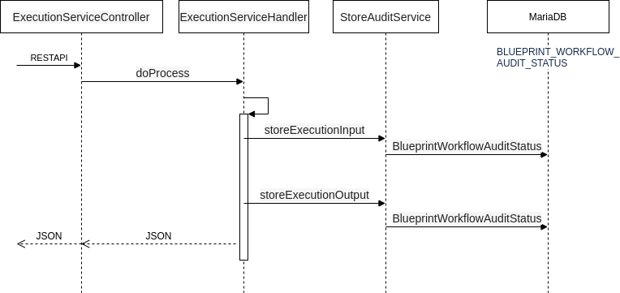
CDS Workflow Auditing Sequence Diagram

Slide 6
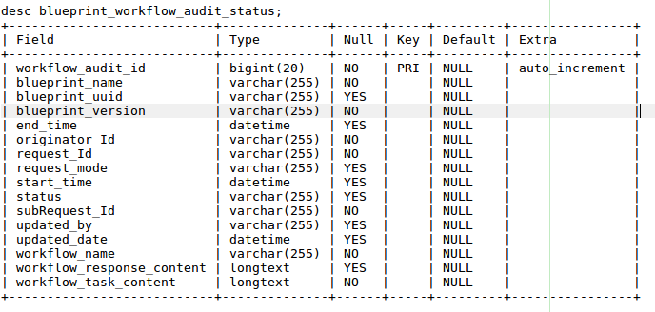
CDS Workflow Auditing Data Model
Introduced a New Database Table

Slide 7
CDS Workflow Audit Logging REST API
New REST API to get the WorkflowController health check
New REST API to get the CDS workflow status
curl -v --location \
--request GET \
http://{{host}}:{{port}}/api/v1/workflow/health-check \
--header 'Content-Type: application/json;charset=UTF-8' \
--header 'Accept: application/json;charset=UTF-8,application/json' \
--header 'Authorization: Basic Y2NzZGthcHBzOmNjc2RrYXBwcw=='
curl -v --location \
--request GET \
http://{{host}}:{{port}}/api/v1/workflow/audit-status/{requestId}/{subRequestId} \
--header 'Content-Type: application/json;charset=UTF-8' \
--header 'Accept: application/json;charset=UTF-8,application/json' \
--header 'Authorization: Basic Y2NzZGthcHBzOmNjc2RrYXBwcw=='

Slide 8
Demo - Recorded Video

Slide 9
Thank You!

