Slide 1
ONAP CDS – Error Handling in Production Deployments
Aarna Networks - Kavitha P
Aarna Networks - Vivekanandan M

Slide 2
Agenda
Problem statement
ONAP CDS Audit logging feature contribution Jira tickets
CDS Workflow Audit Logging Design
CDS Workflow Audit Logging REST APIs
Demo

Slide 3
Problem Statement
CDS does not persist the workflow execution status.
Most practical deployments have CDS to execute long running workflows , where workflow status often need to be accessed in order to trigger workflow resubmit etc.
Need to store all the CDS workflow execution status for audit purpose in production.

Slide 4
CDS Audit logging and ELF Integration features
We contributed the following ONAP Jira tickets
CDS Audi Log persistence
  CCSDK-3434 (CDS Blueprint Processor Changes)
  CCSDK-3435 (CDS py-executor log persistence)
CDS Helm chart changes for ELK integration
  OOM-2801
  OOM-2802
  OOM-2803
    CDS BP flag to enable/disable audit logging

Slide 5
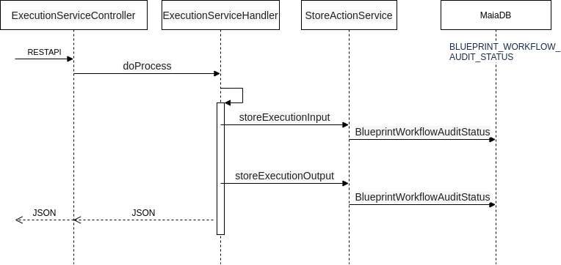
CDS Workflow Auditing Sequence Diagram

Slide 6
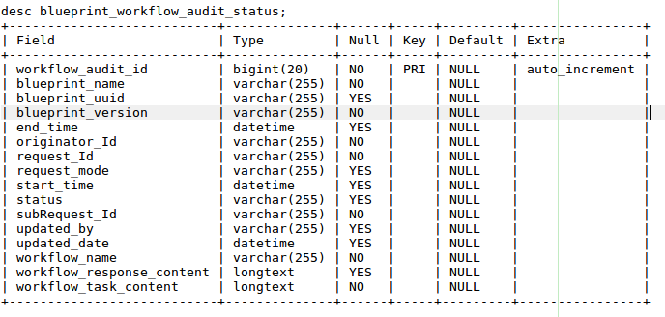
CDS Workflow Auditing Data Model
Introduced a New Database Table

Slide 7
CDS Workflow Audit Logging REST API
New REST API to get the WorkflowController health check
New REST API to get the CDS workflow status
curl -v --location \
--request GET \
http://{{host}}:{{port}}/api/v1/workflow/health-check \
--header 'Content-Type: application/json;charset=UTF-8' \
--header 'Accept: application/json;charset=UTF-8,application/json' \
--header 'Authorization: Basic Y2NzZGthcHBzOmNjc2RrYXBwcw=='
curl -v --location \
--request GET \
http://{{host}}:{{port}}/api/v1/workflow/audit-status/{requestId}/{subRequestId} \
--header 'Content-Type: application/json;charset=UTF-8' \
--header 'Accept: application/json;charset=UTF-8,application/json' \
--header 'Authorization: Basic Y2NzZGthcHBzOmNjc2RrYXBwcw=='

Slide 8
Demo - Recorded Video

Slide 9
Thank You!

