Slide 1
LFN MAC Call
November 03, 2021

Slide 2
Agenda
Strategic Plan Review
  Strategies
  Tactics / KPIs
  Events
  Paid Marketing
  Project Marketing
2

Slide 3
LFN Marketing Strategy
Q4 2021 – Q1, Q2 2022
Draft for Discussion

Slide 4
Recap
4

Slide 5
Overview
Top Focus areas for the MAC
LFN Messaging
  Updates since last GB
  Application to marketing programs
LFN Marketing Plan
  Revised objectives
  Next steps to build out the 2022 plan
Snapshot of Q4 activities
5

Slide 6
MAC Focus Areas
Messaging
  Refresh messaging framework - DONE
  Implement new messaging in marketing programs - Underway
Marketing Plan
  Refresh marketing objectives - DONE
  Build out strategies and marketing mix (tactics + KPIs) to support updated strategies – Underway (focus for today)
Q4 2021 marketing programs - “keep the business running”
  Execute commitments through EOY, intersect new messaging where possible - Underway
6

Slide 7
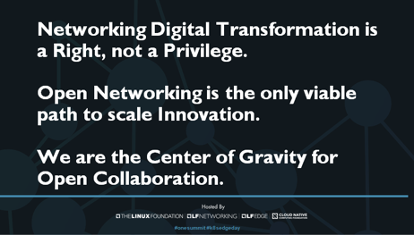
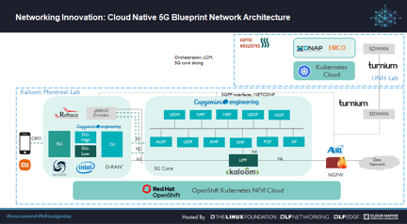
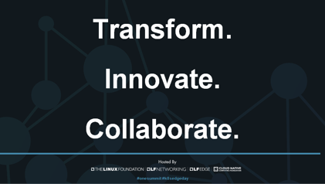
Messaging Update
Messaging Refinements
Adjusted “Save Money” pillar to “Make Money”, encompassing revenue generation + CapEx, OpEx savings
Incorporated “LFN as center of gravity” statement into narrative
Rallying around “Transform. Collaborate. Innovate” as key messaging hooks
Messaging in Action
Aligned on initial intercepts for new messaging
Light integration of new messaging into ONE Summit (blueprint keynote, social)
7

Slide 8
Putting LFN Messaging in Action
LFN Website: homepage, getting started, join (Ola, Paula personas)
LFN Wiki (Sally): homepage, getting started
Updated LFN messages
Bold, Assertive
LFN member onboarding deck
LFN ppt template
LFN Pitch Deck (Mike/Arpit)
Social Outreach
Events: keynote, content
Marketing Campaigns, content
Press material, boilerplate
8

Slide 9
Marketing Plan
9

Slide 10
Key Inputs to LFN Marketing Priorities
LFN Board Priorities
LFN Marketing Objectives and Strategies
LFN Recruitment Goals
LFN Project Goals
10

Slide 11
Proposed LFN Marketing Objectives
Influence consumption of LFN project software and artifacts
Transform
(your business)
Position LFN as center of gravity and source of knowledge in networking
Collaborate
(on steroids)
Heighten awareness of innovations in our communities
Innovate
(5G, cloud native, edge)
11

Slide 12
LFN Marketing Focus: Transform
Objective: Influence consumption of LFN project software and artifacts
Strategies:
Develop and promote proof point portfolio: deployments, consumption, tooling, trials, demos, POCs
Spotlight enterprise participation and use cases via content, social, and press outreach
Key Programs:
Content (webinars, 1-pagers, infographics, case studies, whitepapers, briefs, blogs, videos)
Press pitches (as part of LFN Fabric)
Social outreach (including paid promotion)
Speakerships (LF + non-LF events)
Idea: LFN Podcast Series
Possible KPIs:
2 proof points* per LFN TAC/Mature Project. (1 proof point for Sandbox/incubating)
At least 2 Enterprise-focused Proof Points for X-promotion
* Proof point: TAC/Mature Project: Project code consumed in end user deployment. Sandbox/Incubating Project: POC Trial
12

Slide 13
LFN Marketing Focus: Collaborate
Objective: Position LFN as center of gravity and source of knowledge in networking
Strategies:
Implement bold, assertive messaging in ALL marketing programs, content and communications
Extend LFN reach, voice, and impact by driving marketing collaborations with other groups (LF Edge, CNCF, Magma, ORAN-SC)
Key Programs:
5G SBP promotion and amplification across all channels
Messaging activation and delivery (member uptake + collaboration)
Maintain regular touch points with other umbrellas/projects and seek alignment (LFN GM input)
Anuket Assured
Possible KPIs (Options, narrow to 1-2):
5G Super Blueprint Marketing Asset Consumption Stats (TBD)
Distribute 5 Anuket Assured Badges for Infrastructure & Workload*
Increase 5G Super Blueprint participation by 10% quarterly (projects + companies)
5G Super Blueprint integrations with Magma (Q1), Edge (Q2), ORAN SC (Q4)**
* Requires participating companies/products.
**Requires project integration community participation

Slide 14
LFN Marketing Focus: Innovate
Objective: Heighten awareness of innovations in our communities
Strategies:
Increase developer engagement by collaborating with the technical community at the TAC level and through LFN Developer & Testing Forums, LFN and Industry events
Develop content showcasing LFN developer innovations (POCs, Blogs, Videos, etc.)
Key Programs:
Recognize top community leaders and contributors with Community Badging program
Re-start LFN Project Community Awards programs (Likely in person at June event)
Provide onramps for easy/quick content generation
Possible KPIs:
#/% of LFN Community leaders recognized via badging and/or Awards Program
#/% of Community leaders displaying Badges/Titles/Awards on LinkedIn
#/% of social media pickup around LFN innovation (hashtags, etc.)
#/% of developer-focused Content each quarter (innovation AND innovator)

Slide 15
External KPIs – to be better defined with MAC
How are we measuring that LFN is the nexus / center of gravity?
  Mentions / Share of Voice / etc.
  Idea: Member Survey
    Why are you part of LFN?
    How do we rank relative to other networking orgs?
  Positioning: How is LFN different from ONF?
    What does LFN have to offer that ONF does not?
      Open Source developer model, all volunteers
      Model of true open source development – how do we show this

Slide 16
Target Marketing Channels for Content/Proof Points
Owned
LFN website
LFN webinars
LFN social (Twitter, LI, YouTube)
LFN newsletter
LFN badging efforts
Member social channels, websites
New member programs around transform, innovate, collaborate
Earned
Influencer advocacy
Tech and business PR
Analysts
Industry awards + recognition
Event speakerships (CFP or by invite)
Industry webinars (by invite)
External events (by invite)
Paid
Paid Placements in industry publications
Paid sponsorships, speakerships at industry events
Paid Social Media Campaigns / SEM
Industry webinars
External events
16

Slide 17
LFN Paid Promotions
Recommendation: Develop a paid campaign to amplify our earned/owned channels
Options:
  Paid Placements in industry publications
  Paid sponsorships, speakerships at industry events
  Paid Social Media Campaigns / SEM
  Industry webinars
  External events
Work with the Marketing Strategy Working Group to review/recommend options
Add recommendation into final budget proposal to Finance Committee (11/18) and Board (Dec 1)

Slide 18
Q4 Timeline (To be built out for 2022)
October | November | December
ONE Summit Oct 11-12 | MAC Meeting, Nov 3 | LFN Annual Report Production
LFN Board Meeting Oct 19-20 | Project TSC Marketing Check Ins | Annual Report Promos (Prep)
ODL Phosphorus Marketing Release Oct 28 | Orange Case Study + Webinar Nov 10 | LFN Developer + Testing Forum Promos (Prep)
Verizon One Pager + Blog | DT Case Study + Webinar Nov 16 | LFN Landscape Completion
Orange One Pager | EUAG Webinar TBD | LFN Website Revamp
DT One Pager | Verizon Webinar TBD | LFN Badging Program
EUAG AL-ML Whitepaper | Q3/Q4 Newsletter TBD | Anuket Lakelse Release
 | Istanbul Marketing Release | Project TSC Marketing Check Ins
 | XGVela Technical Architecture
18

Slide 19
Project Marketing
LFN Project Priorities received for October Board meeting
Working with MAC Liaisons to map these against existing Project Marketing priorities and make updates
In order to align best align project marketing, we recommend the following:
  Book time on each Project TSC calendar in November to present marketing priorities and goals
  Goal: Work with each project to develop:
    Project proof points (Deployment/Consumption Stories with End Users)
    A Project Infographic
    A Project 1-Pager (for project websites + LFN.org)
    A Webinar for Q1 (with end user)
    Ongoing: Support blogs and short-form video

Slide 20
Thank You

