Slide 1

Anuket Assured
Badge Markup Exercise
Version 1.1
CVC Proposal

Slide 2
Purpose of this slide deck
Anuket Assured (CVC) has proposed a 4-badge structure to the LFN MAC that can easily expand as needed (see next slide). The initial feedback from the MAC working group is that we need fewer badges while still allowing future capabilities to be incorporated
There is however strong concern from some of the Anuket Assured members that we must provide a clear distinction at the badge level between legacy and cloud native solutions
The purpose of this deck is to expand on the original Anuket Assured (CVC) proposal to evaluate options further with the LFN MAC

Slide 3
The Original Anuket Assured CVC proposal
VM Platform and Infrastructure | Cloud Platform and Infrastructure | Future Architecture
VNF workload Interop (Anuket RC1) ONAP VNF Compliance & Lifecycle | CNF workload Interop (Anuket RC2) CNF Conformance (CNCF based tests) ONAP CNF Compliance & Lifecycle | Future Workload
4 main badging categories with sub attributes.
Sub attributes can be expanded without
requiring new badge categories.
Badge categories only expand for significant technology shifts

Slide 4

NFV Badges
Infrastructure
VNF Workload
NFV
NFV
Assured
Assured
Version/Release
Version/Release

Slide 5
Cloud Native Badges
Infrastructure
CNF Workload
CLOUD NATIVE
CLOUD NATIVE
Assured
Assured
Version/Release
Version/Release

Slide 6
Badge to Portal (Structure Overview)
NFV
Awarded NFV badges are listed on the NFV portal.
NFV Infrastructure badges are grouped together.
VNF Workloads are grouped together.
Infra
Infrastructure
Xxxxxx xxxxxxxx xxxxx xxxxxxx xxxxxxxx xxxx
Xxxxxx xxxxxxxx xxxxx xxxxxxx xxxxxxxx xxxx
Xxxxxx xxxxxxxx xxxxx xxxxxxx xxxxxxxx xxxx
Xxxxxx xxxxxxxx xxxxx xxxxxxx xxxxxxxx xxxx
Hyperlink from badge to NFV portal
Workload
VNF Workload
Xxxxxx xxxxxxxx xxxxx xxxxxxx xxxxxxxx xxxx
Xxxxxx xxxxxxxx xxxxx xxxxxxx xxxxxxxx xxxx
Xxxxxx xxxxxxxx xxxxx xxxxxxx xxxxxxxx xxxx
Xxxxxx xxxxxxxx xxxxx xxxxxxx xxxxxxxx xxxx
Cloud Native
Awarded Cloud Native badges are listed on the Cloud Native portal.
Cloud Native Infrastructure badges are grouped together.
CNF Workloads are grouped together.
Infra
Infrastructure
Xxxxxx xxxxxxxx xxxxx xxxxxxx xxxxxxxx xxxx
Xxxxxx xxxxxxxx xxxxx xxxxxxx xxxxxxxx xxxx
Xxxxxx xxxxxxxx xxxxx xxxxxxx xxxxxxxx xxxx
Xxxxxx xxxxxxxx xxxxx xxxxxxx xxxxxxxx xxxx
Hyperlink from badge to Cloud Native portal
Workload
CNF Workload
Xxxxxx xxxxxxxx xxxxx xxxxxxx xxxxxxxx xxxx
Xxxxxx xxxxxxxx xxxxx xxxxxxx xxxxxxxx xxxx
Xxxxxx xxxxxxxx xxxxx xxxxxxx xxxxxxxx xxxx
Xxxxxx xxxxxxxx xxxxx xxxxxxx xxxxxxxx xxxx

Slide 7
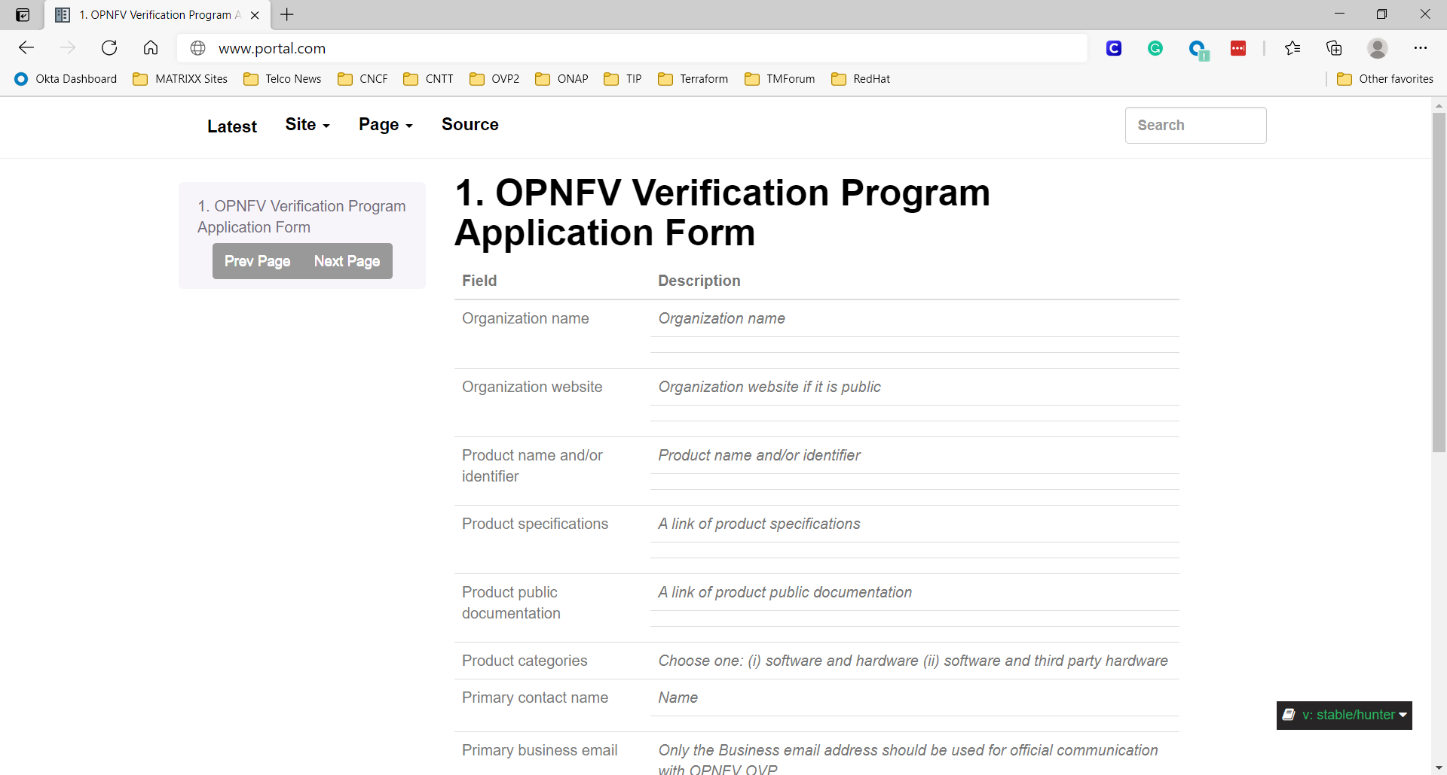
Badge to Portal – Anuket R2 Workload Example
Compliance for 1 CNF Workload badge (1 attribute)
Anuket Assured Cloud Native Portal
CNF Workloads
Hyperlink
Xxxx xxxxxxx xxxxxxxxxxxxxx xxxxxxxxxx xxxxxxxxxxxx
Xxxxx xxxxxxx xxxxxxxxxxxxxxxxx xxxxxxxxxx xxxxxxxxxxxx
Xxxxx xxxxxxx xxxxxxxxxxxxxxxxx xxxxxxxxxx xxxxxxxxxxxx
….
CNF Workload
CLOUD NATIVE
Company: MATRIXX Software
Product: Digital Commerce Platform
Product Version: 5220
Description: A 3GPP Compliant 5G CCS ….
Product/Vendor Link: www.matrix.com/digital-commerce-platform/
Anuket Version: 2021/6
SUT: Anuket R2 Compliant Workload
Date Certified: 2021/11
Assured
2021/6
Hyperlink
Links to 2021/6
Documentation

Slide 8
Badge to Portal – Anuket R2 + ONAP Workload Example
Compliance for 1 CNF Workload badge (2 attributes) earned at different times
Anuket Assured Cloud Native Portal
CNF Workloads
Xxxx xxxxxxx xxxxxxxxxxxxxx xxxxxxxxxx xxxxxxxxxxxx
Xxxxx xxxxxxx xxxxxxxxxxxxxxxxx xxxxxxxxxx xxxxxxxxxxxx
Xxxxx xxxxxxx xxxxxxxxxxxxxxxxx xxxxxxxxxx xxxxxxxxxxxx
Xxxxx xxxxxxx xxxxxxxxxxxxxxxxx xxxxxxxxxx xxxxxxxxxxxx
Hyperlink
CNF Workload
Company: MATRIXX Software
Product: Digital Commerce Platform
Product Version: 5220
Description: 4G OCS and 5G CCS
Product/Vendor Link: www.matrix.com/digital-commerce-platform/
Anuket Version: 2021/6
SUT: ONAP Compliant Workload
Date Certified: 2021/12
CLOUD NATIVE
Earned Second
Assured
Company: MATRIXX Software
Product: Digital Commerce Platform
Product Version: 5220
Description: 4G OCS and 5G CCS
Product/Vendor Link: www.matrix.com/digital-commerce-platform/
Anuket Version: 2021/6
SUT: Anuket R2 Compliant Workload
Date Certified: 2021/11
Earned First
2021/6

Slide 9
Badge to Portal – Anuket R2 + ONAP + CN Workload Example
Compliance for 1 CNF Workload badge (3 attributes) earned at the same time
Anuket Assured Cloud Native Portal
CNF Workloads
Xxxx xxxxxxx xxxxxxxxxxxxxx xxxxxxxxxx xxxxxxxxxxxx
Xxxxx xxxxxxx xxxxxxxxxxxxxxxxx xxxxxxxxxx xxxxxxxxxxxx
Xxxxx xxxxxxx xxxxxxxxxxxxxxxxx xxxxxxxxxx xxxxxxxxxxxx
Xxxxx xxxxxxx xxxxxxxxxxxxxxxxx xxxxxxxxxx xxxxxxxxxxxx
;;;;;
Hyperlink
CNF Workload
Company: MATRIXX Software
Product: Digital Commerce Platform
Product Version: 5220
Description: 4G OCS and 5G CCS
Product/Vendor Link: www.matrix.com/digital-commerce-platform/
Anuket Version: 2021/6
SUT: Anuket R2 Compliant Workload
Date Certified: 2021/11
CLOUD NATIVE
Company: MATRIXX Software
Product: Digital Commerce Platform
Product Version: 5220
Description: 4G OCS and 5G CCS
Product/Vendor Link: www.matrix.com/digital-commerce-platform/
Anuket Version: 2021/6
SUT: ONAP Compliant Workload
Date Certified: 2021/11
Assured
2021/6
Company: MATRIXX Software
Product: Digital Commerce Platform
Product Version: 5220
Description: 4G OCS and 5G CCS
Product/Vendor Link: www.matrix.com/digital-commerce-platform/
Anuket Version: 2021/6
SUT: CNCF Cloud Native Compliant Workload
Date Certified: 2021/11

Slide 10
Badge to Portal – Mixed Example
Compliance for 1 CNF Workload and 1 NFV Infra badge earned at different times
Anuket Assured NFV Portal
NFV
Infrastructure
Hyperlink
Xxxx xxxxxxx xxxxxxxxxxxxxx xxxxxxxxxx xxxxxxxxxxxx
Xxxxx xxxxxxx xxxxxxxxxxxxxxxxx xxxxxxxxxx xxxxxxxxxxxx
Xxxxx xxxxxxx xxxxxxxxxxxxxxxxx xxxxxxxxxx xxxxxxxxxxxx
….
Company: Acme Infra
Product: MME
Product Version: Version 2.0
Description: 4G MME Network Function
Product/Vendor Link: www.acmeinfrastructuref.com/MME
Anuket Version: 2019/1
SUT: Anuket R1 Compliant Infrastructure
Date Certified: 2019/6
2019/1
Anuket Assured Cloud Native Portal
CNF Workload
Hyperlink
Xxxx xxxxxxx xxxxxxxxxxxxxx xxxxxxxxxx xxxxxxxxxxxx
Xxxxx xxxxxxx xxxxxxxxxxxxxxxxx xxxxxxxxxx xxxxxxxxxxxx
Xxxxx xxxxxxx xxxxxxxxxxxxxxxxx xxxxxxxxxx xxxxxxxxxxxx
….
Company: MATRIXX Software
Product: Digital Commerce Platform
Product Version: 5220
Description: 4G OCS and 5G CCS
Product/Vendor Link: www.matrix.com/digital-commerce-platform/
Anuket Version: 2021/6
SUT: Anuket R2 Compliant Workload
Date Certified: 2021/11
2021/6

Slide 11
Vendor page with multiple badges
(Not required for MVP)
Anuket Assured Portal – Vendor Page
The vendor page lists all NFV infrastructure and VNF workloads in one grouping and all cloud native infrastructure and workloads in another grouping but all on the same page.
Cloud Native
Company: Acme
Product: ABC
Product Version: V1
Description: Abc …
Product/Vendor Link: www…
Anuket Version: 2021/6
SUT: Anuket R2 Compliant Workload
Date Certified: 2021/11
Company: Acme
Product: DEF
Product Version: V1
Description: Def …
Product/Vendor Link: www…
Anuket Version: 2021/6
SUT: ONAP Compliant Workload
Date Certified: 2021/12
NFV/VNF
Company: Acme
Product: MME
Product Version: Version 2.0
Description: 4G MME Network Function
Product/Vendor Link: www.acmeinfrastructuref.com/MME
Anuket Version: 2019/1
SUT: Anuket R1 Compliant Workload
Date Certified: 2019/6
Company: ACME
Product: MME
Product Version: Version 2.0
Description: 4G MME Network Function
Product/Vendor Link: www.acmeinfrastructuref.com/MME
Anuket Version: 2019/1
SUT: R1 Compliant Infrastructure
Date Certified: 2019/6

