Slide 1
LFN MAC Meeting
February 17, 2020

Slide 2
Antitrust Compliance Notice
Meetings of the LF Networking Fund involve participation by industry competitors, and it is the intention of the Project to conduct all of its activities in accordance with applicable antitrust and competition laws. It is therefore extremely important that attendees adhere to meeting agendas, and be aware of and not participate in any activities that are prohibited under applicable U.S. state, federal or foreign antitrust and competition laws. Examples of types of actions that are prohibited at LF Networking Fund meetings and in connection with LF Networking Fund activities are described in the The Linux Foundation Antitrust Policy. If you have questions about these matters, please contact your company counsel or Andrew Updegrove, of the firm of Gesmer Updegrove LLP, which provides legal counsel to The Linux Foundation.
Linux Foundation Antitrust Policy: https://www.linuxfoundation.org/antitrust-policy

Slide 3
Agenda
Intros
Major Initiatives
LFN Landscape
LFN Evolution
OVP Evolution
MAC Vice Chair Discussion
LF Events Update
MAC Action List

Slide 4
Intros

Slide 5
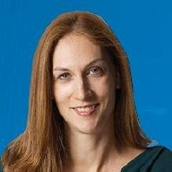
Intros
Welcome new LFN MAC Chair Lindsey Sech
  Director Industry Marketing for Network Platforms at Intel Corporation
LFN Project Liaisons (priorities, messaging, content, website):
  Anuket: Bob Monkman
  FD.io: John DiGiglio
  ONAP: Davide Cherubini
  OpenDaylight: Filip Cuzy
  Tungsten Fabric: Adam Grochowski
  XGVela: TBD

Slide 6
Major Initiatives

Slide 7
Major Initiatives | Tactics & Tools | Outputs | KPIs
Highlight Current & New Deployments / Case Studies / Use Cases / Project Updates / Consumption Models | Project Specific Case Studies / Demos / Webinars / Blogs | 3 major publications / quarter 3 webinars / quarter Short-form video content | 2K Engagements (page views + video views + downloads)
Attract New Developers + Improve Onboarding + Reduce Learning Curve Cultivate “Voice of the Developer” | Update LFN & Project Web, Wikis, Docs Recruit developer SMEs Mentorship Program / LFN Jobs Board | Onboarding sessions at each tech event (4) 3 Developer-focused asset per quarter (blog/video, etc.) | 25 attendees / session 2K Engagements (page views + video views + downloads) 10 LFN Interns / 10 Posted Jobs
Foster LFN integration + Cloud Native Approach + Interoperability | LFN Umbrella Led Whitepapers / Case Studies / Demos / Webinars / Blogs (e.g. TAC / EUAG) Support Community Demos + Surveys | 1 LFN X-project Demo + WP 8 ONES Community Demos 3 major publications / year | 2K Engagements Points (page views + video views + downloads)
Anuket + OVP Evolution | Develop Anuket Brand + Messaging + Comms Integrate Anuket + CNF testing into OVP program Cross-promote with CNCF | Launch Anuket brand, website wiki Revamp OVP Launch CNF Badge | 3K visitors + 10K Page Views per quarter 6 new Anuket participants 4 new badges awarded

Slide 8
LFN Landscape

Slide 9
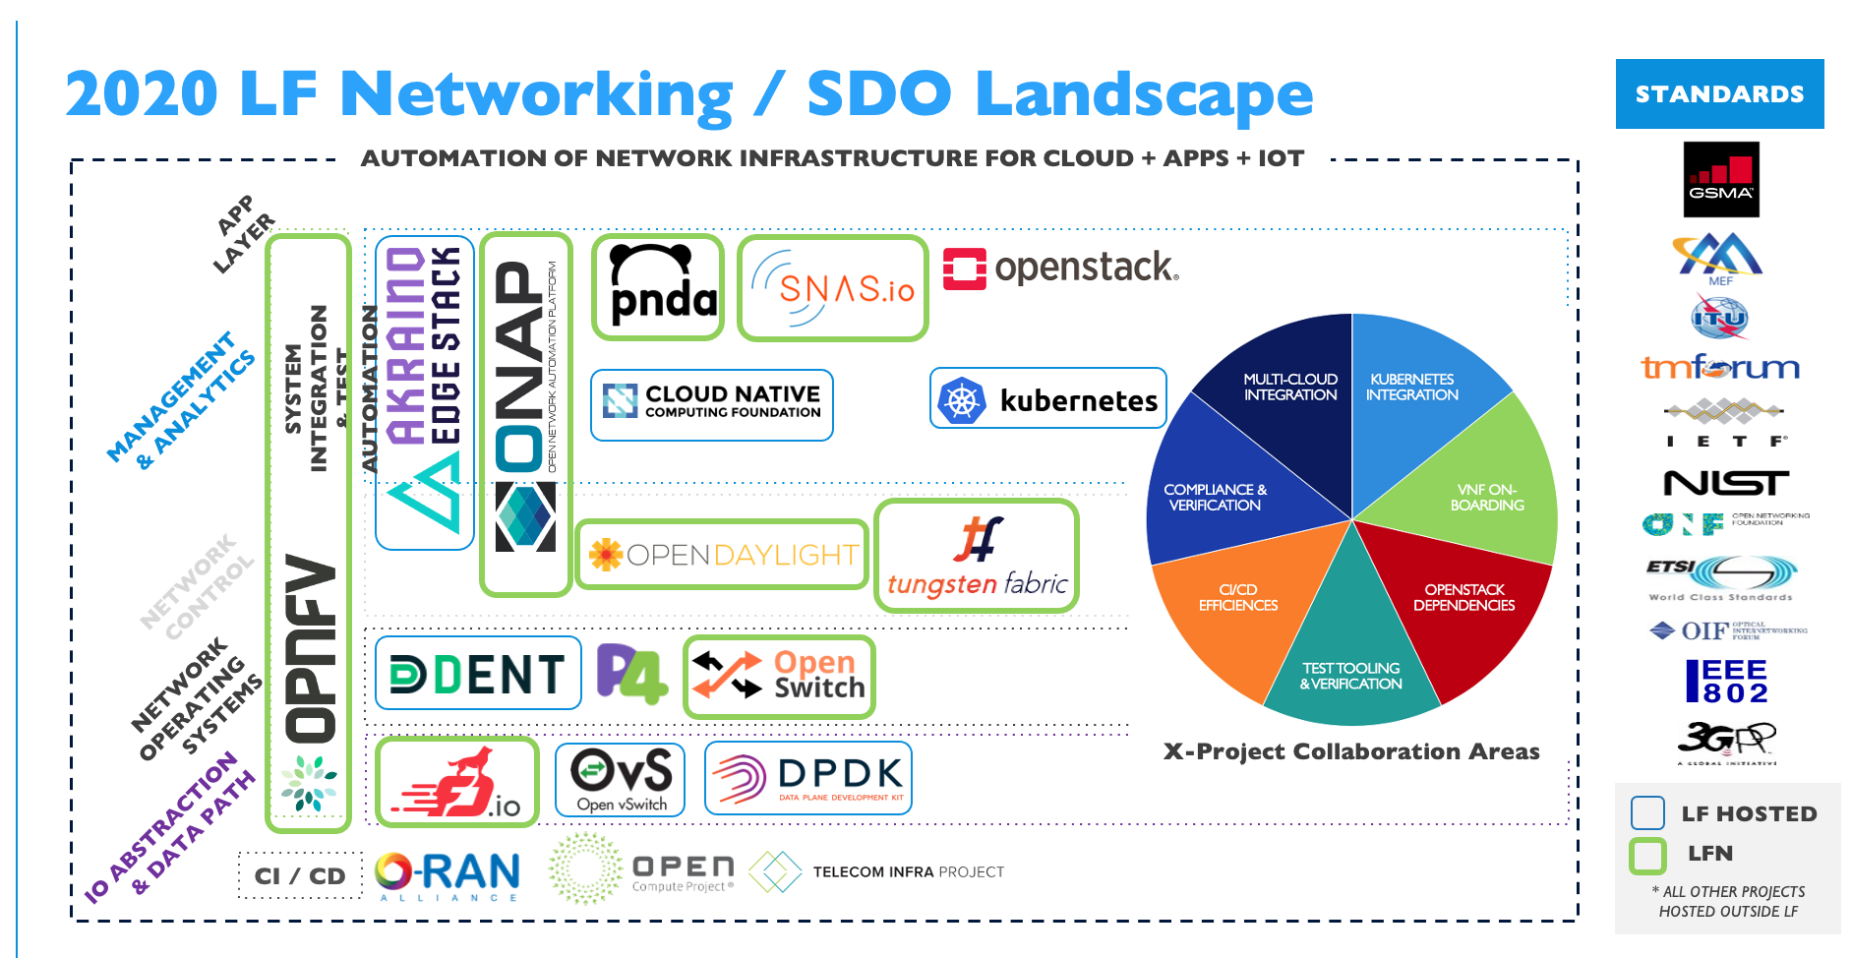
LFN Landscape
Originally developed by CNCF, now open sourced and available for other projects
Example: https://landscape.lfai.foundation/
Example: The LF AI & Data Foundation landscape (png, pdf) is dynamically generated below. It is modeled after the CNCF landscape and based on the same open source code. Please open a pull request to correct any issues. Greyed logos are not open source. Last Updated: 2021-02-16 Proposal: Build the LFN Landscape for LFN (completion goal Q2)
  Potential Uses:
    Augment / replace the “Open Source Networking Stack” Slide
    Serve as the home / portal for verification badging
    Examine the stack layer by layer and highlight project coverage and integration
    Provide a foundation for solution marketing efforts by LFN members
      Idea: Break the stack into layers, create a campaign (webinar / solutions brief / infographic / social) for each, highlight LFN members and where they fit in.

Slide 10
LFN Evolution

Slide 11
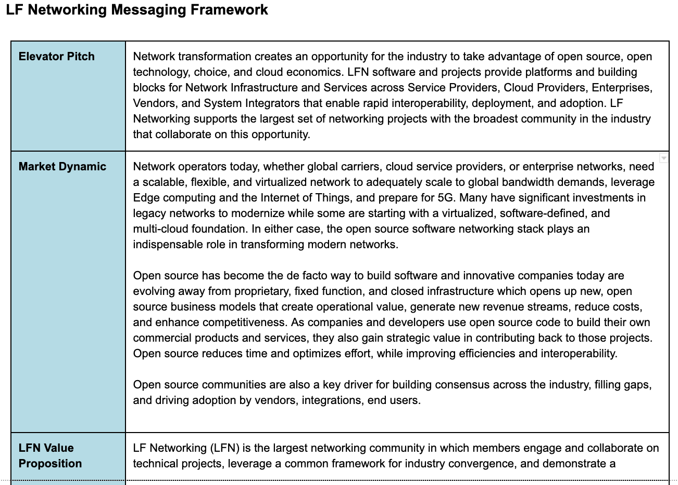
2021 LFN Evolution
LFN capabilities have expanded since the LFN Positioning & Messaging created in Fall 2019
https://docs.google.com/document/d/1LEsGQ6mwM2DXh2xR0ALIR8FIo44hv6pzXEZb2qDdJHU/edit
New Projects:
  XGVela (confirmed)
  ODIM (likely)
  Adjacent Projects: O-RAN, Magma, others
New Members:
  Google (last fall)
  Walmart (not yet announced)
  Others TBD
Proposal:
  Develop LFN Messaging around Enterprise & Cloud verticals
  Looking for volunteers to form a working group

Slide 12
OVP Rebranding

Slide 13



OVP Evolution
OPNFV Verification Program (OVP) launched in 2017
Program merged into LFN
  https://www.lfnetworking.org/OVP/
Badges created for Infrastructure (13), VNFs (2), and Labs (4)
Program directory hosted on 2 different portals
  Infrastructure: https://nfvi-verified.lfnetworking.org/#/
  VNFs: https://vnf-verified.lfnetworking.org/#/
2021 Planning
  Branding: Rename and Rebrand Program (OPNFV now Anuket)
  Migrate portal to LFN infrastructure using landscapes

Slide 14
OVP Rebranding
Proposal from Anuket Marketing Working Group:
Evolve "OPNFV Verification Program" (official name of the program) and "OPNFV Verified" (official name on the badge) to "Anuket Assured” (using Anuket logo and brand elements)
Serve as the testing and integration “anchor brand” for other contributing projects (e.g. CNCF, ONAP, OpenStack, others TBD)
Existing OVP badge holders will be encouraged to resubmit their applications to become “Anuket Assured” using an Anuket release designated by the LFN Compliance and Verification Committee (CVC).
Existing group documentation will be re-worked and the program launched on a new web portal in 1H2021.
Input from OVP Planning committee
  Clarification needed that program is not ONLY Anuket requirements
  Recognize contributions from other projects

Slide 15
LFN MAC Co-Chair

Slide 16
LFN MAC Vice-Chair
Idea presented from the community for an LFN MAC Vice-Chair
Not currently defined within the charter, i.e. we would need to define the role
Duties:
  Collaborate with LFN MAC Chair and LFN Staff on LFN Marketing planning and execution
  Bring an additional perspective on open source marketing best practices
  Serve as community marketing lead when the MAC chair is unavailable (reviews, etc.)
Open Questions:
  Membership-level eligibility
  Number of co-chairs
  How to volunteer
  Need to update the Charter?

Slide 17
LF Events Update

Slide 18
2021 LF Events Update
March 9 (9:00 – 12:00 PT): LF Spring Member Meeting
  Due to COVID-19, we will be delaying the next in-person Member Summit to November 2021. So we’re scheduling this event to share timely information and announcements with members on new project launches, project updates, etc.
  Free for LFN Members, Email: events@linuxfoundation.org for code.
March 10 – 12: Open Networking & Edge Executive Forum
  Executive Edition of Open Networking & Edge Summit, the industry’s premier open networking & edge computing event. Executive leadership across the networking & edge ecosystems can share their visions with a global audience in the Telco, Cloud, and Enterprise Verticals.
  Free for LFN Members. Email: events@linuxfoundation.org for code.
  Learn More & Register: https://www.lfnetworking.org/event/open-networking-edge-executive-forum/
October 11-12: Open Networking & Edge Summit
  Collocated with KubeCon + CloudNativeCon ( Oct 12 – 15)
  Current plan is to hold an in-person event in Los Angeles (contingency for virtual/hybrid event)
  CFP / Registration Info TBD

Slide 19
MAC Action List

Slide 20
MAC Action List
Register:
LFN Spring Member Meeting & Open Networking & Edge Forum (see previous slide)
Help Cross Promote:
LFN Webinars Series: https://www.lfnetworking.org/resources/lfn-webinar-series/
LFN Resources: https://www.lfnetworking.org/category/publications/
LFN LinkedIn Channel: https://www.linkedin.com/company/lf-networking/
Open Networking & Edge Forum: https://www.lfnetworking.org/event/open-networking-edge-executive-forum/
Consider:
Submitting a Webinar Proposal (Need to start filling in the 2021 calendar!) https://docs.google.com/forms/d/e/1FAIpQLSfH5iJV9vXJ_RRuMMUQd171YH1T2RGjAmmFf2Gp4E3WR19jFw/viewform
Submitting ideas for LFN Demos or Surveys to bwick@linuxfoundation.org
Inviting others in your company to join MAC (membership required / up to 3): https://lists.lfnetworking.org/g/lfn-mac
Submitting blog topic, SME, cross-post in key areas (5G, cloud native, edge): jlovato@linuxfoundation.org
Participating in a member spotlight blog: jlovato@linuxfoundation.org

Slide 21
THANK YOU

