Slide 1
Transport Slicing Demo of Guilin
Henry Yu
Jun Sun
Hesam Rahimi
Decheng Zhang
Christopher Janz
Lin Meng
@twitter

Slide 2
E2E Network Slicing on ONAP
ONAP
CSMF
Align with 3GPP
Align with IETF and ZSM
NSMF
Align with 3GPP
3rd Party
RAN NSSMF
RAN NSSMF
TN NSSMF
Core NSSMF
Align with O-RAN
Configure RU, DU, CU
Transport Network Configurations
RU
TN
DU
TN
CU
TN
Core
Front Haul
Mid Haul
Back Haul
RAN Slice Subnet
Core Slice Subnet
Transport Slice Subnet 1
Transport Slice Subnet 2
Transport Slice Subnet 3

Slide 3
Scope of this Demo
Transport slicing solution needs to be:
X-haul agnostic
Consumer agnostic
Self-contained and deployable
Federated solution
ONAP
CSMF
NSMF
3rd Party
RAN NSSMF
RAN NSSMF
TN NSSMF
Core NSSMF
Configure RU, DU, CU
Transport Network Configurations
Demo
RU
TN
DU
TN
CU
TN
Core
Front Haul
Mid Haul
Back Haul
Core Slice Subnet
RAN Slice Subnet
Core Slice Subnet
Transport Slice Subnet 1
Transport Slice Subnet 2
Transport Slice Subnet 3

Slide 4
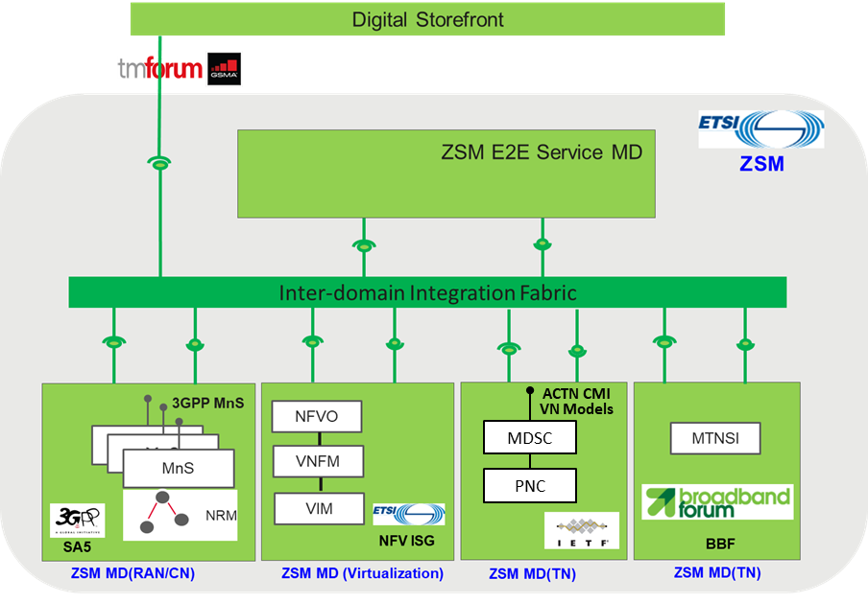
TN Management Domain (ETSI ZSM)
ZSM Management Domain is an architectural solution that satisfies our design requirements
Management Domain: “A scope of management that federates together management services, that enables their exposure towards external service consumers, and that is delineated by a business, administrative, technological or other boundary”.
Our transport slicing solution is implemented as a Management Domain (i.e., TN MD).
Implementing transport slicing as a management domain (source: ZSM 003)

Slide 5
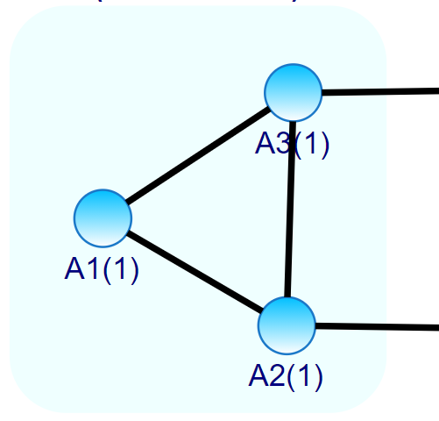
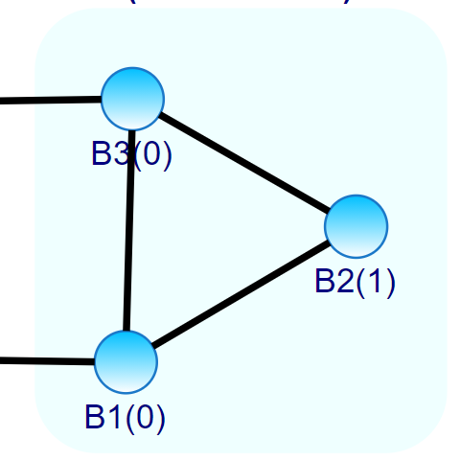
Demo Setup (ONAP + Testing Tools)
ACTN Network
Viewer
3
In addition to the development on ONAP, we also developed a few testing tools to facilitate testing and demo:
ACTN Topo Generator: Design and generate network topology for a particular domain. The generated topology uses the ACTN TE-topology model, and is loaded onto the ACTN PNC simulator.
ACTN PNC Simulator: Simulates transport network domain controller, which interacts with ONAP to deliver transport slicing operations.
ACTN Network Viewer: Visualizes the transport slice configurations. And also simulates TN NSSMF adapter payloads and sends them to TN NSSMF on the SO.
ONAP-SO API
ONAP
(Transport Slicing)
ACTN MPI
ACTN MPI
ACTN MPI
ACTN MPI
ACTN PNC
Simulator (A)
ACTN PNC
Simulator (B)
2
Domain A
Domain B
1
ACTN Topo Generator

Slide 6
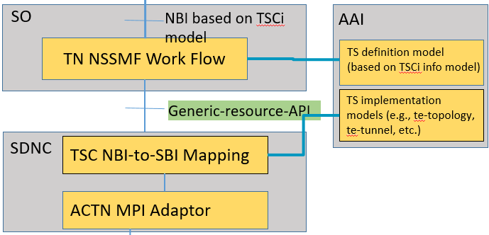
What We Demo
ACTN Network Viewer
TN MD NBI provides a transport slice definition model based on an IETF draft. It also defines four TN NSSI operations: Allocate, Activate, Deactivate, and Deallocate.
Enhanced ACTN MPI: OTN slice creation RPC, EPL/EVPL model for transport slices, and OTN tunnel service model for transport slices
Network configuration data are retrieved from domain controllers and displayed in the ACTN Network Viewer.
1
Allocate, activate, …
TN Management Domain
ONAP
3
Retrieve and visualize network configuration data
Enhanced ACTN MPI
ACTN MPI
2
Optical domain controller simulator
Optical domain controller simulator
Management Functions
UNI
OTN/DWDM
NNI
OTN/DWDM
UNI

Slide 7
How Slice Definition Model Render into Realization Models
RAN NSSI (3gpp)
TN NSSI (IETF TSCi model)
CN NSSI (3gpp)
Management plane data models (in ONAP)
RAN slice 1
Transport Endpoint model
CORE slice 1
Logical transport interface 1
Logical transport interface 2
RAN slice 2
CORE slice 2
abstraction
abstraction
ETH Node
Ethernet TE topology
ETH Node
CORE network node (UPF)
RAN node (gNB)
UNI
UNI
Control plane data models (in ONAP and domain controllers)
NNI
ETH TE Link
NNI
Conn-matrix
Te-link-attributes: Max BW, Avail BW, etc.
Conn-matrix
Application Endpoints
Application Endpoints
abstraction
inter-layer-lock-id
inter-layer-lock-id
OTN TE topology
OTN Node
OTN Node
OTN TE Link
LLCL
TP
Te-link-attributes: reserved ODUs, available ODUs, TS bitmap, etc.
TP
LLCL
TTP
TTP
RAN node (gNB)
OTN TE link (max BW 100G)
OTN node B
CORE network node (UPF)
Data plane (in NEs)
Phy ports
Phy ports
ETH node A
OTN node A
ETH node B
TTP1
TTP2
Phy. ports
OTN TUNNEL on RED_SLICE
Phy ports
TTP3
OTN TUNNEL on BLUE_SLICE
TTP4
TTP5
TTP6
TTP7
Unreserved bandwidth
TTP8

Slide 8
Conclusion and Future Work
We demonstrate the first open source 5G transport slicing solution based on ETSI ZSM and IETF/ACTN standards. Comments/feedbacks are appreciated.
We will open source the IETF/ACTN tools used in this demo (git: onap/integration/ietf-actn-tools).
Future work may focus on closed-loop automation in transport, by continuing to collaborate with ZSM and IETF.

