Slide 1
JavaScript Unit Testing
Using the Jest testing framework
@twitter

Slide 2
Jest – JavaScript Testing Framework
“Jest is a delightful JavaScript Testing Framework with a focus on simplicity.”
  It allows you to write tests with an approachable, familiar and feature-rich API that gives you results quickly.
  Jest is well-documented and requires little configuration
  It works with projects that use: Babel*, TypeScript, Node*, React, Angular, Vue etc.

Slide 3
How does Jest work?
  Looks for files with a “.test.js” extension (.spec can also be used)
  Looks to package.json for jest configuration. (Or, alternatively, a separate jest config file)

Slide 4
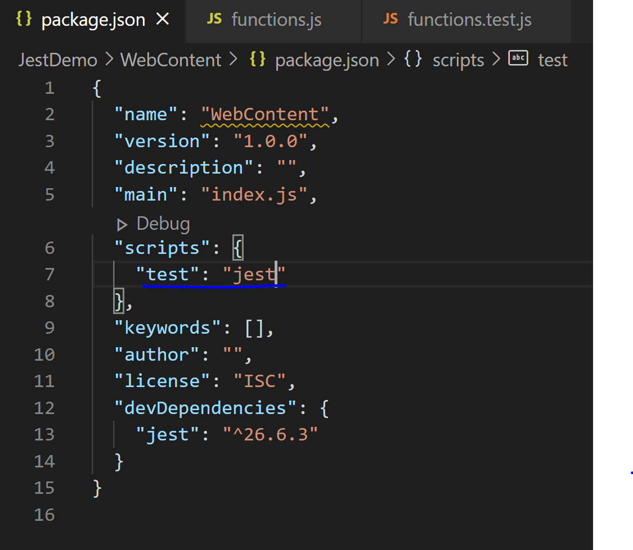
Setup
  Open a terminal
  Cd to web application directory
  npm init –y
    Creates a package.json file
    Edit this to run jest when the test script is ran
  npm install –D jest
    Installs jest as a development dependency

Slide 5
Jest – Writing a test
Structure of a Jest test
test(string: ‘this is the description of the test’, () => {
//This is your test method body
.
**some logic**
.
expect(actual).someMatcher(expected);
});
https://jestjs.io/docs/en/using-matchers
https://jestjs.io/docs/en/expect

Slide 6
Test example
test(‘Test that 1 + 2 = 3’, () => {
const num1 = 1;
const num2 = 2;
const result = num1 + num2; //3
expect(result).toBe(3);
});
assertion actual matcher expected

Slide 7
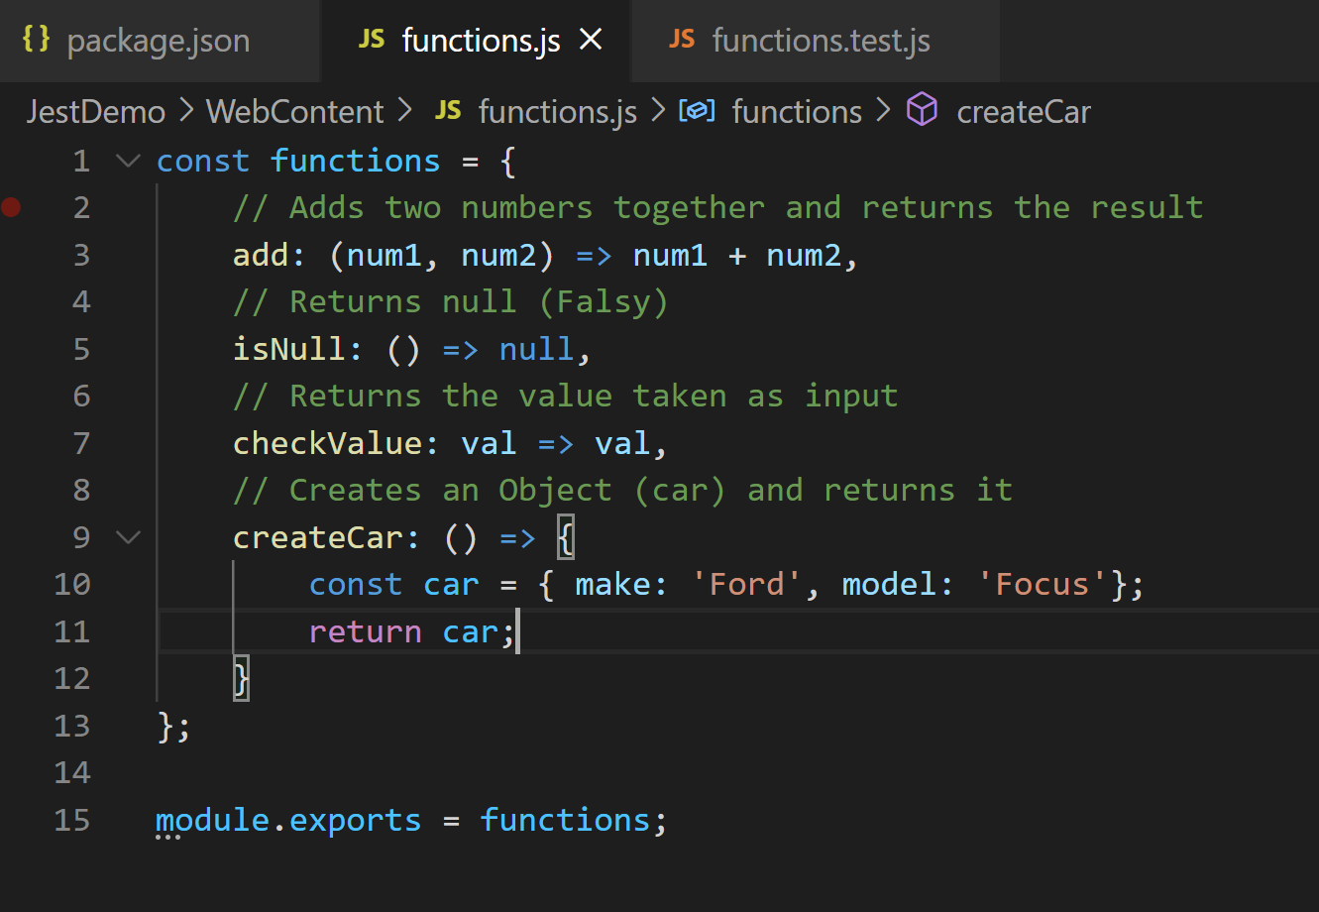
JavaScript file to test
Filename: functions.js
  Contains a number of functions in which we can test.
  This will cover testing:
    Values (toBe)
    “Falsy” values (0, undefined, null)
    Objects (toEqual)
    Arrays

Slide 8
Test example
Testing functions.js

Slide 9
Other Tools
Maven
  Requires a frontend-maven-plugin to install Node and Npm
  Run the test script
  https://github.com/eirslett/frontend-maven-plugin
Babel
  A JavaScript compiler which will convert code to a backwards compatible version of JavaScript
Webpack
  Manages resources, styles and compilation
  “Bundles” our code into a single JS file
  When webpack processes your application, it internally builds a dependency graph which maps every module your project needs and generates one or more bundles.
  Helps to make our testing environment and front-end work together

Slide 10
SonarCloud
Adding coverage to SonarCloud
  Run jest with “—coverage” argument
  This will generate a lcov.info file that Sonar will read
  Make Sonar aware of where the coverage report is located
    <sonar.javascript.lcov.reportPaths>${project.basedir}/target/code-coverage/lcov.info</sonar.javascript.lcov.reportPaths>
  Make Sonar aware of where the Node executable is located
    <sonar.nodejs.executable>${project.basedir}/src/main/resources/webapp/node/node</sonar.nodejs.executable>
  Include JS files. Exclude any test folders, jQuery, resources (css, images etc.).

