Slide 2
TCC Generic Network Management
Magnus Buhrgard
Thinh Nguyenphu
Byung-Woo Jun
Kamel Idir

Slide 3
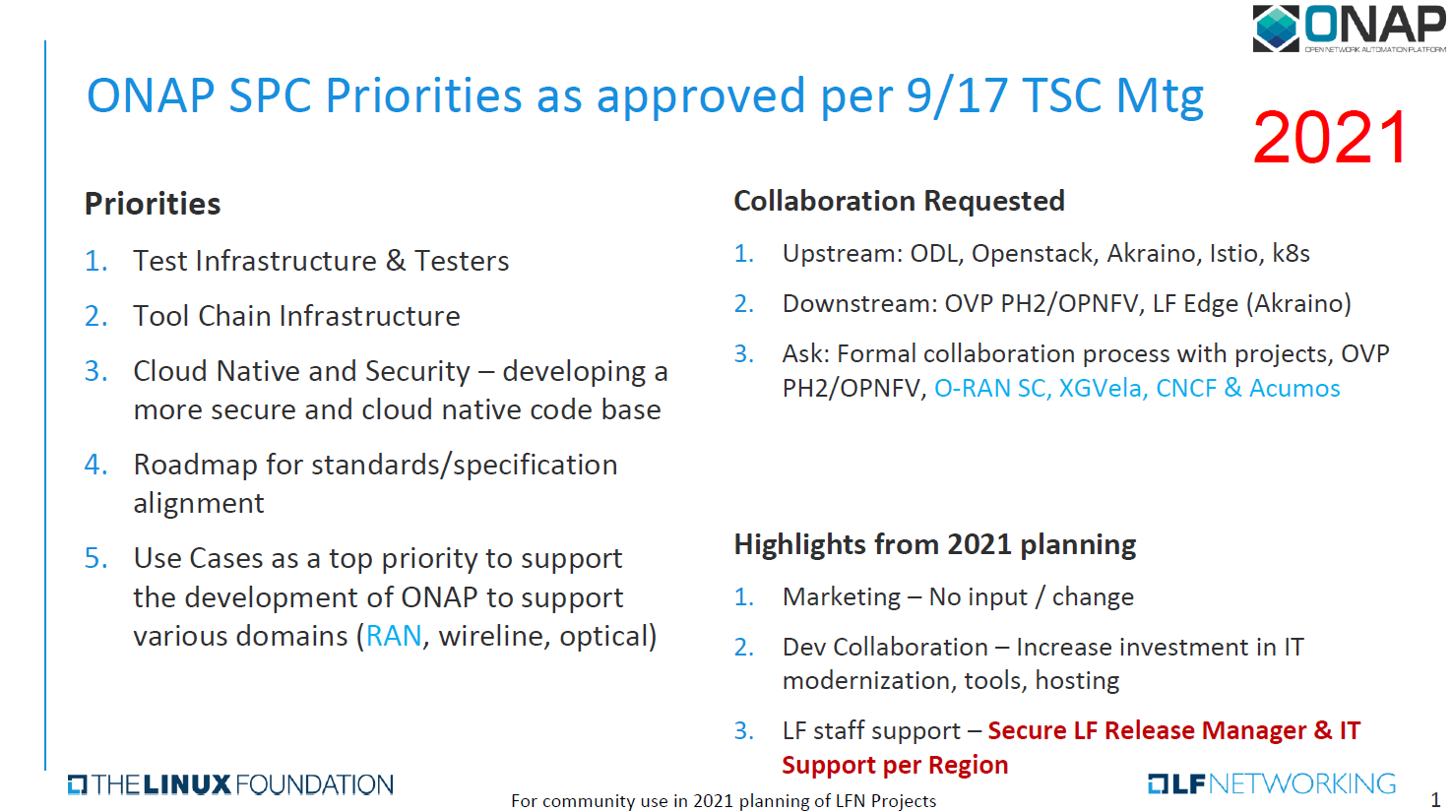

Slide 4
Introduction
Technical Community Coordination – Generic Network Management
ETSI
  ETSI NFV update – Thinh
  ONAP Conformance to ETSI – Byung
3GPP
  RAN Slicing: 5G NR Resource Configuration Management – Kamel
TM Forum
  Digital Transformation World - Magnus
  Catalysts, rapid-fire proof-of-concept projects - Magnus

Slide 5
ETSI NFV update
ETSI NFV Release 2, 3 & 4 updates
Separate presentation

Slide 6
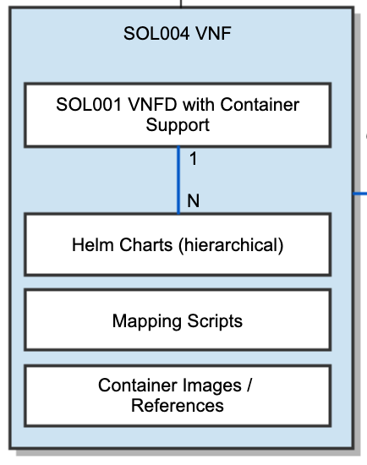
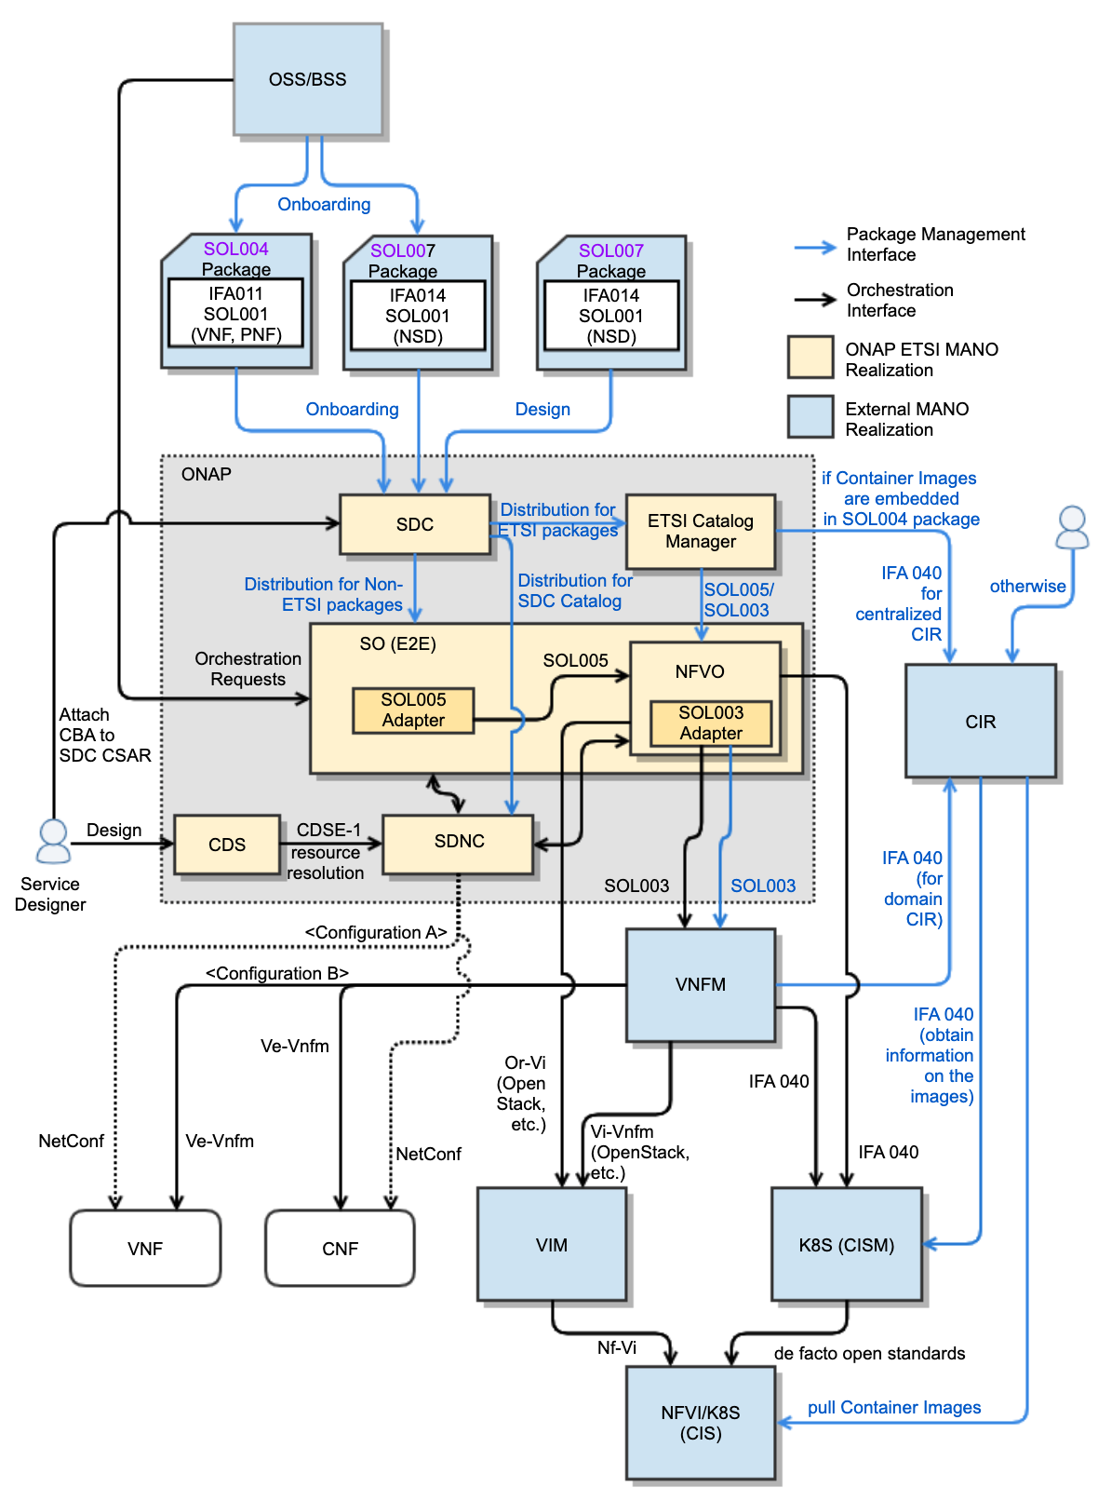
ONAP Conformance to ETSI
NS/VNF/PNF Modeling, Onboarding/Design & Packaging Conformance
SOL004 for VNF and PNF packages (SDC)
SOL007 for NS package (SDC)
SOL001 for describing VNF, PNF and NS models
SOL003 (IFA007) for VNF Package Mgmt (SOL003 Adapter)
SOL005 (IFA 013) for NS/PNF/VNF Package Mgmt (SOL005 Adapter)
SEC022 for ETSI Package and API security
Ongoing CNF Modeling, Packaging and Orchestration Conformance (in Honolulu)
IFA 011 (VNF Descriptor and Packaging Specification)
  ONAP VNF/CNF package and models including Helm Charts & Container Images conform to IFA 011
IFA 040 (Service interfaces for OS Container Mgmt & Orch)
  ONAP conforms to the OS container NFV object model, CISM and CIR management, based on IFA 040
IFA 010 (NFV Mgmt & Orchestration Functional Reqs)
  ONAP NFVO and VNFM orchestration functions conform to IFA 010 requirements
ONAP also conforms to the following specifications:
  IFA 007 (Or-Vnfm Interfaces & IM Specifications)
  IFA 008 (Ve-Vnfm Interfaces & IM Specifications)
  IFA 013 (Os-Ma-Nfvo Interfaces & IM Specifications)
  IFA 014 (NS Templates Specifications)
Note: ETSI SOL specifications profiling CISM solutions (K8S)?
Note: ONAP is waiting for ETSI SOL specifications for CNF
Note: ETSI-based Configuration (Day 0, 1, 2…) would be beneficial in ONAP (See ONAP SO Hierarchical Orch)
Lifecycle Management Conformance for
SDC for SOL004 and SOL007 package onboarding, design and distribution
ONAP NFVO (VFC and SO NFVO) and External NFVO for ETSI MANO NFVO functionalities.
SOL003 Adapter for SOL003-compliant VNF LCM interfaces
SOL005 Adapter for SOL005-compliant NS LCM interfaces
SOL002 Adapter for SOL002-compliant VNF/VNFC LCM interfaces (currently on hold)
ETSI Catalog Manager for ETSI SOL004/SOL007/SOL001 Runtime Package Management and Parsing for NS/VNF/PNF
On top of the ONAP ETSI package onboarding and distribution mechanism, ONAP will support enhanced VNF/CNF models, Helm Charts, CIR and interactions with CISM and VIM for LCM
Leverage
MultiCloud?
Separate Helm Charts Repository?
6

Slide 7
RAN Slicing: 5G NR Resource Configuration Management
Presenters: Kamel Idir (Ericsson), Magnus Buhrgard (Ericsson)
October 14, 2020

Slide 8
Agenda
3GPP NR NRM Deployments
RAN Slicing Use case Description
GNB Auto Discovery Flow Using ONAP PnP
5G NR Resource Configuration Flow

Slide 9
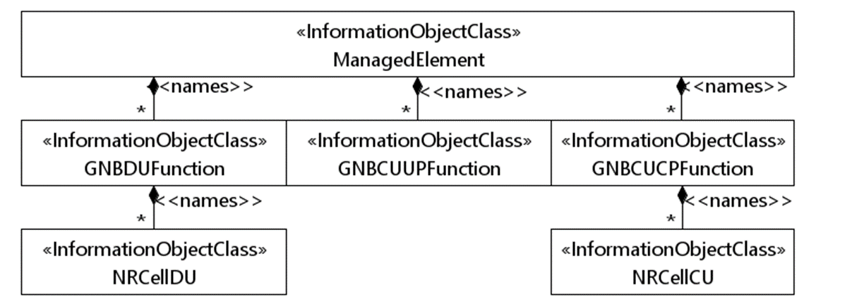
3GPP NR NRM – TS 28.541
GNBDUFunction
GNBCUUPFunction
GNBCUCPFunction
Attribute name | Support Qualifier
gNB­DUId | M
gNBDUName | O
gNBId | M
gNBIdLength | M
Attribute name | Support Qualifier
gNB­CUUPId | M
pLMNInfoList | M
gNBId | M
gNBIdLength | M
Attribute name | Support Qualifier
gNBId | M
gNBIdLength | M
gNBCUName | O
pLMNId | M

Slide 10
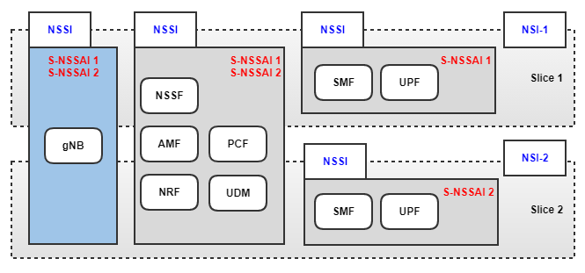


RAN Slicing Use Case Description & Goal
› RAN gNB installed with basic configuration
› Deploy two network slices in different edge locations
› Configure PLMN-Id and S-NSSAIs and other parameters defining characteristics for each slice in the gNB.
5G NR
5GC

Slide 11
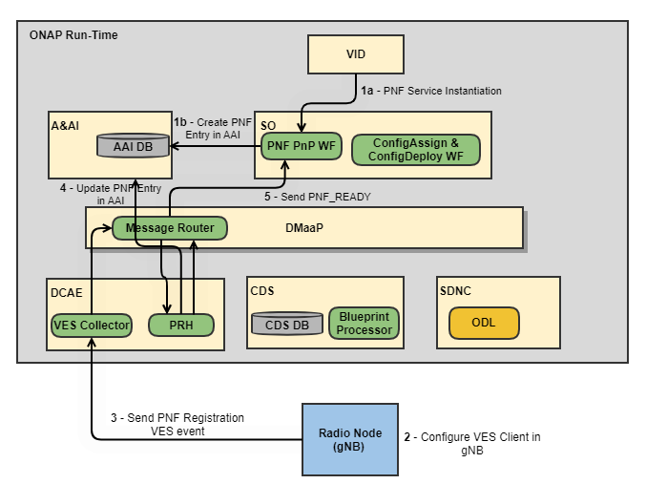
gNB Auto Discovery Flow (PNF PnP)
The goal of this phase is to integrate ONAP with Ericsson gNB to Perform gNB auto discovery mechanism (PNF PnP).
  Instantiate PNF Service.
  Configure VES Client to send PnfRegistration events
  gNB Sends PNF VES Registration event
  PRH Updates AAI entry fir PNF
  PNF sends PNF_READY event

Slide 12
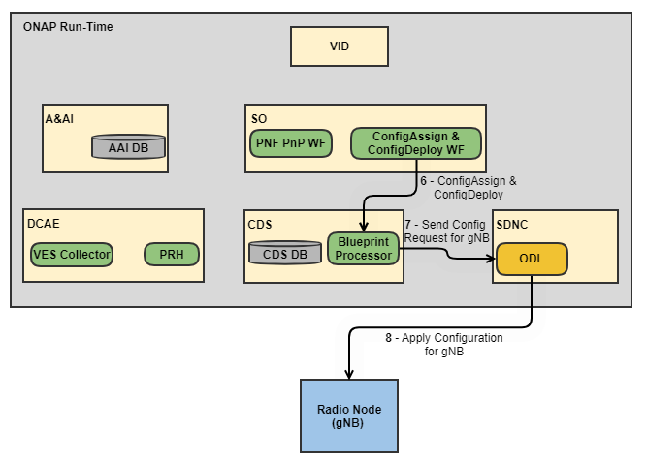
5G NR Resource Configuration Runtime Flow
Trigger CDS ConfigAssign and ConfigDeploy actions to send gNB Resource Configuration related to slicing configuration.
SDNC ODL communication with gNB is based on Netconf

Slide 13
Thank You

Slide 14



TM Forum
Event Registration

Slide 15

TM Forum

Slide 16
TM Forum
Catalyst proof-of-concept projects
Catalysts are rapid-fire proof-of-concept projects bringing together companies large and small to create innovate solutions to common challenges, leveraging key TM Forum best practices and standards to ensure scalability, reuse and reduced costs, and risk.

Slide 17
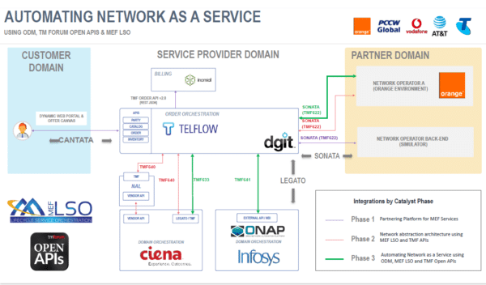

TM Forum

Slide 18
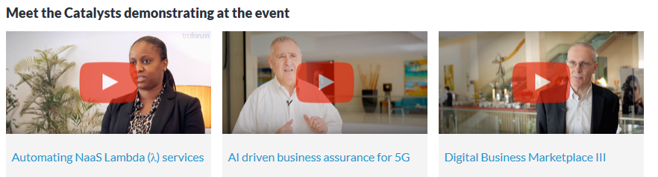


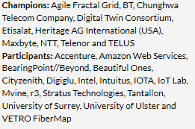
TM Forum Catalysts

Slide 19
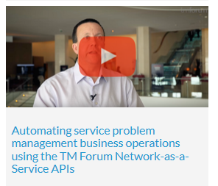
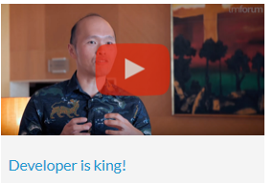
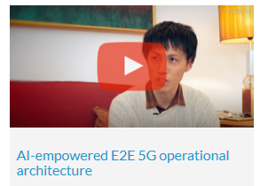



TM Forum Catalysts

Slide 20
TM Forum
Catalyst proof-of-concept projects

Slide 21
Thank You

