Slide 1
Cloud Native OPNF Verified Program (CN OVP)
Trevor Lovett
August, 2020

Slide 2



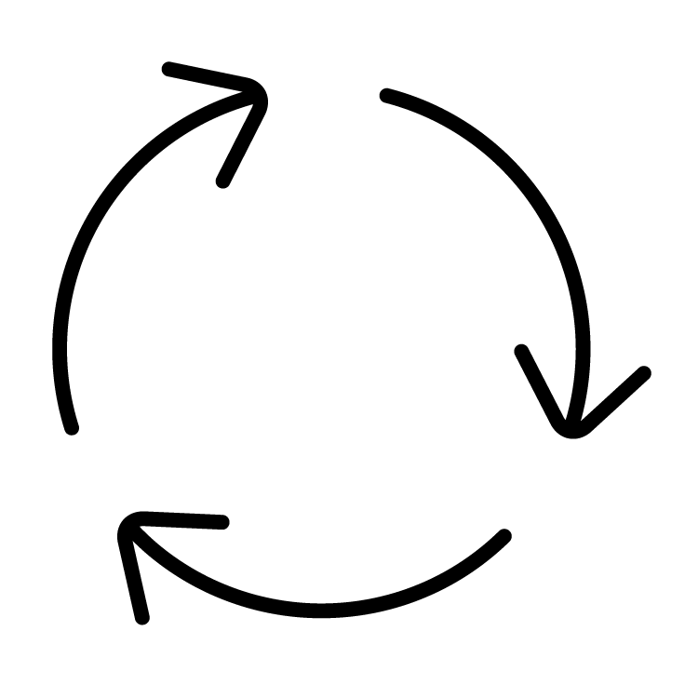

Requirements Work Stream (WS02) Update
Key Concepts
Defines specific acceptable requirements, tests, and process
Reviews and accepts results
Drives
Reference Conformance (ex: RC-2)
OVP
(Reviews & Badges)
Validates
Results
Requirements
(ex: RA-2)
Tests
(ex: CNF Conformance, OPNFV)
Requirements
Covers workloads and/or platforms
Defines what is needed for compatibility and compliance
Provides traceable, testable basis to measure compliance
Ex: CNTT RA-2, ONAP VNF Requirements
Tests
Validate the requirements
Produce test results in a verifiable format (ideally consumable by OVP platform)
Can come from any project or source
Ex: OPNFV, Tempest, K8S Conformance, CNF Conformance
Reference Conf./Test Spec
Defines the approved tests that demonstrate requirement conformance
Documents traceability between tests and requirements
Documents how setup and execute the test suite (can reference other material)
Ex: CNTT RC-2, ONAP Test Cases
OVP Badging
Defines the badges available for LFN projects
Provides portal and process for submission, review, and approval of test results
Promotes alignment between projects
Not a source of requirements or tests, but members can contribute to individual projects

Slide 3
Planned Categories
Category | Sub Category | Requirements | Conformance | Test Impl./Tools | Notes
Cloud Platform Conformance | Functional | RA-2 | RC-2 | CNCF Software Conformance (K8S) CNF Conformance OPNFV | Test tool selection will be driven by RC-2 which is under development.
CNF Conformance | Cloud Native | CNF Conformance | CNF Conformance | CNF Conformance | Driven primarily by CNCF
 | CNTT Compliance | RA-2 | RC-2 | CNF Conformance ?? | Test tool selection will be driven by RC-2 which is under development. Requirements are being drafted under RA-2
 | ONAP Compliance | ONAP VNF/CNF Requirements | ONAP Test Specifications | VNFSDK/VTP | Initial work being delivered in ONAP Guilin release, but formal requirements, tests, and capabilities planned for Honolulu and beyond
 | Performance | RA-2 | RC-2 | TBD | Will be pursued when formal requirements and thresholds are established
Cloud Platform Benchmarking | Performance | TBD | TBD | TBD | Defines the what can be measured and how. No requirements, but provides a common set of metrics that be measured. This will serve as a starting point for later compliance testing using minimum thresholds.
MVP Scope: Highlighted in Green. Goal is to deliver the initial requirements, badge, and testing aligned with 1H2021 release of RI-2.

Slide 4
Key Takeaways and Impacts
Plan for CN OVP is to offer multiple sub-categories of compliance (today each badge is all or nothing)
  NFVI or CNF Provider can pursue 1 or more of the categories
  Each category has its own set of requirements and tests. Each category is aligned with its source community.
    As a set of communities we must strive to prevent conflict and unnecessary overlap between the categories.
  This impacts the OVP portal, and we are requesting this workflow be accommodated during the re-write of the portal (LF contract work)
Projects/communities have autonomy on their definition of compliance
  Each project/community defines what compliance means (i.e. there are no OVP “requirements”)
  The CVC committee will determine if the level of requirements, tests, and support thereof is ready for a marketed compliance bage
  The CVC committee will determine, in partnership with the communities, what badges will be offered, host the OVP site, facilitate the review process, and handle marketing activities
  For ease of integration with OVP portal and process, the main ask for test suites is that they produce a result set compatible with consumption with OVP which aggregates the results and logs in a standard package. This could be produced directly by the test suite or created by a separate conversion process.
Requirements for workloads and conformance specifications are still in early forms
  Development of these requirements and specifications are key factors in determine the scope of tests needed, and the achievability of the MVP for next year.
  Encouraging direct participation in requirement and RC-2 work streams to drive progress
  Cross community requirements task force has been kicked off. Please participate if possible.

