Slide 1
Help Recruit more Developers to LFN Projects!
Jason Hunt, Abhijit Kumbhare, Al Morton, Catherine Lefevre, Morgan Richomme, Ranny Haiby
June 22, 2020

Slide 2
Agenda
Challenge: Recruiting Developers
Review: What have projects tried
Brainstorming: What should LFN do?

Slide 3
The Challenge for LFN Projects
We need more Developers and Testers !
We have more ideas than coders
We have so many non-functional requirements & security vulnerabilities to address to make our project consumable
Our documentation isn’t up-to-date

Slide 4
Review: Project Experiences

Slide 5
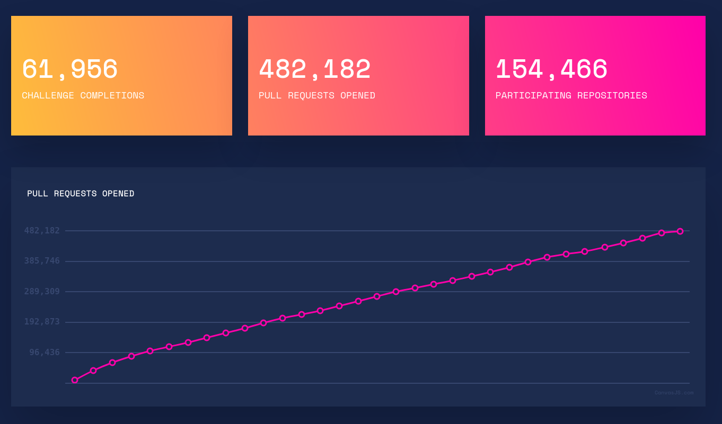
Lessons learned from the Hacktober Fest
What is Hacktoberfest?
Hacktoberfest is a month-long celebration of open source software run by DigitalOcean and DEV.
Hacktoberfest is open to everyone in our global community.
To participate, four pull requests must be submitted to public GitHub repositories.
You can sign up anytime between October 1 and October 31.
See https://hacktoberfest.digitalocean.com/
Through github/gitlab tags, Open Source communities indicate “easy” tasks to be realized by newcomers
If you submit 4 Pull Requests, you got a T-Shirt (and the satisfaction to have contributed to an Open Source project)
Key lessons learned:
Fun
Very inclusive
Force projects to define small achievable tasks easily promoted through git tags
Allow fast integration of new developers into projects via the PR mechanism
Simple because leveraging on basic tooling (github, gitlab) , gerrit may somehow introduce some complexity
Simple because no complex legal aspects/CLA/...
Notes:
Mentorship - Most of the people that are involved in this are people who are looking for senior robotics engineering mentorship. Mentors spend a bunch of my time mentoring, helping design, and reviewing PRs. Expect there to be some spin up time of a month or so where you're spending more time than work product out. You will probably be getting 2-3x your personal output in terms of work from students and professionals you are mentoring and having them work on real projects. Without this, probably none of them would have done anything.
- Encouraging all levels / time - A lot of people are intimidated by open source thinking they have to be experts. We certainly get a number of junior developers or students that haven't much programming experience, but there's always work for them (discrete Wishlist tasks, refactoring, tests, documentation, etc.). By encouraging all levels, We found to get more people involved and most of them are surprisingly competent even without much formal experience. The people that will volunteer to help in open source are self selecting to some degree. Also, encourage any time commitment, some folks are doing 5 hours a week, some are 20. It might take them longer to get things done, but things still get done. It then ties back into mentorship to find an appropriate project for the time and expertise.
- Consistent calls - Not just calling for help or a program once, but consistently over a long time. Every time you announce an update, some changes, etc, add a blurb at the end about mentorship for all levels and time commitment to have new blood flowing in. As people are entering, less people leave from a feeling of momentum. While many of the "star" developers came from the initial call, we've been able to create a really great ecosystem and active collaboration having many people work on projects together.
5

Slide 6
Lessons learned from the ROS community
The community recently managed to onboard new developers for the Navigation2 project. New developers got a chance to improve their skills while gaining public exposure, and the community benefited from their contribution in several areas that were lacking attention.
Key lessons learned:
Successful onboarding requires commitment from senior community members who serve as mentors
Encouraging all experience levels and part time – some tasks are suitable for juniors and/or part time
Consistent calls for participation – There is a funnel from initial response to actual contribution. There is natural churn. You need to keep feeding the program with new members
Notes:
Mentorship - Most of the people that are involved in this are people who are looking for senior robotics engineering mentorship. Mentors spend a bunch of my time mentoring, helping design, and reviewing PRs. Expect there to be some spin up time of a month or so where you're spending more time than work product out. You will probably be getting 2-3x your personal output in terms of work from students and professionals you are mentoring and having them work on real projects. Without this, probably none of them would have done anything.
- Encouraging all levels / time - A lot of people are intimidated by open source thinking they have to be experts. We certainly get a number of junior developers or students that haven't much programming experience, but there's always work for them (discrete Wishlist tasks, refactoring, tests, documentation, etc.). By encouraging all levels, We found to get more people involved and most of them are surprisingly competent even without much formal experience. The people that will volunteer to help in open source are self selecting to some degree. Also, encourage any time commitment, some folks are doing 5 hours a week, some are 20. It might take them longer to get things done, but things still get done. It then ties back into mentorship to find an appropriate project for the time and expertise.
- Consistent calls - Not just calling for help or a program once, but consistently over a long time. Every time you announce an update, some changes, etc, add a blurb at the end about mentorship for all levels and time commitment to have new blood flowing in. As people are entering, less people leave from a feeling of momentum. While many of the "star" developers came from the initial call, we've been able to create a really great ecosystem and active collaboration having many people work on projects together.

Slide 7
Lessons learned from OpenDaylight community
Over the years, OpenDaylight has learned a few lessons about successful onboarding:
Almost all successful onboarding is of developers from the companies who have dedicated resources to work upstream.
Hence recruitment for open source projects really needs to be targeted towards the companies.
  Typically companies to contribute toward the use cases or value-adds. Which is good – open source projects need successful use cases.
  Ideally companies using the open source project should also be interested in making sure there is a pooling of resources to develop core components so they can concentrate on value adds. However it is hard to get companies to actually do so as it makes less of a splash. Projects need to push the companies contributing towards the use-cases only to contribute to core components. This is not easy however as core components are hard and need very strong persistent developers who can understand undocumented code.
  Unfortunately, there are also companies who consume the open source project, but do not contribute due to lack of resources. Somehow recruitment efforts need to be targeted here.
Academics, interested geeks are other contributors who have successfully onboarded, though at a far lesser rate.
Interns can contribute toward low hanging fruit. Some interns who have exceeded expectations have been hired in the past by member companies.
Notes:
Mentorship - Most of the people that are involved in this are people who are looking for senior robotics engineering mentorship. Mentors spend a bunch of my time mentoring, helping design, and reviewing PRs. Expect there to be some spin up time of a month or so where you're spending more time than work product out. You will probably be getting 2-3x your personal output in terms of work from students and professionals you are mentoring and having them work on real projects. Without this, probably none of them would have done anything.
- Encouraging all levels / time - A lot of people are intimidated by open source thinking they have to be experts. We certainly get a number of junior developers or students that haven't much programming experience, but there's always work for them (discrete Wishlist tasks, refactoring, tests, documentation, etc.). By encouraging all levels, We found to get more people involved and most of them are surprisingly competent even without much formal experience. The people that will volunteer to help in open source are self selecting to some degree. Also, encourage any time commitment, some folks are doing 5 hours a week, some are 20. It might take them longer to get things done, but things still get done. It then ties back into mentorship to find an appropriate project for the time and expertise.
- Consistent calls - Not just calling for help or a program once, but consistently over a long time. Every time you announce an update, some changes, etc, add a blurb at the end about mentorship for all levels and time commitment to have new blood flowing in. As people are entering, less people leave from a feeling of momentum. While many of the "star" developers came from the initial call, we've been able to create a really great ecosystem and active collaboration having many people work on projects together.

Slide 8
Lessons learned from OPNFV (VSPERF) Project
The Project considered the possibility of recruiting Students outside the usual calls for INTERNS. Why?
Lots of Applicants for well-advertised Intern opportunities
Interviewing and choosing ONE Intern from many qualified applicants has been challenging!
Many completely satisfactory student developers were lost, particularly sad when the successful applicant fails for unforeseen reasons!
Sridhar Rao, VSPERF PTL, realized that many students would complete a project for a certificate/Letter of Recognition alone!!
OPNFV TSC approved their STUDENT VOLUNTEER Program in September, 2019. The First Letter/Certificate of Completion went to Parth Yadav in early 2020. Parth’s Advisor also joined the project/meetings.
Following this success, Sridhar managed to onboard new developers for the VSPERF project. Another Student/Advisor pair has joined. Parth and his Advisor also stayed-on for a new task.
VSPERF has two LFN Internships in-progress. Among the unsuccessful applicants, 3 Students were willing to begin other tasks as Student Volunteers. A previous Intern has stayed on to help and maintain his work on a specialized Test VM.
Key lessons learned:
Successful recruiting for Student Volunteers involves some travelling in the academic circles, and
Having a plan and Tasks for those who don’t “win” the available Internship(s) is a good thing.
Offer Tasks & Projects that have some academic interest (K8s), but make it clear that the project may need help in areas that are not high visibility (maintenance/keep everything running).

Slide 9
ONAP Experiences
Challenge: Need additional companies focusing on non functional requirements (Security, Integration, OOM) and on improving User Experience.
Attempted Approaches
  Increase SW Quality: Min. Test Coverage per project; Pair-wise testing part of our Release Plan; Integration Lead per Usecase/Functional reqs; Dedicated Integration Team; OOM Gating and setup external labs resources
  Use of Interns
  Implementing a "tax" for the Guilin release that any companies wanting to add new use case or new feature; they must also provide resources to address a couple of ONAP's non-functional requirements in addition to the feature development.
  Demo Contest & Community Awards per release
  Documentation SOW

Slide 10
Brainstorm: What Should LFN Do?

Slide 11
How to Proceed
Awareness
Recognition
Tooling

Slide 12
How to Drive Awareness of Developer Needs

Slide 13
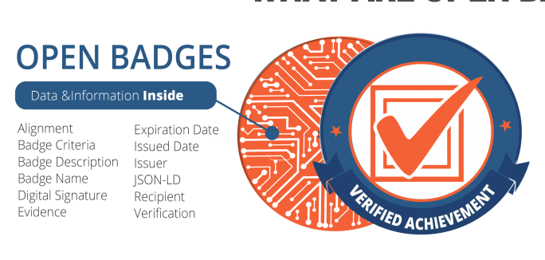
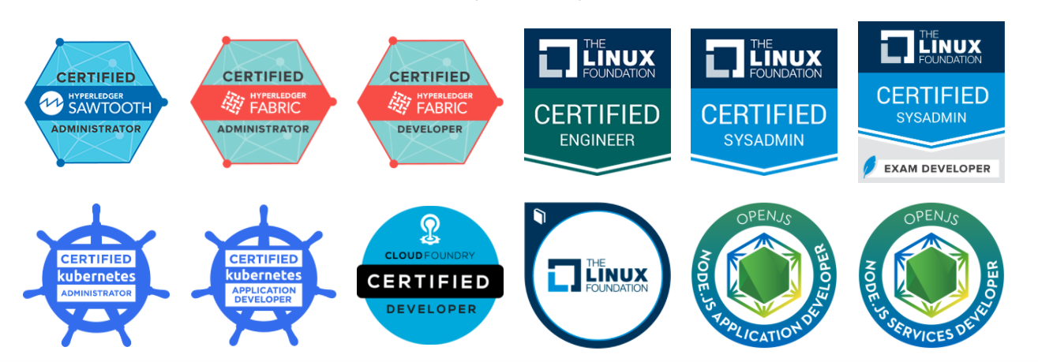
How to Reward/Recognize Developers?
https://training.linuxfoundation.org/badges-2/

Slide 14
Can Tooling Help?

Slide 15
Next Steps
Should this be done at an LFN level?
Volunteers to flesh out these ideas
How to implement – effort needed by each project?

