Slide 1
LFN June DTF: E2E Network Slicing Session
Transport Slicing Solution
Authors: Henry Yu (Huawei), Lin Meng (CMCC), David Allabaugh (Fujitsu) Swaminathan S (Wipro)
Reporters: Henry Yu (Huawei), Lin Meng (CMCC)
June 24, 2020

Slide 2
Common aspects

Slide 3
ONAP-based Slice Management Overall Architecture Choices
✓
OSS/BSS/Apps
2
OSS/BSS/Apps
✓
OSS/BSS/Apps
1
3
OSS/BSS/Apps
4
5
OSS/BSS/Apps
To Be Done in G release
Standard APIs
Enhanced in G release
Standard APIs
CSMF (ONAP)
CSMF
CSMF
CSMF (ONAP)
CSMF
Standard APIs
Standard APIs
NSMF (ONAP)
NSMF (ONAP)
NSMF (ONAP)
NSMF (ONAP)
NSMF
Standard APIs
Standard APIs
Standard APIs
NSSMF(s)¹
(ONAP)
NSSMF(s)¹
(ONAP)
NSSMF(s)¹
NSSMF(s)¹
NSSMF(s)¹
(ONAP)
xNFs
xNFs
xNFs
xNFs
xNFs
3rd party component
Scenario 1 (all 3 sub-nets) & Scenario 4 for RAN and Core will be supported in G release.
¹ Top-most NSSMF/domain-specific NSSMF – under discussion

Slide 4
Common Principles
SO acting as NSMF shall interact with NSSMFs through an adaptor.
3GPP-aligned APIs shall be used between NSMF and Core/RAN NSSMF.
TSCi interface shall be used towards Transport NSSMF on NB interface – by NSMF or RAN NSSMF.
ONAP shall support both scenarios for RAN & Transport Slice interaction (details in later slides).

Slide 5
APIs supported by NSSMF
Operation | REST API
allocateNSSI (create NSSI with service) | POST /api/rest/provMns/{apiVersion}/NSSI/SliceProfiles
createNSSI (create NSSI without service) | POST /api/rest/provMns/{apiVersion}/NSSI/nssi
deallocateNSSI (deallocate NSSI with service) | DELETE /api/rest/provMns/{apiVersion}/NSSI/SliceProfiles /{sliceProfileId}
terminateNSSI (terminate NSSI without service) | DELETE /api/rest/provMns/{apiVersion}/NSSI/nssi/{nssiId}
getNSSI (get info of NSSI by sliceProfile) | GET /api/rest/provMns/{apiVersion}/NSSI/SliceProfiles/{sliceProfileId}
getNSSIbyId（ (Get NSSI by NSSI ID) | GET /api/rest/provMns/{apiVersion}/NSSI/ nssi /{nssiId}
activateNSSI | PUT /api/rest/provMns/{apiVersion}/NSSI/nssi/{nssiId}/Activate
deActivateNSSI | PUT /api/rest/provMns/{apiVersion}/NSSI/nssi/{nssiId}/deActivate
Note: Transport NSSMF may only support a sub-set of these APIs in Guilin release.

Slide 6
RAN & Transport Slicing Interaction for Guilin Release

Slide 7
RAN and Transport Slicing Overview
Options for NSSMFs in Guilin |  | Involved Companies
RAN Slice Subnet | RAN NSSMF within ONAP | CMCC, Wipro, AT&T, Amdocs, QCT, Verizon, Reliance Jio, Tencent, China Telecom
 | 3rd Party RAN NSSMF | Huawei, CMCC, Wipro
Transport Slice Subnet | TN NSSMF within ONAP | Huawei, CMCC, Fujitsu, Wipro
ONAP
CSMF
Align with 3GPP (Note)
NSMF
Align with TSCi
3rd Party
RAN NSSMF
RAN NSSMF
TN NSSMF
Core NSSMF
Align with 3GPP/O-RAN
Configure RU, DU, CU
Transport Network Configurations
RU
TN
DU
TN
CU
TN
Core
Front Haul
Mid Haul
Back Haul
RAN Slice Subnet
Transport Slice Subnet 1
Core Slice Subnet
Transport Slice Subnet 2
Transport Slice Subnet 3
Note: Enables interface with external NSSMF.
Cross Domain Links, Domain NSSMF do not know both ends. It is managed by NSMF.

Slide 8
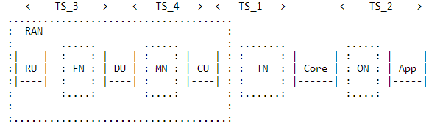
RAN & Transport Subnet: Interaction Scenario 1
Preferred option by O-RAN
& ONAP internal RAN NSSMF
CSMF
NSMF
1
1b-i
3
TS_1
2
TS_1 is backhaul transport slice; TS_3, fronthaul; TS_4, midhaul.
TN MD (T-NSSMF) receives TS_1 from NSMF (step 3), and TS_3 and TS_4 from RAN NSSMF (step 1b-i).
TN MD then configures backhaul (3a), fronthaul (1b-ii), and midhaul (1b-iii), respectively.
RAN NSSMF
TS_3
Transport NSSMF
Core NSSMF
1a
TS_4
3a
2a
1b-ii
1b-iii
RAN NFs Subnet
Fronthaul subnet
Mid haul subnet
Backhaul subnet
Core subnet
RAN NSSMF shall be responsible for determination of Slice Profile of FH, MH and RAN NFs.
RAN NSSMF shall be responsible for entire RAN subnet comprising FH and MH (stitching together, CL actions, etc.)

Slide 9
RAN & Transport Subnet: Interaction Scenario 2
Preferred option for external
RAN-NSSMF, E2E Slicing
CSMF
NSMF
TS_1
TS_3
1
3
TS_4
2
TS_1 is backhaul transport slice; TS_3, fronthaul; TS_4, midhaul.
TN MD (T-NSSMF) receives TS_1, TS_3 and TS_4 from NSMF (step 3).
TN MD then configures backhaul (3a-i), fronthaul (3a-ii), and midhaul (3a-iii), respectively.
RAN NSSMF
Transport NSSMF
Core NSSMF
1a
3a-ii
3a-i
2a
3a-iii
RAN NFs Subnet
Fronthaul subnet
Mid haul subnet
Backhaul subnet
Core subnet
NSMF shall be responsible for determination of Slice Profile of FH, MH and RAN NFs.
NSMF shall be responsible for stitching together e2e slice including FH and MH.

Slide 10
RAN & Transport Slicing interaction
We will support both scenarios in Guilin release
    Scenario 1: RAN NSSMF realized within ONAP shall be responsible for RAN NFs, FH and MH, and shall invoke Transport NSSMF for FH and MH slicing. Impacts: SO (RAN NSSMF), OOF, AAI, SDC (Test only)
    Scenario 2: ONAP acting as NSMF shall interact with an external RAN NSSMF responsible only for RAN NFs. NSMF within ONAP shall interact directly with Transport NSSMF for FH and MH slicing. Impacts: SO (NSMF), OOF, AAI, SDC (Test only)
  Impact foreseen in existing NSMF functionality to support both scenarios.
  Intention is to use a model-driven approach as much as possible.

Slide 11
Transport Slicing for Guilin Release

Slide 12
TN NSSMF: Part of E2E Network Slicing Solution on ONAP
ONAP
CSMF
Align with 3GPP (Note1)
NSMF
Align with IETF (Note2)
3rd Party
RAN NSSMF
RAN NSSMF
TN NSSMF
Core NSSMF
Configure RU, DU, CU
Transport Network Configurations
RU
TN
DU
TN
CU
TN
Core
RAN Slice Subnet
Front Haul
Mid Haul
Back Haul
Transport Slice Subnet 1
Core Slice Subnet
Transport Slice Subnet 2
Transport Slice Subnet 3
Note1: Enables interface with external NSSMF.
Cross Domain Links, Domain NSSMF do not know both ends. It is managed by NSMF.
Note2: Design of TN NSSMF does not exclude non-IETF models, although IETF models are used as the initial implementation.

Slide 13
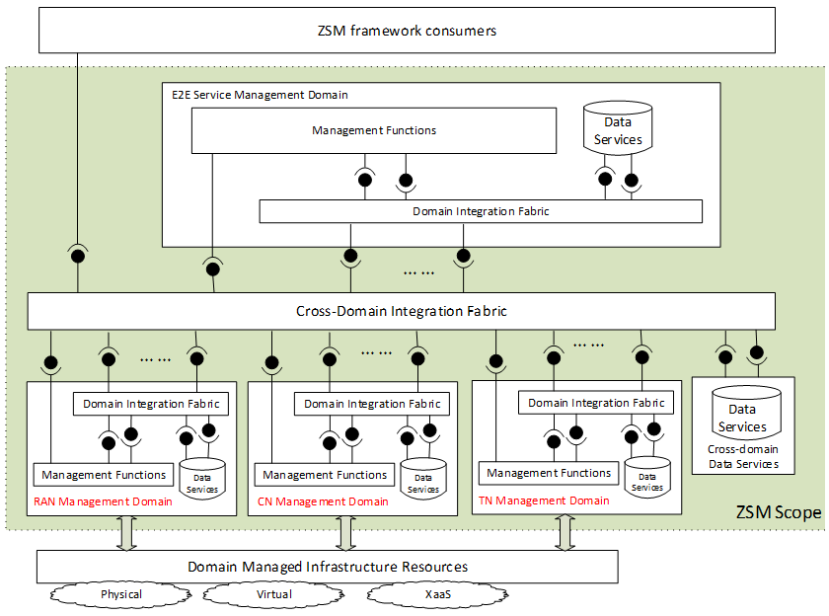
Architectural Framework for Transport Slicing: A Modular Approach
Our proposed design for TN NSSMF adopts the ETSI ZSM framework, which has the following design principles:
Modular design. The TN NSSMF is realized by the TN Management Domain (MD), which is a logically self-contained, independently deployable entity. TN MD encapsulates implementation details (Management Functions are not externally accessible.), and provides a well-defined interface for its consumers.
Model-driven, intent-like interface. The TN MD interface is declarative. It’s a model that defines Transport Slice. In our design, we adopt IETF’s Transport Slice Connectivity Interface (TSCi) as the TN MD interface.
The consumer of TN MD can be RAN MD, CORE MD, or E2E Service MD. i.e., it does not care who calls it.
TN MD interface (TSCi)

Slide 14
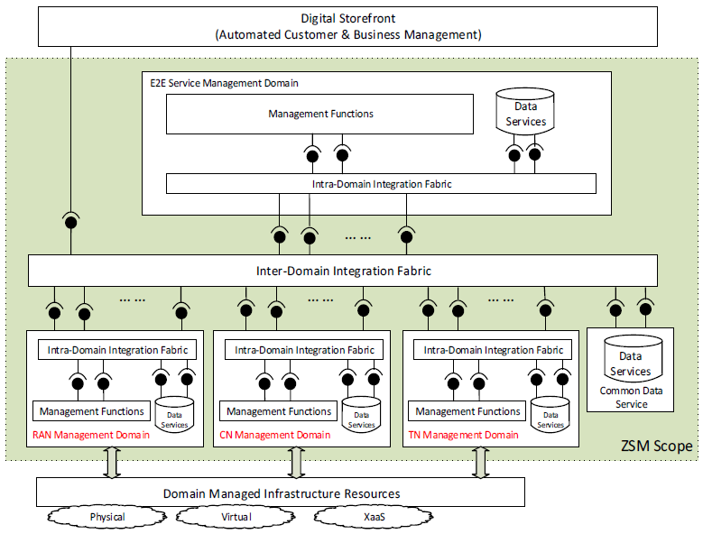
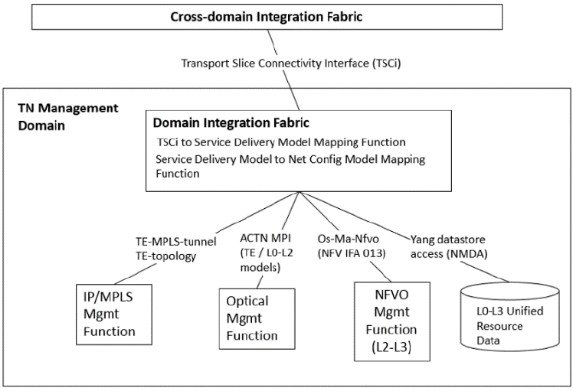
challenges
standards
solutions
ETSI ZSM 003 Architecture + IETF Models: An Implementable Solution
ETSI ZSM E2E Network Slicing Architecture
Logical View of the IETF Transport Slicing Solution

Slide 15
Design Overview and Code Impact for Guilin Release
External interface of TSC NBI
ONAP
UUI
EXT-APIs
ONAP
CSMF
OOF
SO
NSMF Work Flow
AAI
NSMF
Policy
TN NSSMF Adaptor
TS definition model (based on TSCi info model)
Internal APIs (TSCi)
SDC
TS implementation models (e.g., te-topology, te-tunnel, etc.)
TN NSSMF
TN NSSMF Work Flow
Generic-resource-API
Optical Domain Controller
SDNC
TSC NBI-to-SBI Mapping
Existing ONAP code with modifications
TS: Transport Slice
TSC: Transport Slice Controller
TSCi: Transport Slice Connectivity Interface
NBI: Northbound interfaces
SBI: Southbound interfaces
ACTN: Abstract & Control of TE Network
MDSC: Multi-Domain Service Coordinator
PNC: Physical Network Controller
ACTN MPI: ACTN MDSC to PNC Interface
AAI: Active and Available Inventory
OOF: ONAP Optimization Framework
SO: Service Orchestrator
SDNC: SDN Controller
SDC: Service Design and Creation
UUI: Usecase User Interface
EXT-API: External API
ACTN MPI Adaptor (TSC SBI)
New ONAP code for TN NSSMF Functionality
Optical domain controller

Slide 16
Summary of Requirements for Guilin Release
Category | Requirement |  | Content
Architectural Requirements | AR1 | Support multiple slice management architecture choices | A single TN NSSMF design that supports multiple slice management choices (i.e., no duplicated call flows) For different choices, the interface between NSMF and TN NSSMF should remain unchanged (i.e., NSMF should be unaware where/how TN NSSMF is deployed)
 | AR2 | Support different RAN deployment scenarios | Support NSMF to decompose FH, MH, and BH slice Support RAN NSSMF to decompose FH and MH and NSMF to decompose BH
Functional Requirements | FR1 | Support NSI LCM operations | TN NSSMF northbound interface should provide APIs for TN NSSI create, active, deactivate, terminate, and KPI monitoring operations.
 | FR2 | Support pt-to-pt connections on transport slice | Support EPL/EVPL service creation on transport slices
Modeling | MR1 | Define TN NSSI model | Use IETF TSCi information model for TN NSSI modelling on ONAP

Slide 17
AR1-solution: One design that supports both integrated and distributed TN NSSMF
OSS/BSS/Apps
OSS/BSS/Apps
Not in G release
Standard Restconf APIs (TSCi Data Model)
CSMF (ONAP)
CSMF (ONAP)
ONAP
EXT-APIs
Internal call aligned with 3GPP
SO
AAI
NSMF (ONAP)
NSMF (ONAP)
NSMF
Internal APIs (TSCi)
TSCi model
Internal call aligned with TSCi
TSCi Data Model (RESTCONF/YANG)
TN NSSMF WF
TN NSSMF (ONAP)
TN NSSMF
TSCi Data Model is a YANG module
Augmentation of the ACTN VN model; still under development in IETF
RESTCONF/NETCONF interface
xNFs
xNFs

Slide 18
AR1-solution: IETF needs to provide both information and data model for TSCi
Standard TN NSSMF NBI (TSCi Data Model)
implement
Not in G release
IETF Transport Slice Data Model (augmented ACTN VN YANG model)
ONAP
EXT-APIs
alignment
SO
AAI
NSMF
Internal APIs (TSCi)
TSCi model
alignment
IETF Transport Slice Information Model (TSCi) (rokui-5g-transport-slice)
TN NSSMF WF
SDNC
ONAP has its own modelling schema (A&AI). That’s what ONAP really uses.
TSCi Information Model is used to define A&AI Model
ONAP can also offer standard NBI (i.e., augmented VN and RESTCONF) via its EXT-APIs module
ONAP implementation align with IETF-TS-framework-draft
ACTN MPI
Optical domain controller

Slide 19
AR2-solution: One design that supports both scenario 1 and 2
NSMF
RAN NSSMF
TN NSSMF
Query RAN NSSMF capability
RAN_Option
Opt
[ RAN_Option = 1 ]
Create TS_3 (i.e., fronthaul)
Notes:
RAN NSSMF needs to provide an API for NSMF to query whether it supports scenario 1. If the API is missing, then the default option for NSMF is to support scenario 2.
TN NSSMF is consumer agnostic.
TSCi model is universal/generic in defining TS_1 (backhaul), TS_3 (fronthaul), and TS_4 (midhaul).
Create TS_4 (i.e., midhaul)
Opt
[ RAN_Option = 2 ]
Create TS_3 (i.e., fronthaul)
Create TS_4 (i.e., midhaul)
Create TS_1 (i.e., backhaul)

Slide 20
FR1: TN NSSMF northbound API needs to support LCM operations
On ONAP, the NSMF decomposes a NSI into RAN NSSI, TN NSSI, and CORE NSSI, and delegates them to RAN NSSMF, TN NSSMF, and CORE NSSMF respectively. Further, the NSI LCM operations (3GPP 28.530) are also decomposed and delegated to the NSSMFs. As a result, the TN NSSMF NBI needs to provide the following APIs.
API name | Input | Output | Description
Allocate | Transport Slice instance (Transport_Slice_Connectivity object) | {Success, Failure} | Performs TN NSSI Allocate operation, i.e., Service Creation.
Deallocate | Transport Slice ID | {Success, Failure} | Deallocates a Transport Slice created by Service Creation.
Activate | Transport Slice ID | {Success, Failure} | Performs Transport Slice Service Activation. i.e., activates the service created by Service Creation
Deactivate | Transport Slice ID | {Success, Failure} | Deactivates the requested service operating on the target transport slice.
Query | Transport Slice ID | Transport_Slice_Connectivity object | Returns the Transport Slice instance. This API is to support KPI monitoring.
Treat TN slice as a resource
Treat TN slice as a service

Slide 21
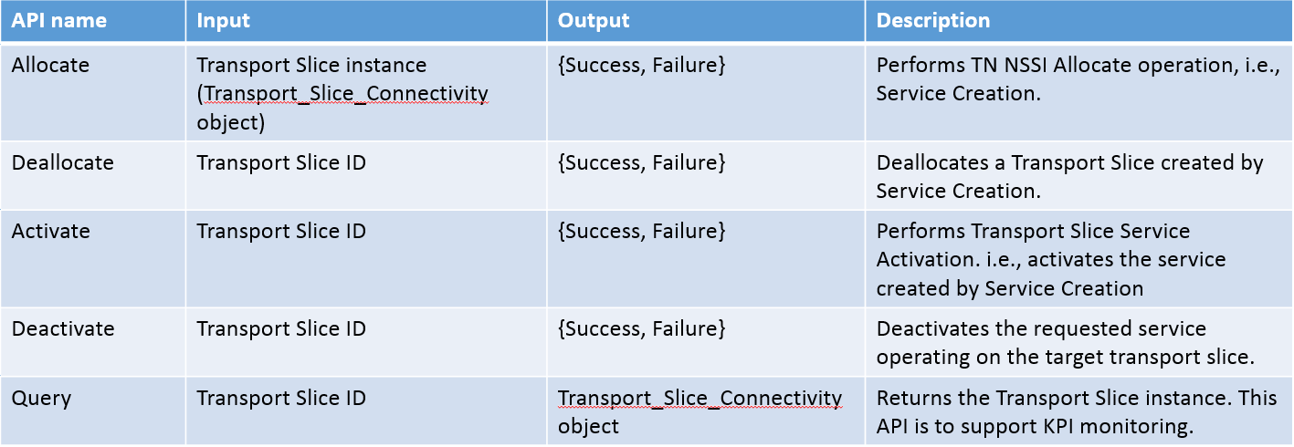
FR1-solution: Where are the TN NSSMF northbound APIs
ONAP
UUI
EXT-APIs
OOF
SO
SO NSMF
AAI
Policy
NSSMF Adaptor (TN)
TSCi model
Internal APIs (TSCi)
SDC
TS implementation models
SO TN NSSMF WF
New code (AAI schema, SO WF, SDNC DGs) in G release
Generic-resource-API
SDNC/
CCSDK
TSCi-NetConfig Mapping
Modifications to existing code/features
CCSDK
ACTN MPI Adaptor
Changes are needed, but planned in G release as stretch
Optical domain controller

Slide 22
Thank You!

