Slide 1
Common NFVI Telco Taskforce
Technical F2F Work Shop – January 13-16, 2020
RI Workstream: Key Updates
Facilitator: Mike Fix, Rajesh Rajamani, Sridhar Rao, Cedric Ollivier

Slide 2
Content & MVP Targets
2

Slide 3
WS Goals
From Document to Code
Infrastructure Realization: As the first WS to translate documents into real code, RI is responsible to provide RC, and even further to the telco industry, with real deployable tools for compliance testing/POC/Lab setup
Snezka RI-Alpha Deliverables: Initial Content, Establish Lab, Install Software, Draft Cookbook
A platform that can perform compliance verification against
Verified test case for future compliance purpose
RM
RA
RI
RC
Automation toolchain to enable compliance verification in a CI/CD manner
Lab experiences for community compliance verification lab establishment
Mike Fix

Slide 4
Approach
Lab
Playbook
Provide generic requirement for the reference implementation
Provide practical machine readable code to reveal and enable these generic requirements
Provide deployable integration packet for implementation in accordance to RM and RA
Provide gating test for the implementation to make sure it meets RM & RA
Provide CI/CD capability for the implementation so as to benefit future release evolvement and compliance testing
Conclude in a playbook for all the necessary operations of the above capabilities
Establish lab environment to demonstrate the above capabilities & provide further guidance to compliance labs
6
1
Deployable Integration Packet
Gating Test
CI/CD Capability
2
3
4
5
3
7
4
5
Machine Readable Code
6
2
Generic Requirement
7
1
Mike Fix

Slide 5
Progress to Date | Key Accomplishments
Requirements
Labs
Initial content of requirements for Reference Implementation, including:
RI Lab requirements specifies:
  Required support for various NFVI profiles defined by RM
  Capabilities required for Compute, Storage, ToR and Controller nodes
  Lab Topology & Power/cooling requirements
Labs
Tooling
Installers, Releases
Automation Requirements
Cookbook
Pod Implementation
Initial operational guide (“Cookbook”)
  Lab Access/Connectivity
  Integration of installers & components
  Deployment validations
RI Dev Chapter 7
  Link to Chapter 7
Intel POD 10
  Airship 1.0 & OpenStack Ocata
  OPNFV Iruya Release
  Performance benchmarking with Funtest
  1 jump host, 3 Controllers & 2 compute
POD 15
  Same configuration as POD 10
  Currently facing infrastructure issue and being fixed
Mike Fix
5

Slide 6
RI Requirement Updates
6

Slide 7
Progress: Initial Content Creation
Initial Content:
https://github.com/cntt-n/CNTT/tree/master/doc/ref_impl/cntt-ri
Chapter
Status
Chapter 01 - Overview | Complete
Chapter 02 - Reference Implementation Requirements | Complete
Chapter 03 - NFVI + VNF Target State and Specification | Still Developing Contents
Chapter 04 - Lab Requirements | Still Developing Contents
Chapter 05 - Installer Requirements | Still Developing Contents
Chapter 06 - Lab Operations | Still Developing Contents
Chapter 07 - Integration | Still Developing Contents
Chapter 08 - Gap analysis & Development | Still Developing Contents
Rajesh
7

Slide 8
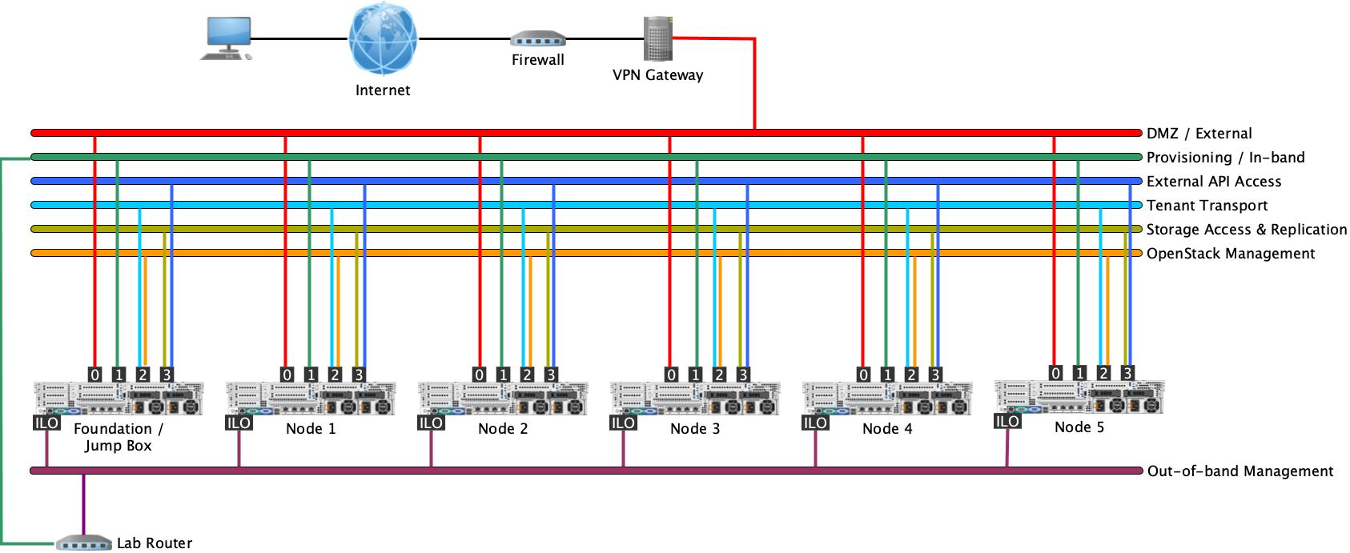
Progress: Lab Requirements
Lab Requirements
Must provide capabilities to support the NFVI Profiles specified by CNTT RM
Must withstand component failures, provide for network path redundancy & Controller HA
Must provide Jump Host, Compute & Storage hosts, Controllers & ToR with adequate compute, memory, storage, acceleration & network bandwidth capabilities (minimum 6 hosts, recommended 12 hosts in lab)
Rack space requirement - at least 19U, sufficient for 10-16 servers
Power requirement - ~ 10KWatts needed for max 16 hosts & 2 ToR
Recommended
Lab topology
Rajesh
8

Slide 9
Progress: Installer Requirements
Descriptor File Contents (Under Consideration)
Hardware Configuration
Server Template
Server Instances
Software Configuration (VM)
Network Configuration
  (VLAN settings, IP)
Storage Configuration
NTP, Proxy Server, etc.
Installer accepts the CNTT format descriptor file as input content
installers
CNTT:
Descriptor File
installers
Installers
Descriptor File Benefits
+ Installer Specific Attribute
Alignment with existing OPNFV Standards
Easily maintained & edited with Templates | YAML
OPNFV installers can consume it, enhancements are needed
CI/CD pipelines built to consume descriptor files
Provides Test Developers a detailed reference for Test Framework Design
Installers’
Own Configuration
Installer translates content to own configuration
Sridhar
* Currently under discussion
9

Slide 10
Progress: Installer Requirements (Continued)
Next Steps: New Content Need to Add
Content to be added as a prerequisite in a new commitment
  Hardware validation requirements(BIOS, RAID, CPU, Memory, IPMI, NIC)
  Network configuration on switch and router.(i.e.: vlan design and set for network plane for BMC and/or public access vlan)
Complementary information to add:
  Metadata (Lab Owner, Location, Purpose),
  Components (SDN-C, NFV features),
  Common Network Info (IP range, Subnets),Deployment Tools (installers) and Hardware Prerequisites (SRIOV, DPDK). ( network information: in range or static? need to further discussion)
See GitHub for additional details: https://github.com/cntt-n/CNTT/blob/master/doc/ref_impl/cntt-ri/chapters/chapter05.md
Sridhar

Slide 11
NFVI Required State
Objective
Provide traceability to RM/RA requirements for RI realization & Manifest Validations, and validated for Compliance.
Requirements Sources
  RM Ch 5: https://github.com/cntt-n/CNTT/blob/master/doc/ref_model/chapters/chapter05.md
  RA Ch 2 Infra: https://github.com/cntt-n/CNTT/blob/master/doc/ref_arch/openstack/chapters/chapter02.md
  RA Ch 5 NFVI API: https://github.com/cntt-n/CNTT/blob/master/doc/ref_arch/chapters/chapter05.md
RI Traceability
Chp03:NFVI + VNF Target State & Specification documents required state of NFVI, as mapped to RM/RA requirements, yielding the “readiness” of the NFVI:
  Sec 3.2 VNF profile – describes what every workload must declare
    instance type (B/N/C), flavor
    network options, persistent storage and acceleration extensions
  Sec 3.3 NFVI SW profile – list of features defining the NFVI software layer
    virtual compute (e.g., CPU allocation ratio, huge page etc),
    storage (e.g., IOPS criteria and replication factor etc)
    network optimization and acceleration options
  Sec 3.4 NFVI required status - architect requirements for VIM, API, tenants, LCM, security, & expected versions
Mike Fix
11

Slide 12
Progress: Reference Implementation Cookbook
Cookbook Outline | Progress
Goal
  Utilize Lab, Install, and Validation Experience with RI POC Lab for initial offering to create content
Purpose
Accelerate, NFVI+VNF Certifications through standardized lab setup & validations
Chapters Created
  Requirements Gathering
  Access and Connectivity (Lab)
  Available Installers
  Airship (as RI alpha installer)
    Descriptor File Preparations
    Deployment Installer & Install Steps
  Deployment Validations
Next Release Plans
  Update Documentation:
    CICD Toolchain (process & scripts)
    Jenkins Setup & Job Creation
    Compliance Validation (steps, process)
  Perform Validation & Optimize Accordingly
Progress to Date
  CICD Toolchain in place
  Initial Draft Complete
  Inclusive of Descriptor Files, Install Manifests (AirShip), & Deployment Validations (Functest)
Link to Additional Information
Sridhar | Cedric
12

Slide 13
Reference Implementation Achievements | Targets for Alpha
13

Slide 14
POD10 | POD15: Install State & Availability
 | Pod-10 | Pod-15
Owner | Trevor Cooper | Mike Fix
Purpose | CNTT testing PoC | CNTT CIRV
Pod-Topology | https://wiki.opnfv.org/display/pharos/Intel+POD10 | https://wiki.opnfv.org/display/pharos/Intel+POD15
Status | Ready to Use. All dashboards up and running. Test Tools deployment in progress | Manifests are ready. Infra Issue is being addressed by Team-Intel.
Installer | Airship | Airship
Infrastructure Definition | https://github.com/opnfv/airship/tree/master/site/intel-pod10 | https://github.com/opnfv/airship/tree/master/site/intel-pod15
OpenStack Installation Type | OOK: OpenStack on Kubernetes | OOK: OpenStack on Kubernetes
Networking support | Openvswitch and SRIOV | Openvswitch and SRIOV
Functest Compatibility | ~90%-95% | NA
Performance Benchmarking | In-Progress | NA
Usecases | NI – SRIOV. Compute Intensive | NI – SRIOV. Compute Intensive
GAPS | Low on Storage | No SSD for data disk.
Deployed and Maintained By | Sridhar@OPNFV-Airship | Sridhar@OPNFV-Airship
Sridhar | Rajesh
14

Slide 15
Initial NFVI Installation – The Installer
Infrastructure defined using Airship Manifests, and deployed using Airship Installer.
  How to create manifests: https://wiki.opnfv.org/display/AIR/Airship+Manifest+Creation+For+New+Sites
Why Airship?
  Opensource, Declarative, Flexibile and Consistent
  OPNFV-Airship has simplified manifest creation
  OPNFV-Airship has also simplified IP planning (Internal)
  Airship has captured all aspects of deployment
    Strategy, definition, networking (networks, NetworkLinks and NIC-Mapping), profiling, security, software, bootactions, baremetal-provisioning, LMA serverside (even RHOSP-13 Director does not support any serverside monitoring)
1.0 Gaps?
  Ubuntu Only, as MaaS is used
  SDN controller deployment is not supported
  MANO (VNFM/NFVO) deployment is not supported
  Airship 2.0 may fix these issues
Contacts with other, related, installer has proved to be unsuccessful
  Kayobe (similar to Airship – OOK)
Sridhar
15
Notes:
Initial NFVI Installation using Airship, challenges, lesson’s learned, and results - explanation of what installation utility was used for deployment, and the current state / Issues

Slide 16
Initial NFVI Installation – The Process, Summarized
Prepare Manifests
Setup Genesis
Run Deploy
Provision Control Nodes
Provision Compute Nodes
Install and Configure Software Components
Single-Node K8S cluster on Genesis
Kube-system
Ceph
ucp
osh-infra
Tenant-Ceph
OpenStack
Sridhar
The Software Components ( Namespaces w.r.t K8s)
16
Notes:
Initial NFVI Installation using Airship, challenges, lesson’s learned, and results - explanation of what installation utility was used for deployment, and the current state / Issues

Slide 17
Initial NFVI Installation - Learnings
Physical-networking (connectivity and configuration), and Internet-Access Issues can cause delays
  Pings and LLDP tools can help in former
  At times the access to repos can be slow
    Offline repository, possibly in jumphost, would be helpful
Getting Ceph right is very important
  It would help to have SSDs for data disks and preferably separate journal disks (NVMes)
  In Intel-Pods, this is not the case
Open IT tickets early and follow it up – provide as much details as possible
  Different time zones (Deployment and IT/Admin) will not help
Though, with its well-defined process, flow and detailed logs, troubleshooting any deployment failures is relatively easier, OPNFV-Airship should come-up with Troubleshooting Guide
  Some simple ‘inspection’ and ‘validation’ tools would be very helpful
OPNFV PDF is not used for manifest creation (yet)
  Shortcomings = Automation Challenges
  Enhancement to PDF/IDF/SDF is under consideration. Once done, auto manifest creation can be achieved
Sridhar
17
Notes:
Initial NFVI Installation using Airship, challenges, lesson’s learned, and results - explanation of what installation utility was used for deployment, and the current state / Issues

Slide 18
Release Notes | Issues
Release Notes, & Issues
  Labs
    Intel POD10 and POD15, Pharos Compliance Labs utilized for Alpha release
  Installer
    Installation performed manually using AirShip manifests.
    Target next release for consumption of detailed machine readable description files.
  Software
    RI based on OpenStack Ocata vs. RA requirements for PIKE
    Installer manifests (i.e. OpenStack Helm (OSH)) supports Pike and Stein (today).
    All core services/capabilities installed, except Live Migration and Resize Services per OSH.
  Validations
    Confirmed RA1 Ch 5 (API) feature capability is exposed per OSH Ocata
    Successfully audited installation and recommended next release changes: (1) increase Neutron Workers, (2) automatic removal of :80 reference in API end-points, and (3) use Nova 2.1 vs 2.0
Mike, Rajesh, Sridhar
18

Slide 19
Next Steps
Current Status
Completed:
RM | RA | RI Requirements
Lab Requirements
Initial Lab Secured
S/W Deployed | Config
Smoke Test | Sanity
Continuous Deployment (with errors)
Note: All events & dates are pending community alignment
Cookbook
v 0.1
Delivered
Cookbook
V 1.0
Delivered
Cookbook Validation
Reference Implementation
In-Progress
RI v 1.0
(Alpha)
Delivered
Manifest > PDF & IDF
Complete Lab PoC & Deliver Lab
Create Cookbook & RI Topology artifact
Implement PoC Key Learnings
RI v 1.0
Delivered
RI v 2.0
Delivered
Lab Setup, Test Automation & Validation
Friendly Trial
Controlled Introduction
Mike Fix
Notes:
Top 3
Finish Cookbook
Enable automatic deployment
Perform Manifest and Perf Validations

Slide 20
Appendix

Slide 21
Initial NFVI Installation – Access
Dashboards | URL | Credentials
Horizon | dashboard-airship.intel-pod10.opnfv.org | admin/password123
Grafana | grafana-airship.intel-pod10.opnfv.org | grafana/password123
Kibana | kibana-airship.intel-pod10.opnfv.org | elasticsearch/password123
Nagios | nagios-airship.intel-pod10.opnfv.org | nagios/password123
Sridhar
21
Notes:
Initial NFVI Installation using Airship, challenges, lesson’s learned, and results - explanation of what installation utility was used for deployment, and the current state / Issues

Slide 22
Progress: Installer Requirements(1/4)
Ref | sub-category | Description
req.gen.ins.01 | Installer | Installer **must** accept a descriptor file to finish deployment.
req.gen.ins.02 | Installer | Installer implementation **must** validate the descriptor file with schema.
req.gen.ins.03 | Installer | Any existing installer implementation **may** need adaption for the descriptor file.
req.gen.ins.04 | Installer | Installer **may** support reporting the deployment progress status.
req.gen.des.01 | Descriptor | Descriptor file **must** include hardware resource configuration, software configuration.
req.gen.des.02 | Descriptor | Descriptor file **may** include additional extending configuration.
Srihdar
22

Slide 23
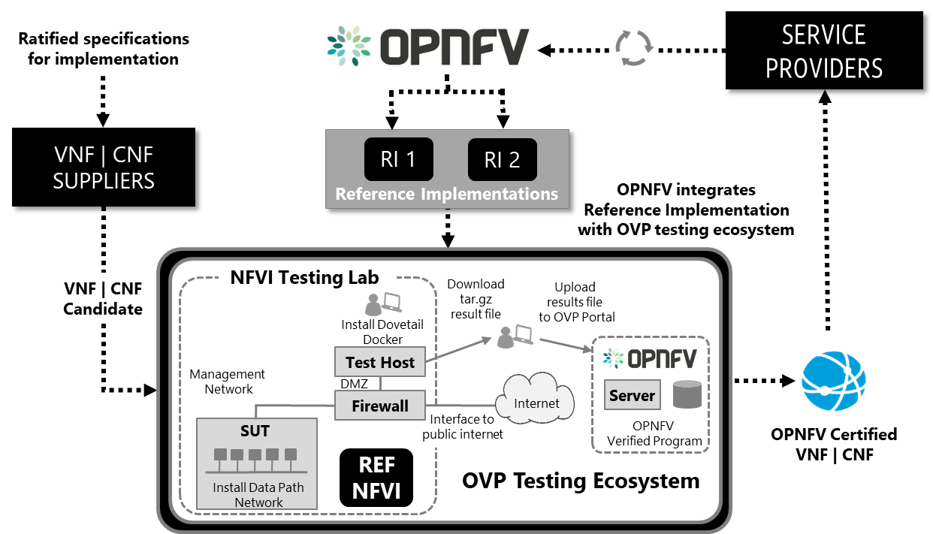
Reference Implementation
Objective
Implement & deploy based on the design & configurations of each Reference Architecture
Goals
Provide CNTT verification labs with standard hardware/software for cloud platform & VNF certification
Providing Reference Implementation leveraging Reference VNFs (“Golden VNFs”) for interoperability testing
Collaborate with OPNFV on approach & tools, aligning with CNTT community requirements
Establish hardware | software manifests
Target Delivery
January 2020 (v 1.0- Alpha)
Aligns with Reference Architecture # 1 (OpenStack)
23

Slide 24







Reference Implementation Approach | Outcome
Actions Underway
Outcomes
Generate eco-system requirements for Reference Implementation, including:
Efficient and effective quality approach while aligning with CNTT objectives.
Labs
Tooling
Installers, Releases
Automation Requirements
Create detailed description file definitions for installers, VNF features, etc..
User follows the steps or procedures to achieve an RI identical to the lab utilized by CNTT
Create detailed Lab criteria & operations
Optimized approach and aligned with CVC lab setup, operations, & support
Create a cookbook for the first RI, which includes detailed steps for the deployment and configuration
User follows the steps or procedures to achieve an RI identical to the lab utilized by CNTT
Create a detailed design for automation for deployment & testing
Reference Implementation is integrated with CVC ecosystem, including test cases & framework
Create continuous integration & delivery pipeline for Reference Implementation
Alignment with OPNFV CI to generate CNTT Reference Implementation in a continuous manner
Perform gap analysis to determine required actions for existing eco-system within LFN/OPNFV community projects
Required test cases & test frameworks are identified & created in collaboration with upstream communities
24

Slide 25
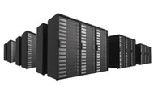
Reference Implementation: Lab Strategy & Plan
Goal
Select a secure, stable, and configurable lab, enabling automated reference implementation (RI) validations
Vision & Recommendation
Establish at least 2 community labs (leverage testing & HW expertise)
  Supports multiple RI validations in parallel
  Readily available supplier test apparatus & expertise
  Leverage geo diversity
Leverage Lab as a Service (UNH-IOL) labs
Promote 3rd Party Vendor Labs for Scalability
RI-1 Lab Chosen (Alpha)
Intel POD10 PoC & POD15 Target State
3 x Controller Nodes
10 x Compute Nodes (4 general + 2 per B/N/C)
1 x Jump Host
1 x Spine Switch and 2 x Leaf Switch in 1 x 48u Rack
Qualifications – Must be Satisfied for Lab Selection
Available with Outage Contingency (4-nine uptime)
Current & Stable (current patch sets)
Demonstrated Integration with the OVP Ecosystem
Secure (physical, and logical)
Configurable with minimal downtime
Effortless onboarding process
25

Slide 26

Reference Implementation Challenges
Community resources (engagement & contributions)
OPNFV capabilities & alignment with CNTT objectives
  Ability to scale to demand
Alignment with other communities
Limited support structure for defects | issues (best-effort community Triage)
Agreement & Support to build a normalized POD/Infrastructure Descriptor File for installers
Closure on target location and quantity of code repos needed
Consensus to create a long-term delivery Work Group (WG) for LCM
Need automated BareMetal validations
CNTT will maintain ownership of the Reference Implementation until a satisfactory level of support, stability, & maturity is attained
26

Slide 27
POD10 | POD15: Install State & Availability
 | Pod-10 | Pod-15
Owner | Trevor Cooper | TBD
Purpose | CNTT testing PoC | CNTT RI
Pod-Topology | https://wiki.opnfv.org/display/pharos/Intel+POD10 | https://wiki.opnfv.org/display/pharos/Intel+POD15
Status | Ready to Use. All dashboards up and running. Test Tools deployment in progress | Manifests are Ready. Infra Issue is being addressed by Team-Intel.
Installer | Airship | Airship
Infrastructure Definition | https://github.com/opnfv/airship/tree/master/site/intel-pod10 | https://github.com/opnfv/airship/tree/master/site/intel-pod15 [Coming Soon]
Openstack Installation Type | OOK: Openstack on Kubernetes | OOK: Openstack on Kubernetes
Networking support | Openvswitch and SRIOV | Openvswitch and SRIOV
Functest Compatibility | ~90%-95% | Yet to be performed
Performance Benchmarking | In-Progress | Yet to be performed
CNTT RA/RM Compatibility | Yet to Assess. Lack to requirement specification | NA
Usecases | NI – SRIOV. Compute Intensive. | NI-SRIOV. Compute Intensive
GAPS | Low on Storage. Yet to assess CNTT RM/RA compatibility due to lack of manifest validation specification | No SSD for datadisk.
Deployed and Maintained By | Sridhar@OPNFV-Airship | Sridhar@OPNFV-Airship
27

Slide 28
POD 10 Configuration Details
Installer:
  Airship version v1.0
  Airship TreasureMap version v1.6
Openstack:
  Openstack version: Ocata
  Installation type: Openstack on Kubernetes
Other software versions & locations:
  https://github.com/airshipit/treasuremap/blob/v1.6/global/software/config/versions.yaml
Infrastructure definition / descriptor files:
  https://github.com/opnfv/airship/tree/master/site/intel-pod10
Hardware details:
Test Tooling:
OPNFV Iruya Release
https://wiki.opnfv.org/display/SWREL/Iruya
OPNFV projects used for testing
  Yardstick
  Functest
    Rally
    Tempest
  Dovetail
Node description | Compute | Memory | Storage
pod10-jump | 2xE5-2699 | 64GB | 3TB (Sata) 180 (SSD)
pod10-node1 | 2xE5-2699 | 64GB | 3TB (Sata) 180 (SSD)
pod10-node2 | 2xE5-2699 | 64GB | 3TB (Sata) 180 (SSD)
pod10-node3 | 2xE5-2699 | 64GB | 3TB (Sata) 180 (SSD)
pod10-node4 | 2xE5-2699 | 64GB | 3TB (Sata) 180 (SSD)
pod10-node5 | 2xE5-2699 | 64GB | 3TB (Sata) 180 (SSD)

Slide 29
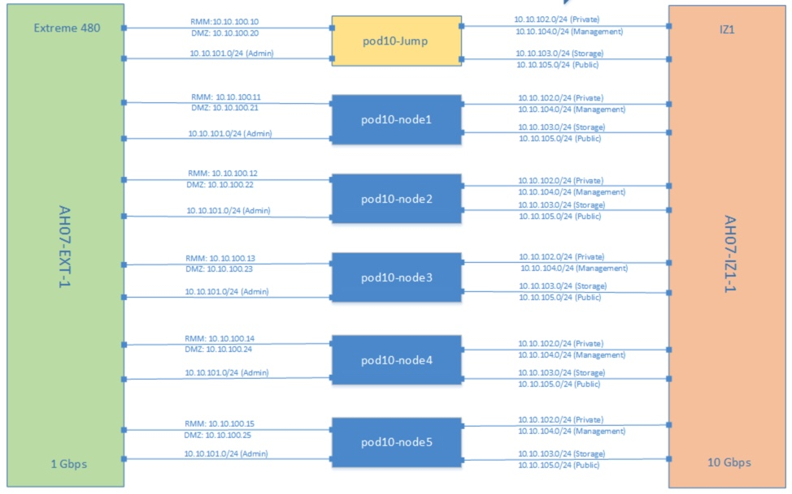
POD 10 Topology

Slide 30
POD 15 Configuration Details
Installer:
  Airship version v1.0
  Airship TreasureMap version v1.6
Openstack:
  Openstack version: Ocata
  Installation type: Openstack on Kubernetes
Other software versions & locations:
  https://github.com/airshipit/treasuremap/blob/v1.6/global/software/config/versions.yaml
Infrastructure definition / descriptor files:
  https://github.com/opnfv/airship/tree/master/site/intel-pod15 [Coming Soon]
Hardware details:
Test Tooling:
OPNFV Iruya Release
https://wiki.opnfv.org/display/SWREL/Iruya
OPNFV projects used for testing
  Yardstick
  Functest
    Rally
    Tempest
  Dovetail
Node description | Compute | Memory | Storage
pod15-jump | 2xE5-2699 | 64GB | 3TB (Sata) 180 (SSD)
pod15-node1 | 2xE5-2699 | 64GB | 3TB (Sata) 180 (SSD)
pod15-node2 | 2xE5-2699 | 64GB | 3TB (Sata) 180 (SSD)
pod15-node3 | 2xE5-2699 | 64GB | 3TB (Sata) 180 (SSD)
pod15-node4 | 2xE5-2699 | 64GB | 3TB (Sata) 180 (SSD)
pod15-node5 | 2xE5-2699 | 64GB | 3TB (Sata) 180 (SSD)

Slide 31
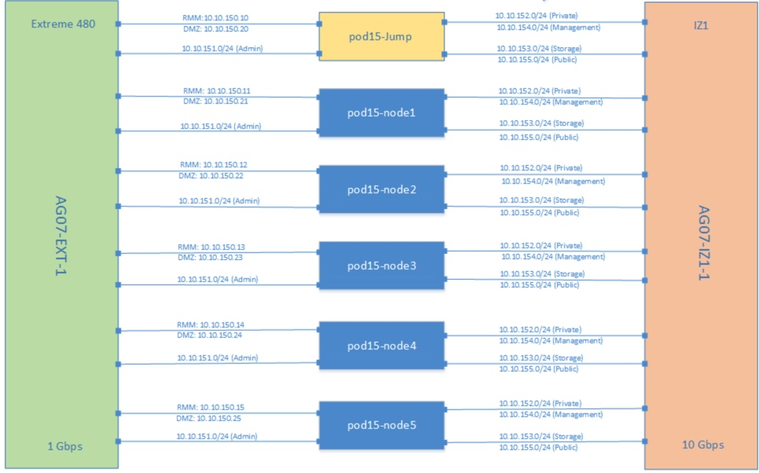
POD 15 Topology

