Slide 1
Common NFVI Telco Taskforce
Technical F2F Work Shop – January 13-16, 2020
RC Workstream: Key Updates
Facilitators: Mike Fix, Cedric Ollivier, Rajesh Rajamani, Kanagaraj Manickam

Slide 2
Content & MVP Targets
2

Slide 3
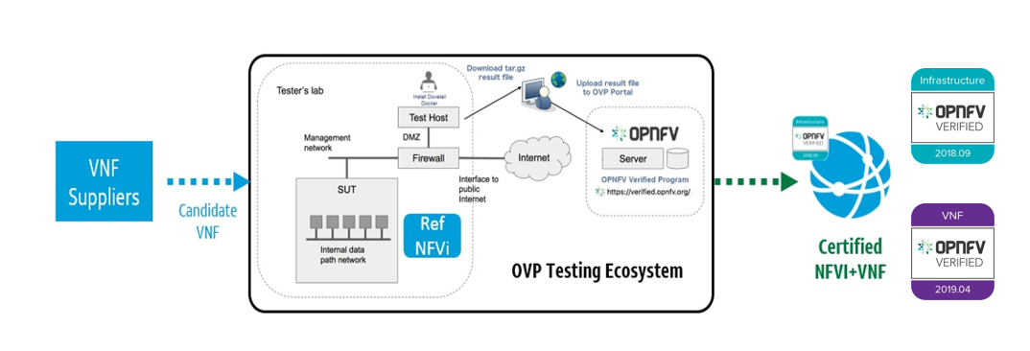
Progress to Date | Key Accomplishments
Objectives
Re-write(WIP) for Certification Process/Frameworks/Badging
Onboard Additional Team Support (Frameworks), Methodologies, Badging
Stage Jenkins Hosts & Enable Daily Jobs for Health/Smoke Suites
Setup & Perform initial compliance validations
Identify Gaps (audit) in initial Alpha RI Release and expected compliance validations
Initial Badging Framework for NFVI | VNFs
Certification Process Drafted
Automation Tool Chain Framework
3
MF
Notes:
“For RC, it will be hard to demonstrate a cookbook at this stage, but I think it will be of a great value if we get the framework requirement and certification process drafted as an alpha version for the discussion in Prague.“

Slide 4
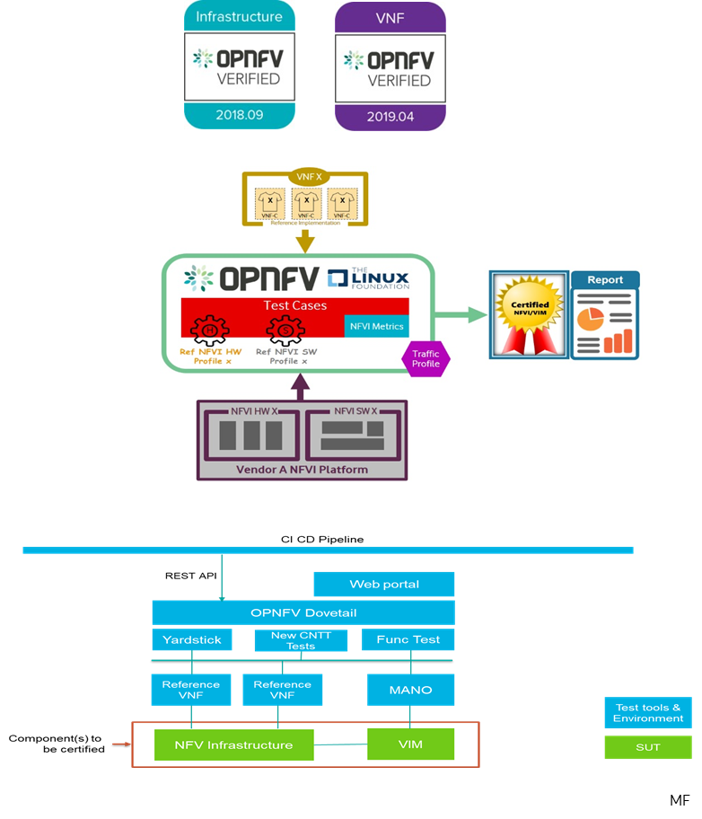
Level Set on MVPs
Initial Badging Framework for NFVI | VNFs
Lab setup
Compliant requirements
Execution empirical, verification & validation
Evidence meeting qualifications
Governance (Badging) reviews & badging
Certification Process Drafted
Certified Lab utilized
Test Case Traceability to req’s
Execution complete & passing
Results Collation normalized & centralized
Evidence meeting qualifications
Governance reviews of Entry/Exit criteria and certification
Automation Tool Chain Framework
Refactor existing OVP toolchain
Versatile test harnesses using standard interfaces & services
Supplier Integration enabling VNF testing using Supplier Apparatus
Adaptable & Portable Tool Chaining across releases
4
Notes:
Support RI-alpha release, with parallel RC-pre alpha deliverables.
Initial Badging Framework for NFVI | VNFs
Based on adherence & demonstration of successful RI installation
NFVI adheres to CNTT RA/RM requirements.
Compliance to Baremetal, Software Versioning, and RM/RA requirements (e.g. B/N/C profile, config, extensions, etc)
Execution of core Verification (Manifest), Validation (Reference and API functional & Performance), Security, and Candidate VNF Tests
Supplier provider artifacts for OVP Corroboration and Certification
Lab certification via Cookbook
Normalized Test Results in Expected Repo
Release Notes
Core Badging
Lab. Adherence to CNTT RI lab cookbook
Compliance. RM/RA requirements met
Execution. Baremetal, Component Verification, API FR/NFR Validation, Security, and Candidate VNF Tests
Evidence. Supplier provided artifacts
Governance (Badging): OVP Review, Consensus, and Certification
Certification Process Drafted
NFVI supplier utilizes, or installs a target RM/RA-x certified RI lab.
NFVI & VNFs perform as expected (i.e. test cases pass) on NFVI with acceptable levels of stability and performance.
Required artifacts are submitted/supplied to the OVP, demonstrating proper Lab Installation, Compliance, Validation, Performance, and Release of Results & Known Issues.
Artifact validations will be corroborated and confirmed by the OVP. with direct comparison between measured results and documented FRs/NFRs for applications, hardware and software configuration settings, and host systems.
All OVP inquiries, requests for re-tests, or reformatting / re-uploading of results data are closed.
Adhere to security compliance
All Entrance/Exit Criteria Satisfied
Core Certification
Certified Lab. NFVI supplier utilizes, or installs a target RM/RA-x certified RI lab.
Test Case Traceability. Clear Traceability of RM/RA-x requirements, Test Scenarios, and Test Cases
Execution. NFVI & VNFs perform as expected (i.e. test cases pass) on NFVI with acceptable levels of stability, security, and performance.
Results Collation: Normalized Results are collated in a central repository
Evidence. Required artifacts are submitted to the OVP
Governance. OVP reviews and provides disposition (i.e. Entry/Exit criteria satisfied)
Certification. OVP inquiries, re-tests, or reformatting / re-uploading of results data are closed
Automation Tool Chain Framework
Refactor. Leverage existing OVP toolchain defined by LFN/OPNFV
Versatile. Test harness is compatible, or conforms to testing against standard interfaces and services.
Supplier Integration. VNF functionality easily tested with addition of Supplier Apparatus.
Adaptable. Tool Chain Portable across test-/release- efforts.

Slide 5





Progress: Initial Content Creation
Initial Content
NFVI
Ch01: Introduction
Ch02: NFVI E2E C&V Framework Requirements
Ch03: NFVI Test Case Requirements
Ch04: NFVI TC Traceability to RA Requirements
VFN
Ch05: VNF E2E C&V Framework Requirements
Ch06: VNF Test Case Requirements
Ch07: VNF TC Traceability to RM Requirements
DEV
Ch08: E2E Framework Integration
Ch09: NFVI Tests Traceability to TC Requirements
Ch10: VNF Tests Traceability to TC Requirements
Ch11: Gap analysis & Development
“RI-Alpha & RC-Pre Alpha Phase”
Delivered - Snezka MVP
Defined Certification
Provide NFVI and VNF Certification Methodology
Outline E2E Frameworks for Tools, Badges, and Process
Included Gaps Identified During Installation
Next Release
Include Normalized Results Template & Repo
Finalize TC Requirements and Traceability
Reach consensus on Entry & Exit Criteria
alpha
alpha
alpha
alpha
alpha
alpha
alpha
alpha
5
MF

Slide 6
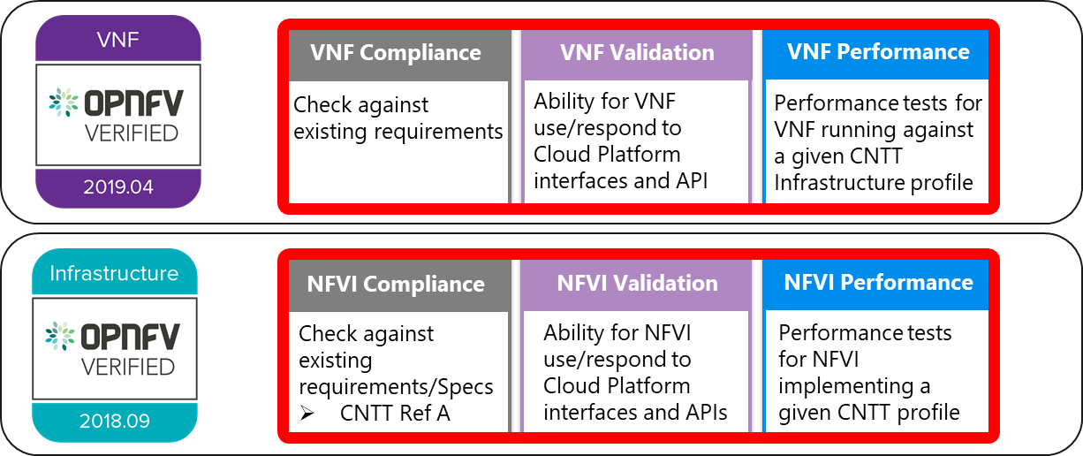
Progress: Badging Requirements
Badging Requirements
Badging Defined
Granting of certification by the OVP to Suppliers of NFVI+VNF upon demonstrating testing confirms:
  NFVI adheres to CNTT RA/RM requirements.
  VNFs pass interoperability tests on target NFVI with acceptable levels of stability and performance.
Suppliers seeking NFVI & VNF certification will furnish the following:
Category | OVP/CVC Expectation | Supporting Artifact(s)
Lab | Delivered test lab conforms to RI-x lab requirements for SUT | Bare-metal H/W Validations
Compliance | Installed software conforms to RM/RA requirements for components & options | Manifest S/W Validations
Validation | FR Validation of Component and API functional behavior meets requirements | API & Platform Test Results
Performance | NFR Validation of Component, Interface, and API, results are within baseline tolerance | Performance Test Results
Results Reporting | Test Results published into centralized and common repository & portal | Normalized Results per Standards
Release Notes | Supplier provides concluding remarks, links to artifacts, having met exit criteria for testing | Release Notes
6
KM
Notes:
Validations performed.
NFVi Verifications (Compliance): Manifest Verifications will ensure the NFVI is compliant, and delivered for testing, with hardware and software profile specifications defined by the Ref Model and Ref Architecture.
Empirical Validation with Reference VNF (Validation): Empirical Validation with Reference Golden VNFs will ensure the NFVI runs with a set of VNF Families, or Classes, to mimic production-like VNFs to baseline infrastructure conformance.
Candidate VNF Validation (Validation & Performance): Candidate VNF Validation will ensure complete interoperability of VNF behavior on the NFVI leveraging VVP/VNFSDK test suites to ensure VNF can be spun up, modified, or removed, on the target NFVI (aka Interoperability).
Badging refers to the granting of a certification badge by the OVP to Suppliers/Testers of CNTT NFVI+VNF upon demonstration the testing performed confirms:
NFVI adheres to CNTT RA/RM requirements.
CNTT certified VNFs functionally perform as expected (i.e. test cases pass) on NFVI with acceptable levels of stability and performance.
Badges offered will consist of Infra (NFVI) and VNF. VNF badges require NFVI badge.
Infrastructure: Adherence and demonstration to Compliance, Validation, and Performance for stated RI-x. (e.g. Lab Verification, Component Delivery, FR/NFR testing).
VNF: Implementation of certified RI, Interoperability Validation including performance measurement within platform tolerance, coupled with VNF instantiation, soak, and removal of the VNF.
Category
OVP/CVC Expectation
Supporting Artifact(s)
Lab - Verification that delivered test lab conforms to RI-x lab requirements for topology, # of nodes, network fabric, etc [Bare-metal H/W Validations]
Compliance - Verification that the installed software conforms to RM/RA requirements for required components and configured options and extensions, etc [Manifest S/W Validations]
Validation - FR Validation of Component and API functional behavior meets requirements specified in RM/RA-x requirements documents [API & Platform Test Results]
Performance - NFR Validation of Component, Interface, and API, results are within tolerance, or achieve baseline measurements [Performance Test Results]000
Results Reporting - Published of Test Results into centralized and common repository and reporting portal [Normalized Results per Standards]
Release Notes - Supplier provides concluding remarks, links to artifacts, and demonstration of having met exit criteria for testing [Release Notes]

Slide 7
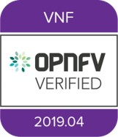
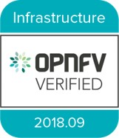
Progress: Badging Requirements.. Test Results
Categorization
Test suites – Functional/Platform or Performance based
Results
Test results communicated as boolean (pass/fail), or Measurements Only
  Functional Pass/Fail - assertions in a test script verify the FR met its stated objective delivered by the developer
  Performance-based Pass/Fail - compares measured results with NFR KPIs &/or Reference VNF KPIs
  Measurement Results - baseline measurements when no benchmarks available to compare
Collation | Portal
Criteria applied to collation and presentation of test-result data:
  RA number and name (e.g. RA-1 OpenStack)
  Version of software tested (e.g. OpenStack Ocata)
  Normalized results will be collated across all test runs (i.e. centralized database)
  Clear time stamps of test runs will be provided.
  Identification of test engineer / executor.
  Traceability to requirements.
  Summarized conclusion if conditions warrant test certification (see Badging Section).
  Portal contains links to certification badge(s) received.
7
KM
Notes:
Categorization. Test suites will be categorized as Functional/Platform or Performance based.
Results. Test results reporting will be communicated as a boolean (pass/fail), or Measurements Only.
Functional Pass/Fail signals the assertions set in a test script verify the Functional Requirements (FR) has met its stated objective as delivered by the developer. This will consist of both positive validation of expected behavior, as well as negative based testing when to confirm error handling is working as expected.
Performance-based Pass/Fail determination will be made by comparing Non-Functional (NFR) NFVI KPIs (obtained after testing) with the Golden KPIs. Some of the examples of performance KPIs include, but not limited to: TCP bandwidth, UDP throughput, Memory latency, Jitter, IOPS etc. See Chapter 4 of RM for a complete list of metrics and requirements.
Measurement Results. Baseline Measurements will be performed when there are no benchmark standards to compare results, or established FRs/NFRs for which to gauge application / platform behavior in an integrated environment, or under load conditions. In these cases, test results will be executed to measure the application, platform, then prepare FRs/NFRs for subsequent enhancements and test runs.
Collation | Portal. The following criteria will be applied to the collation and presentation of test-runs seeking NFVI certification:
RA number and name (e.g. RA-1 OpenStack)
Version of software tested (e.g. OpenStack Ocata)
Normalized results will be collated across all test runs (i.e. centralized database)
Clear time stamps of test runs will be provided.
Identification of test engineer / executor.
Traceability to requirements.
Summarized conclusion if conditions warrant test certification (see Badging Section).
Portal contains links to certification badge(s) received.

Slide 8
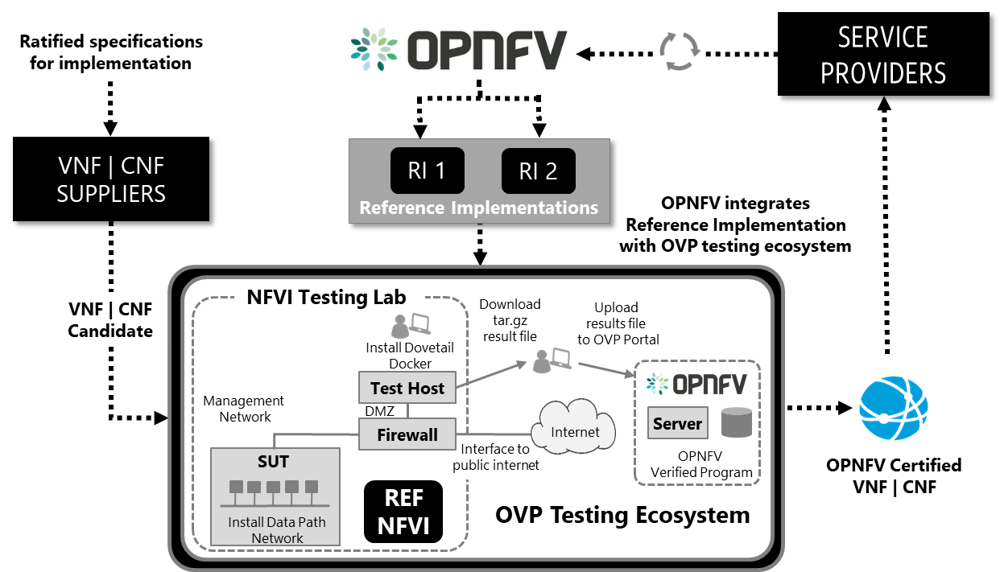
Reference Certification
Objective
Deliver community certified NFVI | VNFs | CNFs to the Service Provider Marketplace
Goals
Provide uniform approach for NFVI | VNF | CNF certification process, lifecycle, & badging
Certify VNF | CNF on infrastructure, instantiation, tear-down, performance, & resiliency
Provide VNFs | CNFs with effective & efficient intake & onboarding for Lab Management
Ensure test framework can be reused for Manifest, Empirical, and Interoperability validations for new distributions
Target Delivery
March | April 2020 (v 1.0 - Alpha)
Aligns with Reference Architecture # 1 (OpenStack)
8
RR

Slide 9
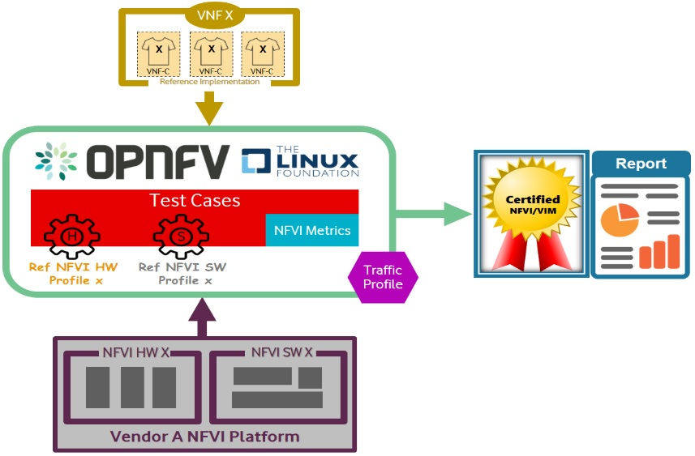
Progress: Certification Process Framework
Certification Process Framework
By Definition
Verification conformance that NFVI is delivered per implementation specifications
Validation testing performed confirms the actual output of a product meets the expected or desired outcome, or behavior
Certification issuance of NFVI/VNF badges in recognition of the successful completion of verification and validation testing
Core Principles
Certification fulfilled by the OPNFV Verified Program (OVP), under the Linux Foundation Networking (LFN) umbrella
Program overseen by the Compliance Verification Committee (CVC) providing tracking and governance
NFVI and VNFs supplied by vendors must adhere to Reference Model (RM) and Reference Architecture (RA)
Certification and Issuance of NFVI+VNF Badges
Utilization of target RM/RA-x certified RI lab
Traceable test cases to requirements
Adoption & Execution of Xtesting for RC pre-alpha validations
Collation of Normalized Results in Centralized Repository
Entry and exit criteria satisfied
Required artifacts supplied to the OVP
9
RR
Notes:
Defined: Testing and compliance processes and requirements to ensure that the NFVI and VNFs supplied by vendors adhere to the CNTT Reference Model (RM) and Reference Architecture (RA).
Certification of NFVI+VNF will be fulfilled by the OPNFV Verified Program (OVP), under the Linux Foundation Networking (LFN) umbrella. The program will be overseen by the Compliance Verification Committee (CVC), who will provide tracking and governance for verification, validation and certification
Verification will be used to indicate conformance to design requirement specifications. Activities involved Reviews and Walk-Throughs to ensure the NFVI is delivered per implementation specifications.
Validation is used to indicate that testing is performed to confirm that the actual output of a product meets the expected or desired outcome, or behavior.
Certification of NFVI and/or VNFs supplied by vendors and the providing of badges/marks in recognition of the successful completion of compliance and verification testing
Certification and issuance of NFVI+VNF badges:
NFVI supplier utilizes, or installs a target RM/RA-x certified RI lab.
Documented test cases which confirm to standards for categorizing, collation, and reporting
Entry and exit criteria defined in below section are pre-requisities for this flow.
Empirical Validation with Reference Golden VNFs performed ensured the NFVI runs with a set of VNF Families, or Classes, to mimic production-like VNF connectivity.
Required artifacts are submitted/supplied to the OVP, demonstrating proper Lab Installation, Compliance, Validation, Performance, and Release of Results & Known Issues.
Artifact validations will be corroborated and confirmed by the OVP. with direct comparison between measured results and documented FRs/NFRs for applications, hardware and software configuration settings, and host systems.
All OVP inquiries, requests for re-tests, or reformatting / re-uploading of results data are closed.
Core Principles
Certification of NFVI+VNF will be fulfilled by the OPNFV Verified Program (OVP), under the Linux Foundation Networking (LFN) umbrella.
The program will be overseen by the Compliance Verification Committee (CVC), who will provide tracking and governance for verification, validation and certification.
NFVI and VNFs supplied by vendors must adhere to the CNTT Reference Model (RM) and Reference Architecture (RA).
By Definition
Verification will be used to indicate conformance to design requirement specifications. Activities involved Reviews and Walk-Throughs to ensure the NFVI is delivered per implementation specifications.
Validation is used to indicate that testing is performed to confirm that the actual output of a product meets the expected or desired outcome, or behavior.
Certification of NFVI and/or VNFs supplied by vendors and the providing of badges/marks in recognition of the successful completion of compliance and verification testing

Slide 10
Reference Certification Achievements | Targets for Alpha
10

Slide 11
NFVI Compliance
Scope & Test Strategy
Manifest Verifications verify NFVI matches hardware and software profile specifications for RM/RA
Empirical Validations baseline NFVI and Ref/Golden VNFs behaviors for future comparison
Interoperability Validation performed leveraging VVP/CVC test suites to ensure VNF can be spun up, modified, or removed, on the target NFVI
Not In Scope
VNF functional testing
MANO for VNFs
Validating VNF’s ability to be upgraded
Georedundant and Load Testing
RI-Alpha & RC-Pre Alpha Release
Xtesting and Xtesting CI meet Requirements for verification, compliance and certification:
Assembly of multiple heterogeneous test cases
OPNFV Release Engineering Jenkins jobs to verify RI
Test case results & logs for third-party certification review
Deploy local CI/CD toolchains to verify RI compliance
11
MF

Slide 12
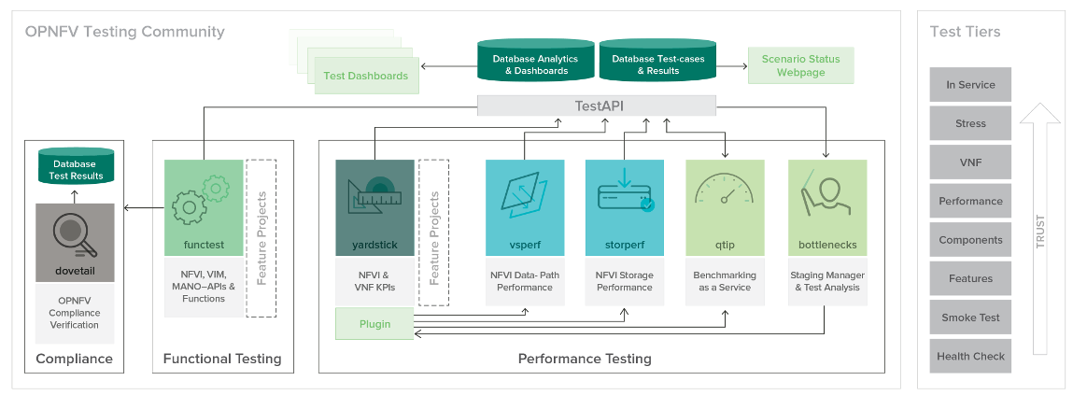
Framework
CICD approach utilizing common components and frameworks:
  RI verification: centralized LF CI toolchain
  RC compliance and cert: local LF-compatible CI toolchains
Defining first framework requirements to simplify CI toolchain:
  Common test case execution
  United way to manage interactions with CI/CD components and with third-parties
Xtesting was pragmatically selected:
  Meets CNTT requirements
  Allows easy adding any new test case
The first test case requirements have been published:
  Test cases delivered as Docker containers
  Xtesting package and the related test case execution description file included
12
CO
Notes:
S3 compatible storage services
e.g. https://www.scality.com/topics/what-is-s3-compatible-storage/
Amazon Web Service (AWS) S3 (Simple Storage Service) has grown to become the largest and most popular public cloud storage service. As a result, it has been embraced by developers of custom and ISV applications as the de-facto standard object storage API for storing unstructured data in the cloud. Unlike traditional file system interfaces, it (S3) provides application developers a means to control data through a rich API set.
S3 Compatible Storage is a storage solution that allows access to and management of the data it stores over an S3 compliant interface.
Principles
NFVI+VNF verifications performed against well defined instance types/profiles.
Leverage existing OPNFV knowledge (projects) and experience (history).
Utilize a common CICD framework across RI and RC via CIRV project:
RI verification (jjb in releng)
RC compliance and certification (local CI toolchains)
Test cases delivered as Docker containers embedding Xtesting Python package and test case execution description files.
Jenkins triggers:
CIRV deployments: PMO: local component deployment, FMO: automated deployments
Runs the OPNFV test cases part of the NFVI verification
Publish test results in a centralized test database and all artifacts (reports, logs, etc.) to an S3 compatible (simple) storage service:
PMO: results and logs provided today via the CIRV and Daily Jobs (Functest)
FMO: incorporation of additional test projects)

Slide 13
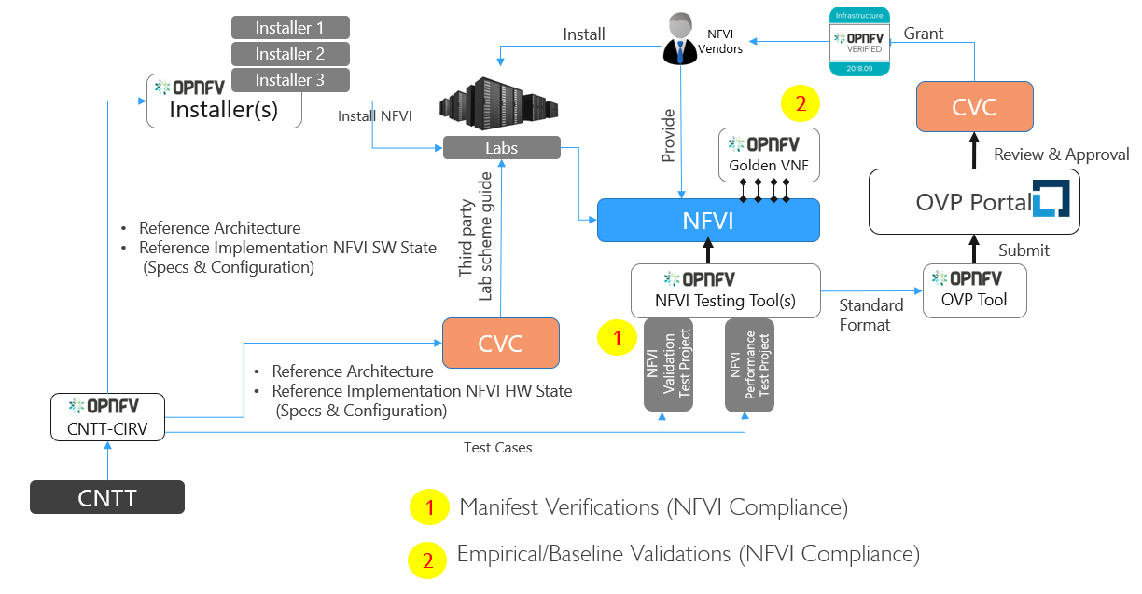
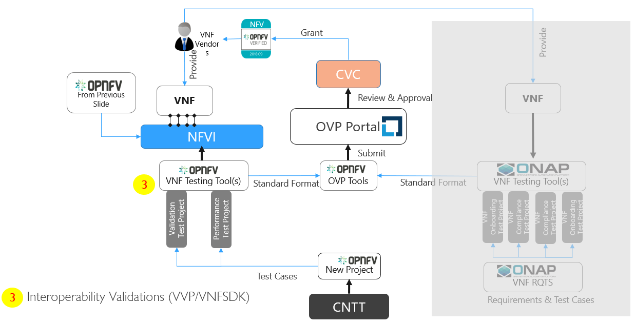
Certification Process | Gap Analysis
Process
Certification based on successful delivery of:
  Manifest Verifications – confirming NFVI delivered per RI-x requirements.
  Baseline Validations – measuring FR/NFR behaviors using reference VNFs
  Interoperability Validations – confirming capabilities, stability and perf
For NFVI Certification:
  Vendor NFVI/VIM images under Test will be installed and configured
  For Phase 1, OPNFV Functest tests used for Compliance and Validation
For VNF Certification.:
  Vendor VNF images are ingested by the CICD pipeline, implemented in lab
  VNF on-boarding and lifecycle operations validation is performed using upstream projects such as VNFSDK and VPP
Test results submitted to OVP for review by committee. If results are validated, the vendor’s application for certification is approved and the badge(s) awarded.
Gaps
  No automated means for Manifest (s/w) or Lab (h/w) Validations
  Need support vehicle for Installer changes (to meet RI-x specs)
  Normalization and Centralization of Results Alignment needed
  Storage and Performance scenarios (or tools) missing
  Need Installers which are OpenStack release agnostic
  Need priority on lab support with proactive monitoring
13
CO
Notes:
VNF or NFVI vendors provide VNF images, NFVI/VIM images or NFVI hardware components for certification. Self-execution by VNF/NFVI vendors is allowed, with final validation by CVC.

Slide 14

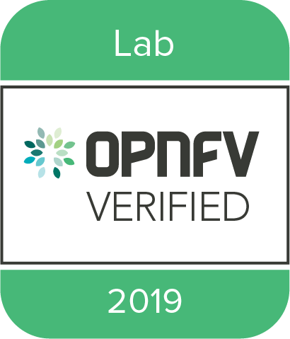
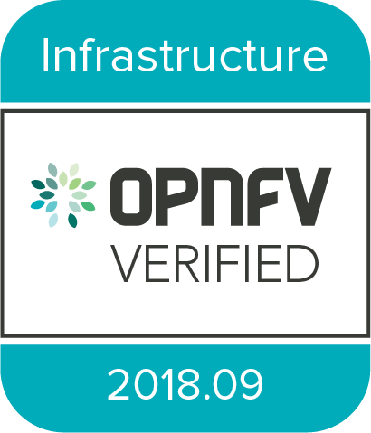
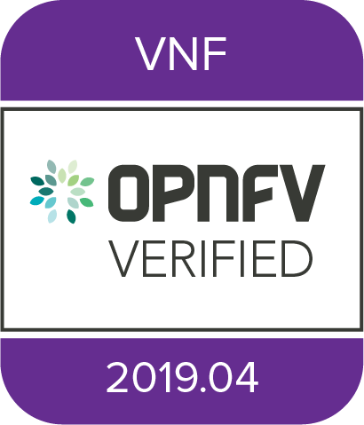
Exceptions: Certifications From the OVP Process
Gap
Gap
Work in Progress
Work in Progress
Work in Progress
Gap
OPNFV Verification Program (OVP) is a five step process resulting in the issuance of three badges: NFVI, VNF, and Lab
CNTT seeks to align with the OVP process, noting three Gaps above in process:
  Step 1 for client (NFVI/VNF) participation in badging and certification
  Step 2 for Test(ing) & tools utilized for testing
  Step 6 for Badging Guidelines
Mitigating Process Gaps:
  Step 1: Friendly and Controlled Introductions in 2020, using key learnings to create formal participation mechanism
  Step 2: Adopt Xtesting as OVP certified Platform Alternative, Expand Test Coverage onboarding/augmenting Test Projects
  Step 6: OVP accepts cookbook results as fulfillment for CNTT NFVI conformance/certification (all actors will run cookbook)
14
CO
Notes:
NFVI
NFVI needs to be validated and expected to be in a required state. This state would be determined by running tests as described in CNTT RI. Once the target NFVI passes these tests, it would become a candidate for NFVI certification.
NFVI+VNF validations consist of a three part process for Compliance, Validation, and Performance. Adherence to Security standards are equally important and addressed in Chapter 7 of CNTT RM.
The three part verification process includes:
NFVI Manifest Validations
NFVI Verification (Compliance): NFVI is the SUT, ensuring NFVI is compliant with specs of RM and RA accomplished with Manifest Validations (performed via Echo Tests)
Empirical Baseline measurements against targeted VNF families
Empirical Validation with Reference VNF (Validation): NFVI is the SUT, ensuring NFVI runs with Golden VNFs and is instrumented to objectively validate resources through consumption and measurement
Candidate VNF verifications
Candidate VNF Certification (Validation & Performance): VNF is the SUT, ensuring VNFs operate with RM and RA leveraging VVP/CVP/VFNSDK Test Suites
Security: Ensures NFVI+VNF is free from known security vulnerabilities, utilizing industry standard cyber security frameworks (Refer to CNTT Chapter 7 Security for additional test/verification details) Validations are performed against an Infrastructure Profile Catalog, VNF performance profile, and targeted VNF class or family for baseline measurements.
VNF
VNF certifications confirm capability of VNF to interact with the target NFVI with a high degree of stability.
Certification begins with confirmation of the NFVI delivered and verified based on B/N/C:
Basic: for VNF that can tolerate resource over-subscription and variable latency.
Network Intensive: for VNF that require predictable computing performance, high network throughput and low network latency.
Compute Intensive: for VNF that require predictable computing performance and low network latency.
Suppliers adhere to documentation standards for test cases:
Test case Name
Test case description
Virtual Network function Name
Network function Feature/functionality name
Test case input parameters
Test case result attributes
Test case version
Validation is performed and Results Collated:
Interoperability validations for VNF functional testing defined.
Interoperability validations for VNF performance testing defined (IOPS, connection, threading, resource consumption).
Mitigating Process Gaps:
Step 1: Friendly and Controlled Introductions introduced in 2020. , after which a formal mechanism to scale the demand will be established: 1) Suppliers with NFVI Cert as their Core Competence, 2) Suppliers/Telcos who have initiated an RI-x setup, and 3) Lab owners to vet Cookbook steps.
Step 2: Compliance Validations will be performed using FuncTest and Xtesting/XTestingCI confirming deployment success, exposure of services and capabilities, & functional validation of RI-x services. RC-alpha pre discussions will be needed to introduce Xtesting as a compliment to Dovetail for Certification, along with collation of normalized test results.

Slide 15




Results: Compliance
With RI-Alpha
  Continuously running deployment, verification and CNTT compliance
  6 Commands to configure the RI daily jobs or to deploy the local toolchain within minutes
  Compared to OVP scope, API testing coverage increased from 15% to 100% as proposed by Functest
  In addition to API testing, test run for Compliance Verification now include:
    API and data plane benchmarking
    VNF deployment and testing
  RI and TC development verification implemented (Functest CI successfully checks its CNTT deliverables
  Conclusion: Successfully audited the RI System Under Tests (SUT), identifying installer changes to enable RI deployments, & confirming RA1 Chapter 5 (API) feature capability and exposure per OSH Ocata.
Observations
  OpenStack Helm (OSH) doesn't support live migration and resize server for Ocata
  Metrics needed for API / data-plane benchmarking
Recommendations (for RC-Alpha)
  Implement Stein, OSH supported
  Update RM/RA-1 OpenStack documentation for Stein
  Link RI gates to verification tests
  Leverage Xtesting to wrap the RI deployment calls, simplifying the RI “cookbook”
15
CO
Notes:
With RI-alpha
Released the first CNTT API compliance containers from OPNFV Functest and the associated tooling to quickly setup plug-and-play Continuous Integration toolchains everywhere (Xtesting CI).
New RI/RC compliance containers forbid skipping tests for mandatory services/capabilities.
8 GNU/Linux commands deploy the full CI/CD toolchain within minutes: https://wiki.opnfv.org/pages/viewpage.action?pageId=32015004
Tests run for Compliance Verification include:
opnfv/functest-benchmarking-cntt
opnfv/functest-healthcheck
functest-vnf (tests mainline API for quick feedback, before onboarding and testing “real” VNFs (e.g. IMS, EPC and vRouter).

Slide 16
Next Steps
Current Status
Note: All events & dates are pending community alignment
Completed:
RM | RA | RI Requirements
Lab Requirements
Initial Lab Secured
S/W Deployed | Config
Smoke Test | Sanity
Continuous Deployment (with errors)
Cookbook
v 0.1
Delivered
Cookbook
V 1.0
Delivered
Cookbook Validation
Reference Implementation
In-Progress
RI v 1.0
(Alpha)
Delivered
Manifest > PDF & IDF
Complete Lab PoC & Deliver Lab
Create Cookbook & RI Topology artifact
Implement PoC Key Learnings
RI v 1.0
Delivered
RI v 2.0
Delivered
Lab Setup, Test Automation & Validation
Friendly Trial
Controlled Introduction
Completed:
Test Automation
Trial
Define & Vet Verification Methodology
Stage Jenkins Hosts
Prep Health/Smoke Suites
Completed API test harness setup
Initial API Compliance Validation
VNF
Prototypes
VNF
PoC
VNF
Certification
Golden VNF Creation
Reference Certification
In-Progress
Profile Perf
PoC
Manifest
Validations
RC v 1.0 (Alpha)
Delivered
Design & deliver VNF Prototypes
Integrate upstream community performance & storage test cases
RC v 1.0 Delivered
January 2020
April 2020
September 2020
MF
16

Slide 17

Reference Certification Challenges
Availability of OVP | CNTT resources & active engagement
OVP’s ability to scale to demand, & alignment with CNTT objectives, including:
  Fully automated ecosystem & badging process
  Intuitive and efficient VNF on-boarding processes
  Lab optimization & rationalization
  Lab-use management & control strategy
    Augmentation of OVP processes to include third party certification platforms & process
    Clear and efficient third party certification requirements
  Audits of lab certifications confirming availability, state (current), & accessibility
Normalized test results with a centralized repository
Manifest validations require an automated check of requirements
CNTT will maintain ownership of the Reference Certification until a satisfactory level of support, stability, & maturity is attained
17
RR

Slide 18
Appendix

Slide 19

Reference Certification Approach | Outcomes
Actions Underway
Outcomes
Define requirements & criteria for profile based implementations & certifications
Clearly defined requirements to assess vendor software, hardware, and VNF solutions
Define badging requirements to achieve certification
Deliver compliant & stable VNFs | CNFs to CSPs
Define, align, and select NFVI | VNF | CNF test case requirements, covering:
Ensure certification criteria and badging requirements are met through an robust & optimized test suite
Infrastructure
Instantiation
Tear-Down
Performance
Resiliency
Security
Establish guidelines and/or processes for:
Ensure proper level of structure & discipline exists within test ecosystem to effectively manage & scale to demand
Entry | Exit Criteria
Quality Assurance
Test Case In-Take
Test Categories
Define & align across communities on the test framework & tooling
Optimized test ecosystem, designed to scale, manage, & perform VNF | CNF certifications
19

Slide 20
Relationship with CVC
Lincoln Lavoie
What do we expect from CVC?
  Certification process and life-cycle
  OVP E2E Framework Creation (NFVI + VNF)
  OVP Releases and timelines
  Intake and Onboard for Lab management
CVC
Governance
Framework
OVP Releases
Labs
CNTT (WG)
Participate in Discussion
CNTT will work directly with CVC to align with governance
Output of CNTT will be input to release scope, labs needs, and augment governance where needed
MF
Notes:
CNTT’s relationship with CVC is participating member to seek council, but also influence
Governance
Framework
Releases
Labs (procurement and needs perspective)
Look to CVC for guidance, cadence, and governance
Notice: CNTT (WG) – implies that this transitions from a Task Force, to a Working Group for future delivery and engagements.

Slide 21

Relationship with OPNFV and OVP
What do we expect from OPNFV?
  Installers to install NFVI with a state aligned with CNTT RM, RA.
  Test tools to test NFVI (against a given state) and VNFs.
  Provide test scripts to cover tests cases of CNTT interest.
  Leverage OVP Ecosystem for labs and certification.
Bin Hu
OPNFV
Installer(s)
Tool(s)
Tests
OVP Ecosystem
CNTT (WG)
CNTT-RI
Engineering Resources to accelerate development
CNTT will work directly with OPNFV via the RI Project
Output of CNTT-RI will be RI requirements and test cases
MF
Notes:
Similar to CVC
Look to OPNFV to drive delivery, storage of artifacts, guidenance and execution for NFVI+VNF verification and validations
Primary output will be delivery of requirements, test cases, use cases, for testing and validations
Notice: CNTT (WG) – implies that this transitions from a Task Force, to a Working Group for future delivery and engagements.

Slide 22
Chapter 8 Team: North Star
Mission
Ensure Implementation of CNTT Reference Model and Reference Architecture meets industry driven quality assurance standards for compliance, verification and validation.
Objectives
Data Driven RA Verification and Validations
OPNFV, CVC, and OVP Processes used to onboard and check for NFVI compliance
Entry and Exit Quality Standards are satisfied
Ensure test harnesses can be ported and utilized across multiple distributions
Guiding Tenets
Verification and Validations determine NFVI+VNF compliance
Verification signals conformance to design requirement specifications
Validations signals compliance that output of a product meets the expected, or desired outcome
Certifications, are out of scope as this measures adherence to development, however, no code is being delivered by testing
OVP and CVC track and govern RM/RA verification
MF
Notes:
Mission
Ensure Reference Implementation of CNTT Reference Model and CNTT Reference Architecture meets industry driven quality assurance standards for compliance, verification and validation.
Objectives
Perform NFVI+VNF Verification and Validations using CNTT reference architecture
Leveraging existing OPNFV and CVC Intake and Validation Process to onboard and validate new test projects for NFVI compliance.
Guiding Tenants
OVP and CVC track and govern RM/RA verification.
Verification and Validations determine NFVI+VNF compliance
Verification will be used to indicate conformance to design requirement specifications. Activities involved Reviews and Walk-Throughs to ensure the NFVI is delivered per implementation specifications.
Validations signals compliance that output of a product meets the expected, or desired outcome
Certifications, which are Out of Scope, include a measured performance of the adherence to development of which there are no code developed/delivered with the NFVI+VNF testing and verification.

Slide 23
Test Category / Case Gap Summary
Projects Identified
Assessment Strategy
* Airship Installer
Barometer
Bottlenecks
Doctor
* Dovetail
* Fuel
Functest
* High Availability
NFVBench
* Pharos
SampleVNF
VSPerf
Yardstick
  Select Project by activity, use, and maturity state
  Compare Against Test Categories
  Identify Gaps
  Form Professional Opinion – e.g. augment, adopt
  Solicit Strategic Partner Contributions
Test Categories
  (Hardware Validations) BareMetal – HW & O/S validations
  (Component Validation and VNF Validation Config Only) VNF Interoperability – validations
  (Platform Stability) Compute Component – validations
  (Platform Resiliency) Control Plane Component – validations
# Total OPNFV Projects = 31
# CNTT-NFVI = 13 (potential value)
# 5/13 NA for Review – *Already Covered by Yardstick and Functest
Results
Next Steps
  Review Projects Identified during Antwerp not considered
  Integrate TCs from these projects into the delivery stream
  Discuss augmenting existing test projects, or create new
  Onboard Spirent Test Case contributions – Where?
  Finalize Test-/Use- Case Needs
# 6 Projects can be adopted (as is)
# 4 We can add/augment TCs for gaps
# 3 Create projects for new testing
MF
Notes:
Solicit Strategic Partners
FuncTest partners willing participant
Spirent wants to contribute (240 TCs identified as potential adds; 50% contributed to open source)
(Hardware Validations) BareMetal – HW & O/S validations
Interface – Validate nic status for all member in bond1 group
Interface – MTU speed for bond1 interface
SR-IOV is enabled
Numa – Each server should configure with two numa boundaries
Dedicate mount point for following file system
(Component Validation and VNF Validation Config Only) VNF Interoperability – validations
Create Tenan
Create users
Assign role to user
Load images to glance repository
Create VMs using flavors defined, and attach ceph storage
Validate VM connectivity between L3/Tenant network
Delete all Heat stack created as part of this testing
(Platform Stability) Compute Component – validations
Validate/Document VMs status and connectivity results
Verify restart lag times
Restart openvswitch-db pod
Restart openvswitch-vswitchd pod
Restart neutron-ovs-agent pod
(Platform Resiliency) Control Plane Component – validations
Validate RabbitMQ resiliency by shutting down 1 or more pods. Make nova/openstack API call to see system result
Validate nova-api resilency by shutting down 1 or more pods. Document API call results.
Shutdown mariadb and upon restart ensure its sync up with masterdb.
(Security)
Validate User Role to ensure it allow user to perform all designated task and prohibits user performing any unassigned task
Validate Security Policy/Rules are enforced

Slide 24
Test Category / Case Gap Summary.. Continued
Project | Purpose | Recommendation
Functest | Functional interoperability validations | ADOPT, as an RI suite. Covers 2k+ Openstack Interoperability Validations Augment to include Baremetal testing for Manifest Validations
Yardstick | VNF/Payload performance validations | ADOPT, 62 TCs, leverages Shaker and YAML for test-case development Augment to perform POD restarts and HA for Maria/Ceph restarts
VSPerf | vSwitch perf testing | ADOPT, for OVS-DPDK validations with 32 perf and functional TCs Setup external packet generator to avoid latency caused by the tool.
DoveTail | Automation framework | ADOPT, with large number of test cases for conformance evaluation
Barometer | Platform availability and NW usage validations | ADOPT, for use of NFVI+VNF validations capturing Telemetry data Augment to include device specific resiliency testing and monitoring.
“NEW” | Baremetal Validations | CREATE New Baremetal Validations to verify engineering packages
“Augment” | Spirent Validations | Augment projects with 240 TC adds for load, scaling, cloud migration.
“NEW” | Chaos Toolkit | CREATE New, project to test POD resiliency by injecting chaos (failover)
Bottlenecks | Stress Testing | Not recommended with limited test sets and results categorization
Doctor | Computer NFVI Fault Mgmt validations | Not recommended with limited/no coverage for SDN, KVM, or containers
Xtesting | CICD tool chaining in CNTT validations. | REQUIRES POC if CNTT NFVI requires ADOPTION and USE of tool chaining. There are no specific TCs, as Xtesting is for chaining together CICD test projects, and not for NFVI validation.
NFVBench | NFVI Perf Measurements (at physical hardware/host level) | ADOPT, as a complement to vsperf and yardstick Augment to expand SRIOV and/or OVS-DPDK test cases.
MF
Notes:
Solicit Strategic Partners
FuncTest partners willing participant
Spirent wants to contribute (240 TCs identified as potential adds; 50% contributed to open source)
(Hardware Validations) BareMetal – HW & O/S validations
Interface – Validate nic status for all member in bond1 group
Interface – MTU speed for bond1 interface
SR-IOV is enabled
Numa – Each server should configure with two numa boundaries
Dedicate mount point for following file system
(Component Validation and VNF Validation Config Only) VNF Interoperability – validations
Create Tenan
Create users
Assign role to user
Load images to glance repository
Create VMs using flavors defined, and attach ceph storage
Validate VM connectivity between L3/Tenant network
Delete all Heat stack created as part of this testing
(Platform Stability) Compute Component – validations
Validate/Document VMs status and connectivity results
Verify restart lag times
Restart openvswitch-db pod
Restart openvswitch-vswitchd pod
Restart neutron-ovs-agent pod
(Platform Resiliency) Control Plane Component – validations
Validate RabbitMQ resiliency by shutting down 1 or more pods. Make nova/openstack API call to see system result
Validate nova-api resilency by shutting down 1 or more pods. Document API call results.
Shutdown mariadb and upon restart ensure its sync up with masterdb.
(Security)
Validate User Role to ensure it allow user to perform all designated task and prohibits user performing any unassigned task
Validate Security Policy/Rules are enforced

