Slide 1
Common NFVI Telco Taskforce
CNTT F2F, Prague
January 13, 2020

Slide 2
CNTT | Agenda/Content
Date/Time | Topic | Notes
Monday 13th 10.30 – 11.00 | Current State of the Community | Go to Slides.
Monday 13th 11.40 – 12.30 | CNTT Technical Steering Review | Go to Slides.
Tuesday 14th 11:00 – 11:45 | Governance WS: Key Updates | Go to Slides.
Tuesday 14th 11:45 – 12:30 | Telco | Partner Adoption Roadmaps | Go to Slides.
Tuesday 14th 14:00 – 15:30 | OVP Phase 2.0 | Go to Slides.
Tuesday 14th 16:00 – 16:45 | Beyond Snezka | Go to Slides.
Wednesday 15th 9.45 – 11.45 | Community Structure, Methods, & Tools | Go to Slides.
Wednesday 15th 16:00 – 17:00 | Roadmap Discussion. | Go to Slides.
Thursday 16th 9:00 – 10:30 | CNTT Recruiting & Adoption | Go to Slides.
Thursday 16th 11:45 – 12:30 | GSMA Documentation Plans | Go to Slides.

Slide 3
Common NFVI Telco Taskforce
Current State of the Community
January 13, 2020 (10:30 – 11:00)

Slide 4
CNTT | State of the Community
Use Mark C Slides

Slide 5








































CNTT COMMUNITY
Note: View includes observers, supporters, & contributors
SPONSORS
5

Slide 6
CNTT | Ground Principles
CNTT was created as a result of fragmentation of technologies/solutions provided by Open Source Project.
It is vitally important that CNTT keeps a tight grip of choices made, technologies used to fulfill it’s fundamental principles.
CNTT Requires community support for success and CNTT requires strong mandate to make this possible.

Slide 7




CNTT: 2019 Year in Review
Community Growth
CNTT (Common NFVi Telco Taskforce) was formally established in April 2019
CNTT community membership increased 160% during 2019 to 39 companies
(up from 15 in April)
CNTT community formally sponsored by
&
in June 2019
Through recruitment, suppliers joined the CNTT community in 2019, currently @ 19 members
Community growth & diversity has increased overall momentum
Reference Model v2.0 was released in September 2019
CNTT Outcomes
1646 GitHub contributions from 37 individuals & 90 registered participants
228 pages of published CNTT framework documentation created
Reference Architecture v1.0,
based, was released in September 2019
CNTT Reference Implementation & Certification became an official
project
in September 2019 - Common Infrastructure Realization & Validation (CIRV)
CNTT community restructured in October 2019 to enable scaling to workload demands
(23 Work Streams established)
2019 built a strong foundation for delivery of the first Reference Implementation with NFVI | VNF certification trials scheduled to begin in the spring of 2020
7

Slide 8
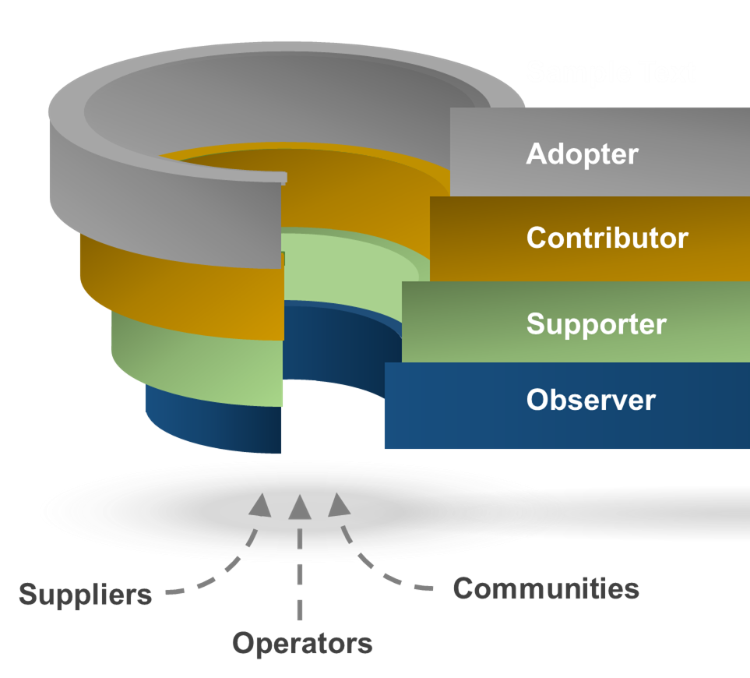
2020: Key Objectives
Levels of Engagement
Expand base of contributors
Convert observers & supporters into contributors
Achieve diversification through balanced contributions from Operators & Suppliers
Identify & recruit key industry innovators into the community
Scale to demand through increased levels of contributions
Establish base of adopters
Develop marketing strategy to inform CSP decision makers of the impact & benefits of adoption
Identify initial adopters for RA 1 & RA 2
Build business case, based on analytics, to promote wide-scale adoption
In order to deliver on CNTT objectives, community members need to fully engage & contribute to the work streams
Engagement includes support, contributions, adoption of artifacts, issue ownership & resolution
8

Slide 9
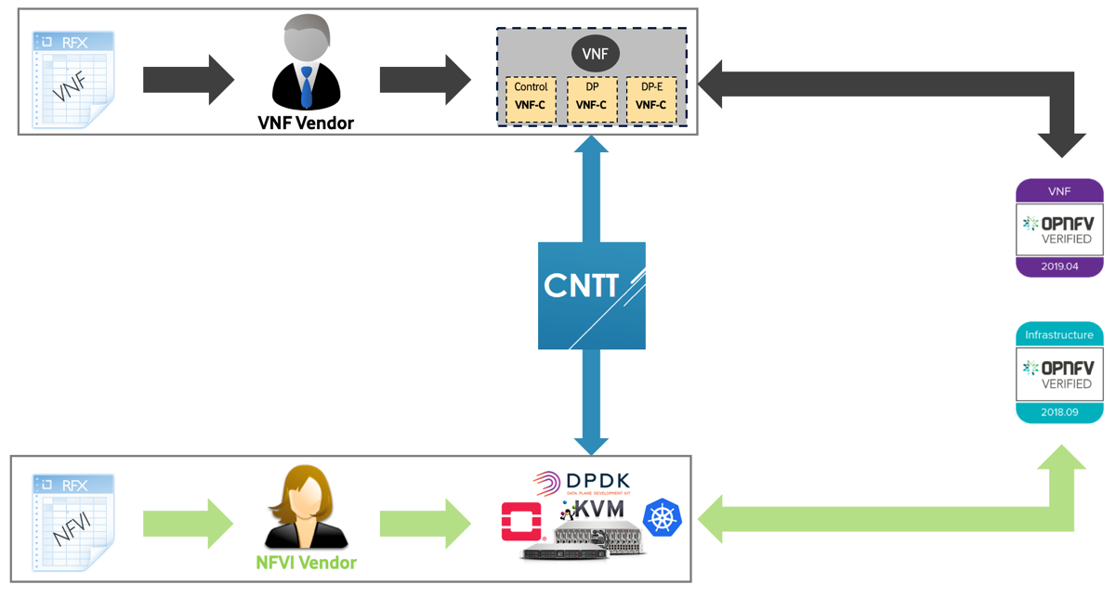
2020: Key Objectives - Cont
Achieve Full Industry Alignments
E-E Framework
Achieve full industry alignment with Key players such as OPNFV, CNCF, OVP, GSMA, etc.
Agree on a Release Cadence that aligns with the industry.
Create a clear technical transitional plan for both operators and vendors.
Identify Gaps and work in the industry to address them.
Establish E2E Framework
Enrich OVP Program and provide higher Bar of verification and testing.
Support OVP Phase 2 with a clear strategy for Containers based Verification and Certification.
Support Industry Badging programs.
In order to deliver on CNTT objectives, various industry communities need to fully align in objectives and approach.
Engagement includes support, contributions, adoption of artifacts, issue ownership & resolution
9

Slide 10





CNTT | Expected Outcome
OVP
VNF
Vendor
VNF
Compute flavour
Control
DP
DP
S
M
L
B
N
N
VNF-C
VNF-C
VNF-C
Instance type
Reference Architecture
NFVI Vendor
NFVI Vendor
Vendor B
NFVI Implementation
Vendor A
Reference Architecture
NFVI Implementation
Instances
Catalogue
Instance Type
Compute flavour
Reference Architecture
Reference Implementation
Reference Model
RM
Reference Architecture(s)
RA
NFVI Implementation
& RI
Reference Certification
RC

Slide 11

CNTT | Current Specs
Reference Architecture
RA 1
Reference Implementation
RI 1
Reference Certification
RC 1
OVP
OpenStack Based
Specification
Guidelines
Gap analysis.
Innovation
Install & Lab Requirements
Playbook (Cookbook)
Gap analysis.
Development Planning
Framework & Testcases Requirements
Playbook (Cookbook)
Gap analysis.
Development Planning.
Reference Model
RM
Requirements.
Guidelines
Reference Architecture
RA 2
Cloud Native
Specification
Guidelines
Gap analysis.
Innovation

Slide 12


CNTT | Roadmap
Pre-alpha releases
alpha releases
RC1
v1.0-pre-alpha
RC1
v1.0-alpha
RC1
v1.0
Reference Model
RI1
v1.0-alpha
RI1
v1.0
RI1
v2.0-alpha
RI1
v2.0
Reference Architecture
Reference Implementation
RA2
v1.0-alpha
RA2
v1.0
RA2
v2.0-alpha
RA2
v2.0
Reference Certification
RA1
v2.0-alpha
RA1
v2.0
RA1
v3.0-alpha
RA1
v3.0
Stable
Released!
RM
v3.0-alpha
RM
v3.0
RM
v3.x
RM
v3.x
Stable
Botrange
Snezka
TBD
TBD
TBD
Sep
Oct
Nov
Dec
Jan
Feb
Mar
Apr
May
Jun
Jul
Aug
Sep
Oct
Nov
Dec
2019
2020

Slide 13



CNTT | How to Contribute
https://github.com/cntt-n/CNTT
https://cntt-n.github.io/CNTT/
https://github.com/cntt-n/CNTT/wiki
Reference Model
RM
https://github.com/cntt-n/CNTT/tree/master/doc/ref_model
Reference Architecture
RA
https://github.com/cntt-n/CNTT/tree/master/doc/ref_arch
Reference Implementation
RI
https://github.com/cntt-n/CNTT/tree/master/doc/ref_impl
Reference Certification
RC
https://github.com/cntt-n/CNTT/tree/master/doc/ref_cert

Slide 14


CNTT | Work Streams
CNTT Governance
Community Strategy & Oversight
Release & Lifecycle Management
Recruiting, Engagement, & Adoption
Marketing & Communications
Business | Technical Metrics
Technical F2F Workshop
Technical Steering
RM Core
RA1 Core
RA2 Core
RI 1 Core
RC NFVI
RM Ops
RA1 Ops
RA2 Ops
RI 1 Labs
RC VNF
RM Compliance
RA1 Dev
RA2 Dev
RI 1 Dev
RC Dev
Notes:
Snowdon
Cruachan

Slide 15
Common NFVI Telco Taskforce
CNTT Technical Steering Review
January 13, 2020 (11:40 – 12:30)

Slide 16
CNTT | Work Streams
CNTT Governance
Community Strategy & Oversight
Release & Lifecycle Management
Recruiting, Engagement, & Adoption
Marketing & Communications
Business | Technical Metrics
Technical F2F Workshop
Technical Steering
RM Core
RA1 Core
RA2 Core
RI 1 Core
RC NFVI
RM Ops
RA1 Ops
RA2 Ops
RI 1 Labs
RC VNF
RM Compliance
RA1 Dev
RA2 Dev
RI 1 Dev
RC Dev
Notes:
Snowdon
Cruachan

Slide 17
CNTT | Snezka Release High Level Features
RM Core
RA1 Core
RA2 Core
RI 1 Core
RC1 NFVI
✓ Supporting containers
✓ More Metrics
✓ VNF Guidelines
✓ Next Level of Details
✓ Storage
✓ Neutron Extension
✓ Acceleration
✓ Principles
✓ Requirements
✓ Initial Requirements
✓ RI Requirements
✓ NFVI Required State
✓ Installer Requirements.
✓ Labs Requirements.
✓ E2E NFVI Frwk Requirements
✓ NFVI Test Cases Requirements.
✓ Test Cases Traceability.
RM Ops
RA1 Ops
RA2 Ops
RI 1 Labs
RC1 VNF
✓ Ops & LCM Requirements.
✓ Security Requirements.
✓ Ops & LCM.
✓ Security.
✓ APIs.
✓ Ops & LCM
✓ Security.
✓ APIs.
✓ Lab Models.
✓ Labs Playbook.
✓ E2E VNF Frwk Requirements
✓ VNF Test Cases Requirements.
✓ Test Cases Traceability.
RM Compliance
RA1 Dev
RA2 Dev
RI 1 Dev
RC1 Dev
✓ Certification Requirements.
✓ Badging Requirements.
✓ E2E Frmwrk Requirements.
✓ Gap analysis.
✓ HW Accel Interfaces.
✓ Gap analysis.
✓ Standard Interfaces.
✓ Multi-Tenancy.
✓ Operating Model.
✓ Installation Playbook.
✓ User Manual.
✓ Gaps Analysis.
✓ Certification Playbook.
✓ User Manuals.
✓ Tests Traceability.
✓ Gaps Analysis.
Full Roadmap here: https://wiki.lfnetworking.org/display/LN/CNTT+Snezka

Slide 18
CNTT | Work Stream Leads/Co-Leads
RM Core
RA1 Core
RA2 Core
RI 1 Core
RC1 NFVI
Leads
Mark Shostak (AT&T)
Kelvin Edmison (Nokia)
Ulrich Kleber (Huawei)
Leads
Pankaj Goyal (AT&T)
Ian Gardner (Vodafone)
Leads
Tom Kivlin (Vodafone)
Gergely Csatari (Nokia)
Peter Woerndle (E///)
Xu Yang (Huawei)
Leads
Fu Qiao (China Mobile)
Leads
Mike Fix (AT&T)
Rajesh Rajamani (Spirent)
Dan Xu (Huawei)
RM Ops
RA1 Ops
RA2 Ops
RI 1 Labs
RC1 VNF
Leads
Ahmed ElSawaf (STC)
Beth Cohen (Verizon)
Leads
Karine Sevilla (Orange)
Ian Gardner (Vodafone)
Leads
Tom Kivlin (Vodafone)
Mike Bustamente (AT&T)
Walter Kozlowski (Telstra)
Leads
Rajesh Rajamani (Spirent)
Leads
Mike Fix (AT&T)
Kanagaraj Manickam (Huawei)
Yan Yang (China Mobile)
RM Compliance
RA1 Dev
RA2 Dev
RI 1 Dev
RC1 Dev
Leads
Victor Gao (Huawei)
Yan Yang (China Mobile)
Leads
Sukhdev Kapur (Juniper Networks)
Leads
Rabi Abdel (VF)
Pankaj Goyal (AT&T)
Sukhdev Kapur (Juniper Networks)
Leads
Cedric Ollivier(Orange)
Rex Lee (Huawei)
Lei Huang (China Mobile)
Leads
Cedric Ollivier(Orange)
Kanagaraj Manickam (Huawei)
Yan Yang (China Mobile)

Slide 19
CNTT | The Community

Slide 20

CNTT | Workstreams Details – RM & RI
RA1 Core
NFVI
Target Architecture
VNF/CNF
app
RA1 Ops
RM Core
Reference Architecture
RA 1
Interfaces, LCM, Security
Infrastructure Abstraction
RA – Appendix
Exceptions
RA1 Dev
RM Ops
Reference Model
RM
Gaps & Development
Interfaces & LCM, Security
RM – Appendix
Exceptions
RM Compliance
RA – Appendix
Exceptions
RA2 Core
Verification & Certification
Requirements
Target Architecture
Reference Architecture
RA 2
RA2 Ops
Interfaces, LCM, Security
RA2 Dev
Gaps & Development
NFVI

Slide 21
CNTT | Workstreams Details – RI
Reference Model
RM
Reference Architecture
RA 1
RI1 Core (Requirements)
RI1 Labs (Operations)
Self
Ch02: Overall Req
Ch03: Target State
Ch05: Installer Req
Ch04:
Labs Req
Ch06:
Ops (Cookbook)
LaaS
Community
Labs
RI1 Dev (Gaps & Development)
Community Installers
Vendors/ Third Party Installers
Ch07: Integration (Cookbook)
Ch08:
Gaps & Development
Airship
Triple-O
Labs

Slide 22
CNTT | Workstreams Details – RC
Reference Model
RM
Reference Architecture
RA 1
RC1 NFVI (Requirements & Traceability)
RC1 VNF (Requirements & Traceability)
Ch02: Framework Req
Ch03:
TC Req
Ch04: TC Trackability
Ch05: Framework Req
Ch06:
TC Req
Ch07: TC Trackability
Community Tools
Community Test Project
Community Test Project
Community Tools
Ch09: NFVI Testing
Traceability
Ch08: Integration
Cookbook
Ch11: Gaps &
Development
Ch10: VNF Testing
Traceability
RC1 Dev (Gaps & Development)

Slide 23
CNTT | Introducing New Technical Workstream
A new Work Stream Proposal has to be created and should contain the following information:
  The nature (Architecture, Implementation, Certification, else).
  Scope & Roadmap.
  Relation to other WS.
  Contributors List.
New Work Stream has to be Endorsed from at least 2 service providers and 2 vendors.
New Work Stream proposals need to be approved by the Technical Steering Committee during their regular meetings.
New Work Stream proposals need to be approved and signed off by Governance Steering Committee during their regular meetings.
https://github.com/cntt-n/CNTT/blob/master/doc/gov/chapters/chapter03.md#34-new-work-streams-policy

Slide 24



CNTT | NFVI Testing and Certification
CVC
Reference Implementation
RI 1
Award
NFVI
Vendor
Install NFVI
Community Installers
Golden/Ref VNF
OVP Portal
Labs
NFVI
Airship
Triple-O
CVC
Community Test Project
Community Tools
Submit Results
Reference Certification
RC 1

Slide 25
CNTT | VNF Testing and Certification
Reference Implementation
RI 1
Award
VNF
VNF
Vendor
Community Installers
app
CVC
VNF
NFVI
app
Airship
Labs
Triple-O
CVC
Community Test Project
Community Tools
Submit
OVP Portal
Submit
VNF Testing Tool(s)
Reference Certification
RC 1

Slide 26
CNTT | Release Cadence
Q4 ’19
Q1 ’20
Q2 ’20
Q3’ 20
Q4 ’20
Q1 ’21
Start with Relatively new and stable OpenStack Release.
Only upgrade when there is a real need to (major features) and at least 2 years before upgrading.
Only the latest Two OpenStack releases are expected to be supported by OVP program..
Stein
or Train
?
At least two years before upgrading
?
Botrange
Snezka
Palooza
TBN
TBN
TBN
…
TBN
TBN
TBN
TBN
OVP
Rel2
Rel3
Please Attend Jonathan Session

Slide 27
CNTT | Current Contribution Process
Community
Discussing best form of Action.
1
Issue created
2
Issue
assigned to committer
3
PR Created
WSL
Committer
To make sure process is followed
Can request for Additional Community Approvals
Approval Process
4
Committer
Committer A Operator/Vendor ✓
TSL Approval
WSL Approval
TSL ✓
WSL ✓
…
PR reached consensus & approved
5
PR being reviewed & Edited
Individuals
Committer X Operator/Vendor ✓
2 business days cool off period
Community
At least one Community Approval
Reflecting community
feedback
If no consensus reached
PR Merged
6
Discuss and/or Vote
Technical Steering Meeting
5A

Slide 28
CNTT | Feedback
Is there enough contribution from the community?
Is the contribution process fit for purpose?
How can we improve?
Any Particular Feedback?

Slide 29
Common NFVI Telco Taskforce
Governance WS: Key Updates
January 14, 2020 (11:00 – 11:45)

Slide 30
CNTT | Governance WS: Key Updates
Use Mark C Slides

Slide 31
Common NFVI Telco Taskforce
Telco | Partner Adoption
January 14, 2020 (11:45 – 12:30)

Slide 32
CNTT | Work Streams
CNTT Governance
Community Strategy & Oversight
Release & Lifecycle Management
Recruiting, Engagement, & Adoption
Marketing & Communications
Business | Technical Metrics
Technical F2F Workshop
Technical Steering
RM Core
RA1 Core
RA2 Core
RI 1 Core
RC NFVI
RM Ops
RA1 Ops
RA2 Ops
RI 1 Labs
RC VNF
RM Compliance
RA1 Dev
RA2 Dev
RI 1 Dev
RC Dev
Notes:
Snowdon
Cruachan

Slide 33
CNTT | Telco | Partner Adoption
Current Onboarding Model.
Proposed Onboarding Model with CNTT.
Expectation from Operators.
Expectations from Vendors.
Expectations from Open Source Communities.
More discussion about transitional plans on Day 4.

Slide 34




CNTT | Traditional Onboarding
RFX
VNF
RFX
VNF
VNF
RFX
Control
DP
VNF
VNF
RFX
DP-E
VNF-C
VNF-C
VNF
Control
DP
VNF-C
VNF
RFX
VNF Vendor
DP-E
VNF-C
VNF-C
VNF
Control
DP
VNF-C
VNF
VNF Vendor
DP-E
VNF-C
VNF-C
VNF-C
VNF
VNF Vendor
Control
DP
DP-E
VNF-C
VNF-C
VNF-C
VNF Vendor
Control
DP
DP-E
VNF Vendor
VNF-C
VNF-C
VNF-C
Design & Implementation
Design & Implementation
Design & Implementation
Design & Implementation
Design & Implementation
RFX
RFX
NFVI
RFX
NFVI
RFX
NFVI Vendor
NFVI
RFX
NFVI Vendor
NFVI
NFVI Vendor
NFVI
NFVI Vendor
NFVI Vendor

Slide 35
CNTT | Onboarding with CNTT
RFX
VNF
RFX
VNF
VNF
RFX
Control
DP
VNF
VNF
RFX
DP-E
VNF-C
VNF-C
VNF
Control
DP
VNF-C
VNF
VNF Vendor
DP-E
VNF-C
VNF-C
VNF-C
VNF
VNF Vendor
Control
DP
DP-E
VNF-C
VNF-C
VNF-C
VNF Vendor
Control
DP
DP-E
VNF Vendor
VNF-C
VNF-C
VNF-C
RFX
RFX
NFVI
RFX
NFVI
RFX
NFVI Vendor
NFVI
NFVI Vendor
NFVI
NFVI Vendor
NFVI Vendor

Slide 36
CNTT | The need for a transition Plan
VNFs are not ready yet to be cloud native.
VNFs/CNFs still have hardware decencies.
There are still technical challenges to move to cloud native (such as performance/latency, state, load balancing).
We need a transition Plan.
Current State
Target State

Slide 37

CNTT | Transition Plan – Levels of Conformance
PR#
893
VNF/CNF
app
NFVI
Fully Conformant: VNFs/CNFs or NFVI are written and designed to be fully conformant to CNTT specs with no use of any of the allowed Exceptions.
Conformant with Exceptions: VNFs/CNFs or NFVI are written and designed to be conformant to CNTT with one or more of the allowed Exceptions used.
Technology Exceptions : Using specific technologies that are considered non conformant to CNTT principles (such as PCIe Direct Assignment, exposure of hardware features to VNFs/CNFs).
Version Exceptions: Using Versions of Software components, , APIs, or Hardware that are different from the one specified in the Specs.

Slide 38
CNTT | Transition Plan – VNF/CNFs
VNF/CNF
VNF/CNF
VNF/CNF
Fewer Exceptions will be allowed in different CNTT releases.
For each CNTT Release, VNF/CNF can be either:
  Fully Conformant: No Exception used.
  Conformant with Exception: One or More of the allowed Exceptions in RM has been used.
app
app
app
RM – Target
CNTT REL 1
CNTT REL 2
CNTT REL 3
RM – Appendix-a
VNF/CNF Transition Generations
Exceptions
Exceptions
Exceptions
Exception Item 1
Exception Item 2
Exception Item 3
Exception Item 1
Exception Item 2
Exception Item 1
Roadmap

Slide 39
CNTT | Transition Plan – NFVI
CNTT REL 1
CNTT REL 2
CNTT REL 3
Less Exceptions will be allowed in different CNTT releases.
For each CNTT Release, NFVI can be either:
  Fully Conformant: Support Target Architecture with all RM Exceptions supported. There should be a technology choice in RA to support RM Exceptions. However, none of the Exceptions allowed in RA has been used.
  Conformant with Exceptions: One or more of the allowed exceptions in RA are used.
Roadmap
RA – Appendix-a
Exceptions
Exceptions
Exceptions
Exception Item 1
Exception Item 2
Exception Item 3
Exception Item 1
Exception Item 2
Exception Item 1
RA – Target
NFVI
NFVI
NFVI

Slide 40
CNTT | Transition Plan – Exceptions Policies
RM – Target
RA – Target
Core Components
RM – Appendix-a
Exceptions
Exception Item 1
Exception Item 2
Exception Item 3
Plugins/Extensions
RA – Appendix-a
RA Core Components are designed to fulfill RM-Target requirements..
Exception Items in RM are supported by RA through plugins/Extensions.
Fully Conformant NFVI must be able to run any VNFs/CNF (wither uses RM exceptions or not) with zero change in VNFs/CNFs.
Exceptions
Exception Item 1
Exception Item 2
Exception Item 3

Slide 41
CNTT | Adoption & Roadmap
More on Day 4 (9:00 – 10:30).

Slide 42
Common NFVI Telco Taskforce
OVP Ph2.0
January 14, 2020 (14:00 – 15:30)

Slide 43
CNTT | OVP Phase 2.0
https://etherpad.opnfv.org/p/OVPp2_Kickoff

Slide 44
Common NFVI Telco Taskforce
Beyond Snezka
January 14, 2020 (16:00 – 16:45)

Slide 45
CNTT | Beyond Snezka
What would you like to see?

Slide 46
Common NFVI Telco Taskforce
Community Structure, Methods, & Tools
January 15, 2020 (9:45 – 11:45)

Slide 47

CNTT | Consensus-based Decision Making
PR#
897
Goal is ALWAYS to get consensus on EVERYTHING
✓ Physically Attended at least ONE F2F Workshop in the past 6 months.
✓ Attended at least FIVE CNTT Meetings in the past 3 months.
✓ Provided enough Contributions into GitHub.
Voting
Representative
https://github.com/cntt-n/CNTT/blob/master/doc/gov/chapters/chapter05.md#52-voting-representatives
No consensus reached!
A
Tech/Gov Steering Meeting
50% Votes Needed!

Slide 48
CNTT | Nomination and Selection
PR#
896
One Lead and up to two Co-leads positions are available per each WS
Any individual can nominate someone else for a lead/co-lead position (requires acceptance from the nominee)
Any individual can self nominate themselves for a Lead/Co-Lead position as long they agree to CNTT ToR.
One individual can self-nominate themselves to as many positions as they like.
Nomination deadline will be determined by Technical or Governance Steering (depending on the nature of the WS)
No voting will be required if number of nominations received less than available positions.
Online Voting process will take place to select candidate(s) from the nominee list for any given position .
Only Voting representatives can vote (from the up to date voting representative list).
Candidate(s) who receives the highest number of votes wins.
Terms will last for 1 calendar year with voting for all WS to beginning End of January. (next election will be January 2021).
In case a Lead/Co-Lead steps down, an interim person (proposed by the person who is stepping down) will take over until
next available election.
For new Work Streams, a new Lead/Co-Leads will be assigned by Technical Steering/Governance Steering to be interim until next
available election.
https://github.com/cntt-n/CNTT/blob/master/doc/gov/chapters/chapter04.md#4-nomination-and-selection

Slide 49
Common NFVI Telco Taskforce
CNTT Roadmap
January 15, 2020 (16:00 – 17:00)

Slide 50
2020: Key Objectives
Levels of Engagement
Expand base of contributors
Convert observers & supporters into contributors
Achieve diversification through balanced contributions from Operators & Suppliers
Identify & recruit key industry innovators into the community
Scale to demand through increased levels of contributions
Establish base of adopters
Develop marketing strategy to inform CSP decision makers of the impact & benefits of adoption
Identify initial adopters for RA 1 & RA 2
Build business case, based on analytics, to promote wide-scale adoption
In order to deliver on CNTT objectives, community members need to fully engage & contribute to the work streams
Engagement includes support, contributions, adoption of artifacts, issue ownership & resolution
50

Slide 51
2020: Key Objectives - Cont
Achieve Full Industry Alignments
E-E Framework
Achieve full industry alignment with Key players such as OPNFV, CNCF, OVP, GSMA, etc.
Agree on a Release Cadence that aligns with the industry.
Create a clear technical transitional plan for both operators and vendors.
Identify Gaps and work in the industry to address them.
Establish E2E Framework
Enrich OVP Program and provide higher Bar of verification and testing.
Support OVP Phase 2 with a clear strategy for Containers based Verification and Certification.
Support Industry Badging programs.
In order to deliver on CNTT objectives, various industry communities need to fully align in objectives and approach.
Engagement includes support, contributions, adoption of artifacts, issue ownership & resolution
51

Slide 52








CNTT | 2020 Governance Roadmap
Targeted
Complete
In Progress
Not Started
Deliverable | Key Initiatives | Delivery Timeframe |  |  |  | Initialize | Develop | Approve | Deliver | Comment
 |  | Q1 | Q2 | Q3 | Q4+
 | CNTT Community Guidelines |  |  |  |  |  |  |  |  | Onboarding, org structure, nominating, decision-making
 | Reference Model into GSMA PRD |  |  |  |  |  |  |  |  | PRD = Permanent Reference Document
 | ONES NA 2020 Planning (4/20-4/21) |  |  |  |  |  |  |  |  | Los Angeles, CA, USA
 | Reference Certification 1 Rollout Strategy | Phase 1 | Phase 2 | Phase 3 |  |  |  |  |  | (P1)Alpha, (P2)Beta, (P3)General Availability
 | LFN DDF/CNTT F2F Planning (6/XX-6/XX) |  |  |  |  |  |  |  |  | TBD
 | VNF/CNF Adoption & Badging Strategy |  |  |  |  |  |  |  |  | Phasing TBD
 | ONES Europe 2020 Planning (9/29-9/30) |  |  |  |  |  |  |  |  | Antwerp, Belgium
 | Release & Lifecycle Management |  |  |  |  |  |  |  |  | Phasing TBD
 | CNTT Business I Technical Analytics | Phase 1 | Phase 2 | Phase 3 |  |  |  |  |  | (P1)Engagement, (P2)Adoption, (P3) Quality & Value
Prague*
Prague*
Prague*
* Pending community alignment
Document
Operations
F2F Event

Slide 53
CNTT | 2020 Governance Roadmap
Targeted
Complete
In Progress
Not Started
Deliverable | Key Initiatives | Delivery Timeframe |  |  |  | Initialize | Status | Comment
 |  | Q1 | Q2 | Q3 | Q4+
 | CNTT Reference Model |  |  |  |  |  |  | Reference Model Specification Releases
 | CNTT Reference Architecture 1 |  |  |  |  |  |  | OpenStack Reference Architecture Spec Releases
 | CNTT Reference Architecture 2 |  |  |  |  |  |  | K8s Reference Architecture Spec Releases
 | CNTT Reference Implementation 1 |  |  |  |  |  |  | OPNFV Reference Implementation Req and Cookbook Releases
 | CNTT Reference Certification 1 |  |  |  |  |  |  | LFN Reference Certification Req and Cookbook Releases
 | Reference Implementation 1 Launch |  |  |  |  |  |  | Official initial Launch
 | Accommodating OVP Program |  |  |  |  |  |  | NFVI Badging. VNF Badging programs
 | Accommodating OVP Ph2 Program |  |  |  |  |  |  | Cloud Native Badging Program
 | Complete Alignement with SDO |  |  |  |  |  |  | Alignments with Main SDOs
3.0a
3.0
3.1
3.2
2.0a
2.0
3.0a
3.0
1.0a
1.0
2.0a
2.0
1.0a
1.0
2.0a
2.0
1.0aa
1.0a
1.0
NFVI
VNF
Prague*
OPNFV
CNCF
* Pending community alignment
Document
Operations
F2F Event

Slide 54
CNTT | Roadmap
Pre-alpha releases
alpha releases
RC1
v1.0-pre-alpha
RC1
v1.0-alpha
RC1
v1.0
Reference Model
RI1
v1.0-alpha
RI1
v1.0
RI1
v2.0-alpha
RI1
v2.0
Reference Architecture
Reference Implementation
RA2
v1.0-alpha
RA2
v1.0
RA2
v2.0-alpha
RA2
v2.0
Reference Certification
RA1
v2.0-alpha
RA1
v2.0
RA1
v3.0-alpha
RA1
v3.0
Stable
Released!
RM
v3.0-alpha
RM
v3.0
RM
v3.x
RM
v3.x
Stable
Botrange
Snezka
TBD
TBD
TBD
Sep
Oct
Nov
Dec
Jan
Feb
Mar
Apr
May
Jun
Jul
Aug
Sep
Oct
Nov
Dec
2019
2020

Slide 55
CNTT | CNTT Roadmap
See “Beyond Snezka slide”.

Slide 56
Common NFVI Telco Taskforce
CNTT Recruiting & Adoption
January 16, 2020 (9:00 – 11:00)

Slide 57
CNTT | Recruiting & Adoption
Recruiting.
Adoption.
Roadmaps.

Slide 58
CNTT | Recruiting – Purpose & Objectives
Expand CNTT community with new participants, plus more support from existing contributors
  Develop more contacts in the Open Source, telecom and vendor communities
  Identify new groups and market verticals to target
Encourage more engagement from contributing companies
  Need buy-in from broader community of companies to support CNTT goals
  As the project expands, more opportunities for developers and vendors to contribute
General adoption of CNTT badged architectures and modals
  Become the de facto standard for NFVI deployments
  Gain buy-in from operators and vendors alike
58

Slide 59
CNTT | Recruiting - Progress to Date | Key Accomplishments
Key Accomplishments to Date
Issues | Challenges
CNTT Community Growth
  From May 2019 initial group of 12 from 6 companies to over 312 from 59 organizations
Community Engagement
  Over 300 pages of documentation and content
  Planning first lab testing of reference deployments
Adoption of CNTT
  68 google hits for CNTT news items (published stories, video interviews, etc.)
  7 conference presentations (Layer123, Kubecon, ONS, etc.)
Need better messaging collateral (marketing)
Resources to get the message out to the larger telecom community
Methods for reaching beyond the usual suspects
Overcome skepticism about the potential of the CNTT project
59

Slide 60

















CNTT | Recruiting - Planned Deliverables | Roadmap
Increase outreach efforts
  Work on methods for establishing buy-in from broader community of companies to support CNTT goals
  As the project expands, more opportunities for developers and vendors to contribute
  Develop more collateral materials to support outreach
Increase support for CNTT activities/badging
  Push community to make CNTT the de facto standard for NFVI deployments
  Gain buy-in from operators and vendors alike
60

Slide 61
CNTT | Adoption
Adoption – Transition Plan
Expectation From Operators.
Expectations From Vendors.
Expectations from Industry.

Slide 62
CNTT | Adoption - Expectation from Operators
Text.
Text.
Text.

Slide 63
CNTT | Adoption - Expectation from Vendors
Text.
Text.
Text.

Slide 64
CNTT | Adoption - Expectation from Industry
Text.
Text.
Text.

Slide 65
CNTT | Roadmaps
Roadmaps.

Slide 66
Common NFVI Telco Taskforce
GSMA Documentations Plans
January 16, 2020 (11:45 – 12:30)

Slide 67
CNTT | GSMA Documentation Plans
Reference Model.
Reference Architectures (RA-1, RA-2, future).

Slide 68
Backup

