Slide 1
Common NFVI Telco Taskforce
Business | Technical Metrics Planning (Final)
CNTT F2F Workshop
LFN DDF, Prague, Czech Republic
Jan. 13th – 16th , 2020

Slide 2
CNTT | Discussion
Introduction
Proposed Key Metrics 2020
Data Analytics
Repos
Measuring Quality and Value

Slide 3
CNTT | Discussion – Business | Technical Metrics
What are we doing?
  Developing metrics for measuring quality, value, and realization of benefits of badging to RAx standards
  Proposing Key Metrics for 2020
  Designing and building data analytics tools
Why are we doing it?
  Gather feedback on approach, metrics, and data.
  Provide insights to support CNTT mission and goals.

Slide 4
CNTT | Proposed Key Metrics 2020 – Governance
# | Function, Segment | Targeted Benefits | Metric | Priority (Urgency) | Data Source(s) | Benchmark | 2020 Target | Future
1 | Engagement | Increase engagement of community members | Code/content contribution rates - by company | 1 | GitHub, Groups.io, Confluence | wip | wip | wip
2 |  |  | Code/content contribution rates - by individual | 1 | GitHub, Groups.io, Confluence | wip | wip | wip
3 | Recruiting | Increase acquisition of community members | New member acquisition rate - by company | 2 | Onboarding | wip | wip | wip
4 |  |  | New member acquisition rate - by individual | 2 | Onboarding | wip | wip | wip
Priorities will be revised once we start measuring adoption & deployments

Slide 5
CNTT | Proposed Key Metrics 2020 – Governance
ID # | Function, Segments | Targeted Benefits | Metric | Priority (Urgency) | Data Source(s) | Benchmark | 2020 Target | Future
5 | Engagement by Lab Type | Increase options to obtain badging | # of Community labs | 2 | wip | wip | wip | wip
6 |  |  | # of Self-Service labs | 2 | wip | wip | wip | wip
7 |  |  | # of LAAS labs | 2 | wip | wip | wip | wip
8 | Adoption | Increase adoption | rate of adoption of RAx - by company type | 2 | wip | wip | wip | wip
9 |  |  | rate of badges issued - by company type | 2 | wip | wip | wip | wip

Slide 6
CNTT | Proposed Key Metrics 2020 – Technology
ID # | Function Segments | Targeted Benefits | Metric | Priority | Data Source(s) | Benchmark | 2020 Target | Future
10 | Certification: Service Providers | Reduce costs | TCO Analysis Needed | 2 | wip | wip | wip | wip
11 |  | Accelerate time to deployment for new network services | # of weeks to deploy VNF product x into lab (or deployment) | 3 | wip | wip | wip | wip
12
 |  | Improve interoperability and software quality | (TBD: criteria: technical, evolutionary, configuration, security, operations performance?) | 1 | wip | wip | wip | wip
13 |  | Reduce in-house testing effort | # of weeks to test VNF product in lab to deploy (time to productivity) | 3 | wip | wip | wip | wip

Slide 7
CNTT | Proposed Key Metrics 2020 – Technology
ID # | Function Segments | Targeted Benefits | Metric | Priority (Urgency) | Data Source(s) | Benchmark | 2020 Target | Future
14 | Certification: Vendors | Achieve greater alignment with service provider customer requirements | % of VNFs badged - by company | TBD | wip | wip | wip | wip
15 |  | Demonstrate product quality through open ecosystem testing | # of badges issued - by company | TBD | wip | wip | wip | wip

Slide 8
Common NFVI Telco Taskforce
Data Analytics

Slide 9
CNTT | Data Analytics – Platforms
Current – Alpha testing versions only
  Cauldron, https://cauldron.io/dashboard/298 (Bitergia)
    Current: count of GitHub Contributor commitments
    Future: TBD
  Stackalytics, www.stackalytics.com (Mirantis)
    CNTT GitHub Commits by Company
  Bitergia, legacy platform used by OPNFV/LFN
    No CNTT specific engagement parsed, but CIRV work assumed to be underlying the data
Future
  LFV Developer Analytics – new LFN platform
    CNTT to be POC / Pilot
    Ability to aggregate/clean disparate data sources, detailed visualizations, etc.

Slide 10
CNTT | Data Sources – Operating Repos
  GitHub (Current)
  https://github.com/cntt-n/CNTT
  Groups.io (Future Enhancement)
  https://lists.opnfv.org/g/cntt-gov
  https://lists.opnfv.org/g/cntt-ref-imp
  https://lists.opnfv.org/g/cntt-tech-refa
  https://lists.opnfv.org/g/cntt-tech-refc
  https://lists.opnfv.org/g/cntt-tech-steering
  Confluence (Future Enhancement)
  https://wiki.lfnetworking.org/display/LN/Common+NFVI+Telco+Task+Force+-+CNTT

Slide 11
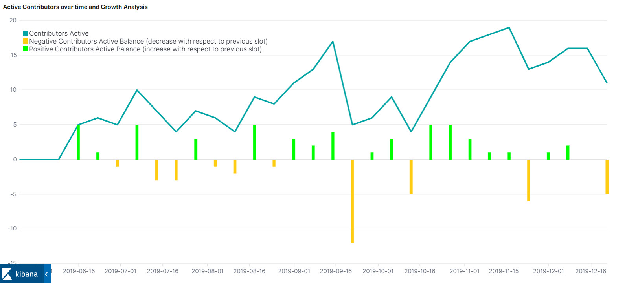
CNTT | GitHub Contributors (Cauldron)
Total Contributors
57
Jun. 1, 2019 – Dec. 20 2019
α – alpha development version only
https://cauldron.io/dashboard/298
Paris
Antwerp

Slide 12
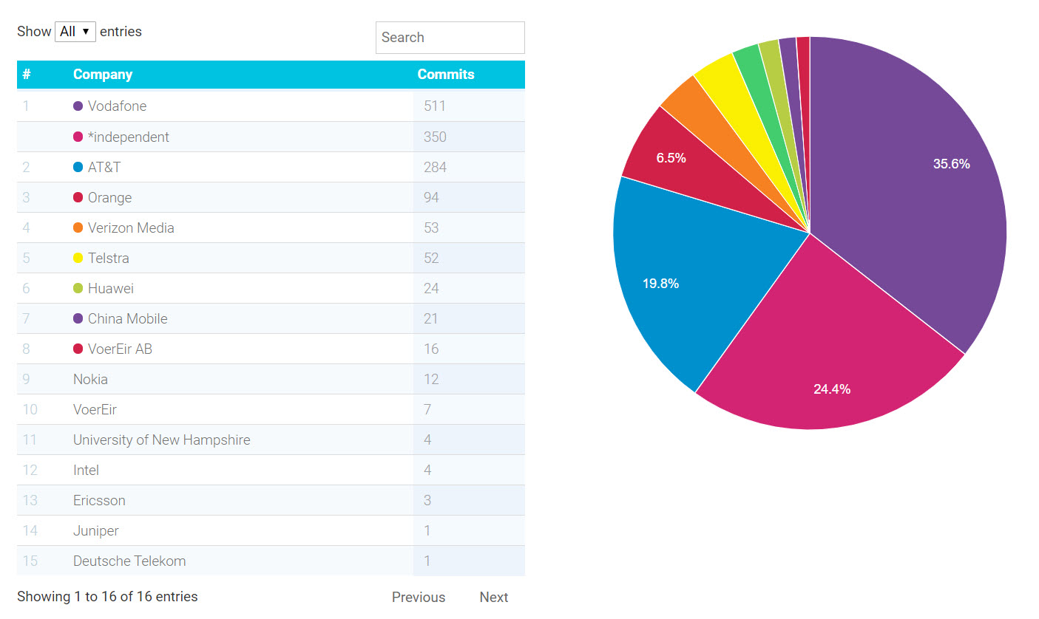
CNTT | GitHub Commits by Org (Stackalytics)
Note: this is a reflection of the CNTT Technical track only. All Governance work is not being counted, as its in Confluence.
α – alpha development version only
www.stackalytics.com

Slide 13
CNTT | Measuring Quality and Value Delivery
    As vendors;
      What should we be seeing in the RFIs and RFQs?
  Is badge required or mandatory (i.e. if you don’t have badge SPs won’t buy from you)?
  How many VNFs have badging on their product development roadmap?
  How many VNFs have badging? (Future)
Do we need surveys or polls? Anecdotal or hard data will work.

Slide 14
CNTT | Measuring Quality and Value Delivery
    As operators;
      How close are we for telcos to mandate by X date?
      How many Operators have RAx on their architectural design roadmaps?
      What common activities vis-à-vis special sauce shall we focus on measuring?
      Can we capture deployment time frames?
      When shall we expect measurable deployment results?
Do we need surveys or polls?

Slide 15
CNTT | Measuring Quality and Value Delivery
    Add’ Questions
      What about objective $$$ and or ROI
      What economic models, ROI spreadsheet(s)?
      How do we move from ‘marketing’ to ‘actual’ data?
      No public access to what it costs to deploy today.
      How shall we represent cost of testing, cost of procurement, cost of integration and customization, etc.?
This data will serve adoption messaging.

Slide 16
Common NFVI Telco Taskforce
End

