Slide 1
Common NFVI Telco Taskforce
Technical F2F Work Shop – January 13-16, 2020
Current State of the Community
Facilitator: Mark Cottrell, Rabi Abdel

Slide 2








































CNTT COMMUNITY
Note: View includes observers, supporters, & contributors
SPONSORS
2

Slide 3

CNTT: 2019 Year in Review
Community Growth
CNTT (Common NFVi Telco Taskforce) was formally established in April 2019
CNTT community membership increased 160% during 2019 to 39 companies
(up from 15 in April)
CNTT community formally sponsored by
&
in June 2019
Through recruitment, suppliers joined the CNTT community in 2019, currently @ 19 members
Community growth & diversity has increased overall momentum
Reference Model v2.0 was released in September 2019
CNTT Outcomes
1646 GitHub contributions from 37 individuals & 90 registered participants
300+ pages of published CNTT framework documentation created
Reference Architecture v1.0,
based, was released in September 2019
CNTT Reference Implementation & Certification became an official
project
in September 2019 - Common Infrastructure Realization & Validation (CIRV)
CNTT community restructured in October 2019 to enable scaling to workload demands
(23 Work Streams established)
2019 built a strong foundation for delivery of the first Reference Implementation with NFVI | VNF certification trials scheduled to begin in the spring of 2020
3

Slide 4
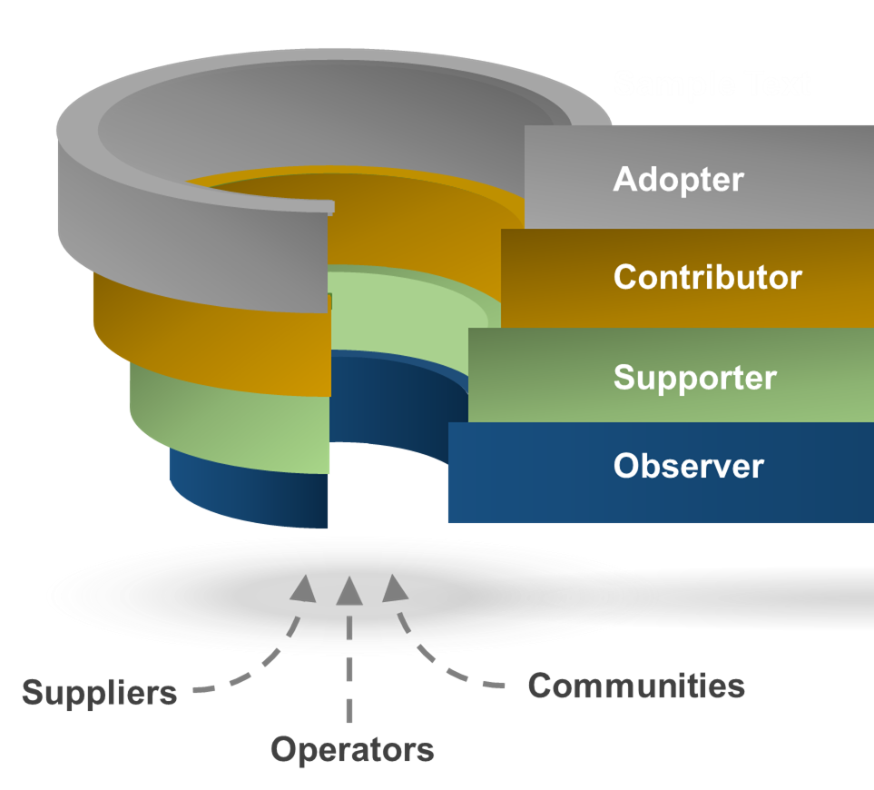
2020: Key Objectives
Levels of Engagement
Expand base of contributors
Convert observers & supporters into contributors
Achieve diversification through balanced contributions from Operators & Suppliers
Identify & recruit key industry innovators into the community
Scale to demand through increased levels of contributions
Establish base of adopters
Develop marketing strategy to inform CSP decision makers of the impact & benefits of adoption
Identify initial adopters for RA 1 & RA 2
Build business case, based on analytics, to promote wide-scale adoption
In order to deliver on CNTT objectives, community members need to fully engage & contribute to the work streams
Engagement includes support, contributions, adoption of artifacts, issue ownership & resolution
4

Slide 5
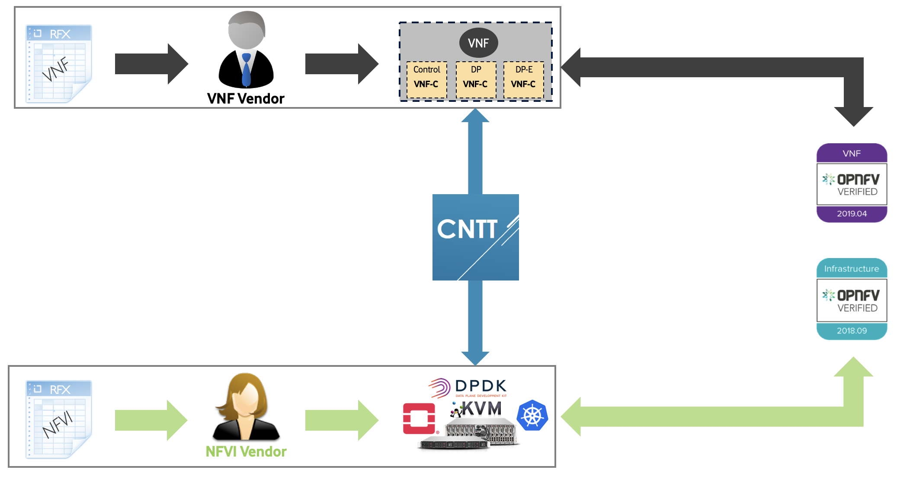
2020: Key Objectives - Continued
Achieve Full Industry Alignment
E-E Framework
Achieve full industry alignment with Key players such as OPNFV, ONAP, CNCF, OVP, GSMA, etc.
Agree on a Release Cadence that aligns with the industry.
Create a clear technical transitional plan for both operators and vendors.
Identify Gaps and work in the industry to address them.
Establish E2E Framework
Enrich OVP Program and provide higher Bar of verification and testing.
Support OVP Phase 2 with a clear strategy for Containers based Verification and Certification.
Support Industry Badging programs.
In order to deliver on CNTT objectives, various industry communities need to fully align in objectives and approach.
5

Slide 6





CNTT | Expected Outcome
OVP
VNF
Vendor
VNF
Compute flavour
Control
DP
DP
S
M
L
B
N
N
VNF-C
VNF-C
VNF-C
Instance type
Reference Architecture
NFVI Vendor
NFVI Vendor
Vendor B
NFVI Implementation
Vendor A
Reference Architecture
NFVI Implementation
Instances
Catalogue
Instance Type
Compute flavour
Reference Architecture
Reference Implementation
Reference Model
RM
Reference Architecture(s)
RA
NFVI Implementation
& RI
Reference Certification
RC

Slide 7

CNTT | Current Specs
Reference Architecture
RA 1
Reference Implementation
RI 1
Reference Certification
RC 1
OVP
OpenStack Based
Specification
Guidelines
Gap analysis.
Innovation
Install & Lab Requirements
Playbook (Cookbook)
Gap analysis.
Development Planning
Framework & Testcases Requirements
Playbook (Cookbook)
Gap analysis.
Development Planning.
Reference Model
RM
Requirements.
Guidelines
Reference Architecture
RA 2
Cloud Native
Specification
Guidelines
Gap analysis.
Innovation

Slide 8


CNTT | Roadmap
Pre-alpha releases
alpha releases
RC1
v1.0-pre-alpha
RC1
v1.0-alpha
RC1
v1.0
Reference Model
RI1
v1.0-alpha
RI1
v1.0
RI1
v2.0-alpha
RI1
v2.0
Reference Architecture
Reference Implementation
RA2
v1.0-alpha
RA2
v1.0
RA2
v2.0-alpha
RA2
v2.0
Reference Certification
RA1
v2.0-alpha
RA1
v2.0
RA1
v3.0-alpha
RA1
v3.0
Stable
Released!
RM
v3.0-alpha
RM
v3.0
RM
v3.x
RM
v3.x
Stable
Botrange
Snezka
TBD
TBD
TBD
Sep
Oct
Nov
Dec
Jan
Feb
Mar
Apr
May
Jun
Jul
Aug
Sep
Oct
Nov
Dec
2019
2020

