Slide 1
Common NFVI Telco Taskforce
Technical F2F Work Shop – January 13-16, 2020
Marketing & Communications WorkShop- Day 4
Facilitator: Johnathan Beltran, Beth Cohen, Bob Monkman
Contributions: Nick Chase

Slide 2
Initial Marketing Team Efforts- Review from Day 2
Job #1- Validate/Refine CNTT Messaging
  Survey/Direct Interview Questions Developed
  Intention is to arrange interviews with execs within CNTT stakeholder companies
  Problem Statement, Goals, Timelines, ROI criteria among the topics
  Timeline: Ready to arrange meetings now!
Refreshed Collateral will follow, based on updated messaging
  Range of Presentations (target different audiences), White Paper(s)
Building an Event Calendar & Speakers/Ambassadors
  Panels, Speaking , Collaboration Meetings, Press/Analyst Briefings, Press Releases, Social Media, Blogs
Monitor/promote CNTT contributor uptake (BTM WorkStream output)
2

Slide 3
CNTT | Adoption Message Discovery
DRAFT ONLY
How to Execute To Reach Adoption Critical Mass
Proposed High-Level Approach
Discovery
Develop set of strategic questions designed to understand and help align vision, objectives, value propositions, messaging
  $$$, Growth, etc.
Schedule meetings with high-influence executives and key technology influencers (at major events? Phone? In Person?)
  C-level / Senior / Board
Pose the strategic questions to them
Design
Analyze and identify key common business alignments
  $$$ Targets, Segments, Tech, Geographies, Companies
Define and align measures of objectives
  Timelines
  Benefits
  Specifications
Evaluate among multiple perspectives
  VNF product development lifecycle
  Operations support cost model
  What is needed year 1/3/5?
Detail who and what components are needed to execute
Execution
Individually sign-up (i.e. by name) high-influence executives and key technology influencers to sponsor and own adoption components
Get ‘pledges’ to adopt based on high-level roadmap/timeline (e.g. X% of footprint by Y date)
Identify resources and workgroups to “lead and do”
  Lead, motivate, organize, and leverage volunteers
  Leverage resources from all sectors that benefit
3

Slide 4
Survey Draft Goals
CNTT is a group is comprised of individuals and company representatives from across the Telecom ecosystem spectrum, vendors and operators alike.
It is supported by both the GSMA and the LFN organizations.
The purpose of this interview is to find out what is important to you and/or your company, in terms of NFV and NFV Infrastructure transformation projects and adoption.
The information you share will help guide the work priorities of the CNTT NFVi project.
The conversation will cover technologies, components and most importantly, what can the CNTT group do to best drive adoption and support from your company.

Slide 5
Sample Question Examples- General
Is your company or you as an individual contributing to any Open Source or Standards networking projects?
  If so, what are they? (Network standards, NFV, Edge, Infrastructure, Orchestration, Other)
What do you know about the CNTT Project?
  (Nothing, Heard the name, Have been following the progress, active in the project)
When did you first hear about the CNTT project? (from the beginning, 6 months ago, 3 months ago, within the last month, Just now)
If you have contributed, how has your company contributed to the project?
  Check as many as apply: (Reviewing documentation, writing docs, attending online, F2F meetings, writing code/tests, admin, other)
What impressions about how effective the CNTT may be, thus far? What can you share?

Slide 6
Sample Question Examples- Technology
Technology Questions
Does your company have a technology transformation plan?
  If yes, how far along on the plan are you?
    (Planning, POC, deployment, production, BAU operational)
  If no, Do you have any plans and when would you start?
    (Within 3 months, 3-6 months, 6-12 months, 18 months or more, not planning yet?)
What parts of the CNTT technical efforts are of the most interest to you or your company? (Reference Models, Architecture Models, Deployment Models, Testing and Certification, Other)
Are you finding that multiple NFVI platforms are needed to accommodate VNF integration?
  Are you ending up adopting bespoke virtual appliances? (i.e. every VNF need its own NFVi platform?)
Are there other technology issues impeding your network transformation goals that we should be addressing with this project?

Slide 7
Sample Question Examples- Adoption
Business case – how will a network drive revenue, cost reduction, cost avoidance, customer experience, compliance value-add?
  What else? Specifically for individuals and companies, or in aggregate?
What is your most important reasons for undertaking a network transformation project?
  (Metrics – what would you use to objectively measure the success or failure of a Common NFVI transformation project?
Has your team quantified the economic impact of a network transformation project?
  If yes, what percentage of savings are you anticipating? (<5%, 5-10%, 10-20%, >20%
  What ROI are you expecting? (<1 year, 1-2 years, 2-3 years, >3 years)
Stakeholders – who would be interested in the results here in the broad context? What parts of supply chain?
How is CNTT strategy decided at your company? Do you require executive sponsorship, or ?
What business challenges do you see impacting your adoption of a network transformation project?

Slide 8
Collateral & Outreach
We have some good starting presentations
  We would like to create 30 Sec- 3 Min- 30 Minute versions
  Targeting different audiences
  Need to coordinate with Recruitment team
We would like to drive a White Paper
  Starting with a base of Chapter 1 Reference Model? Ideas?
Develop Event plan social media plan with leadership & LF…
  Ideas?

Slide 9
Appendix

Slide 10
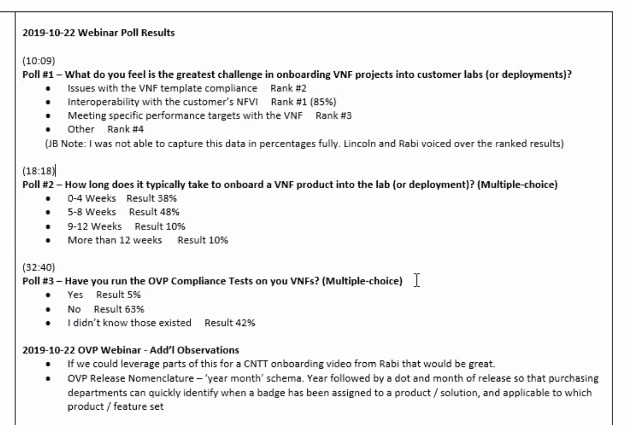
Q42019 Webinar Poll results… speak to Problem Statement

Slide 11
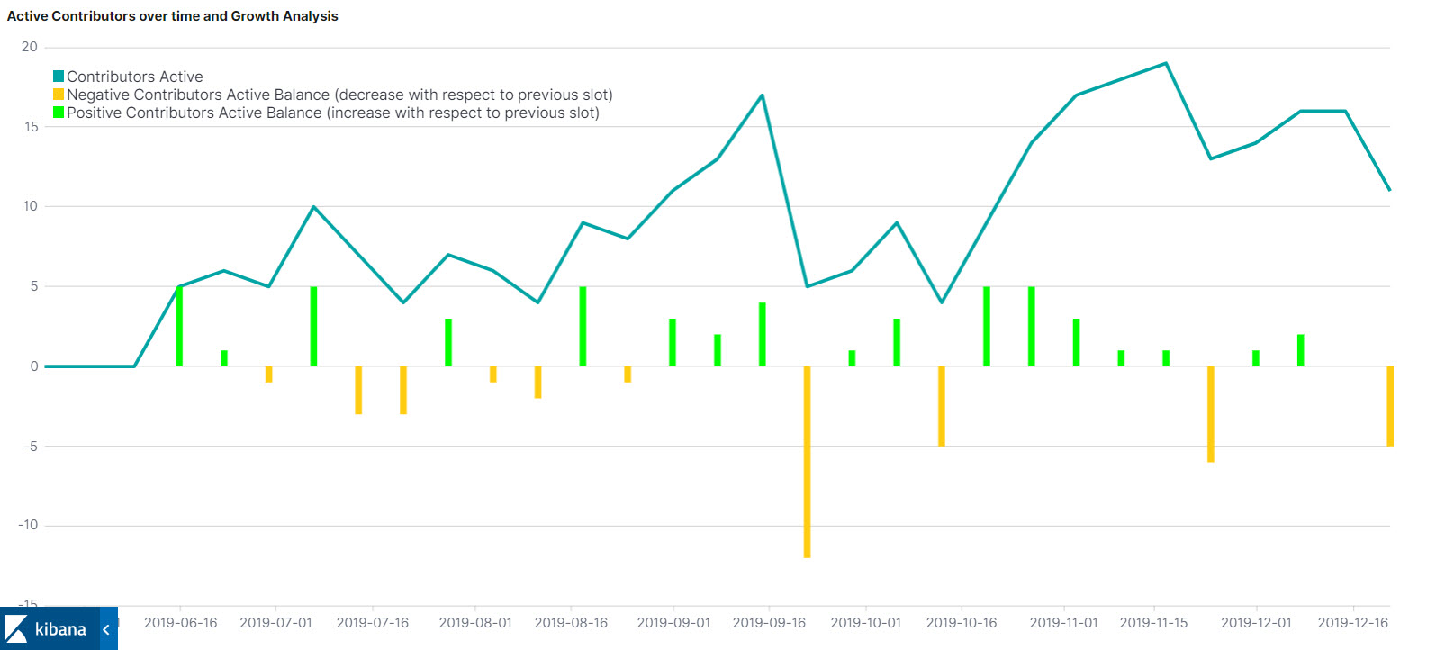
CNTT | Contribution Metrics
Total Contributors
57
Jun. 1, 2019 – Dec. 20 2019
Paris
Antwerp

Slide 12
Marketing and Communications: Next Steps
Please work with our team to arrange interviews with leaders in your org
  We will discuss invitation crafting and process in Thursday workshop
We would like to coordinate with CNTT leadership, Recruiting WS on pitch presentations, event coordination
  Std. Presentations, coordinate/promote w/ LF event activities & outcomes
We know of one session submission & one panel proposal for KubeConEU
12

