Slide 1
ETSI-Alignment Architecture and Roadmaps
January 15, 2020
Participating Companies & Contacts:
Ericsson: Byung-Woo Jun
Verizon: Fred Oliveira
Samsung: Miroslaw Medrek
CMCC: Yan Yang, Yuanhong Deng
ZTE: Hongyu Zhao
Intel: Haibin Huang, Alex Vul
Huawei: Seshu Kumar
Andrew Lamb, Eoin Hanan, Gareth Roper,
Michael Morris, Ronan Kenny, Waqas Ikram
Orchestration Scenarios (a.k.a. ETSI-Alignment) Task Force weekly meeting,
  Weekly meeting: Mondays at 12PM UTC, 5AM PT, 8AM ET, 2PM CET, 5:30PM India, 8PM China.
  https://zoom.us/j/722438866
  One tap mobile: +16699006833,,722438866# US (San Jose) +16465588656,,722438866# US (New York)
ETSI Alignment Support, https://wiki.onap.org/display/DW/ETSI+Alignment+Support

Slide 2
Agenda
1 | ETSI MANO and ONAP ETSI Alignment Landscape
2 | ONAP ETSI-Alignment Overall Architecture
3 | ETSI-Alignment Requirements and Roadmaps
4 | ONAP ETSI Package Structure, Security & Validation
5 | ONAP ETSI Package Management Components
6 | ONAP ETSI Package Onboarding & Distribution Flows
7 | ONAP ETSI Catalog Management Component
8 | ONAP ETSI VNF Package Management Interfaces
9 | SOL003 Adapter Architecture & Use Cases
10 | SOL003 Adapter – Granting with HPA, leveraging OOF*
11 | SOL005 Adapter Architecture & Use Cases
12 | SOL002 Adapter Architecture
13 | SOL002 Adapter LCM Notification Use Case
14 | SOL002 Adapter LCM Notification Sequence Diagram
15 | SOL002 Adapter Future Use Cases *
16 | Communication Security between ONAP and SVNFM/NFVO *
17 | CNF Support *
18 | Hierarchical ETSI-Based Orchestration *
19 | SOL001 NSD and VNFD Mapping *
20 | References
* Topics for Guilin and Future releases

Slide 3
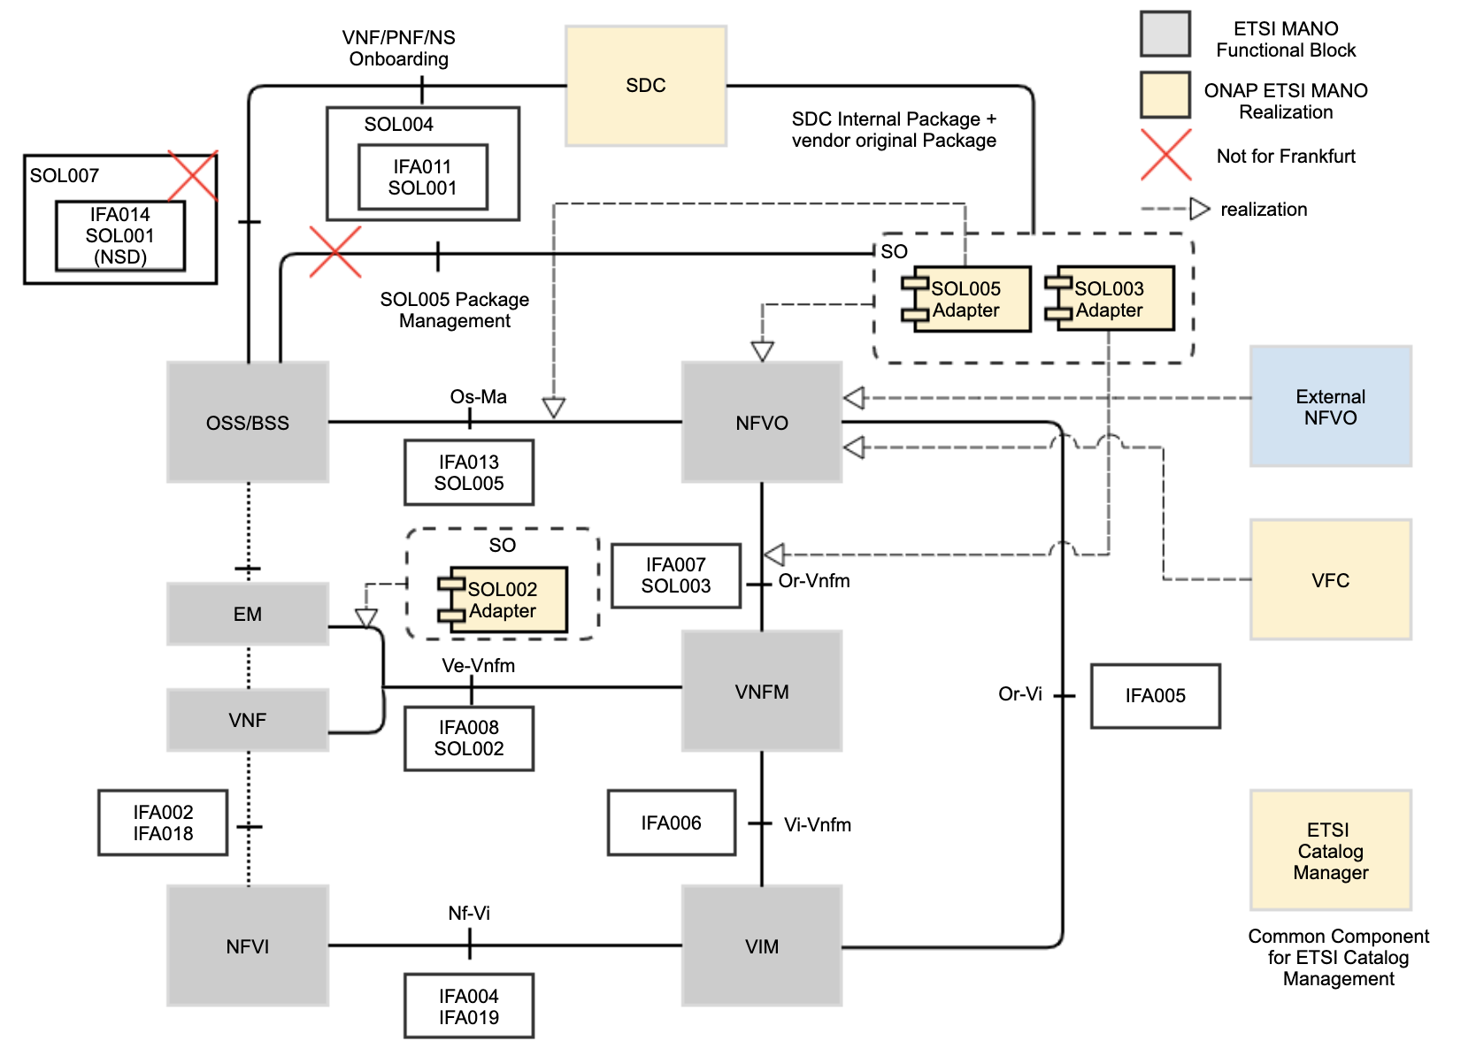
ETSI MANO and ONAP ETSI Alignment Landscape
As part of aligning ONAP to ETSI MANO, ONAP supports ETSI standards for packaging, LCM operations, security for managing VNF, PNF and NS.
For packaging, the SOL004 standard is used for the VNF and PNF package, and the SOL007 standard will be used for the NS package
  SOL007 support is not for Frankfurt
  SOL005 Package onboarding to SO is not for Frankfurt
VNF, PNF and NS descriptors are described by the SOL001 standard.
The SOL003 standard is used for VNF LCM, Package Management and Monitoring.
The SOL005 standard is used for NS LCM and VNF Package Management and Monitoring.
The SOL002 standard is used for VNF/VNFC-level EM triggered scenarios (LCM, Fault, Performance, Configuration).
ETSI Package and communication security are supported.
ONAP components target realization of ETSI MANO
SDC realizes SOL004 and SOL007 package onboarding, design and distribution functionalities.
  SOL007 package onboarding is not for Frankfurt
External NFVO and VFC realize the NFVO functionalities.
SOL003 Adapter realizes the Or-Vnfm (SOL003) interface.
SOL005 Adapter realizes the Os-Ma (SOL005) interface.
SOL002 Adapter realizes the Ve-Vnfm (SOL002) interface.
ETSI Catalog Manager provides ETSI Catalog/Package management.

Slide 4
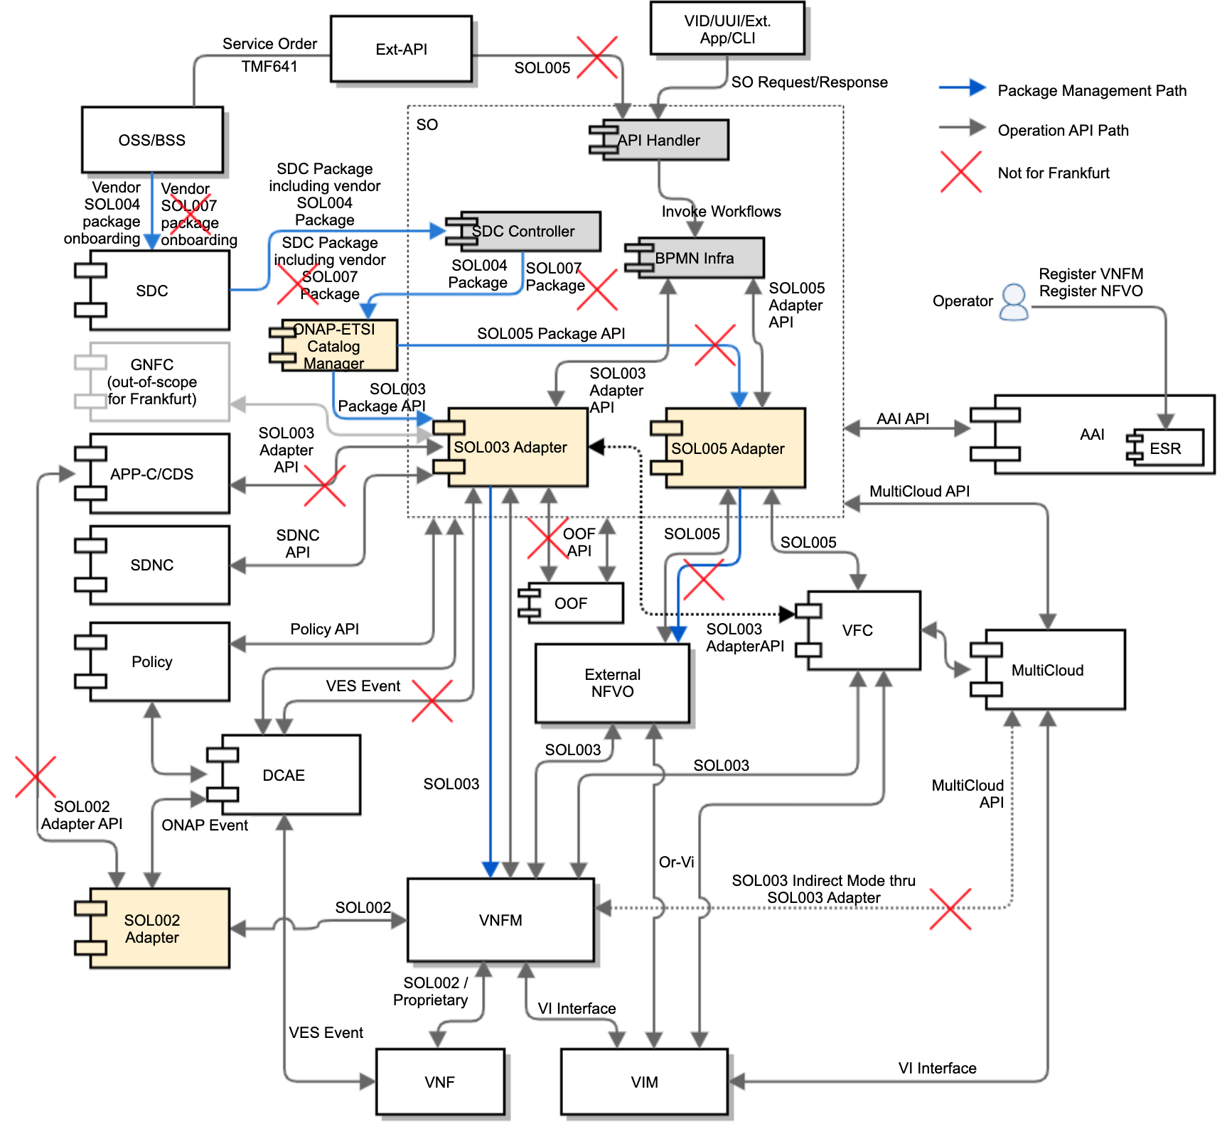
ONAP ETSI-Alignment Overall Target Architecture
ONAP will be aligned with ETSI standards: SOL004, SOL007, SOL001, SOL003, SOL005, SOL002
SDC supports SOL004 Package Onboarding (SOL007 is not for Frankfurt)
  SDC CSAR embeds the vendor SOL004 package
SO (SDC Controller) gets an SDC package notification and queries for the SDC package including the vendor SOL004 package (SOL007 is not for Frankfurt)
SDC Controller invokes the ETSI Catalog Manager (common component) to store vendor packages, by passing the CSAR Id
ONAP-ETSI Catalog Manager queries for the SDC CSAR and stores the SOL004 vendor packages in its database
SOL003 Adapter supports VNF package management and LCM
SOL003 Adapter forwards VNF packages to VNFM over SOL003 Package Management Interface
SOL005 Adapter queries for NS/PNF descriptors & VNF packages (not for Frankfurt)
SOL005 Adapter forwards NS/PNF descriptors & VNF packages to External NFVO (not for Frankfurt)
SOL003 Adapter supports SOL003 Operations
SOL005 Adapter supports SOL005 Operations
SOL002 Adapter supports SOL002 Operations
Note: SOL003/SOL005/SOL002 Adapters will be designed to leverage common functionalities such as:
  Security, HPA, AAI access, Policy Access, ETSI Catalog Manager
SOL005 Northbound support is not for Frankfurt
SOL003/SOL002 Adapter NBI GNFC-Ready & APPC/CDS are not for Frankfurt
SOL003 Adapter DCAE event mapping is not for Frankfurt
2
1
3
4
5
7
10
8
9
6
11
For more architecture and design details: https://wiki.onap.org/display/DW/ETSI+Alignment+Support

Slide 5
ETSI-Alignment Requirements & Roadmaps
Dublin | El Alto | Frankfurt Support | Guilin Proposals | Future Topics
ETSI SOL 2.5.1 support SOL003 Adapter Create VNF Instantiate VNF Terminate VNF Delete VNF Subscription Notification Granting SO ETSI VNF BB Workflows VNFM Simulator in the SO project SDC SOL004 PNF onboarding | ETSI SOL 2.5.1 support CSIT (test automation) for SOL003 Adapter SOL003 Adapter Bug fixes Communication security between SOL003 Adapter and SVNFM HTTPS support SpringBoot-based authentication VNFM Simulator migration to the Integration Test project SDC SOL004 VNF and PNF onboarding | ETSI SOL 2.5.1 support SO & SOL003 Adapter enhancements SO SOL004 and SOL001 package storage/retrieval support leveraging ETSI Catalog Manager SOL003-based package management API support SOL003 VNF LCM Operations ETSI Catalog Manager Storing vendor ETSI packages Providing ETSI package APIs to the SOL003/SOL005 Adapters Software Image delivery SOL005 Adapter for Create NS Instantiate NS Terminate NS Delete NS SOL002 Adapter VNF LCM notification AAF-based HTTPS and Authentication – partial OAuth2 support | ETSI SOL 2.7.1 support SDC enhancements SOL007 NS package onboarding SOL001 NSD and VNFD mapping to SDC AID DM SOL003 Adapter enhancements and additional SOL003 operations support SOL003 NBI enhancements for GNFC-ready VNF Query VNF Modify (ModifyVnfInfo) VNF Heal Policy-based Scaling (VNF-level and/or VF-Module-level) SOL003 LCN and translation into DCAE events (FM/PM) High Availability and Fault-Tolerant Granting with HPA via OOF OOF VNF-level Homing Request Support CNF support Model-Driven Orchestration leveraging, Puccini? CDS integration? SOL005 Northbound Interface support SOL005 Adapter enhancements ETSI Package Management Security Additional NS LCM FM/PM Configuration OAuth2-based authentication support between SOL002/SOL003/SOL005 Adapters and SVNFM/NFVO | SDC SOL007 Design and generation of SOL004/SOL007 packages ETSI-based VNF software upgrade ONAP SO embedded NFVO for hierarchical orchestration, as one of the NFVO options – see the hierarchical orchestration section Move package management, Granting, Software-Image handling from SOL003 Adapter to NFVO NS LCM orchestration support
✔
✔

Slide 6
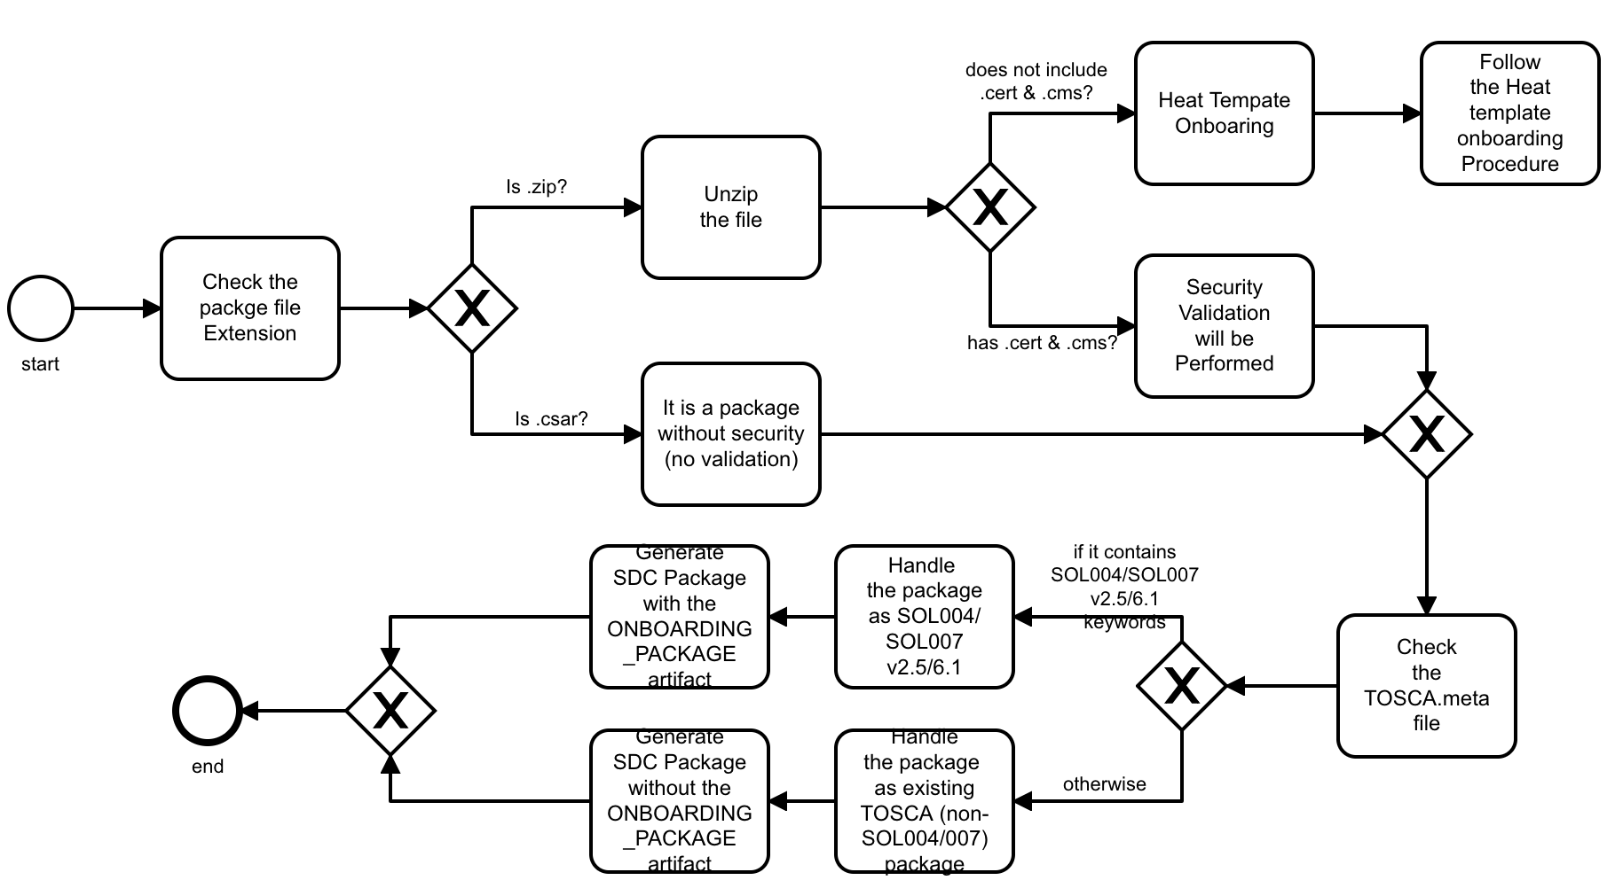
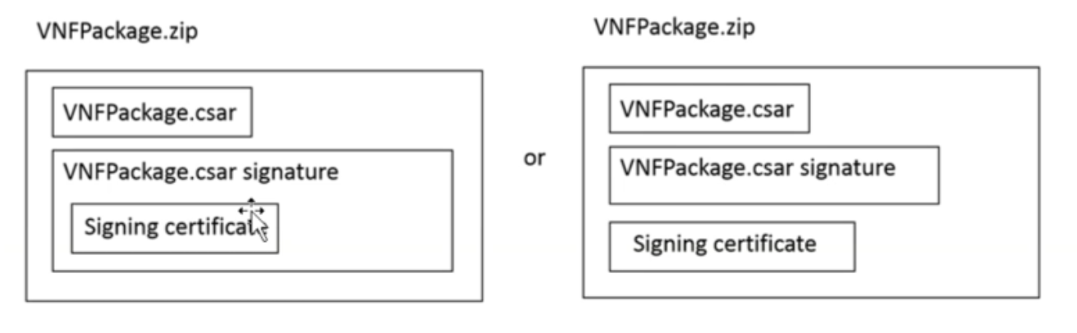
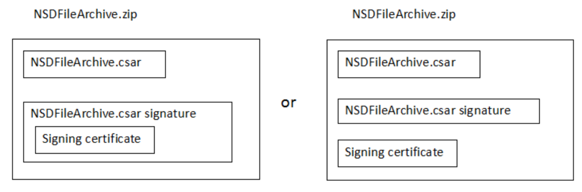
ONAP ETSI Package Structure, Security & Validation
- SOL004 is done in Dublin & El Alto; SOL007 for Guilin
Ericsson
Based on SEC021, the ETSI Package validation is a must. For that,
  SOL004 VNF/PNF Package security is supported by the package signature and certificate.
  SOL007 NS Package security will be supported by the package signature and certificate (not for Frankfurt)
SDC supports the SOL004 package security option 2:
  The complete CSAR file shall be digitally signed with the VNF/NS designer private key.
  The VNF/NS designer delivers one zip file consisting of the CSAR file, a signature file and a certificate file that includes the VNF/NS designer public key.
SDC will store the vendor package with vendor-provided signature and certificate in a zip format in the ONBOARDED_PACKAGE directory.
  SDC VSP and Resource CSAR files have the ONBOARDED_PACKAGE, which contains the original vendor VNF/PNF/NS package.
  For Frankfurt, SDC does not generate its own signature and certificates for package distribution to other ONAP components.
ETSI Catalog Manager stores the vendor SOL004 Zip/CSAR files in its DB.
SVNFM/NFVO will extract the CSAR file from the vendor package
  For Frankfurt, extracting the CSAR without validation is allowed
SDC Package Security Validation Process Sequence
At onboarding, SDC will check the file extension and perform the following procedures
  If the file is .zip, SDC unzips
    If it has .cert & .cms, it is a package with security, and security validation will be performed.
    If it does not include .cert & .cms, it is an existing Heat template onboarding, and SDC follows the Heat template onboarding procedure
  If the file is .csar, it is a package without security.
For TOSCA, SDC will check the TOSCA.meta file.
  If it contains SOL004 v2.5/6.1 keywords, the package will be handled as SOL004 v2.5/6.1.
  Otherwise, it will be handled as existing TOSCA (non-SOL004/SOL007) package onboarding which will not have the ONBOARDED_PACKAGE artifact.
Option 2
Option 2

Slide 7
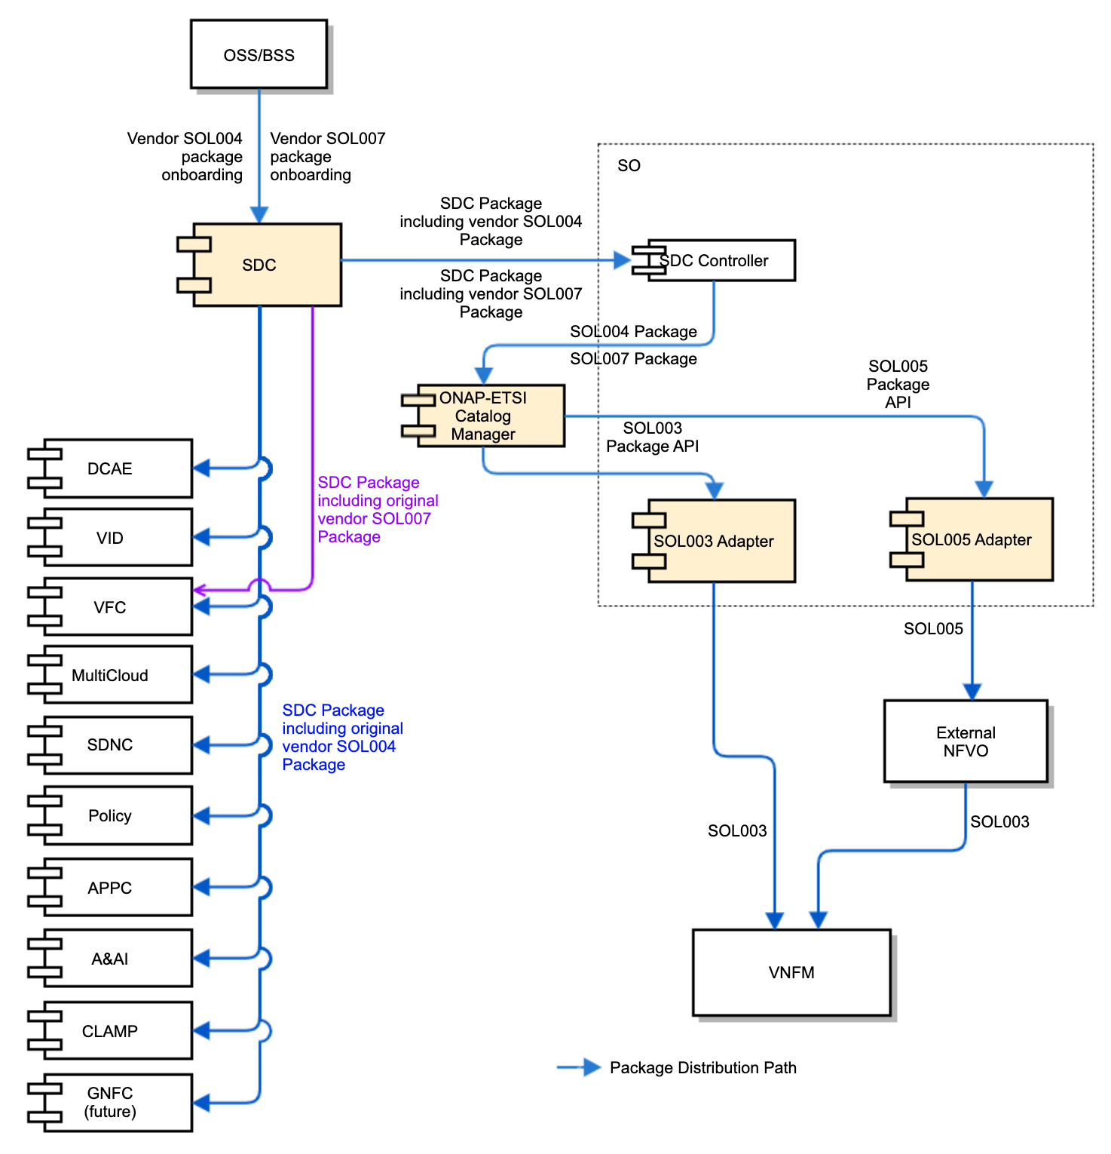

ONAP ETSI Package Management Components
CMCC, Ericsson, Verizon, ZTE
ONAP will support the End-To-End ETSI Package onboarding and distribution.
SDC supports SOL004/SOL007 package onboarding, including SOL001 (VNFD/PNFD/NSD)
  SOL004 for VNF and PNF Packages
  SOL007 for NS Packages (not for Frankfurt)
  SDC will store the original vendor SOL004 CSAR/Zip in the ONBOARDED_PACKAGE directory
SO gets the SDC package which includes the original vendor SOL004 CSAR/Zip, but not storing the vendor SOL004 packages into its catalog DB – delegates the storage to ETSI Catalog Manager
SO SDC Controller invokes the ETSI Catalog Manager by passing the CSAR id & the ETSI Catalog Manager gets the original vendor SOL004 CSAR/Zip from SDC
SOL003 Adapter retrieves the original vendor SOL004 VNF package from the Catalog Manager
SOL003 Adapter forwards the original vendor SOL004 VNF package to VNFM
SOL005 Adapter retrieves the original vendor SOL007 NS package from the Catalog Manager (not for Frankfurt)
SOL005 Adapter forwards the original vendor SOL007 NS package to External NFVO (not for Frankfurt)
External NFVO forwards the original vendor SOL004 VNF package to VNFM (not for Frankfurt)
VFC gets the SDC package with the original vendor SOL007 CSAR/Zip from SDC (not for Frankfurt)
Note 1: Direct SOL007 NS package onboarding to SO through SOL005 Package APIs is out-of-scope for Frankfurt
Note 2: This architecture could support the PNF distribution.
ONAP component Impacts: SDC, VNFSDK, SO, ETSI Catalog Manager, SOL003/SOL005 Adapters, VFC
1
2
3
6
4
9
5
7
8

Slide 8
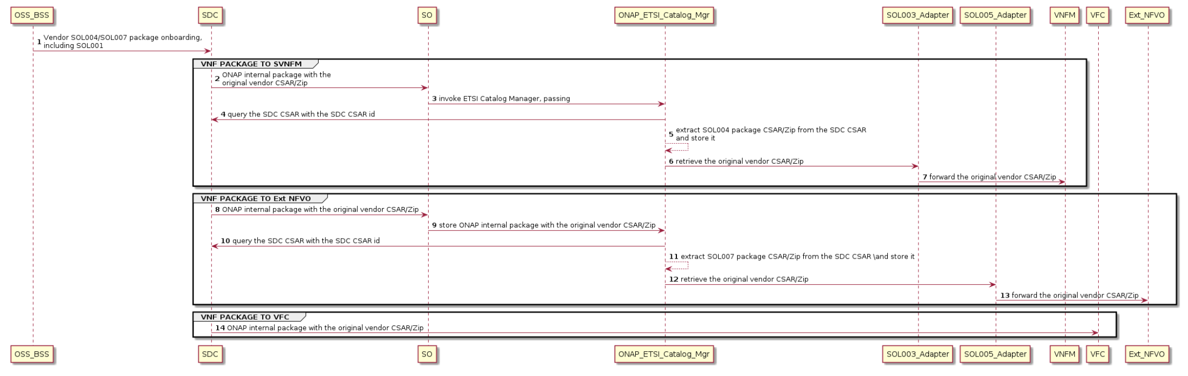
ONAP ETSI Package Onboarding &
Distribution Flows
CMCC, Ericsson, Verizon, ZTE
The following sequence diagram depicts ETSI package onboarding and distribution.
  ETSI SOL004 packages will be onboarded into ONAP through SDC and will be distributed to external VNFM and NFVO.
    Distribution to the external NFVO is not for the Frankfurt release
  ETSI SOL007 NS packages will be not supported in the Frankfurt release.
Not for Frankfurt

Slide 9
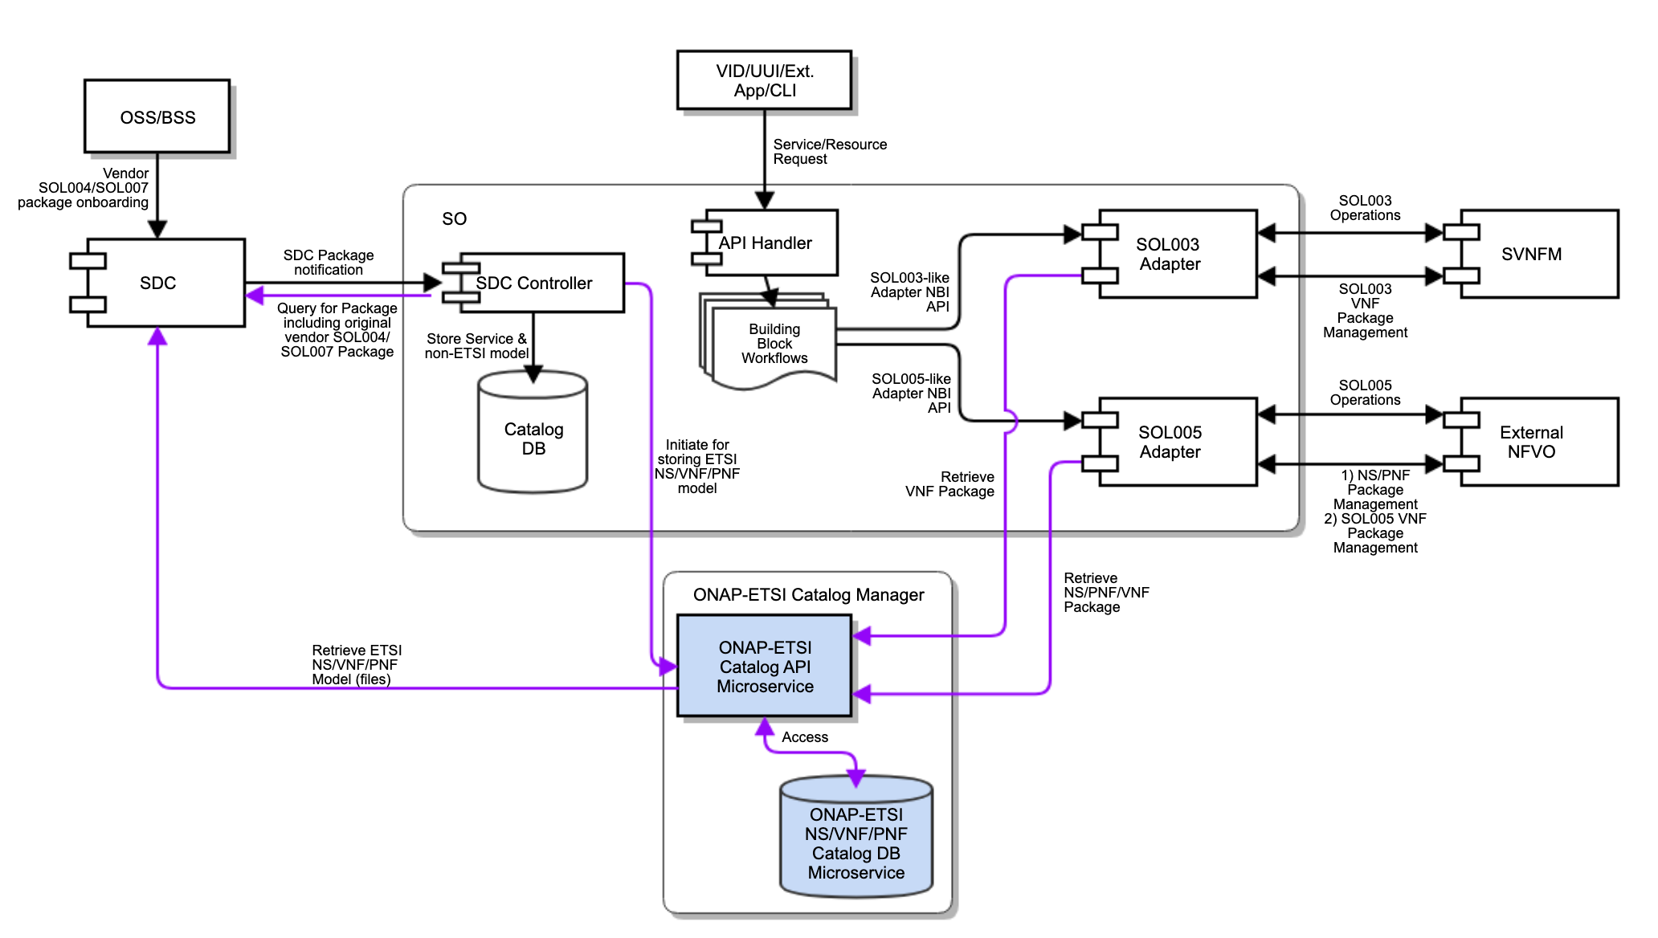
ONAP ETSI Catalog Management Component
CMCC, ZTE
ETSI Catalog Manager is a common component.
SO (SDC Controller) queries the package from SDC.
SO invokes ETSI Catalog Manager for storing vendor packages to the ETSI Catalog database
  ONAP-ETSI Catalog Manager APIs are used for storage of vendor packages.
  SO passes the CSAR id to the ONAP-ETSI Catalog Manager, and the Manager will retrieve the CSAR file(s) from SDC
For Non-ETSI models (Service + Non-ETSI Resource, metadata), SO uses the existing SO embedded Catalog DB
ONAP-ETSI Catalog Manager provides package management APIs and Catalog Database
  Catalog_NSPackage
  Catalog_VNFPackage
  Catalog_PNFPackage
  Catalog_SoftwareImageModel
SOL003/SOL005 Adapter accesses ONAP-ETSI Catalog through ONAP-ETSI Catalog Manager APIs
SOL003 Adapter provides SOL003 Package Management APIs to SVNFM
SOL005 Adapter provides SOL005 Package Management APIs to External NFVO (not for Frankfurt)
Note: PNF package distribution use cases are under discussion.
Parses the service csar
Get resource CSARs (CSAR ID)
Invoke ETSI Catalog Manager to store vendor packages in ETSI Catalog
  VNF first and then NS
6
1
3
2.A
7
(pass CSAR id)
5
2.B
4
The Catalog Manager is a common component (part of Modelling project)
It could be evolved to store other catalogs.
ETSI Catalog Documentation Wiki page: https://wiki.onap.org/display/DW/Etsicatalog+Documentation

Slide 10
ONAP ETSI VNF Package Management Interfaces
CMCC, Ericsson, ZTE
SO SDC Controller -> ETSI Catalog Manager
  /api/catalog/v1/vnfpackages/{csarId}
  pass the sdc csar uuid
ETSI Catalog Manager -> SDC
  /sdc/v1/catalog/{assetType}/{uuid}/toscalModel (download CSAR)
  /sdc/v1/catalog/{assetType}/{uuid}/metadata
ETSI Catalog Manager
  Get an SDC CSAR and extract the vendor SOL004 package from the Onboarded_Package artifact directory
  Store the vendor SOL004 package into the ETSI Catalog Manager DB
ETSI Catalog Manager provides package management APIs and package management notification APIs based on the SOL003 specification.
  etsicatalog.swagger.json
  etsicatalog.swagger.notification.json
  For more details, see https://wiki.onap.org/display/DW/ETSI+Catalog+Management > SO ETSI Catalog DB Support for NS, VNF and PNF packages
SOL003 Adapter provides notification APIs for ETSI Catalog Manager and invokes the package management APIs.
SOL003 Adapter and SVNFM use SOL003 package management APIs.
  SVNFM implements VNF package management notification API
SDC package
notification
Get an SDC
CSAR uuid
SOL003-VNFPackageManagementNotification-API.json
SDC
SO SDC
Controller
Query for
SDC package
etsicatalogswagger.notification.json
1
notification
/api/catalog/v1/vnfpackages/{csarId}
5
SOL003
Adapter
6
SVNFM
Notification
Subscription,
Query,
Read VNFD,
Fetch VNF pkg,
Fetch VNF artifacts
etsicatalogswagger.json
Subscription,
Query,
Read VNFD,
Fetch VNF pkg,
Fetch VNF artifacts
2
3
/sdc/v1/catalog/{assetType}/{uuid}/toscalModel
ETSI
Catalog
Manager
4
/sdc/v1/catalog/{assetType}/{uuid}/metadata
SOL003-VNFPackageManagement-API.json
https://{serverRoot}/sdc/v1/catalog/{assetType}
etsicatalogswagger.json
swagger
Interface Provider Endpoint
ETSI Catalog Documentation Wiki page: https://wiki.onap.org/display/DW/Etsicatalog+Documentation
ETSI Catalog Management Wiki Page: https://wiki.onap.org/display/DW/ETSI+Catalog+Management

Slide 11
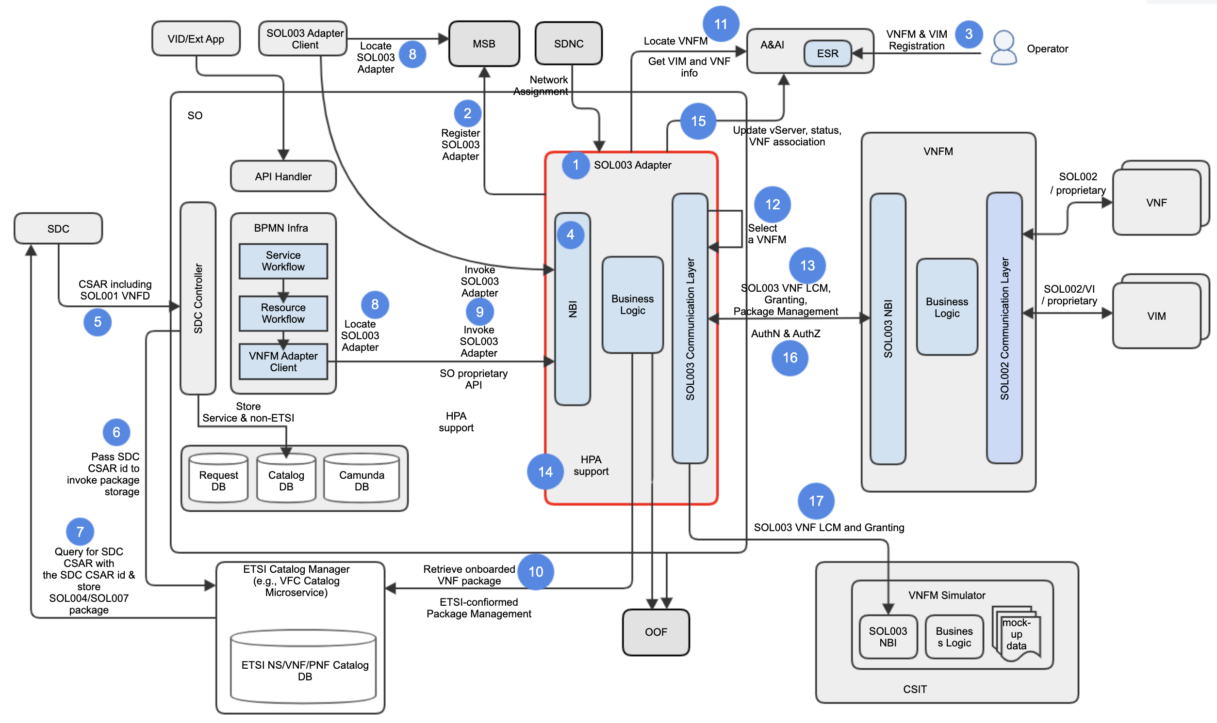
SOL003 Adapter Architecture & Use Cases
Ericsson
SOL003 Adapter is a SO microservice component
SOL003 Adapter is registered to MSB.
Operator registers VNFM and VIM to ESR in AAI.
SOL003 Adapter exposes its NBI to any SOL003 Adapter client in ONAP (not for Frankfurt)
  Interfaces will be refactored to be generic to allow access by other ONAP components.
  The NBI will be enhanced for additional SOL003 operation support
SDC distributes SDC packages including the vendor original SOL004 (VNF and PNF) and SOL007 (NS) packages – SOL007 is not for Frankfurt
SO (SDC Controller) passes the SDC CSAR ID to ETSI Catalog Manager to invoke storage
ETSI Catalog Manager queries for SDC CSAR with the SDC CSAR id & store SOL004 package.
SO (BPMN) and the SOL003 Adapter client locates SOL003 Adapter.
SO (BPMN) and the SOL003 Adapter client invokes SOL003 Adapter.
SOL003 Adapter retrieves VNF package from Catalog Manager.
SOL003 Adapter gets available VNFM locations (endpoints) and gets VIM and VNF Info.
SOL003 Adapter selects a VNFM, based on a VNFM locating mechanism.
SOL003 Adapter and SVNFM supports SOL003 VNF LCM, granting and package management operations.
SOL003 Adapter supports HPA-based Granting, leveraging OOF.
SOL003 Adapter updates vServer, status and VNF association in AAI
SOL003 Adapter and SVNFM support authentication and authorization (AAF, and vendor AA mechanism) – partially for Frankfurt.
For integration testing, the VNFM Simulator is used.
✔
✔
Supports
SOL003
VNF
Package
Mgmt
✔

Slide 12
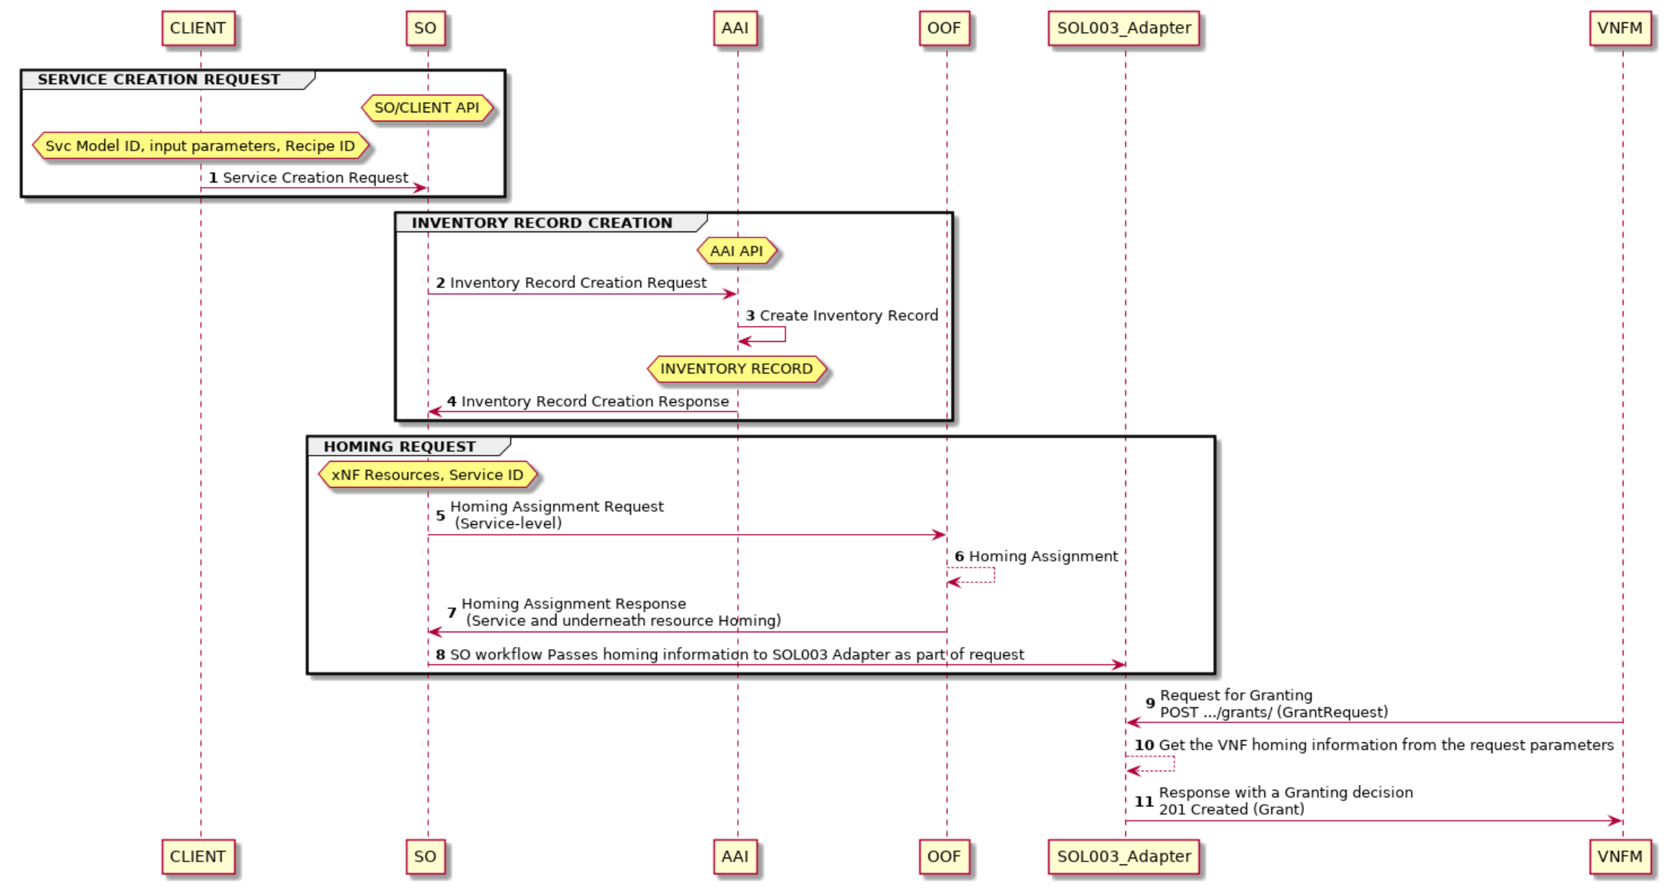
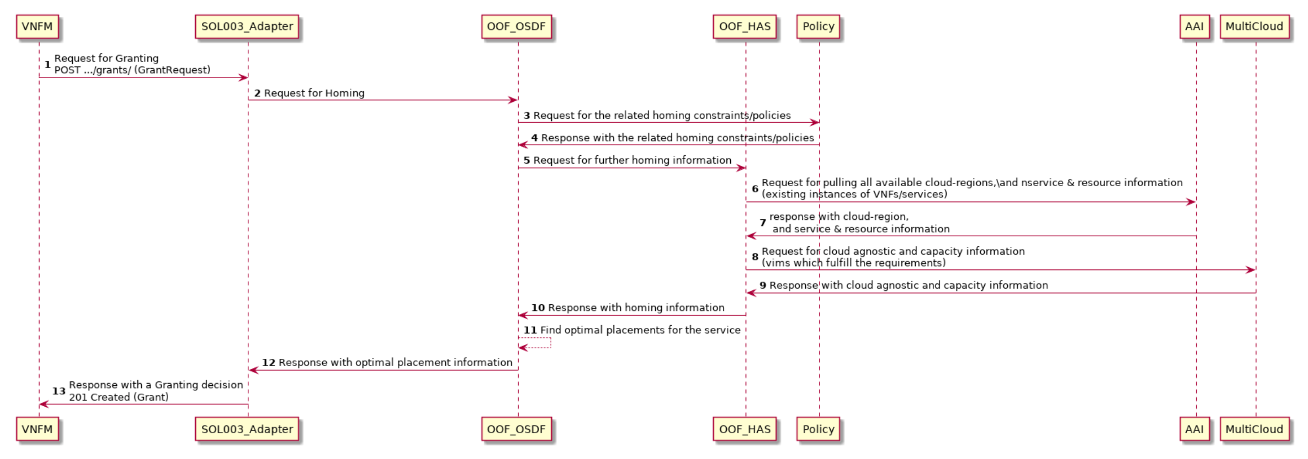
SOL003 Adapter - Granting with HPA, Leveraging OOF
(postponed to the Guilin release)
Intel
The SOL003 Adapter will act as an NFVO and support the Synchronous Grant operation with HPA by leveraging OOF.
Hardware Platform capability requirements will be defined as part of the VNFD data.
There will be two methods to support HPA in SO:
Option 1 (Service-Level Homing) : Use of Homing information that is made during the SO decompose processing – postponed to Guilin
  During SO decompose processing, SO calls OOF for collecting homing information for the service (which includes the VNFs).
  Call the OOF APIs to perform the optimize service/VNF homing and placement.
  Use the existing homing workflows to pass hardware platform capability requirements to OOF.
Option 2 (VNF-Level Homing): If the above processing does not work for the vendor VNF HPA, OOF will be called from the SOL003 Adapter per VNF granting – out of scope for Frankfurt
  Currently, OOF does NOT support the VNF Level Homing request. OOF API enhancement is requested.
    OOF needs to enhance their node graph structures for searching for hierarchical service structures.
  SOL003 Adapter will locate the corresponding Service ID by the VNF name which came from SVNFM. Then, the Adapter will pass service uuid, along with VNF uuid to OOF for homing request.
  If OOF does not support the VNF-Level Homing request, the option 1 (Service Level Homing) will be used for granting in Frankfurt.
  VNF-Level Homing request could be useful for scaling or healing that is initiated by VNFs and not associated with a service (see also SOL002 Adapter use cases).
Note 1: SOL002 Adapter will also leverage OOF for HPA – not for Frankfurt
Option 1
✔
✔
Not for Frankfurt
Option 2

Slide 13
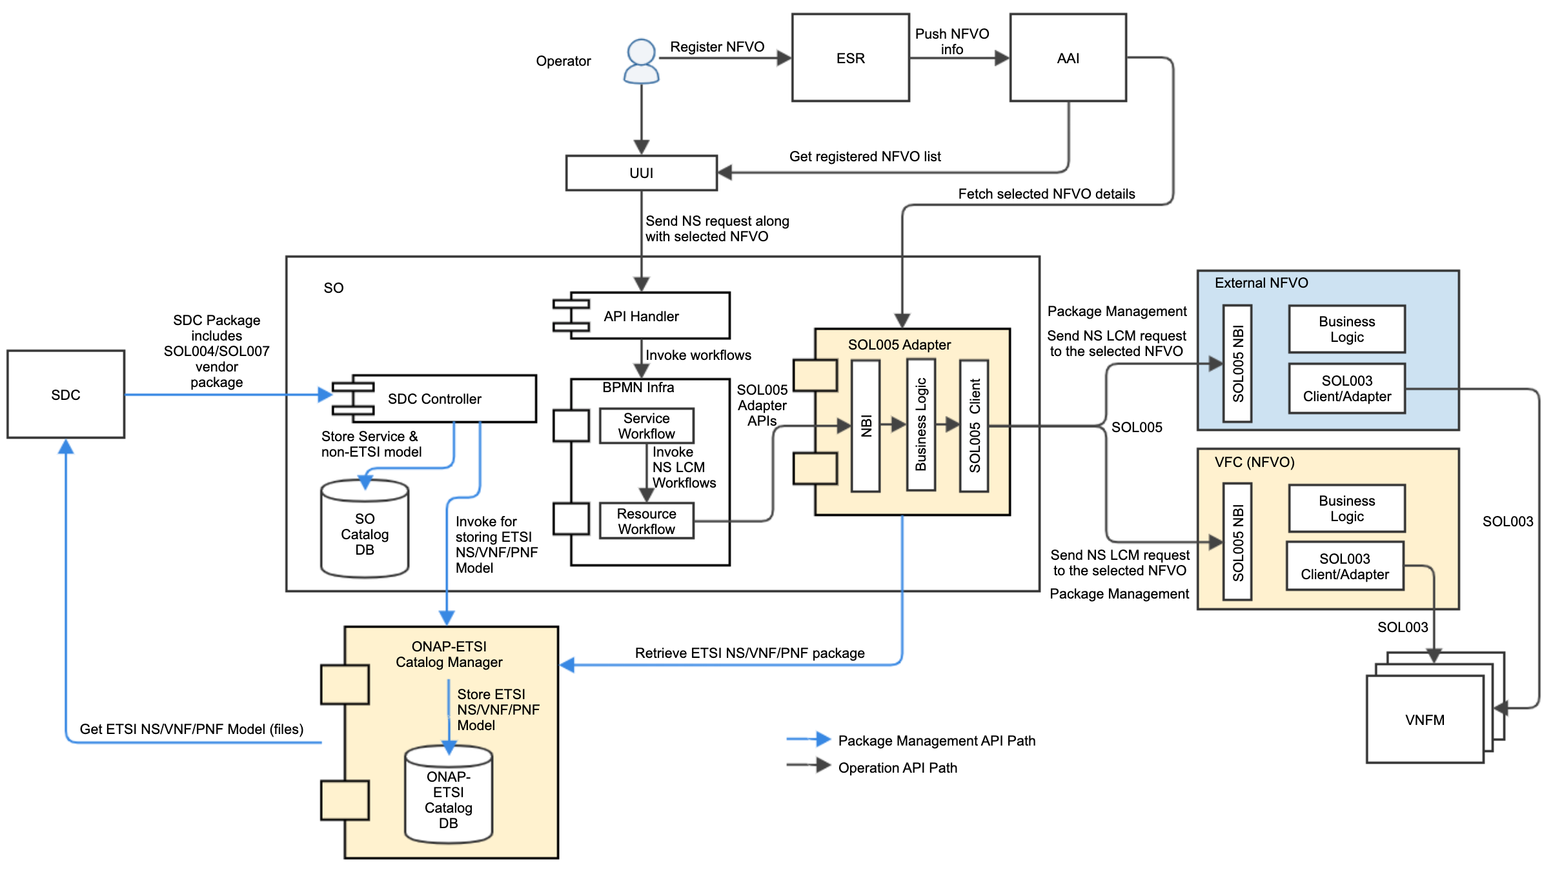
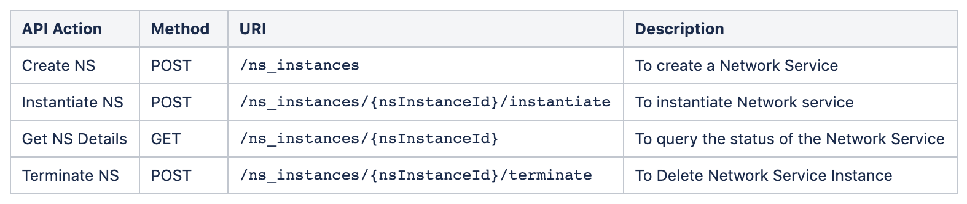
SOL005 Adapter Architecture & Use Cases
CMCC, Verizon, ZTE
SOL005 Adapter is a Microservice that will make connections between SO and VF-C/External NFVO through SOL005 standards.
SOL005 Adapter will support the following APIs in Frankfurt
  NS LCM : Create NS, Delete NS, Get NS, Instantiate NS, Terminate NS
  Package/Descriptor Management is not for Frankfurt
  NSD Management : Subscribe, Query Subscribe Information, Terminate Subscription, Notify
  VNF Package Management : Fetch VNF Package Artifacts, Subscribe, Query Subscription Information, Terminate Subscription
Use Cases
  Operator registers NFVO to ONAP via ESR
  ESR registration entities are pushed to AAI
  Operator sends NS requests from UUI along with selected NFVO details
  SOL005 Adapter fetches NFVO details from AAI
  SOL005 Adapter sends the requests to NFVO
Supports only
NS LCM, not
Package Mgmt
Package
management

Slide 14
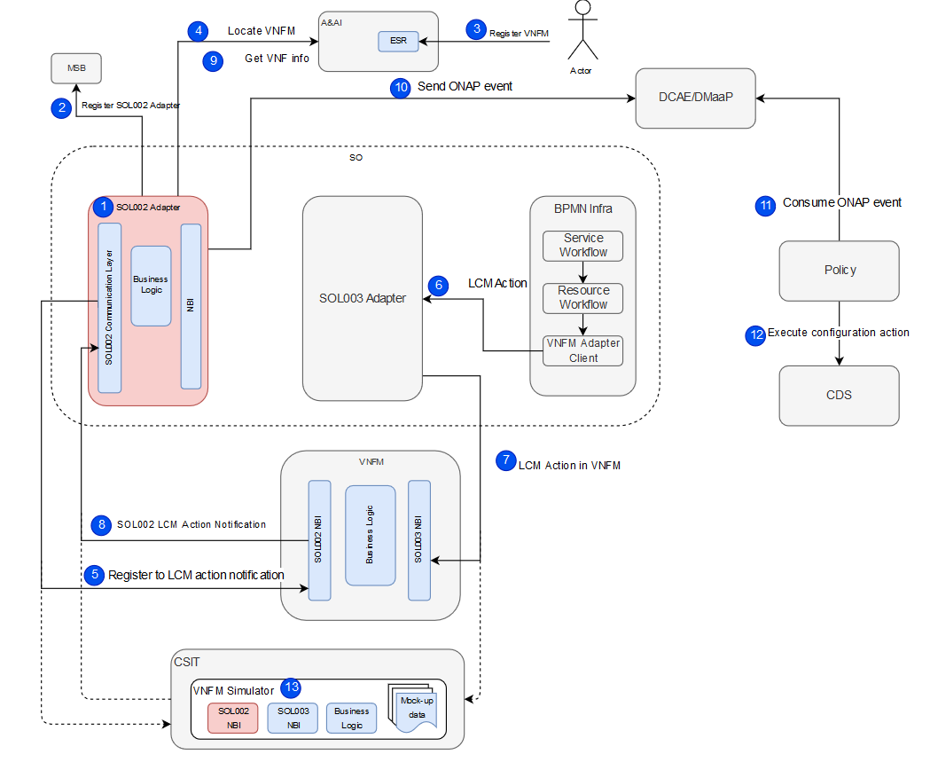
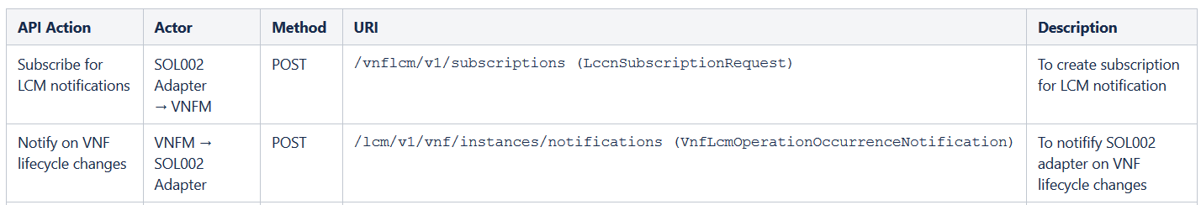
SOL002 Adapter Architecture
Samsung
SOL002 Adapter will be an SO micro-service that makes connections between VNFM and ONAP (as Element Manager) through ETSI defined Ve-Vnfm interface
  SOL002 Adapter registers to MSB
  Operator registers VNFMs to ESR in AAI
  SOL002 Adapter locates VNFMs via AAI
  SOL002 Adapter subscribes for VNFM notifications
  SOL002 Adapter receives calls from VNFM
  SOL002 Adapter gets VNF info from AAI
  SOL002 Adapter sends ONAP events to DCAE/DMaaP
  VNFM Simulator will be enhanced to interact with the SOL002 Adapter for SOL002 use case testing

Slide 15
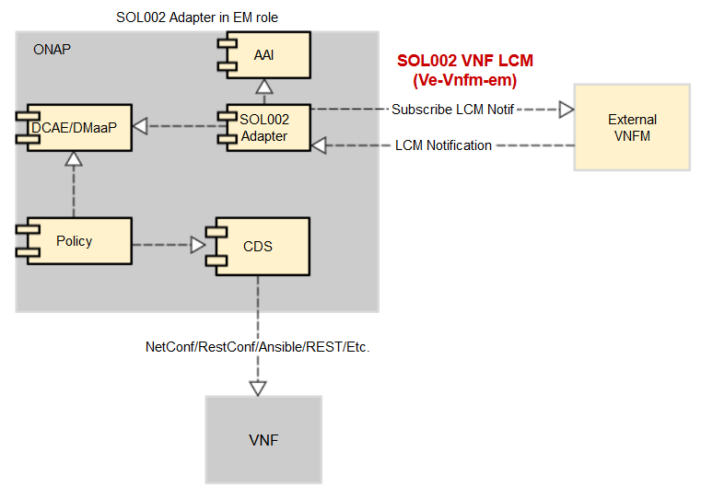
SOL002 Adapter LCM Notification Use Cases
Samsung
SOL002 Adapter receives VNFM notifications and VNF/VNFC Configuration is performed

Slide 16
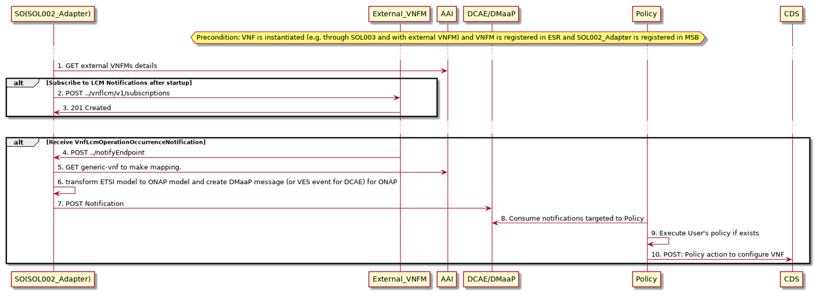
SOL002 Adapter LCM Notification Sequence Diagram
Samsung

Slide 17
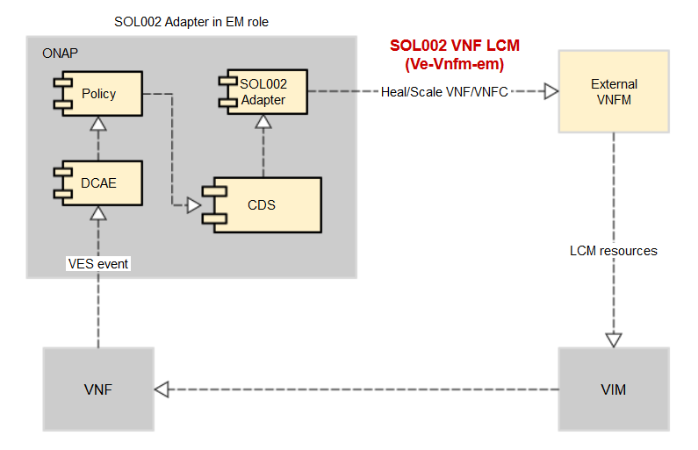
SOL002 Adapter Future Use Cases (1/2)
Samsung
SOL002 VNF/VNFC (Ve-Vnfm-em) LCM Action Execution towards VNFM Use Case:
ONAP Close Loop will be supported (Heal/Scale VNF/VNFC through SOL002)
VNF-Level (possibly VNFC-level) Homing requests to OOF would be necessary.

Slide 18
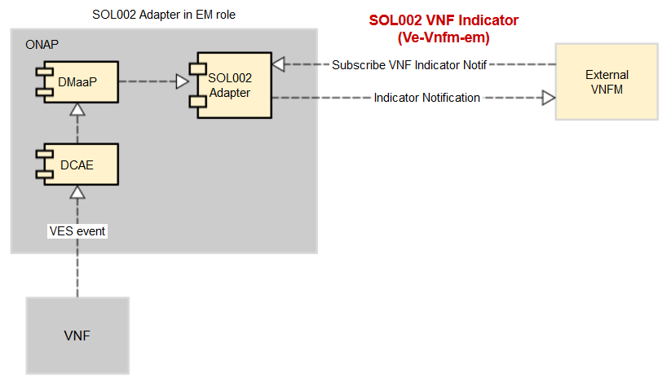
SOL002 Adapter Future Use Cases (2/2)
Samsung
SOL002 Indicator Interface (Ve-Vnfm-em) Use Case:
    External VNFM can subscribe to SOL002 VNF Indicator notifications
SOL002 Adapter reads VNF specific VES events from DMaaP according to subscriptions and converts events to SOL002 interface format and sends as Notify events to external VNFM

Slide 19
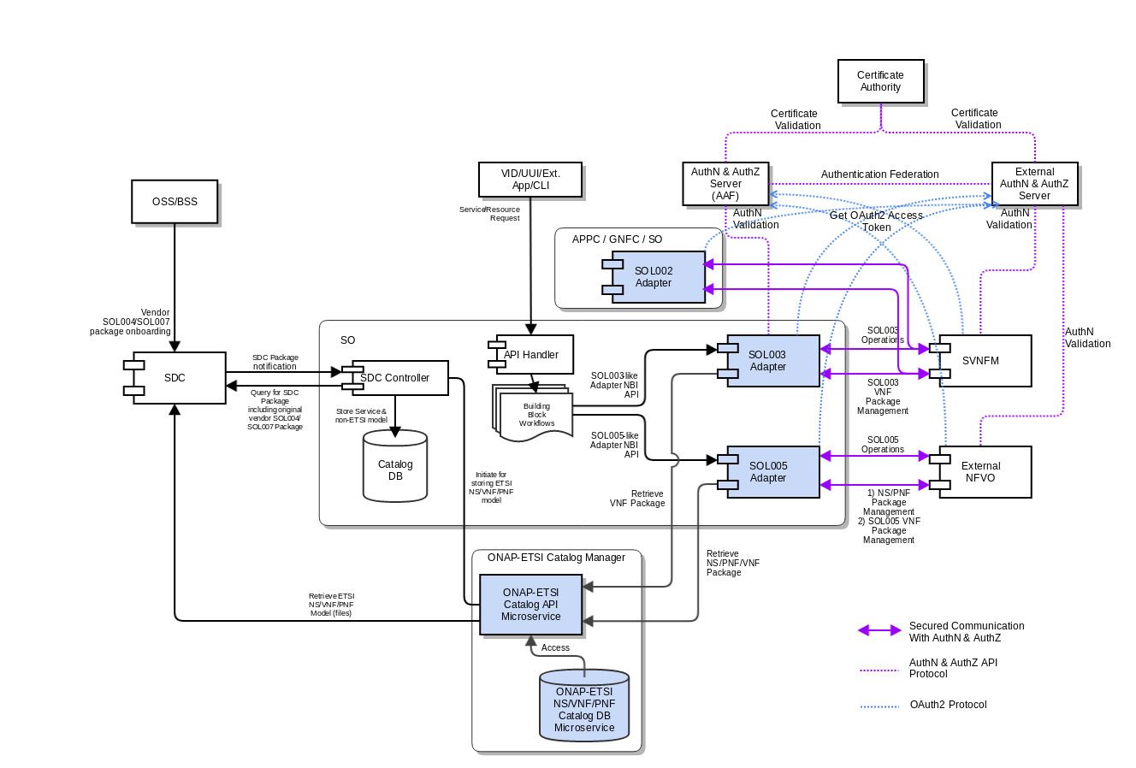
Communication Security between ONAP and SVNFM/NFVO
(postponed to the Guilin release)
SOL003/SOL005/SOL002 Adapters will communicate with the SVNFM/NFVO via secured HTTPS protocol with authentication and authorization.
  SOL003/005 API call security needs to conform to OAuth2
  SOL003/005 Notification call security needs to conform to OAuith2 or HTTP Basic authorization (user/pass)
  SOL003/005 Adapters will leverage the AAF security mechanism (as authorization server)
  Currently, SOL003 Adapter supports one-way and two-way AA.
  SOL002 Adapter will use OAuth2 Token-based authentication
SVNFM/NFVO will be allowed to have their own security mechanisms based on their security requirements but is required to support OAuth2 and HTTP Basic Authentication.
  Authentication Federation between the Adapters and the SVNFM/NFVO is under discussion.
  Some vendors prefer SAML-based federation
    AAF Authentication and External Authentication Server will exchange authentication tokens, based on federation configuration. It depends on AAF.
    In the Frankfurt release, the authentication federation may not be supported.
Note 1: All SO external interfaces for other ONAP components (e.g., SDC, ONAP-ETSI Catalog Manager, VID, AAI, SDNC, OOF) will be secured in the Frankfurt release by leveraging AAF.
Note 2: SOL002 Adapter will also leverage the AAF security mechanism and will support OAuth2 and HTTP Basic.
Note 3: More communication Security use cases are under discussion.

Slide 20
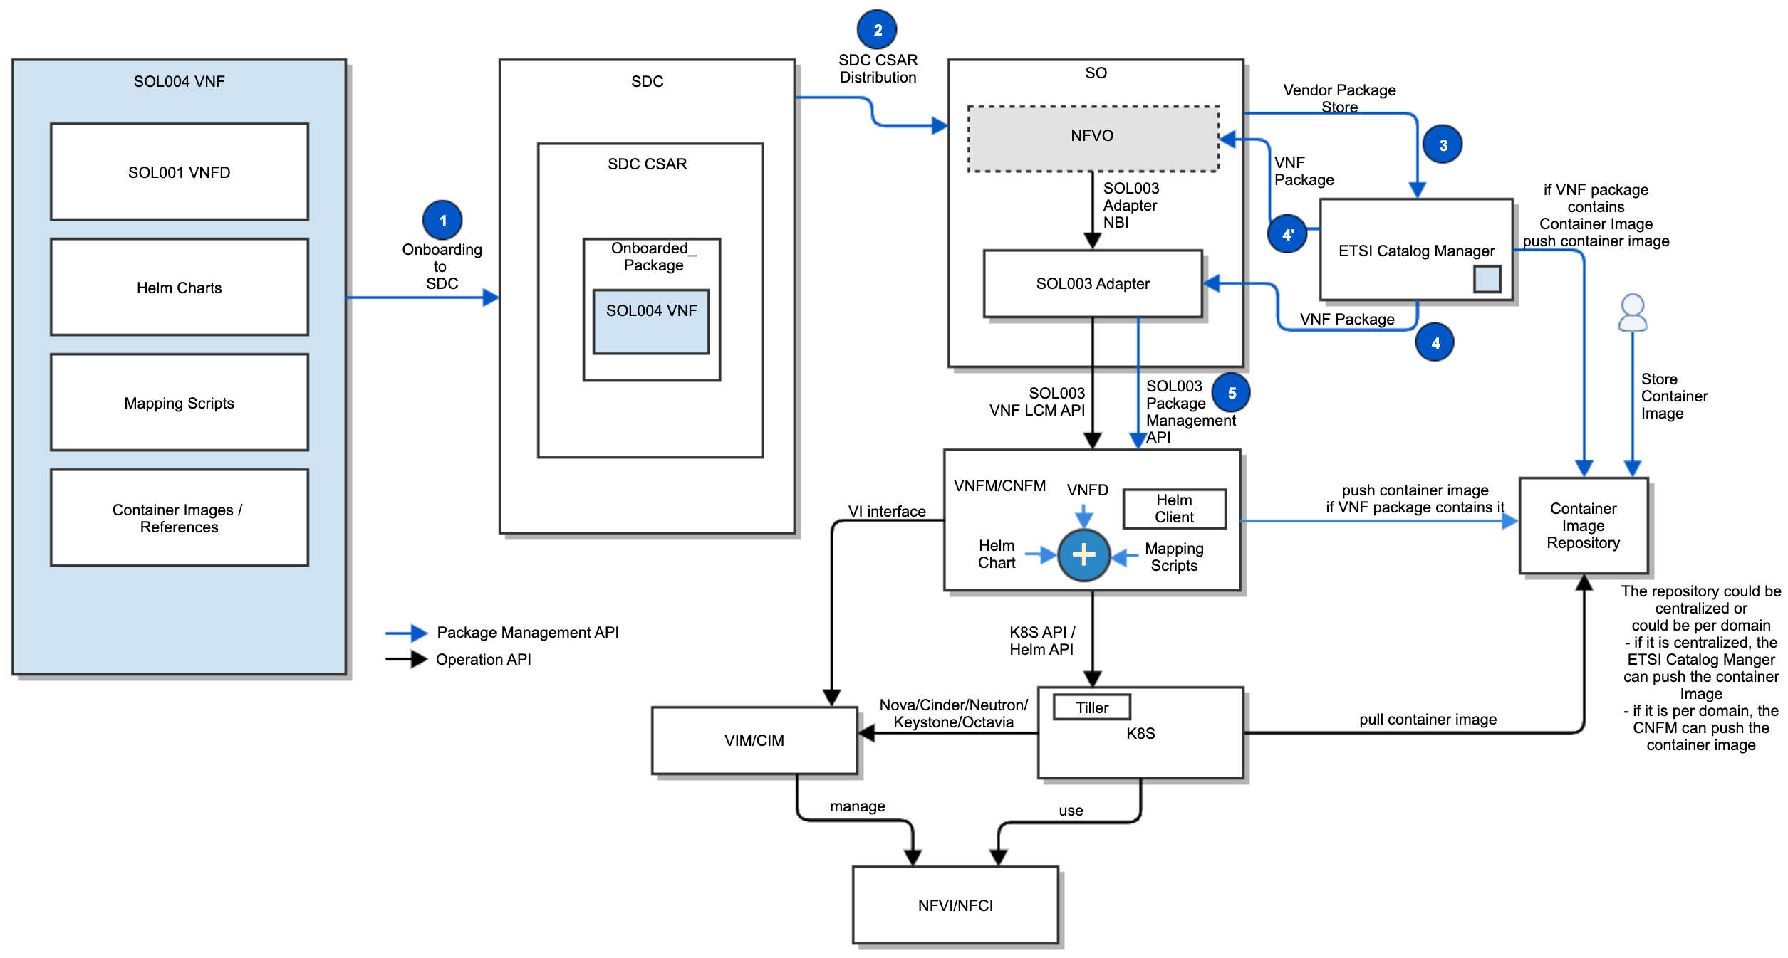
CNF Support (Guilin topic)
Hybrid orchestration templates – TOSCA VNFD and Helm Charts
  TOSCA VNFD drives the interaction between NFVO and VNFM and NS/VNF LCMs
  Helm Charts are included as a binary archive in the VNF package, and are consumed by VNFM
Container images are either included in the VNF package or referenced in the descriptors (URL to CIR)
  If the VNF package includes Container images, NFVO/ETSI Catalog Manager uploads them to the CIR
  Otherwise, operators store Container images to the CIR
K8S specific mapping to the TOSCA VNFD node resources
Parameter mapping from Or-Vnfm (SOL003) incoming information to Helm input parameters
Resource Mapping between resources in TOSCA VNFD and K8S resources described in Helm chart (for granting between VNFM and NFVO)
Mapping the LCM operations to HELM commands (VNFM behavior triggered on Or-Vnfm), etc.
VNFM-K8S communication prefers Helm APIs to lower level K8S APIs
K8S-VIM/CIM communication uses de facto open source standards (Nova/Cinder/Neutron/Keystone/Octavia)
The Container Image Repository (CIR) function can be done by the ETSI Catalog Manager (TBD)
The Operator can upload container images to the centralized CIR and the VNF package can define its reference
If the Container Image Repository is per domain, VNFM can push the container image
K8S pulls the container image from the repository
If the vendor VNFM has CNF capabilities, SO will leverage it through the SOL003 Adapter. Otherwise, SO/NFVO could invoke K8S API/Helm API towards K8S (TBD)

Slide 21
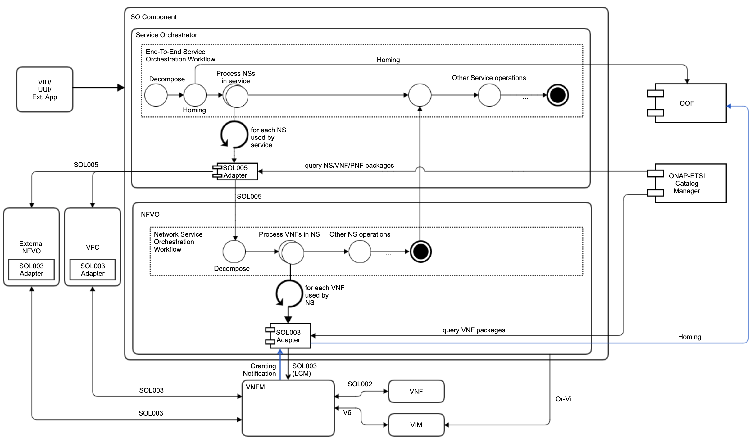
Hierarchical ETSI-based Orchestration (Guilin+Future topic)
Just a working draft to depict the orchestration functional blocks
ETSI-based hierarchical orchestration concept, to facilitate ONAP orchestration adoption by operators who have their own NFVOs and/or VNFMs
Working with the existing VFC and external NFVOs
Leveraging the common ETSI Catalog Manager
Leveraging the common OOF for homing
Possible ONAP SO embedded NFVO block
  Handle NS LCM Orchestration
  Take over Granting and Package Management from the SOL003 Adapter
  Support SOL005 Northbound Interface
  Support Or-Vi Indirect Resource control for VIM

Slide 22
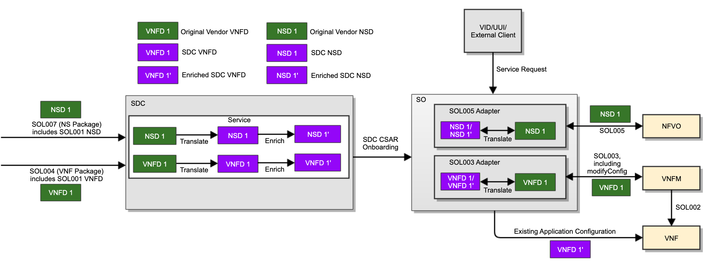
SOL001 NSD and VNFD Mapping (Guilin topic)
Mapping between SOL001 VNFD and SDC AID DM
  SDC shall support mapping between SOL001 VNFD and SDC AID DM during the VNFD onboarding
  SOL003 Adapter shall support mapping between SOL001 VNFD and SDC AID DM for SOL003 operations
Mapping between SOL001 NSD and SDC AID DM
  SDC shall support mapping between SOL001 NSD and SDC AID DM during the NSD onboarding
  SOL005 Adapter shall support mapping between SOL001 NSD and SDC AID DM for SOL005 operations
Note 1: SOL003 Adapter will extract SOL003 operation parameters from the SDC VNFD 1/VNFD 1’. Full-blown mapping between the vendor VNFD and the SDC VNFD may not be necessary for the SOL003 operations. For Frankfurt, may stop at the SDC internal TOSCA model.
Note 2: SOL005 Adapter will extract SOL005 operation parameters from the SDC NSD 1/NSD 1’. Full-blown mapping between the vendor NSD and the SDC NSD may not be necessary for the SOL005 operations. For Frankfurt, may stop at the SDC internal TOSCA model.
Note 3: PNFD mapping to SDC AID DM (ONAP internal representation) has been done in Dublin, ONAP R6 Resource IM Call 2019-8-19
Note 4: NSD type yaml, https://forge.etsi.org/deliver/tosca/nfv/etsi_nfv_sol001_nsd_2_5_1_types.yaml
Is it possible to have a common TOSCA parser, so we don’t need those mappings?
?
SOL001 NSD TOSCA templet needs be added into SDC
A new resource type, NS, has to be added into SDC
SDC Internal TOSCA Template, A&AI Data Mapping?
SDC UI handling on NSD and VNFD
Input parameters handling in VID / UUI
Package Delivery
Pre-Onboarding
Onboarding
Design Time
Run Time
SOL004/SOL007 Package
SOL001 xD
SOL 001 xD
TOSCA/AID Model
AID Model
xD Package
Onboarding Package
VNF-SDK Validation
Resource CSAR
Service CSAR Creation
Package Storage
PNFD
AID Model
VNFD
TOSCA Template
AID Model (?)
Current Support
new
NSD
TOSCA Template
AID Model (?)

Slide 23
References
ETSI Alignment Support, https://wiki.onap.org/display/DW/ETSI+Alignment+Support
  ETSI Package Management, https://wiki.onap.org/display/DW/ETSI+Package+Management
  ETSI Catalog Management, https://wiki.onap.org/display/DW/ETSI+Catalog+Management
  Communication Security, https://wiki.onap.org/display/DW/Communication+Security
  SOL003 Adapter, https://wiki.onap.org/display/DW/SOL003+Adapter
  SOL005 Adapter, https://wiki.onap.org/display/DW/SOL005+Adapter
  SOL002 Adapter, https://wiki.onap.org/display/DW/SOL002+Adapter
SOL003 Adapter APIs, https://wiki.onap.org/display/DW/SO+VNFM+Adapter+APIs
SOL003 Adapter Test Case, https://wiki.onap.org/display/DW/SO+VNFM+Adapter+Test+Case
SOL002 Adapter, https://wiki.onap.org/display/DW/SOL002+Adapter
ETSI Catalog Manager, https://wiki.onap.org/display/DW/Etsicatalog+Documentation
SOL003 Package Management API swagger: https://forge.etsi.org/jenkins/view/All%20jobs/job/NFV%20-%20Network%20Functions%20Virtualisation/job/sol002-sol003-master/42/artifact/build/
Orchestration Scenarios (a.k.a. ETSI-Alignment) Task Force weekly meeting,
  Weekly meeting: Mondays at 12PM UTC, 5AM PT, 8AM ET, 2PM CET, 5:30PM India, 8PM China.
  https://zoom.us/j/722438866
  One tap mobile: +16699006833,,722438866# US (San Jose) +16465588656,,722438866# US (New York)

Slide 24
Thank you!

