Slide 1
Common NFVI Telco Taskforce
Antwerp Workshop
Michael Bustamente, [AT&T]
Walter Kozlowski, [Telstra]
RM Chapter 7 -Security
Sept 2019

Slide 2
Security Objectives
Secure by Design at delivery
Networking functions must be designed with common security principles and standards.
Perform VNF security validation/certification using CNTT reference implementations
Ensure the OPNFV Verification Program for NFVi and VNFs meet CNTT Security design principles and requirements
Security Areas
  Platform Security
  Workload Security
  VNF Security
Notes:
The NFVI reference model and the supporting architectures are not only required to optimally support networking functions, but they must be designed with common security principles and standards from inception. - Beth

Slide 3
Discussion Items
Core Infrastructure Initiative badging
Opportunities for collaboration and partnerships in Security
How security fits within OVP
Options for Code Quality Scanning
Notes:
The NFVI reference model and the supporting architectures are not only required to optimally support networking functions, but they must be designed with common security principles and standards from inception. - Beth

Slide 4

Where we are today?
The OPNFV Security has CII Best Practices badging
The program is following Linux Foundation (LF) Core Infrastructure Initiative (CII)
  “Best Practices badge is a way for Free/Libre and Open Source Software (FLOSS) projects to show that they follow best practices. Projects can voluntarily self-certify, at no cost, by using this web application to explain how they follow each best practice. The CII Best Practices Badge is inspired by the many badges available to projects on GitHub. Consumers of the badge can quickly assess which FLOSS projects are following best practices and as a result are more likely to produce higher-quality secure software.”
This shows a level of trust between various Linux Foundation projects and our users, we use security-conscience development processes that produce high quality software
https://bestpractices.coreinfrastructure.org
https://wiki.opnfv.org/display/security/Security+Home

Slide 5
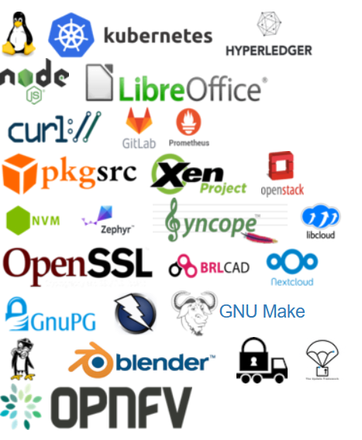
Who is using the Core Infrastructure initiative badging?
  Sponsored by the Linux Foundation
  Widespread adoption
  Includes:
  OPNFV
  OpenStack
  ONAP
  Kubernetes

Slide 6
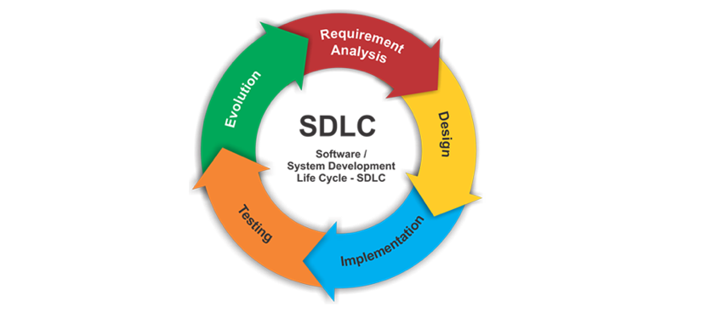
What are our opportunities in partnerships?
Develop a functional security test life cycle that can be used to ensure security compliance within the OVP process:
Become an active participant in the OPNFV Security Working Group, focus on functional test case creation
Create testing tickets & artifacts > slotting tests to releases > managing backlog
Platform
  For Reference Implementation 1, work with OpenStack
Workload/Operator
  CNTT member’s best practices (Sweet Spot)
VNF
  Partner with ONAP and with VNF vendors on development practices
  ONAP has a large head start in developing VNF security test cases

Slide 7









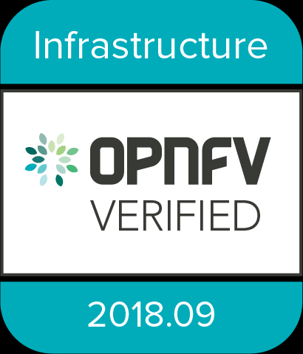

CNTT NFVI LIFECYCLE FRAMEWORK
Feedback for improvement of
Reference Model & Reference Architectures
Community Standards
Reference Model
External
Innovation
Feedback for improvement
Identified escaping defects for
Root Cause Analysis
RA 1
RA 2
RA 3
Ratified specifications for implementation
TELCO
OPERATORS
Reference Architectures
CNTT community defined
Reference Model & Reference Architectures
VNF
SUPPLIERS
RI 1
RI 2
Reference Implementations
OPNFV integrates
Reference Implementation with OVP testing ecosystem
SAMPLE NFVI STACK *
VNF1
VNF2
CNF3
NFVI Testing Lab
VNF Candidate
Download
tar.gz
result file
Upload
results file
to OVP Portal
VM
VM
VM
VM
C
C
Install Dovetail
Docker
Virtualization/Container Layer
(OS, KVM, VMWare, Kubernetes)
Management
Network
Test Host
DMZ
Server
Compute
Network
Storage
Firewall
Interface to public internet
Internet
SUT
OPNFV
Verified Program
OPNFV Verified VNF
Bare Metal Install
Common Node Setup
Ceph Setup
REF
NFVI
Install Data Path Network
OVP Testing Ecosystem
* For illustrative purposes only
Notes:
What security features cannot be functionally tested in the OVP testing ecosystem?

Slide 8
Software Code Quality
Do we have anything to consider with centralized security scanning to increase VNF onboarding velocity? Can we do it with self-attestation from the VNF vendors?
For example, AT&T requires:
Vendors use industry recognized software testing suites and perform:
  Automated static code review with remediation of Medium/High/Critical security issues. The tool used for static code analysis and analysis of code being released must be shared.
  Dynamic security tests with remediation of Medium/High/Critical security issues. The tool used for Dynamic security analysis of code being released must be shared.
  Penetration tests (pen tests) with remediation of Medium/High/Critical security issues.
  Methodology for ensuring security is included in the Agile/DevOps delivery lifecycle for ongoing feature enhancement/maintenance.

Slide 9
Workload Security
Do we integrate with the OPNFV End User Advisory Group and/or Yardstick?
Ability to ensure that the configuration of the control plane and NFVI meet general security policies of the service provider.
The ability of VIMs to leverage and be protected by open source tools and best practices for security hardening, can be verified with functional testing such as:
  real-time vulnerability scanning
  network intrusion and host intrusion
  security audits
  open source scanning for licenses, vulnerabilities, and known defects
  compute host software configuration
  image software configuration
  real-time installation from a local, pre-scanned package/repo/image/container cache
https://wiki.opnfv.org/display/EUAG/Security+and+Policy

Slide 10
Appendix

