Slide 1
CNCF Telecom Users Group
Intro for CNTT 3rd face-to-face meeting, Antwerp
Gergely Csatari (Nokia)

Slide 2








































Cloud Native Computing Foundation
Nonprofit, part of the Linux Foundation; founded Dec 2015
Graduated
Incubating
Network Proxy
Distributed Tracing
API
Remote Procedure Call
Networking API
Distributed Tracing
Software Update
Spec
Security
Storage
Messaging
Orchestration
Monitoring
Service Discovery
Container Runtime
Logging
Service Mesh
Package Management
Storage
Registry
Key/Value Store
Policy
Container Runtime
Key/Value
Store
Platinum members:

Slide 3










From Virtualization to Cloud Native
Cloud native computing uses an open source software stack to:
  segment applications into microservices,
  package each part into its own container
  and dynamically orchestrate those containers to optimize resource utilization
Non-
Virtualized
Hardware
Open
Source
IaaS
Open
Source
PaaS
Cloud
Native
Virtualiza-
tion
IaaS
PaaS
Containers
2000
2001
2006
2009
2010
2011
2013
2015

Slide 4
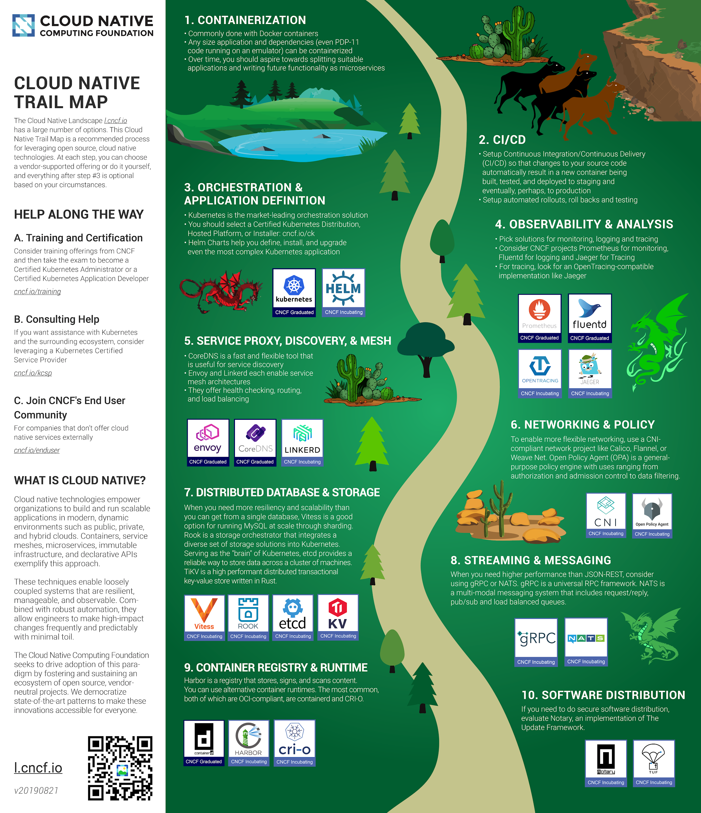
Cloud Native Trail Map
Trail Map: l.cncf.io

Slide 5
CNCF Structure
Governing Board
Technical Oversight Committee
End User Community
Marketing Committee
Mainly vendors
Fund the organization
Marketing and strategic direction
9 top technical architects
Admit new projects
Acts as a resource to projects
Real end users of these technologies
Communicate back requirements
And good and bad experiences

Slide 6

CNCF Telecom User Group (TUG)
Not a final logo
Design by Alex Contini
CNCF has launced the Telecom User Group (TUG) for operators and their vendors who are using or aiming to use cloud native technologies in their networks.
The TUG will operate in a similar capacity to CNCF's End User Community (since operators have never been included in CNCF's definition of end users). Unlike the End User Community, telecom vendors are also encouraged to participate in the TUG.
The TUG is not expected to do software development, but may write up requirements, best practices, gap analysis, or similar documents.
We're planning to present the TUG in a birds-of-a-feather (BoF) in San Diego
We have twice-a-month Zoom calls.

Slide 7


CNCF Telecom User Group (TUG)
Not a final logo
Design by Alex Contini
Starting point: https://github.com/cncf/telecom-user-group
Meetings:
  first Monday of the month at 3:00PM UTC (8AM Pacific Time) and the third Monday of the month at 11:00 UTC (7pm China Standard Time)
  Minutes
Comms:
  : https://lists.cncf.io/g/telecom-user-group/join
  : https://slack.cncf.io/ - #tug

Slide 8
CNCF TUG Work items
Not a final logo
Design by Alex Contini
Whitepaper
  Deploying Cloud Native Network Functions in a telecom service provider ecosystem
    Definition of CNF
    Characteristics of a telecom deployment
    Concept of a vanilla K8s-based CaaS
    The ideal CNF
    Best Practices
Actual experimenting
  Using the CNF Testbed

Slide 9
Collaboration between CNTT and CNCF TUG
People/participation
  There are overlaps in the participation lists
  I can volunteer to provide upgrades of the two teams activities regularly
Is there a need for some more formal collaboration?

Slide 10
Q&A

Slide 11
Sources
CNCF overview presentation by Dan Kohn
How Good Is Our Code? - presentation by Dan Kohn (2018)
CNCF Telecom User Group Kickoff presentation by Cheryl Hung, Dan Kohn and Taylor Carpenter

