Slide 1
VF-C Dublin Highlights and E/F Planning
China Mobile: Yan Yang
ZTE: Maopeng Zhang
Intel: Haibin Huang
June, 2019

Slide 2
Part1 VF-C Dublin Highlights

Slide 3
Catalog Enhancement—Flexible Mechanism to Support Multi-version VNFD
Catalog provides a flexible mechanism that is compatible with different versions of VNFD
Catalog VNFD Model Parser
ONAP VNFD Base(R2)
vnfdmodel(common)
VNFD_SCHEMA_VERSION
VNFD JSON API
ONAP R4 VNFD
vnfd_sol_base
vnfd_sol_251
vnfd_sol_xxx
ONAP Rxxx VNFD

Slide 4
SOL005 Alignment— Reference Implementation of ETSI NFVO
SO
    The Interface alignment include：
    NFVO support SOL005 API, including
    Create/Instantiate/Operate/Terminate/Delete/Query NS Instance
    NS LCM Operation subscriptions and notification.
    Catalog support SOL005 related API, including package subscription and notification
VF-C Adapter
NFVO
NS Package
( NSD)
GVNFM Driver
Catalog
GVNFM
VNF Package
( VNFD)

Slide 5
CLI Integration — Provides Automated Testing Capabilities
With SDC
Without SDC
SDC output data model is AID
VFC input data model is SOL001
SDC
1.onboarding API
1.Upload API package
VFC Catalog
Artifacts/Deployment/OTHER/
Definitions
TOSCA-Metadata
MainServiceTemplate.mf
MainServiceTemplate.yaml
VFC Catalog
Create Customer
Create Service Type
VFC NFVO&GVNFM
VFC NFVO&GVNFM
2.Create NS API
3.Instantiate NS API
2.Create NS
3.Instantiate NS
VNFM Register
VIM Register
Add Policy

Slide 6
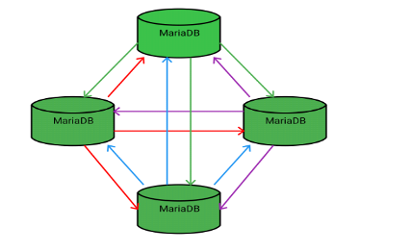
DB Migration — Support HA and Horizontal Scalability
Mysql migrate to the mariadb Galera Cluster
Leverage OOM shared MariaDB Galera Cluster Charts
create database
vfc-nslcm docker
docker entrypoint
vfc-vnflcm db
create database
vfc-catalog docker
vfc-catalog db
docker entrypoint
vfc-nslcm db
Galera Cluster
create database
vfc-vnflcm docker
docker entrypoint

Slide 7
VF-C Other Work in Dublin
Functional Enhancement
Function | Description
Upgrade Multicloud API | Upgrade Multicloud API to support consistent identification of cloud region functional requirement
OOF Integration Optimization | Optimize the methodology for VNF(vdu) placement, add the process for placement with selected candidates(VIM）
Maturity Enhancement
Function | Description
Configuration inject automatically | All the configuration will inject automatically through OOM env
Data Persistent | Add data persistent storage to avoid data loss due to pod restart
Image Optimization | All docker images of python components have optimized

Slide 8
Part2 VF-C E Planning

Slide 9
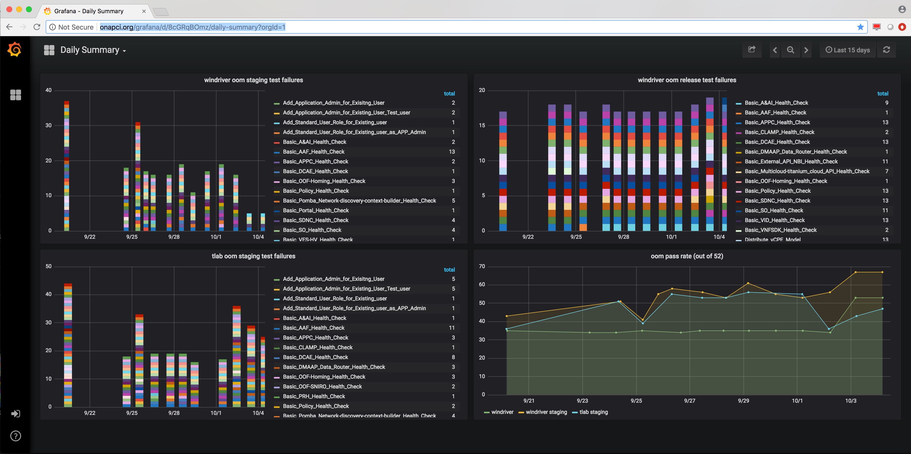
Tosca-based VNF Deployment Automation
Current CI/CD with Daily Summary include functional tests + health checks,the functional tests such as:
    ONAP CI.Vnf-Orchestration.Instantiate Virtual DNS
    ONAP CI.Vnf-Orchestration.Instantiate Virtual FirewallCL
All current functional tests only cover heat-based VNF deployment, will plan to add tosca-based VNF deployment functional tests. And want to leverage the CLI existing capabilities.

Slide 10
Tosca-based VNF Deployment Automation
Plan1:Add destroy operation which can automatically delete VNF and NS automation
Plan2:Integrate python script to robot. Robot can call it and automatically test vCPE with TOSCA.
Plan3:Integrate python script to Jenkins. We can automatically test it when someone submit a patch.
Plan4:SDC provide external API for design VNF and NS.

Slide 11
OVP Tosca VNF Validation Support
VF-C will participate in OVP tosca based VNF Validation testing using the existing Interfaces and capabilities
Test
Tools
ONAP
VNFSDK
Design Time
Run time
LCM
Run time
CloseLoop
SUT
VNFM
PNFs
VNFs
NFVI

Slide 12
Part3 VF-C F Planning

Slide 13
WorkFlow Optimization
VF-C Worflow
VF-C workflow has different options, the build-in workflow has higher execution efficiency and VF-C also provides workflow microservice that can integrate with different workflow engines. This design allows VF-C to be decoupled from specific workflow engines and more flexible.
The built-in workflow is executed by default in current VF-C code.
In F release, we would like to perform different workflow branches through flexible configuration. And increase the capabilities that workflow microservices can provide, such as monitoring …
VF-C NSLCM
NS
VF-C Runtime
Catalog
REST API
Activity
Model
Build-In Flows (python script)
VF-C WORKFLOWaas
WSO
......
REST API
VNF
VL
PNF
......
REST API
OOF
AAI
Drivers
Drivers
Drivers

Slide 14
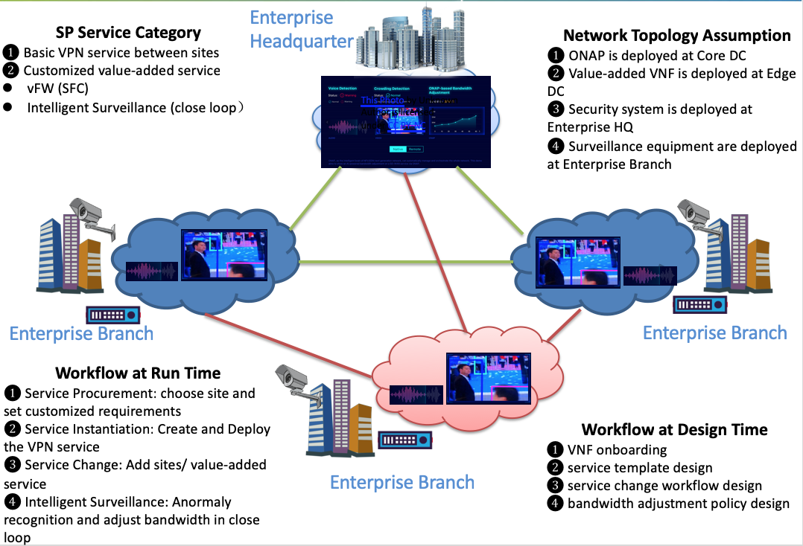
CCVPN Edge NS Deployment
In CCVPN use case, assumes the SP provides two types of service: Basic VPN service and Value-Added services.
The AI applications for collecting both the vioce/video monitoring and anormaly recognition, are deployed in a distributed fashion to the edge DCs that are near the specific site(s) under surveillance.
Site NS
Site NS
Site NS

Slide 15
Requirements Collection
Collected Requirements
Open Catalog as common service | Open Catalog capabilities , ONAP projects can leverage its capabilities to manage csar package
Dmaap python library | There is no python library for dmaap, if can provide a python library , the csar package can distribute to VF-C from SDC directly not need to through UUI
LCM rollback | Once NS/VNF LCM is abnormal, should Support NS and VNF rollback
K8S Integration | Plan to support VNF as containers according to integrate with K8S
VNFFG/NFP | SFC supporting

Slide 16
Thanks

